Slide 1
ProMinent Aquatics Group
Distributor Sales Territories (June, 2012)

Slide 2
Table of Contents
Regional Sales Territories
Distributor Sales Territories
Jim Tanner Unassigned Territories
American Enzyme
AquaFection
Aquatic Consulting Equipment
Buddenbaum Moore
Deep Run Aquatics
Harper & Company
Legacy
Miami Products Chemical Co.
Smith Enterprises
Streamline Aquatics
Bob Kappel Unassigned Territories
Aquatic Chemical Solutions
Badger Pools
Burton Pools & Spas
Commercial Aquatics
Commercial Pool Repair
Dynamic Water Solutions
Knorr Systems
Lincoln Aquatics
Signature Aquatics
Watco Pools

Slide 3
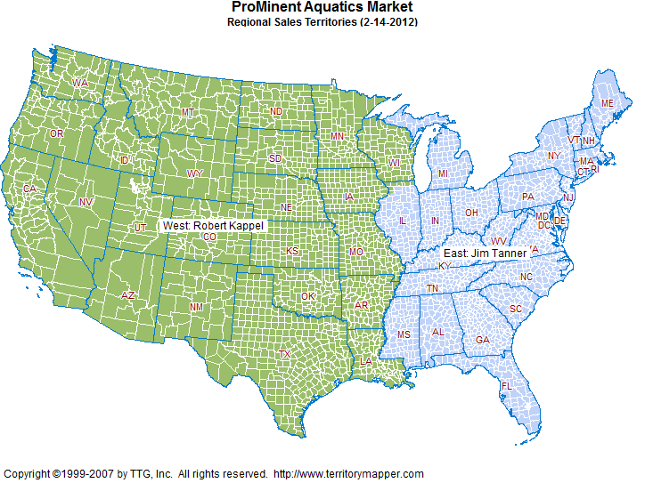

Slide 4
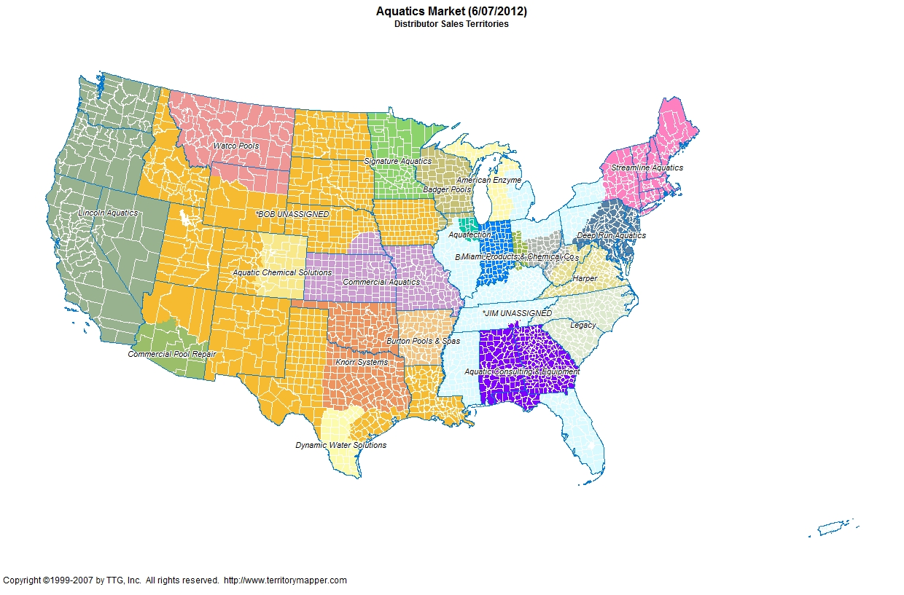

Slide 5
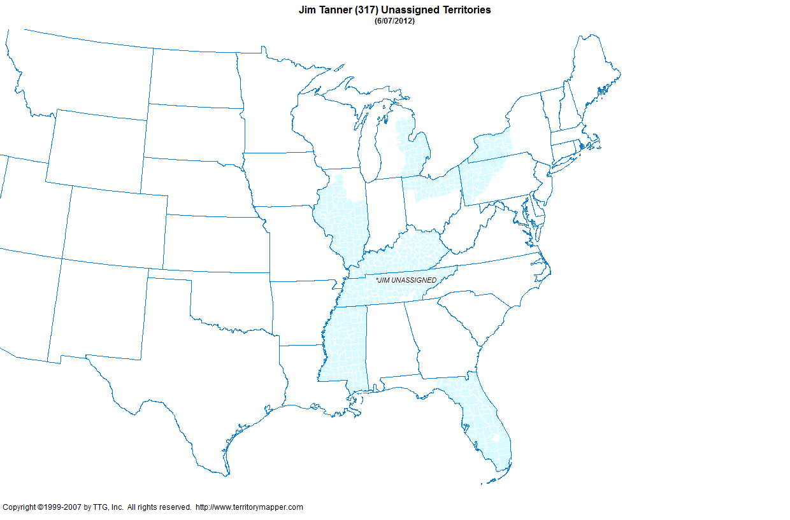

Slide 6
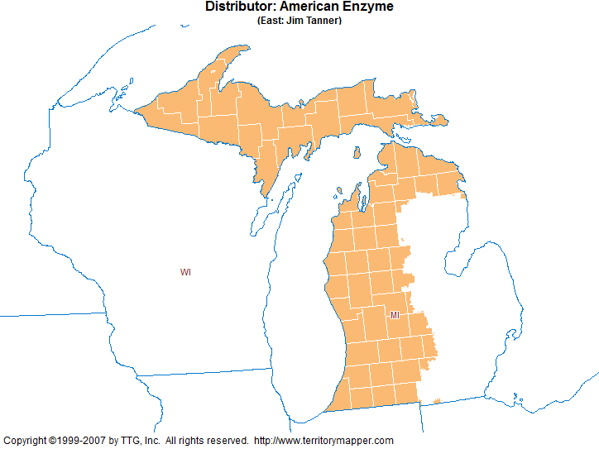

Slide 7
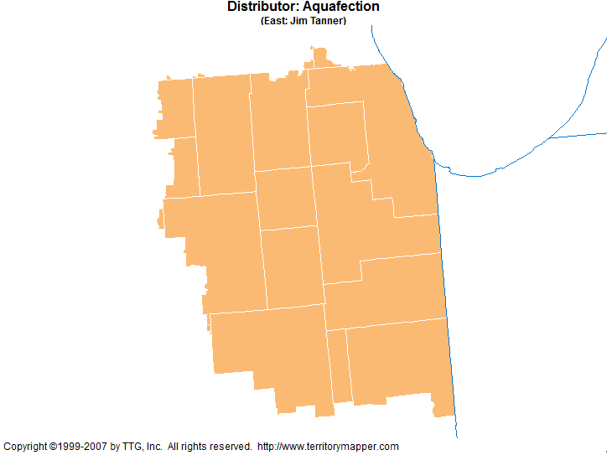

Slide 8
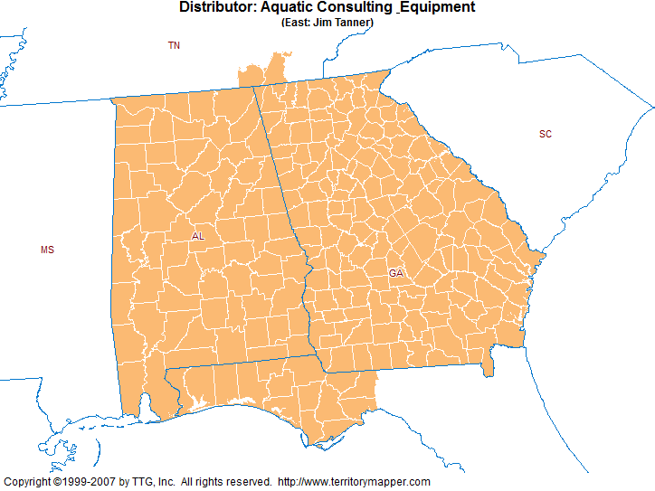

Slide 9
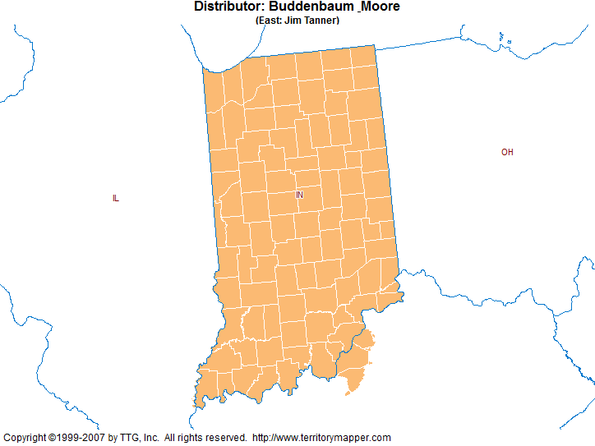

Slide 10
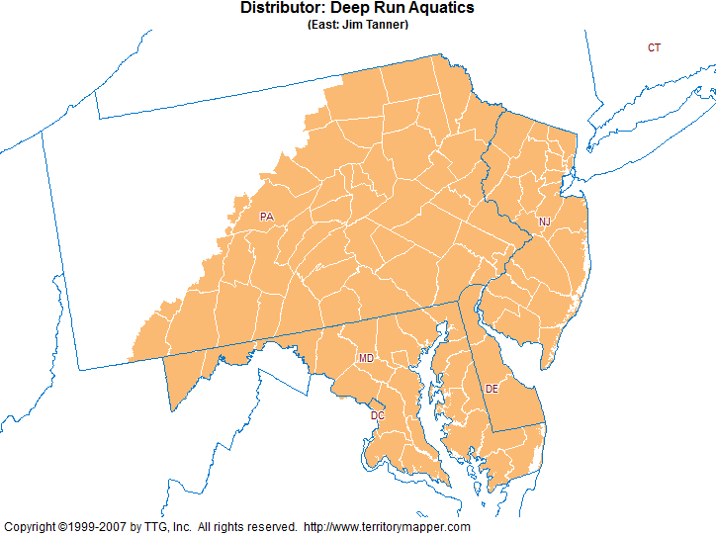

Slide 11
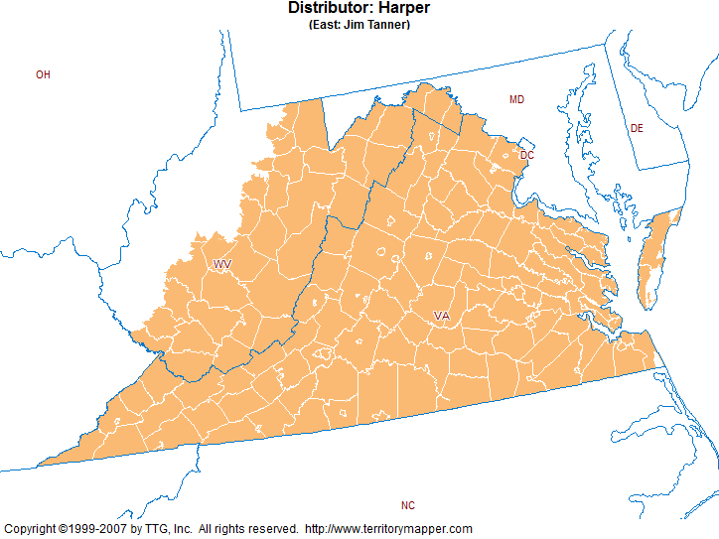

Slide 12
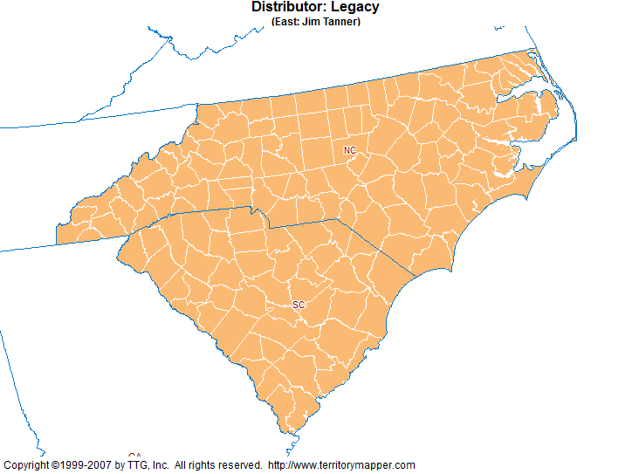

Slide 13
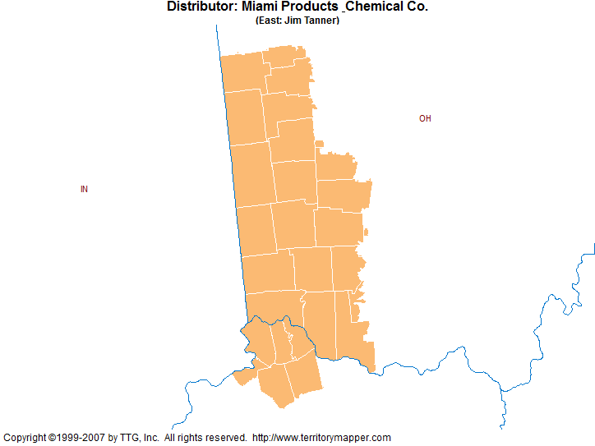

Slide 14
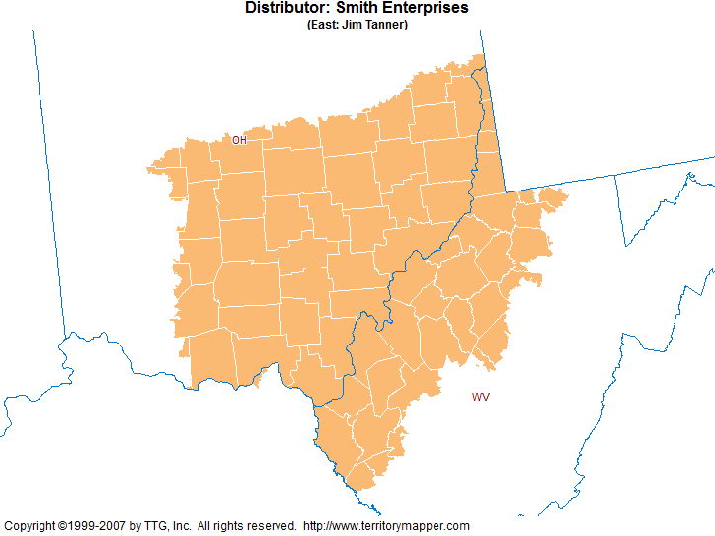

Slide 15
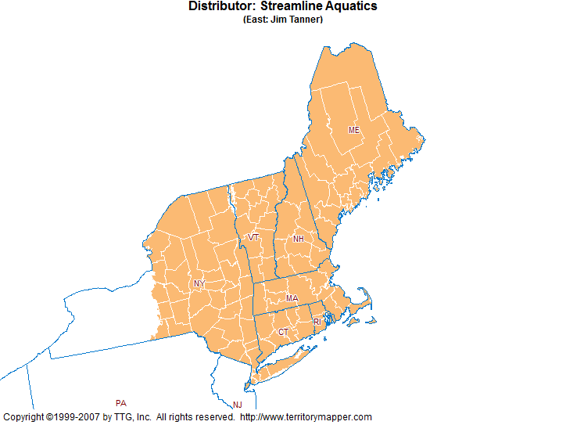

Slide 16
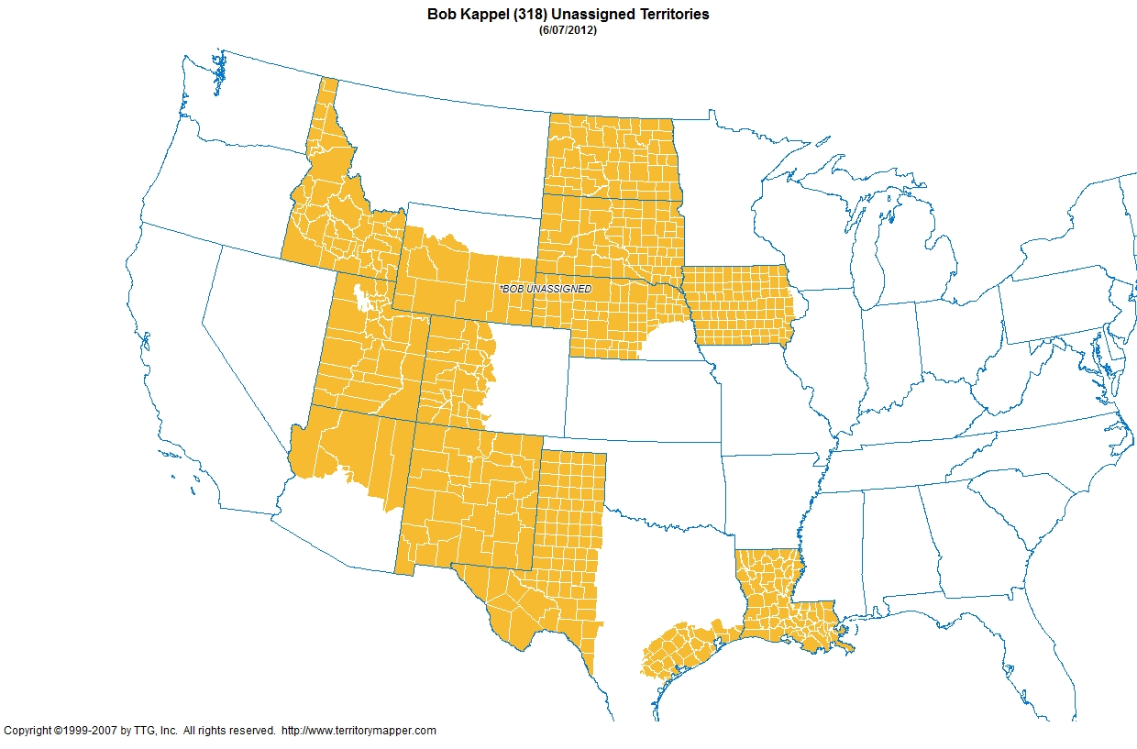

Slide 17
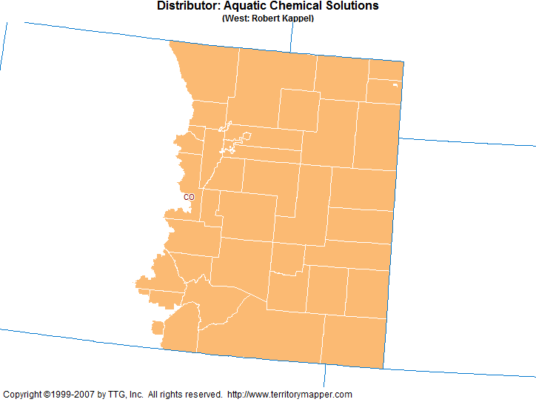

Slide 18
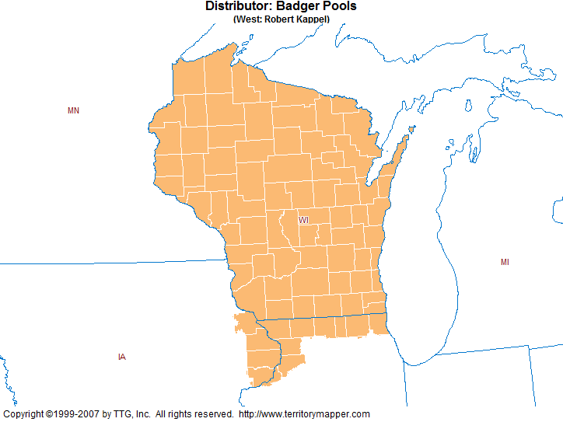

Slide 19
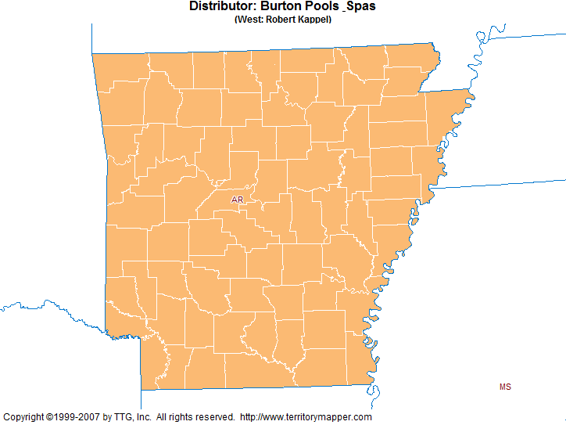

Slide 20
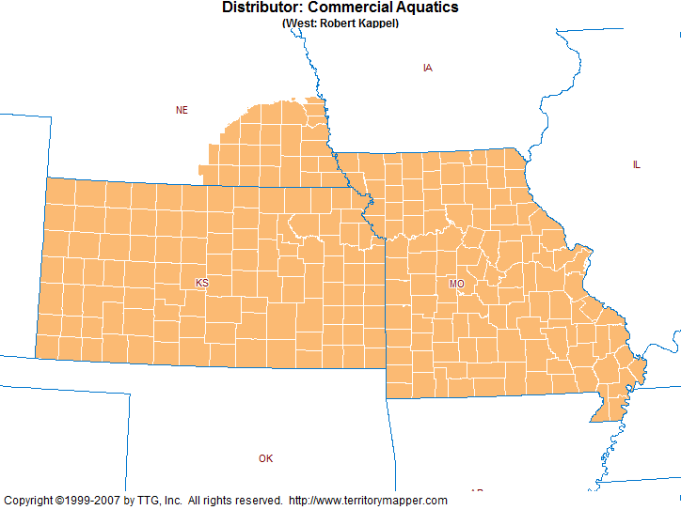

Slide 21
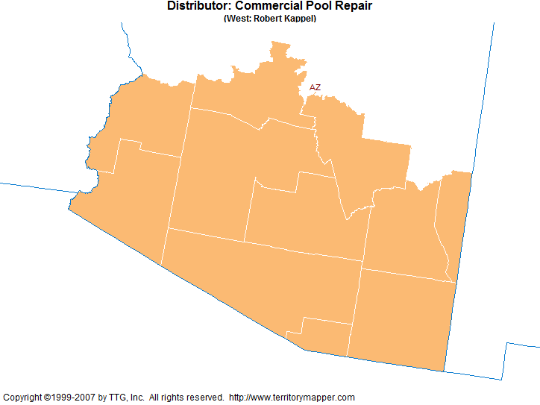

Slide 22
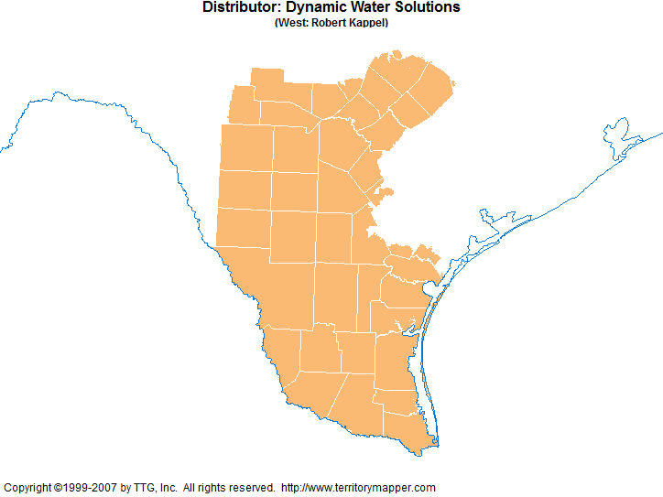

Slide 23
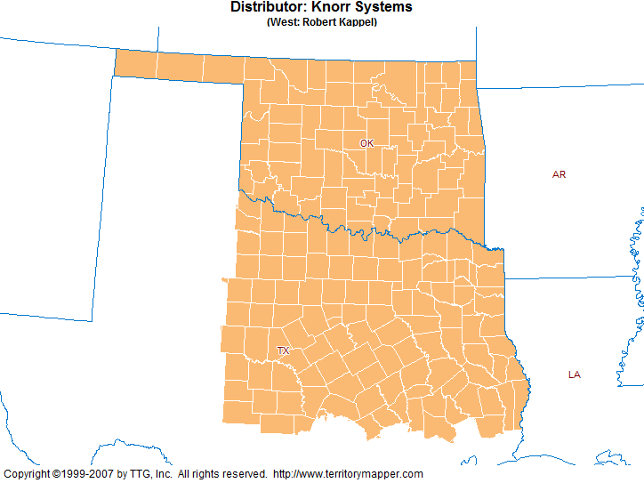

Slide 24
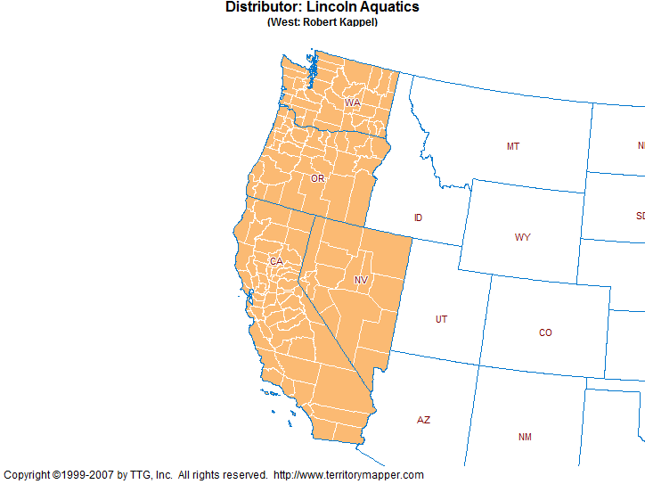

Slide 25
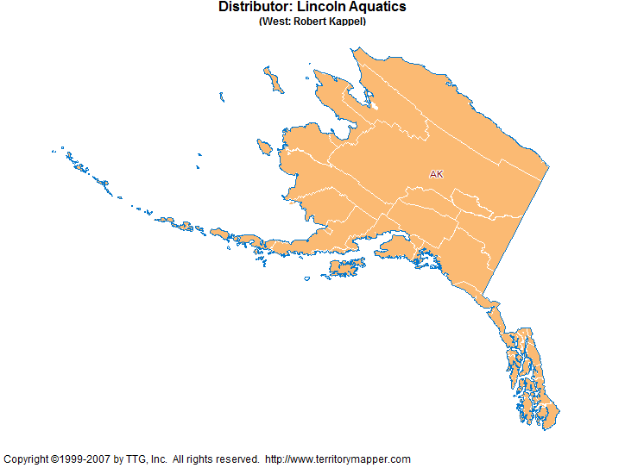

Slide 26
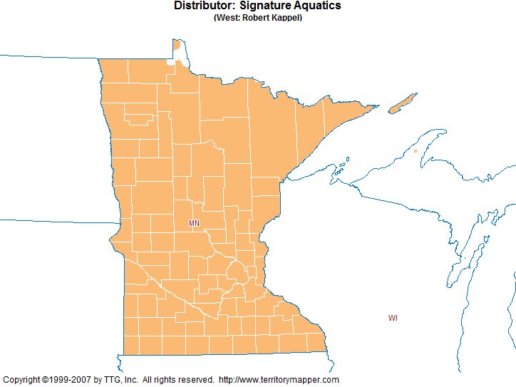

Slide 27
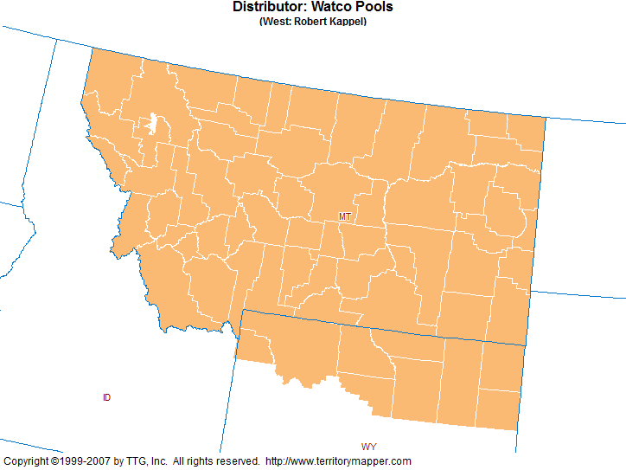

Slide 28
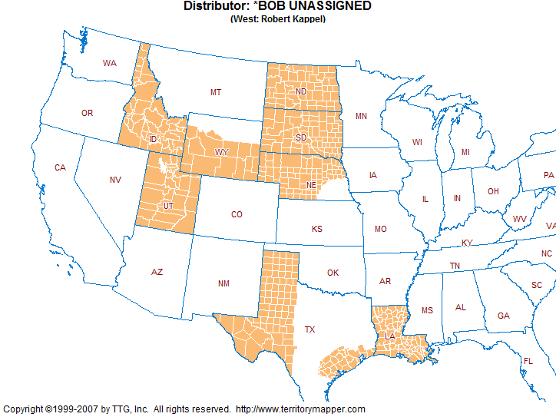

Slide 29
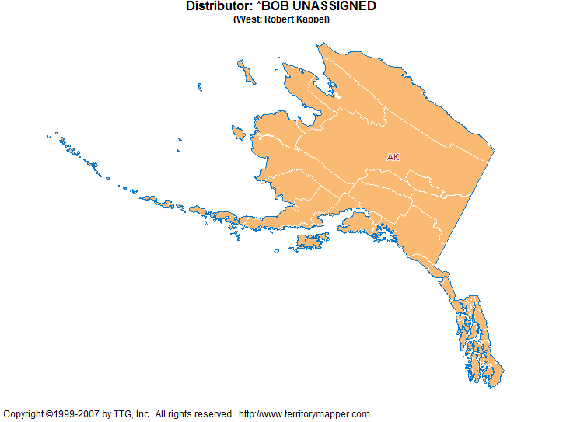

Slide 30
