Slide 1
ProMinent Aquatics
Territory Maps January 1, 2013

Slide 2
Aquatics Distribution by Region
East Region 317, Dustin Kauffman
American Enzyme
AquaFection, Inc.
Aquatic Consulting and Equipment Inc.
Buddenbaum & Moore
Deep Run Aquatics
Harper and Company
Legacy Commercial Pool Services, Inc.
Miami Products & Chemical Company
Smith Enterprise
Streamline Aquatics
West Region 318, Robert Kappel
American Pool Supply
Aquatic Chemical Solutions
Badger Swimpools
Burton Pools and Spas, LLC.
Commercial Aquatic Services, Inc.
Commercial Pool Repair
Dynamic Water Solutions
Knorr Systems, Inc.
Lincoln Equipment Inc.
Pool Pro
Signature Aquatics
Watco Pools

Slide 3
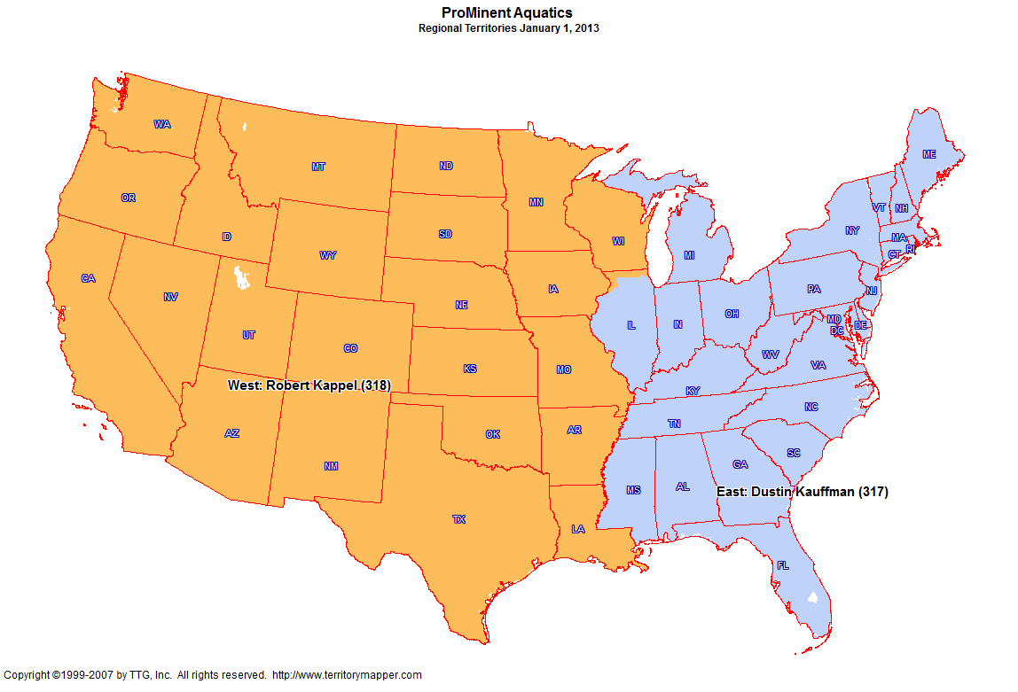
Back to Contents

Slide 4
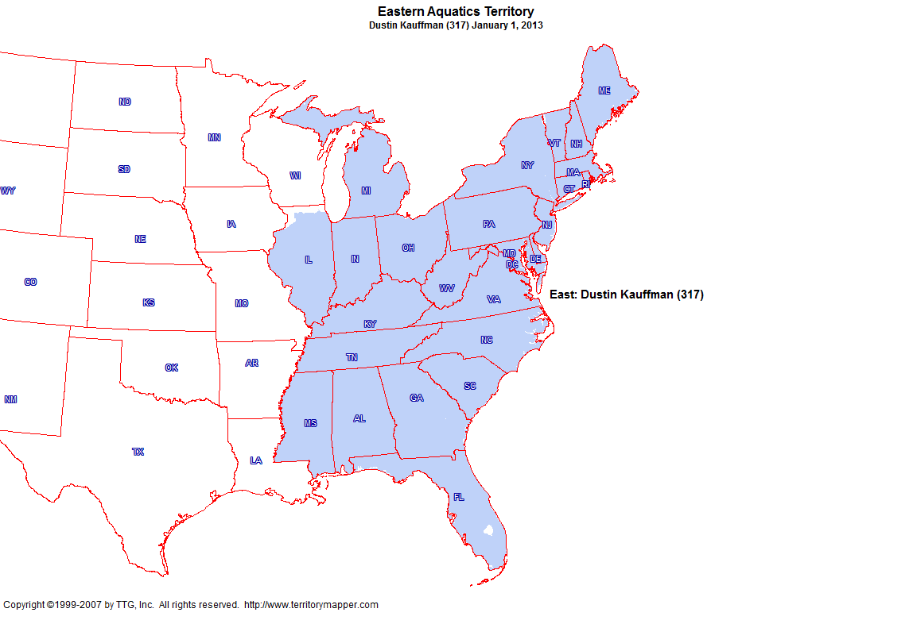
Back to Contents

Slide 5
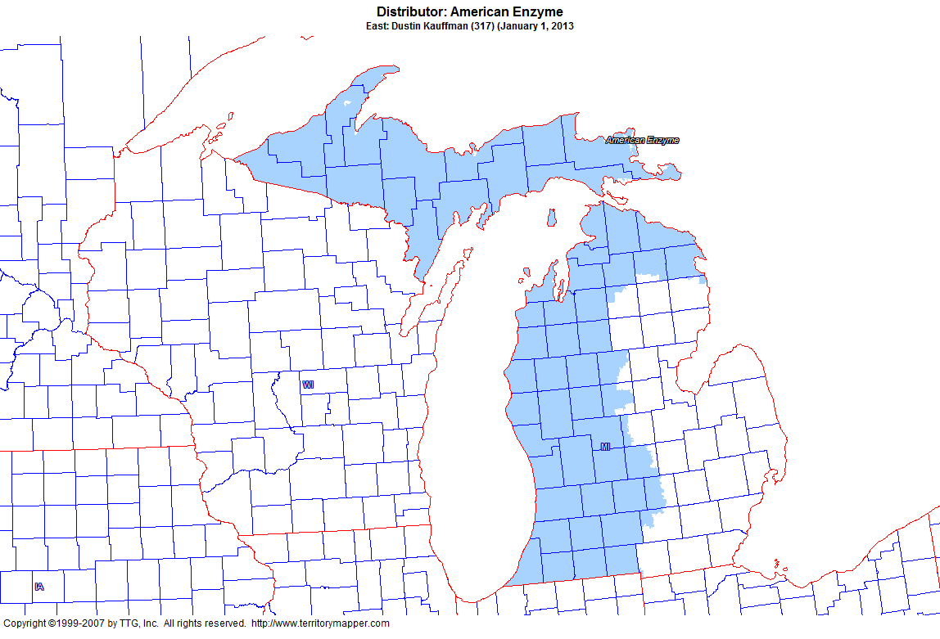
Back to Contents

Slide 6
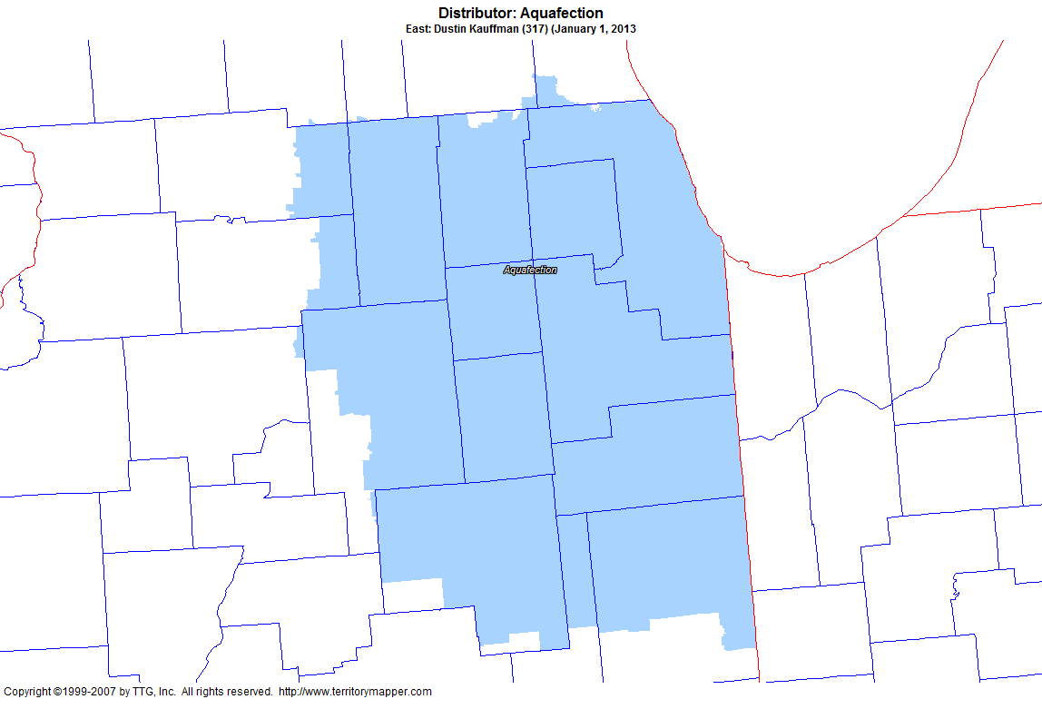
Back to Contents

Slide 7
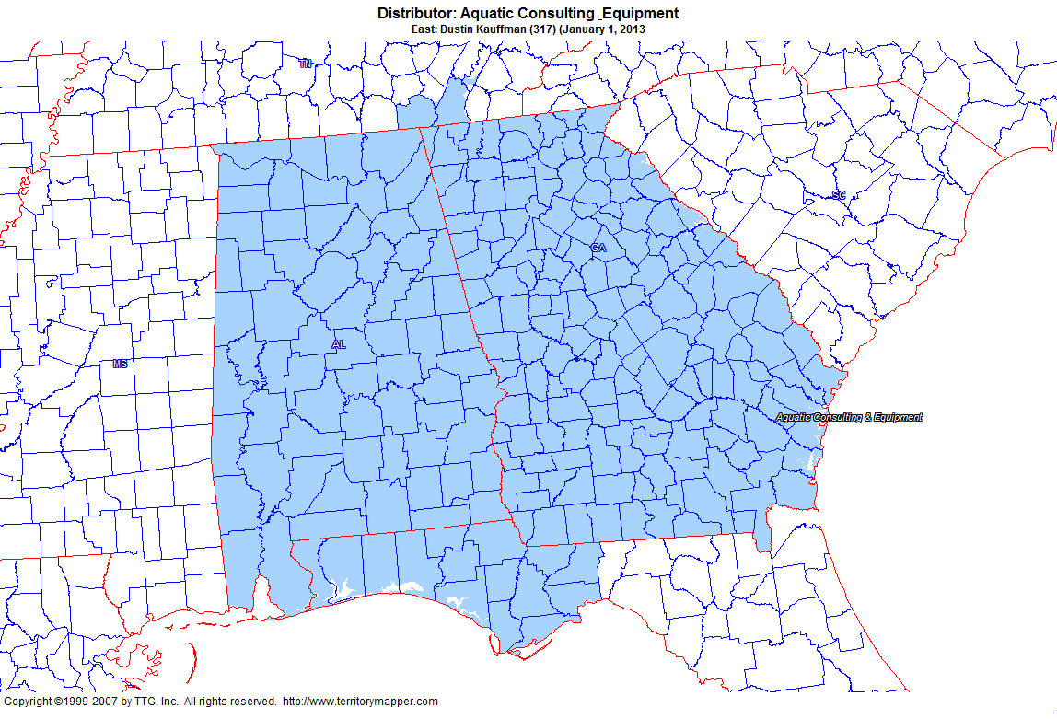
Back to Contents

Slide 8
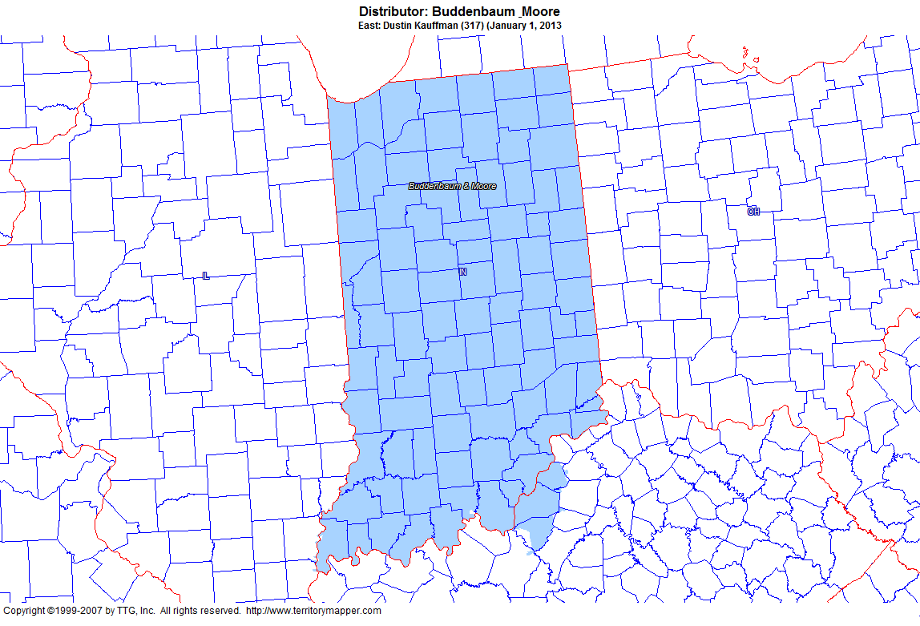
Back to Contents

Slide 9
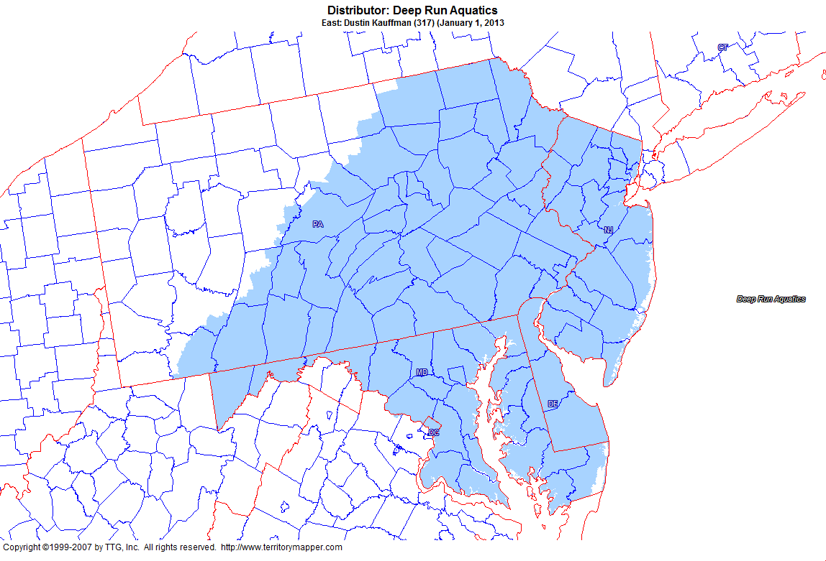
Back to Contents

Slide 10
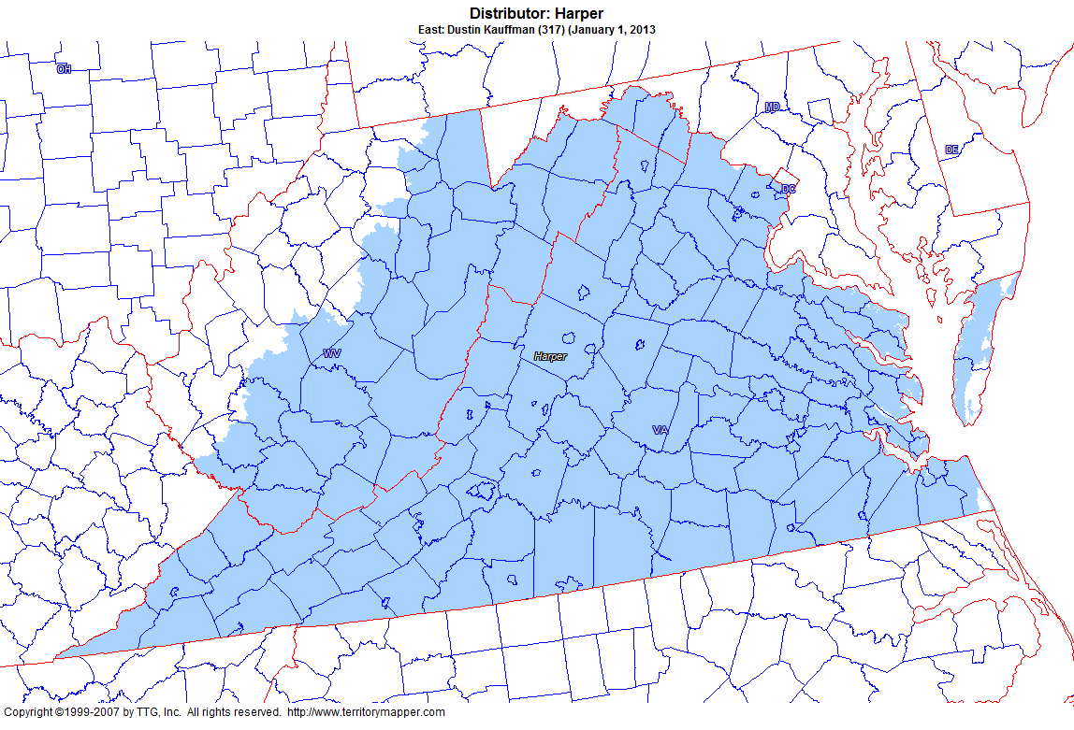
Back to Contents

Slide 11
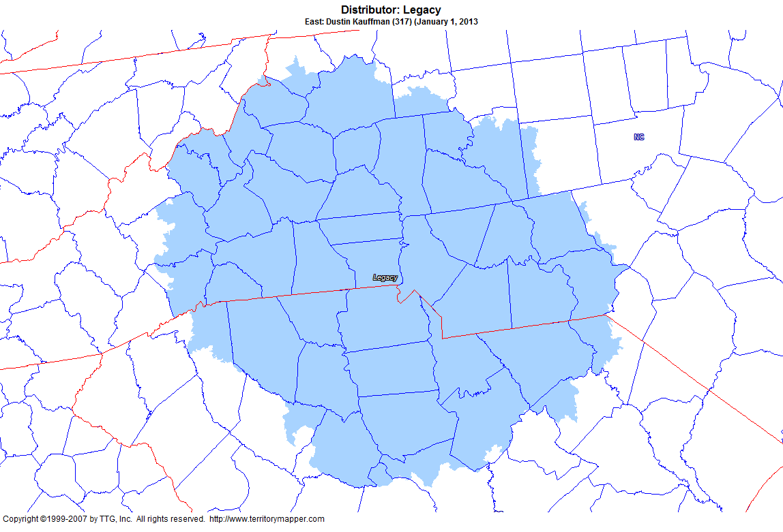
Back to Contents

Slide 12
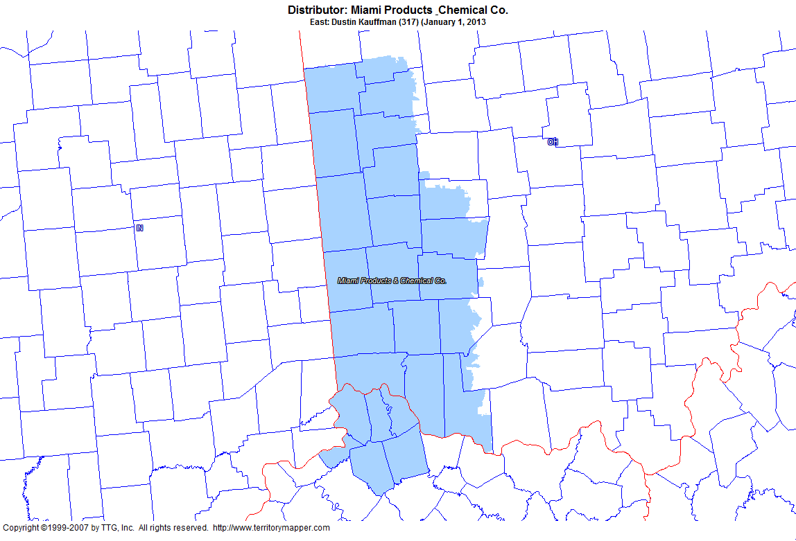
Back to Contents

Slide 13
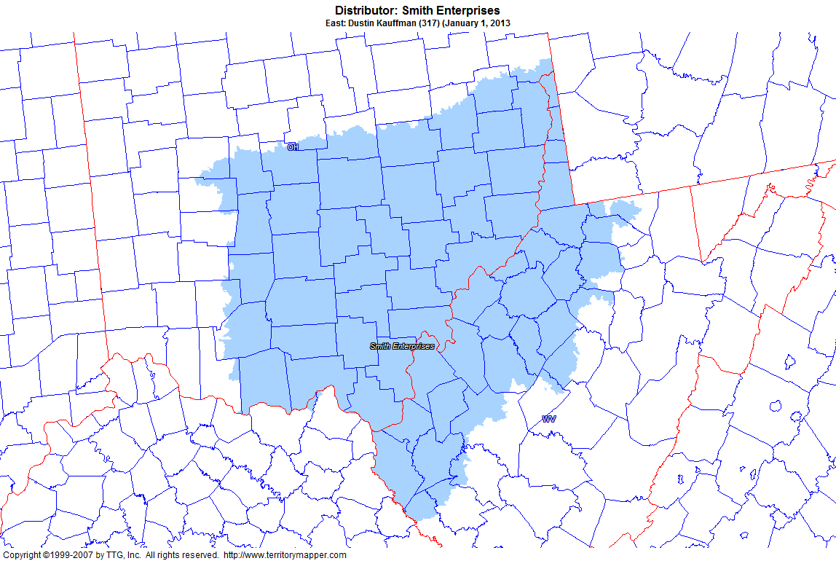
Back to Contents

Slide 14
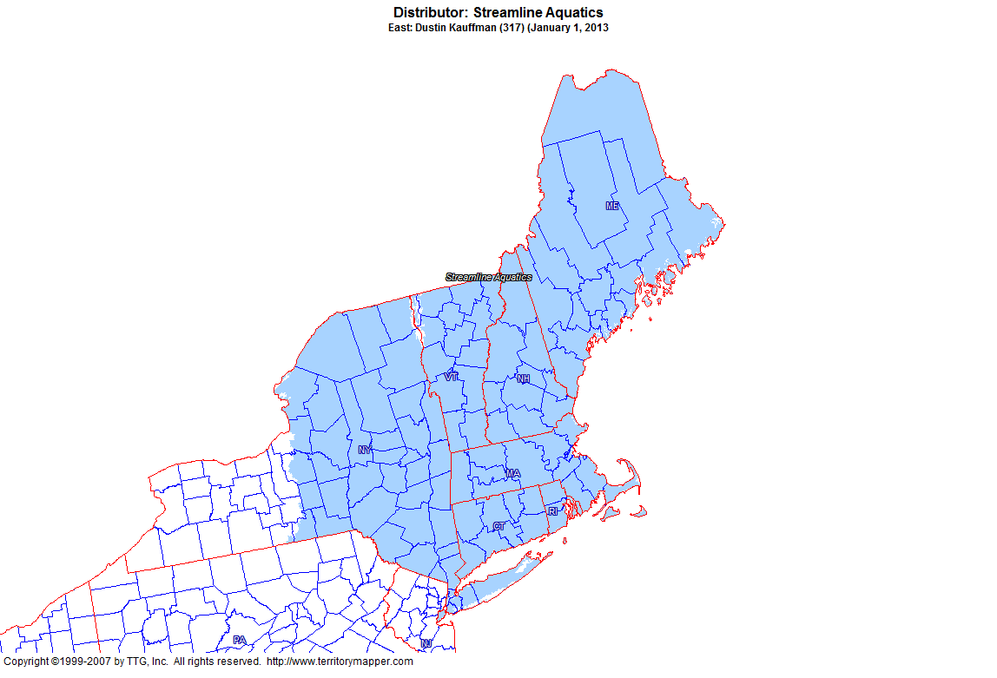
Back to Contents

Slide 15
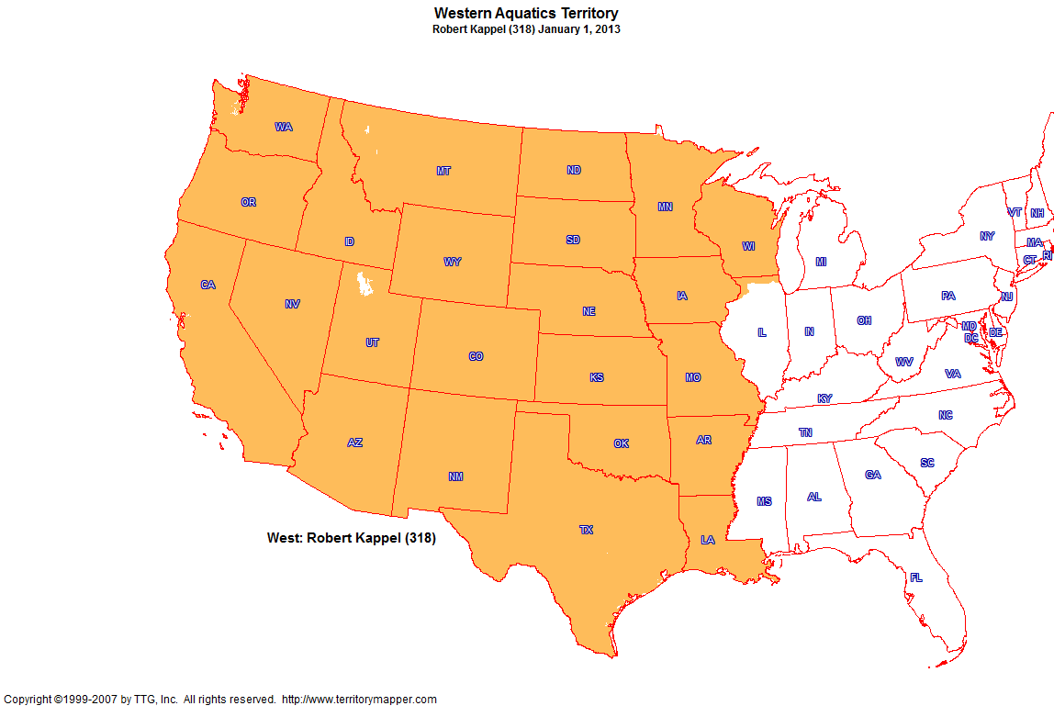
Back to Contents

Slide 16
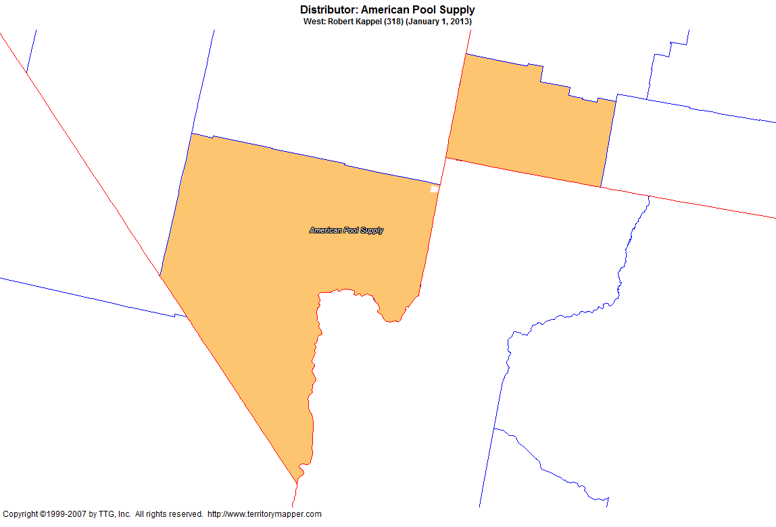
Back to Contents

Slide 17
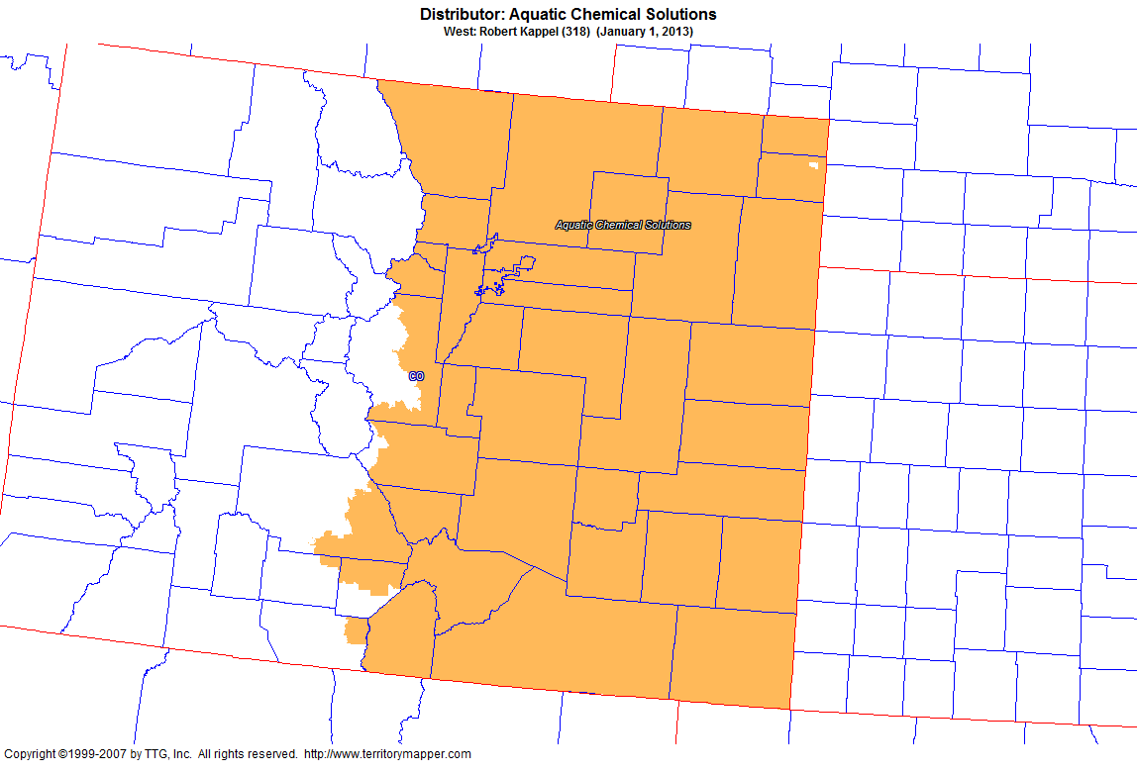
Back to Contents

Slide 18
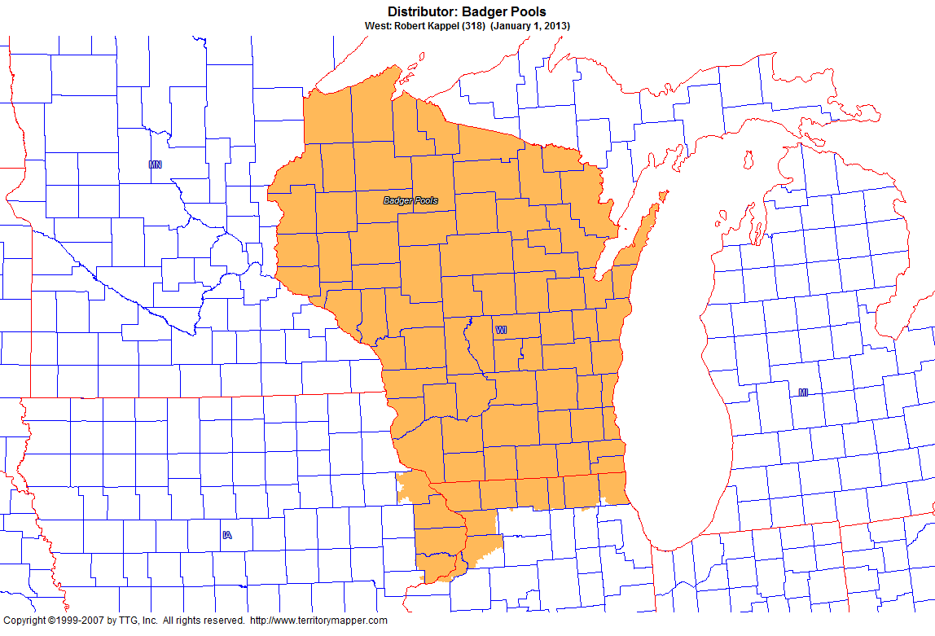
Back to Contents

Slide 19
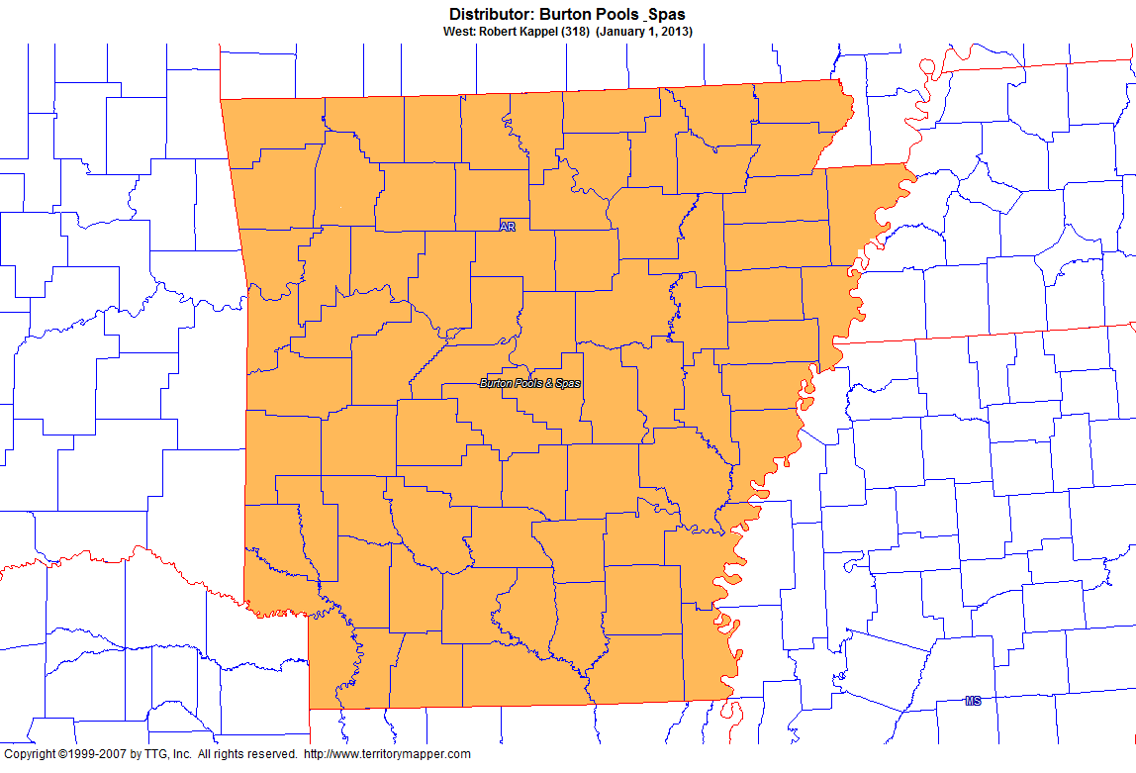
Back to Contents

Slide 20
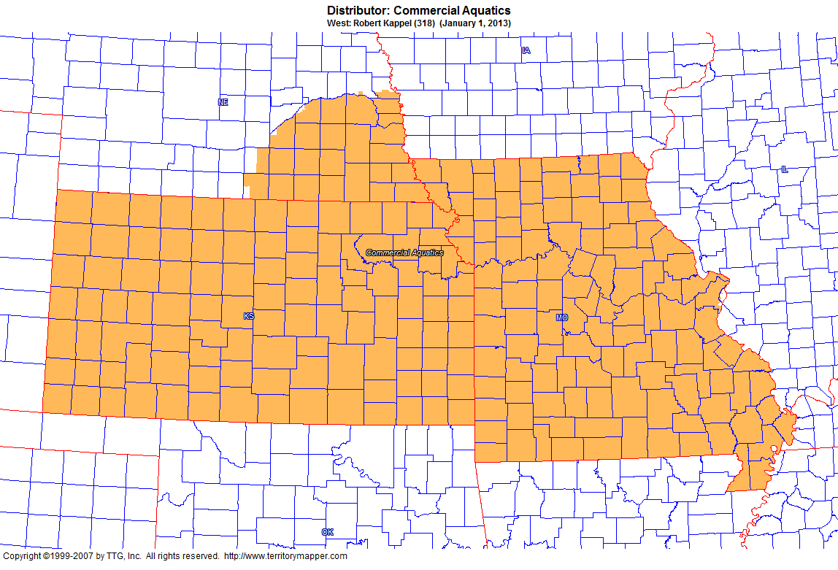
Back to Contents

Slide 21
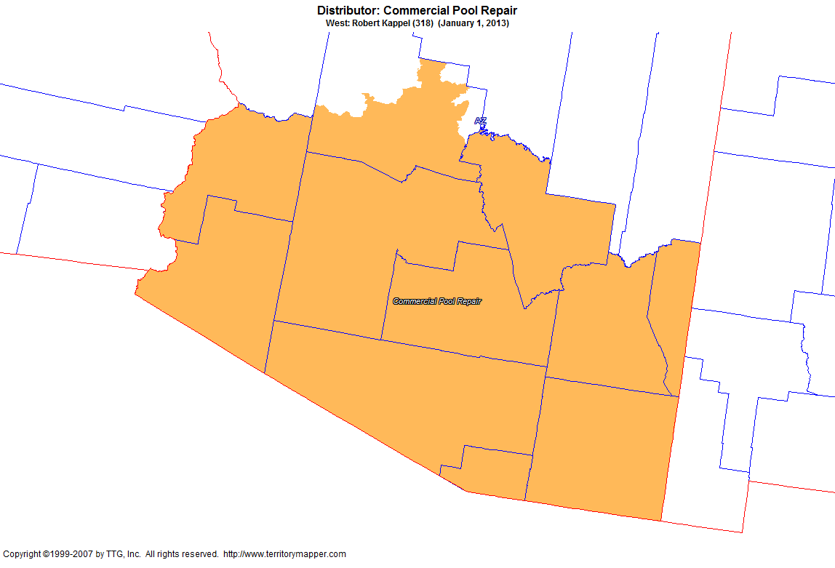
Back to Contents

Slide 22
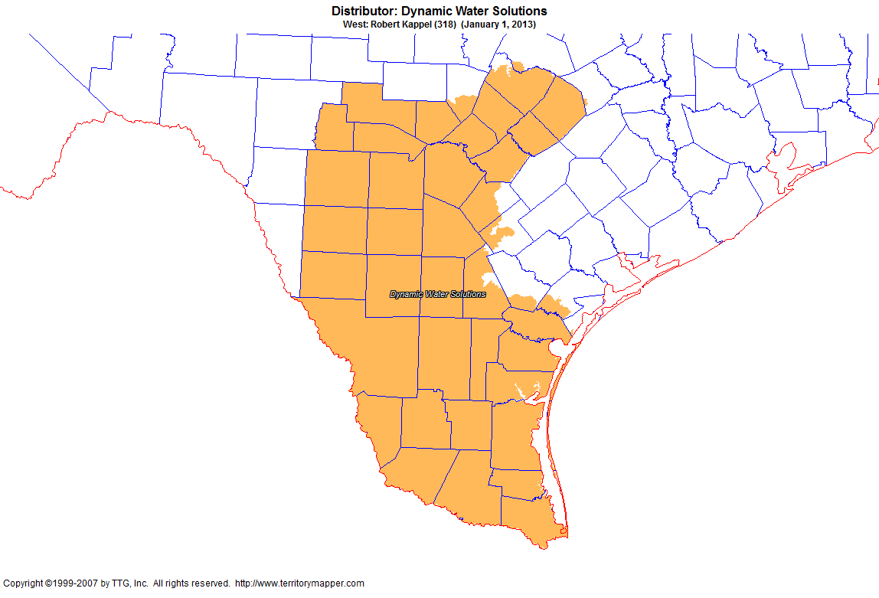
Back to Contents

Slide 23
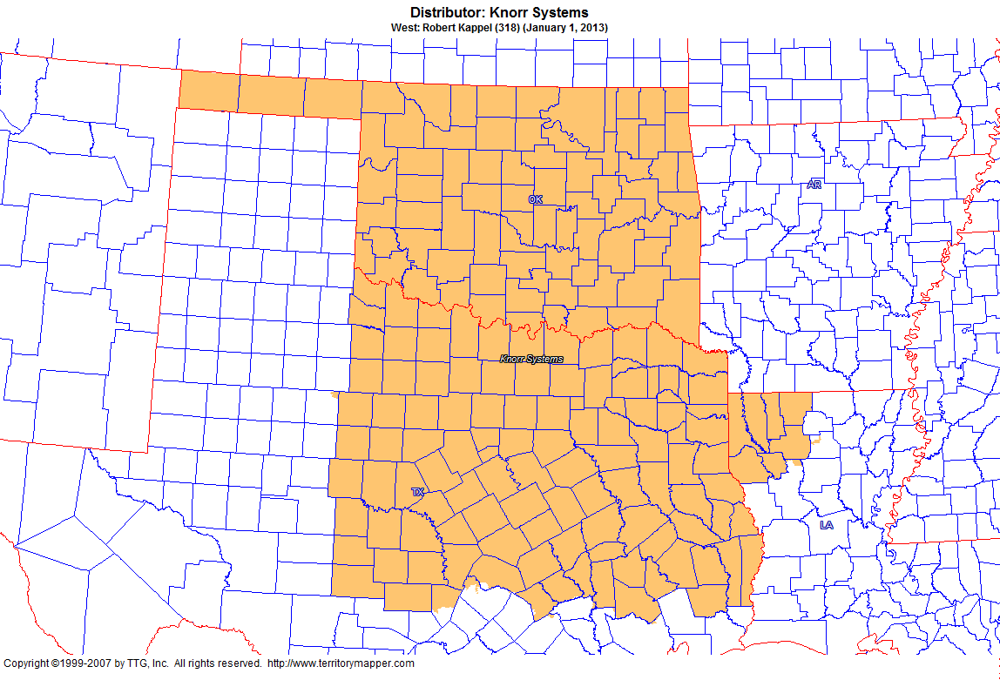
Back to Contents

Slide 24
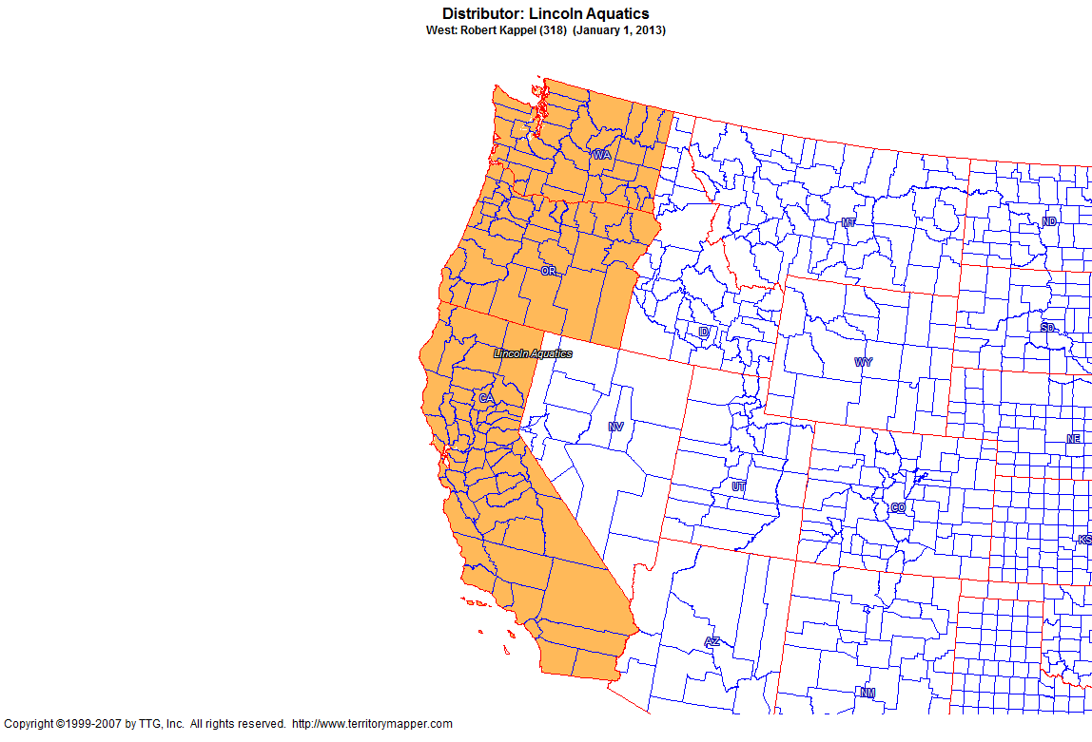
Back to Contents

Slide 25
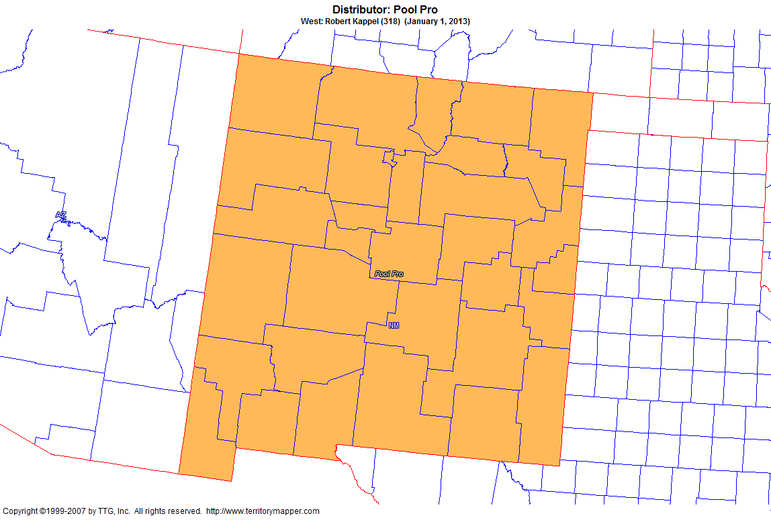
Back to Contents

Slide 26
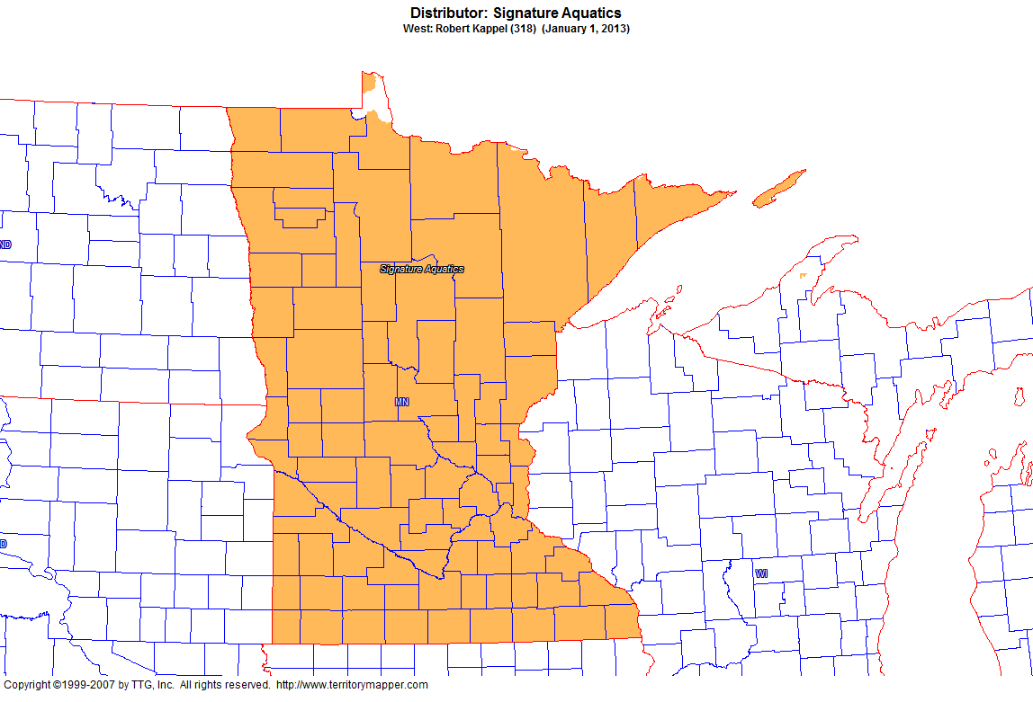
Back to Contents

Slide 27
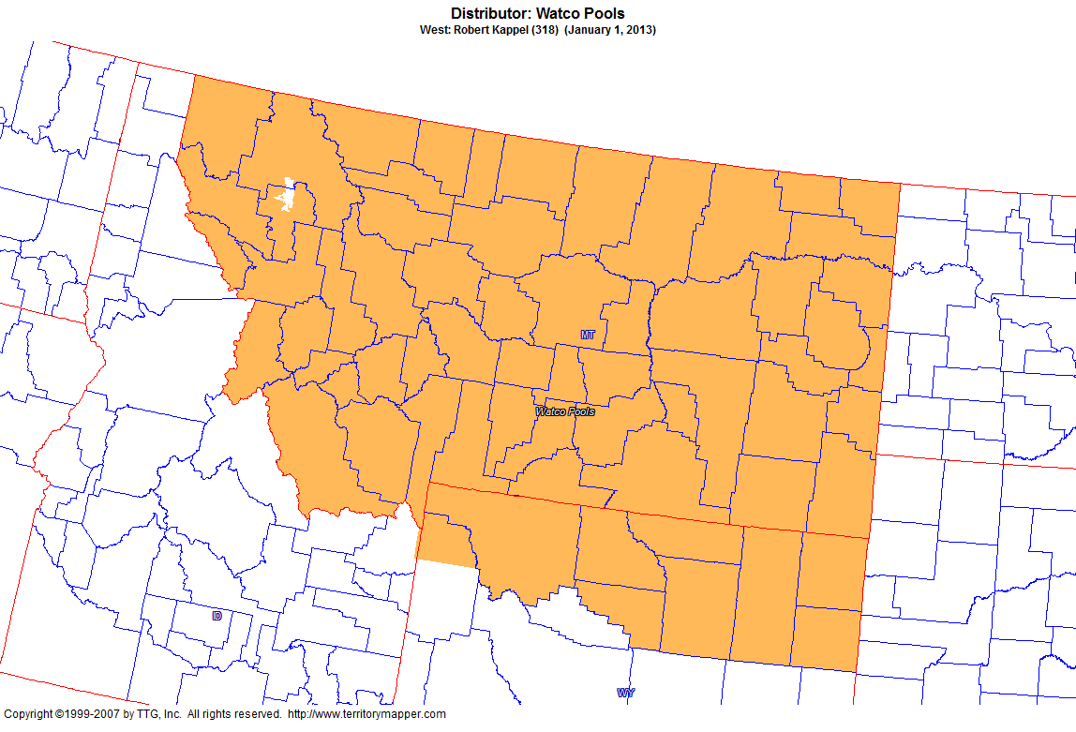
Back to Contents

