Slide 1
ProMinent Industrial Territories
Updated: 05/01/12

Slide 2
Table of Contents
Able Wright, Inc.
ALEDco Inc
Allwatert L.L.C.
Atlantic Equipment Resources, LLC
Atlantic Pump & Engineering Inc.
Brown & Morrison, LTD
Buckeye Pumps, Inc.
Delta Process
Fluid Engineering
Fluid Process Equipment Inc.
FORCE Engineered Products
Hayes Pump Inc.
Hopkins Technical Products, Inc.
Humbleton Industrial Sales, Inc.
Intergrated Process Technologies
Mountain States Instruments
Odessa – Farmington
Odessa – Amarillo
Odessa – Boerne
Odessa – Corpus Christi
Odessa – Dallas/Fortworth
Odessa – Hobbs
Odessa – Houston
Odessa
Odessa – Palestine
Odessa – Pharr
Phillip R. Walker Associates
Process Controls Corp.
Pumping Solutions Inc.
Saladin Pump & Equipment Company
Shupe & Associates, Inc.
Southwest Pumps & Filters
Specialized Operations Services, Inc.
Thornton & Company
TMG Services
TriCor Equipment Co., LLC
Vessco, Inc.
West View Cunningham
William/Reid LTD, LLC

Slide 3
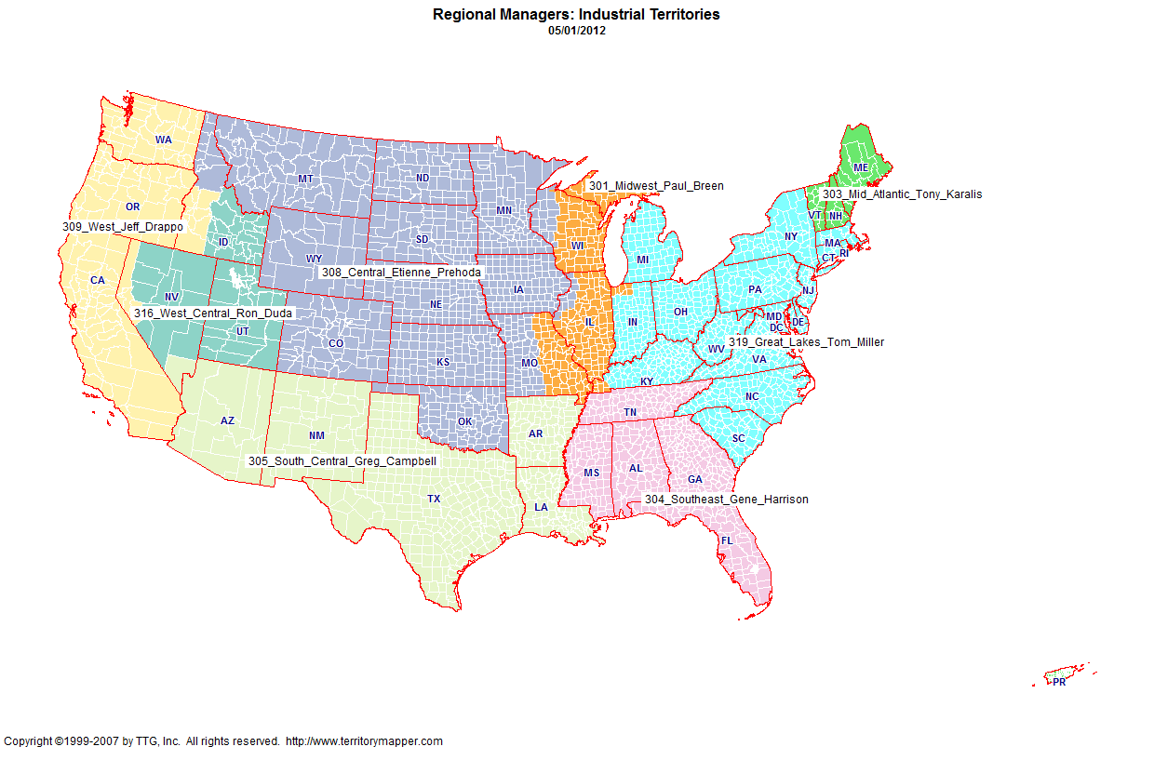

Slide 4
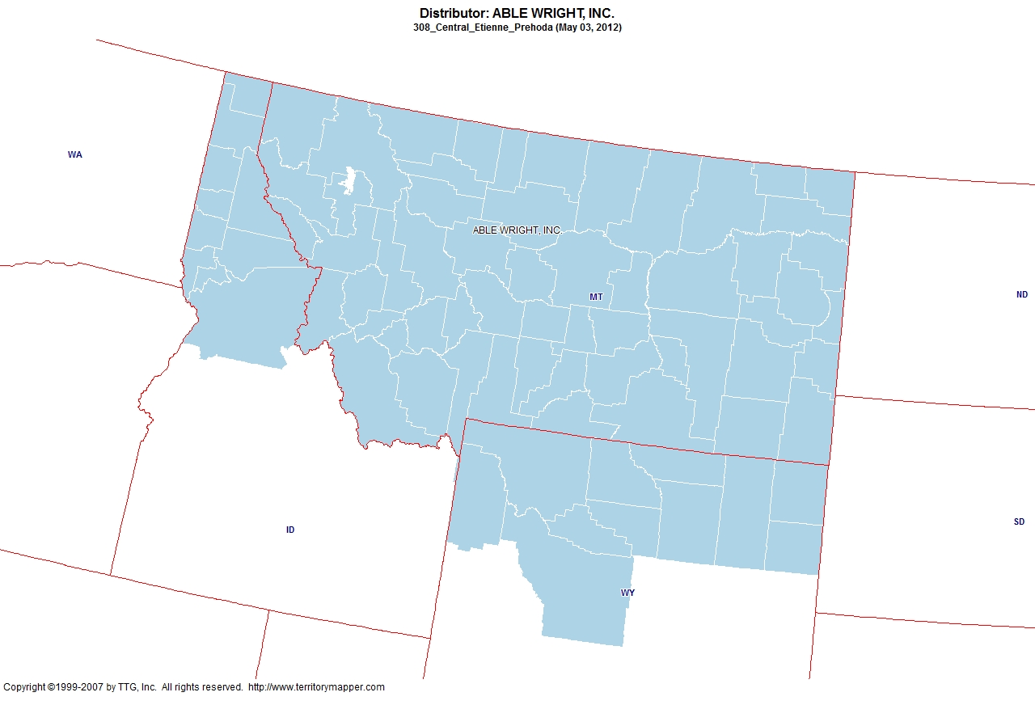
Back to Contents

Slide 5
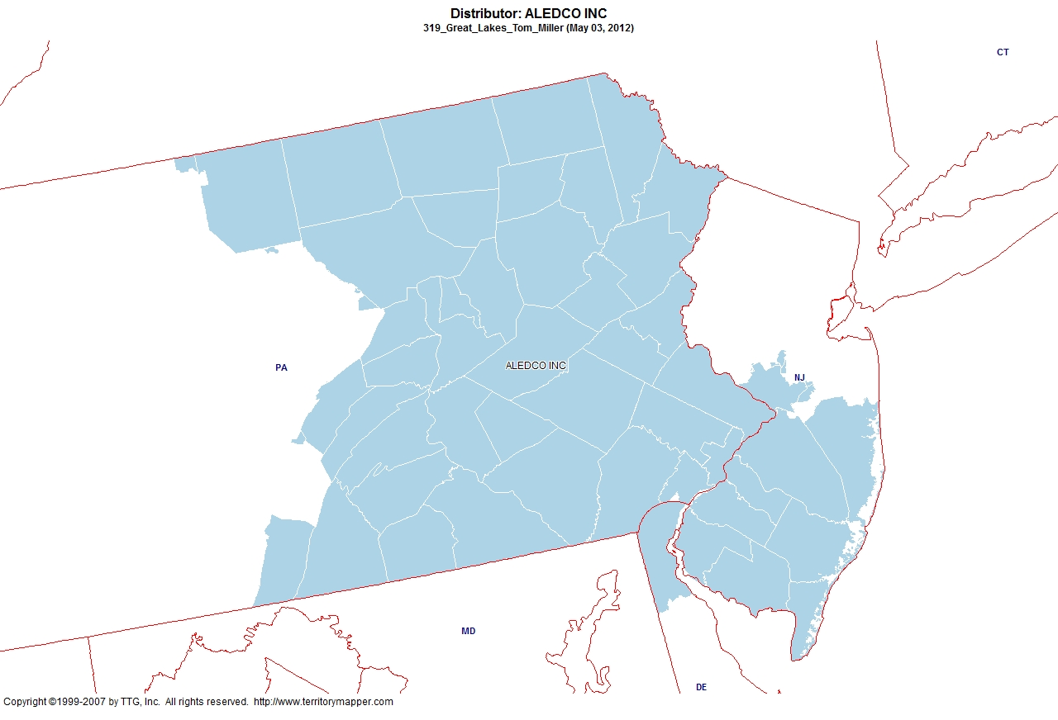
Back to Contents

Slide 6
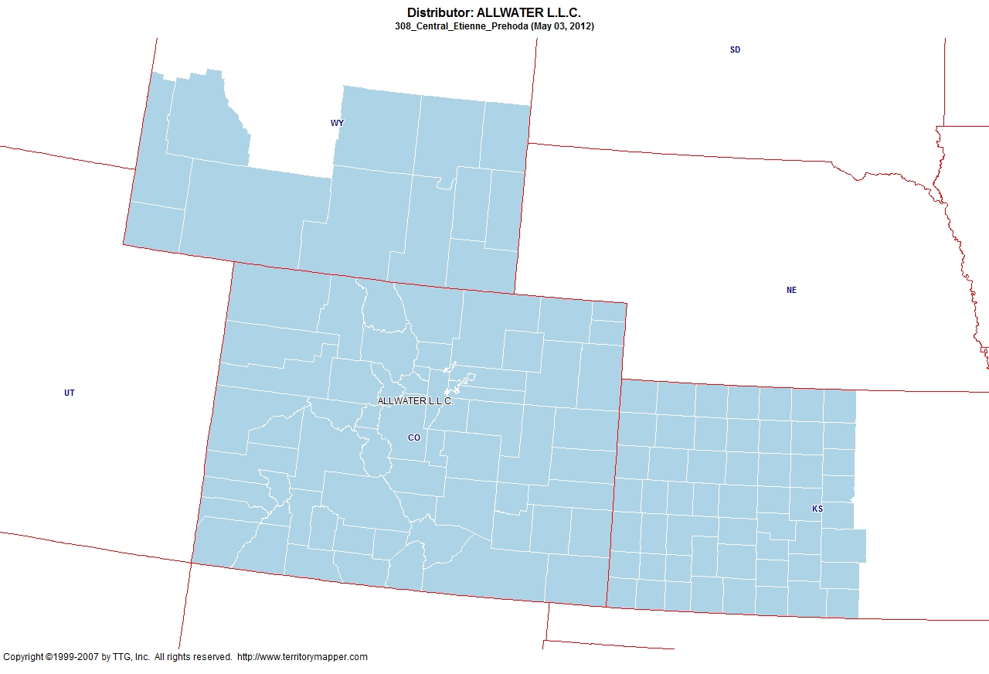
Back to Contents

Slide 7
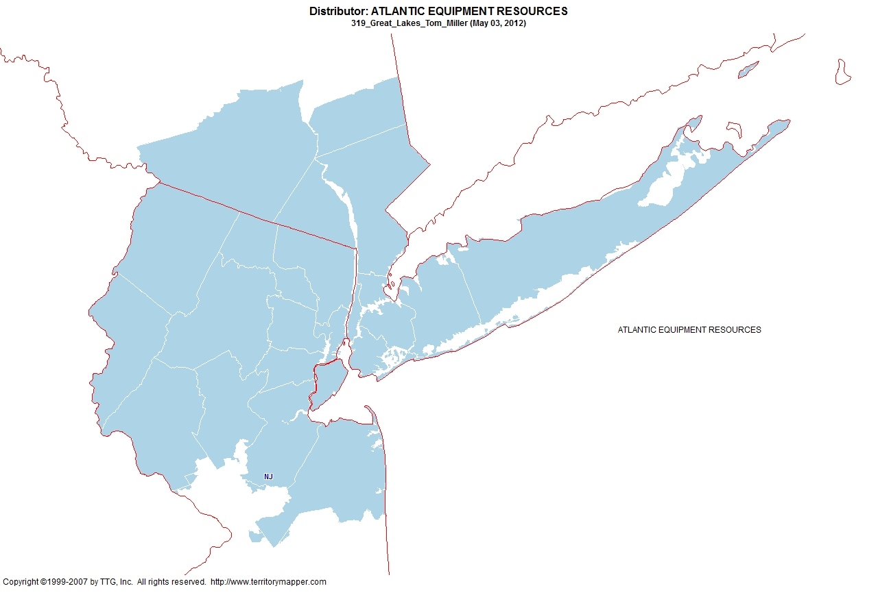
Back to Contents

Slide 8
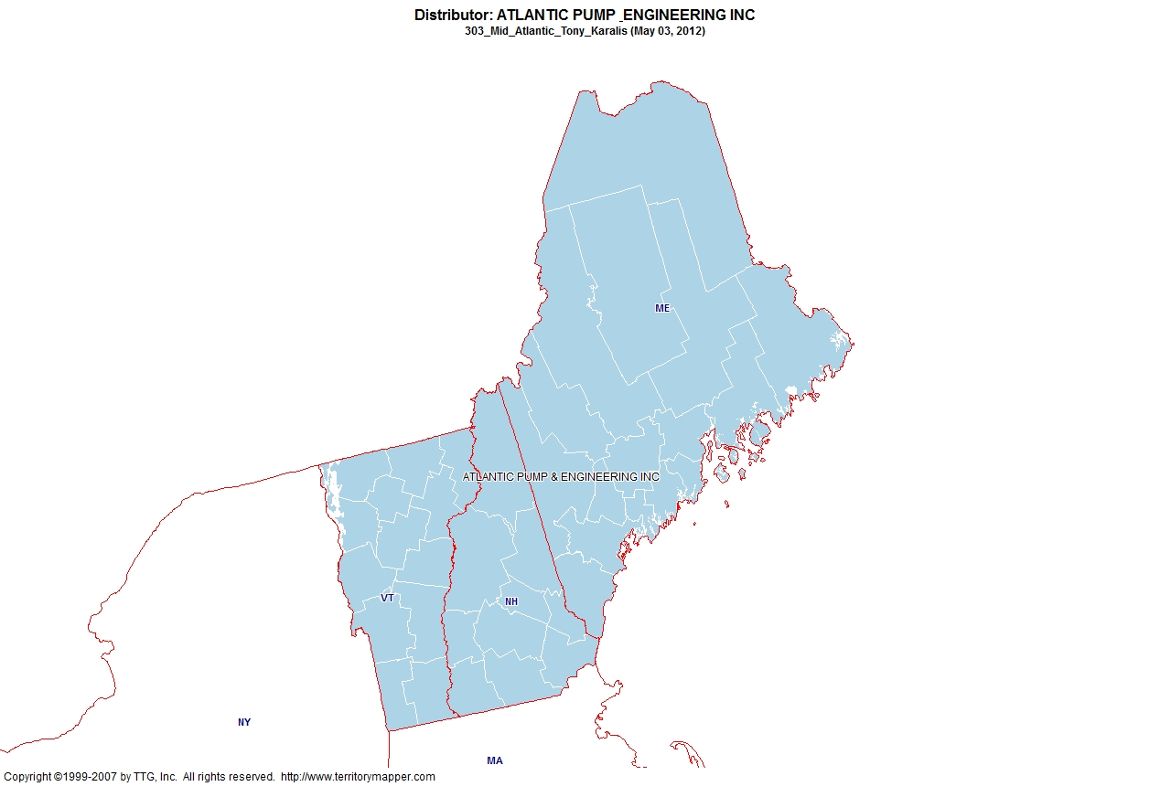
Back to Contents

Slide 9
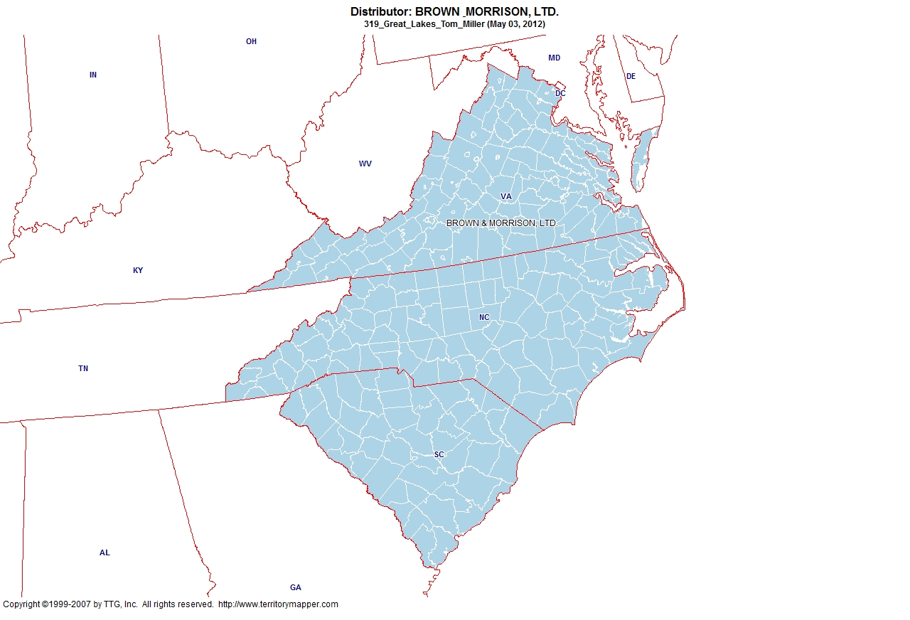
Back to Contents

Slide 10
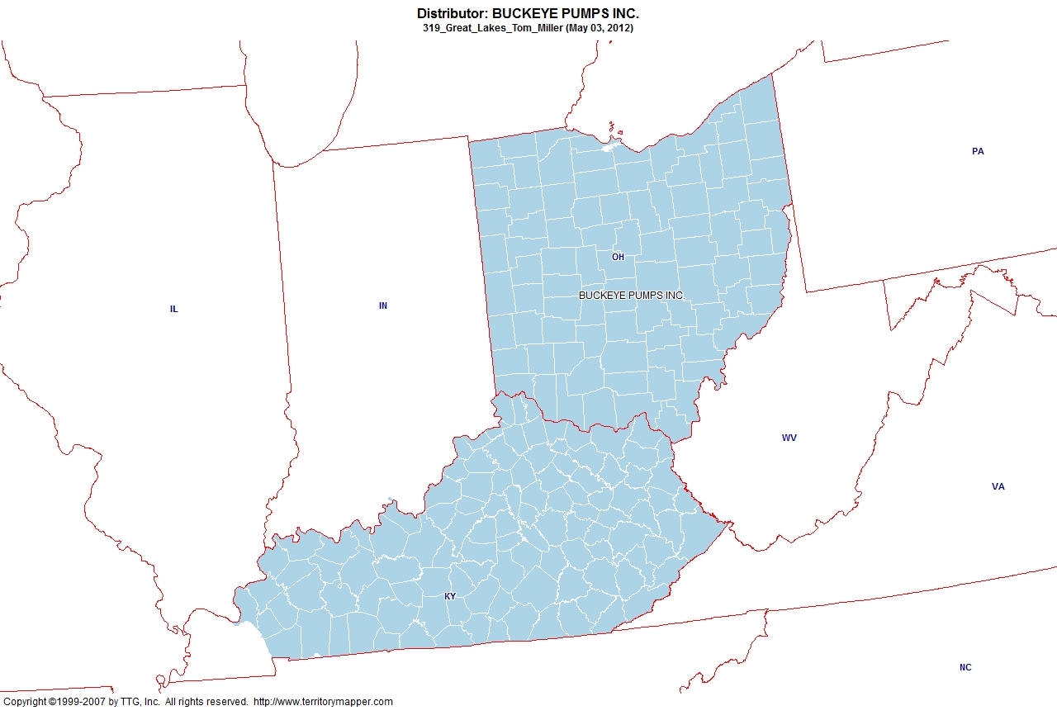
Back to Contents

Slide 11
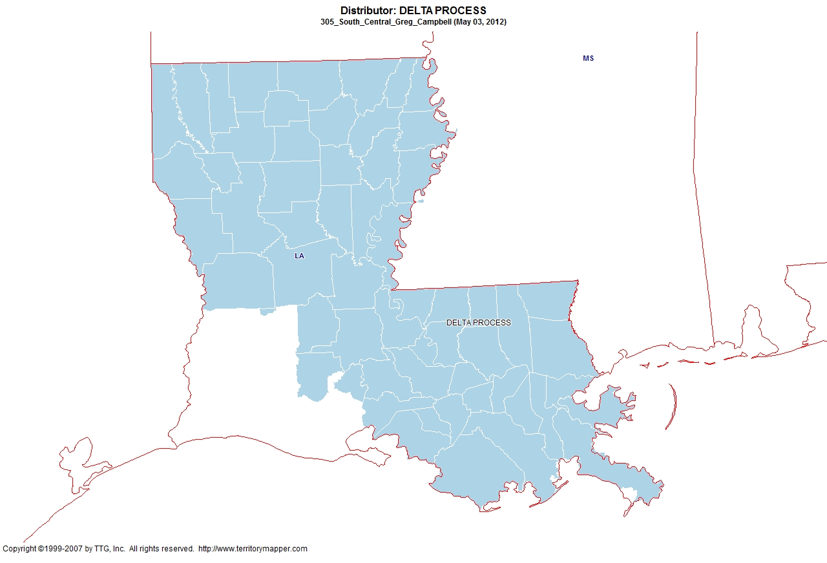
Back to Contents

Slide 12
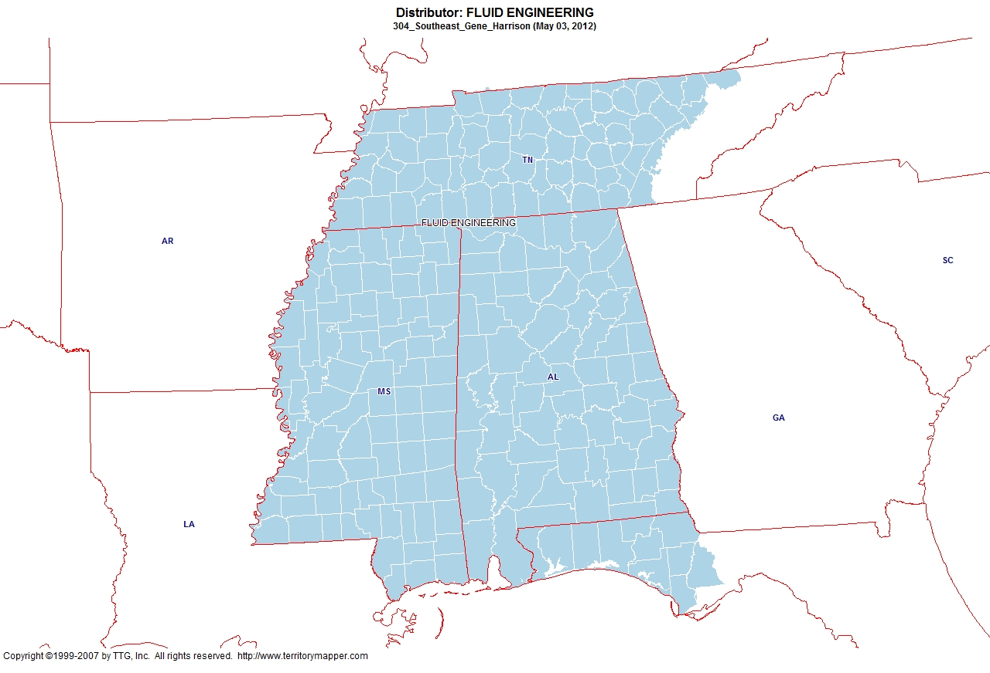
Back to Contents

Slide 13
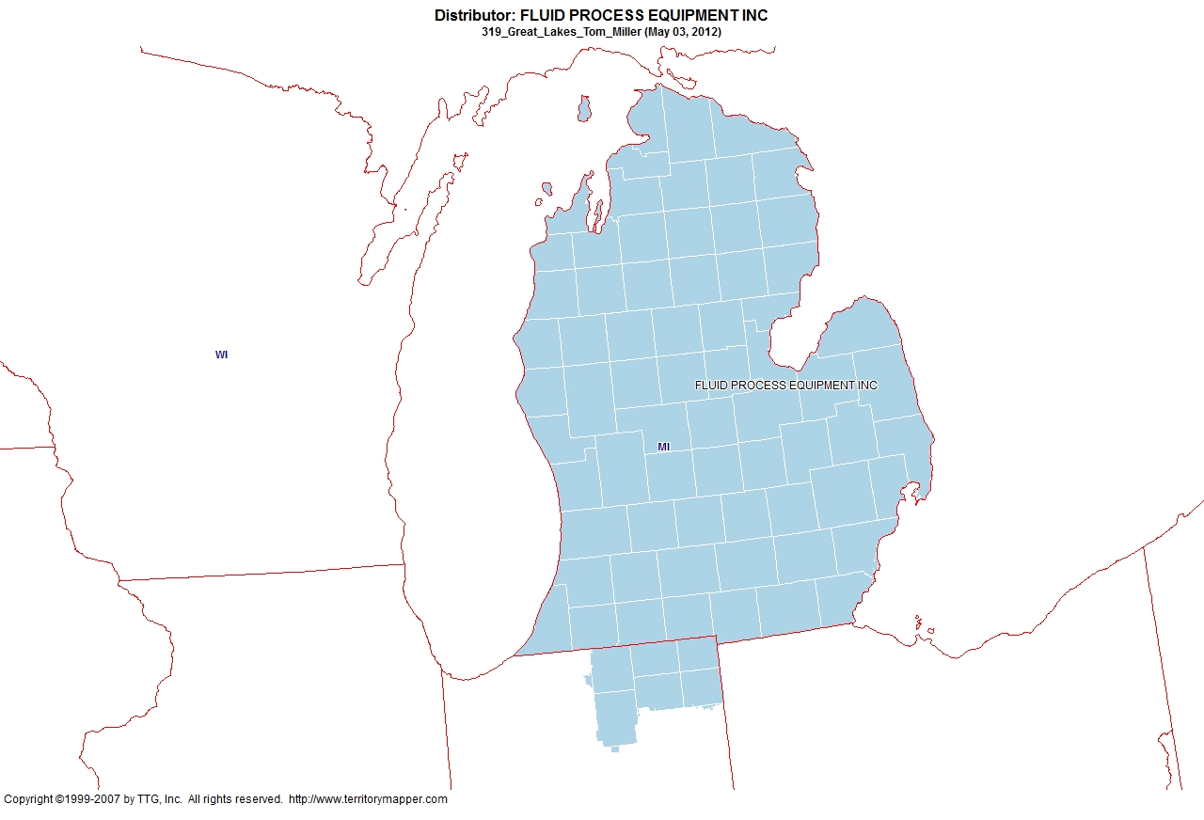
Back to Contents

Slide 14
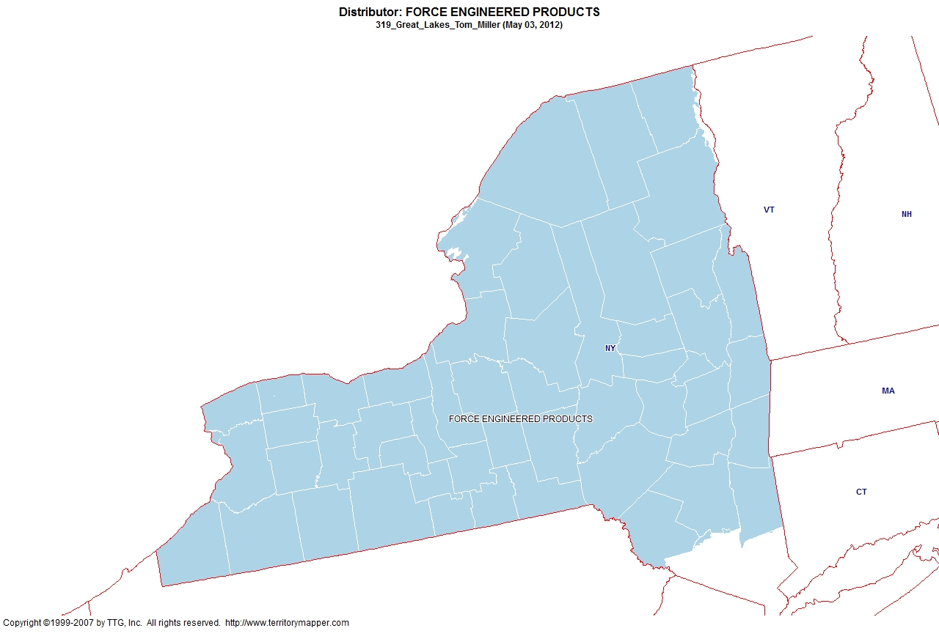
Back to Contents

Slide 15
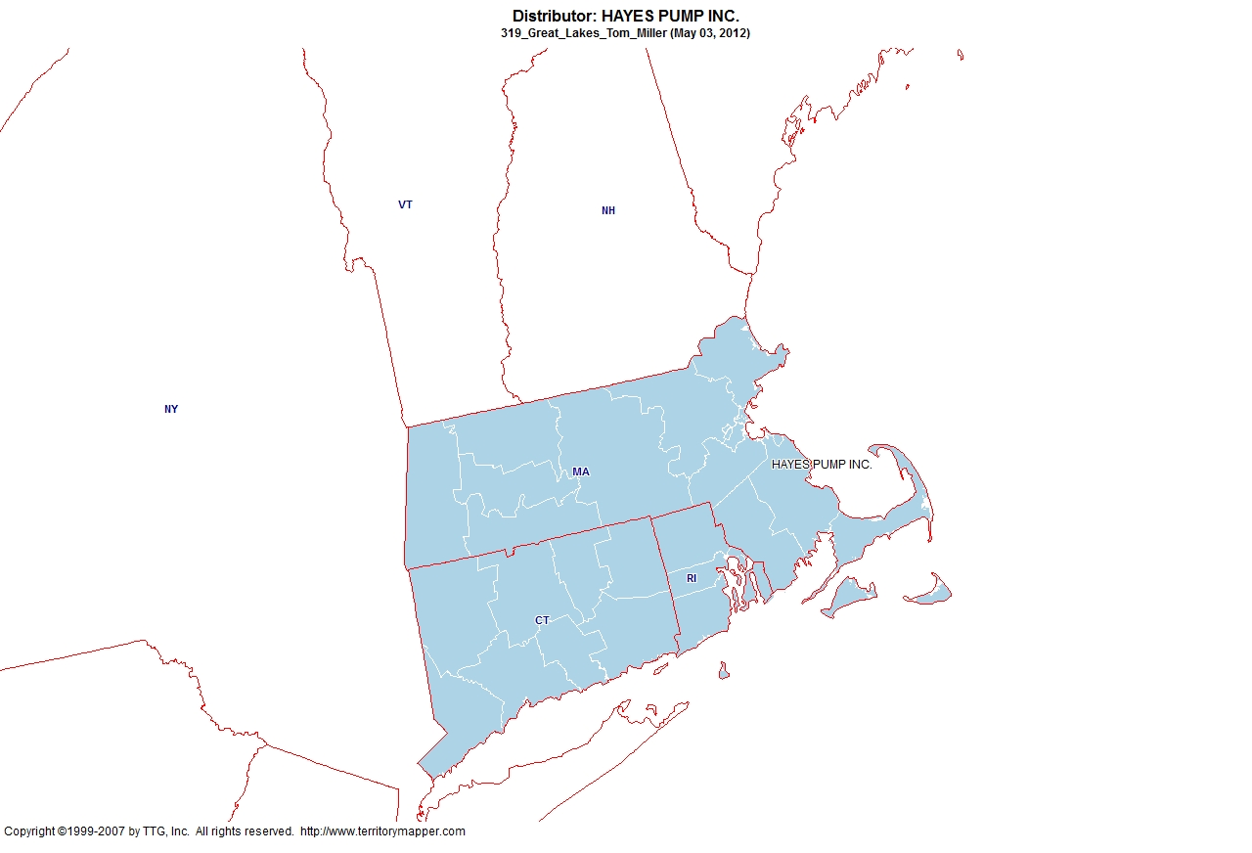
Back to Contents

Slide 16
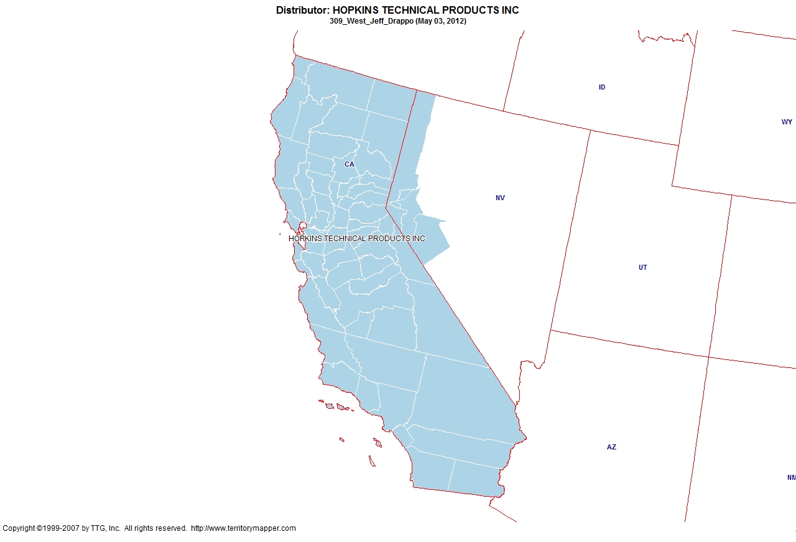
Back to Contents

Slide 17
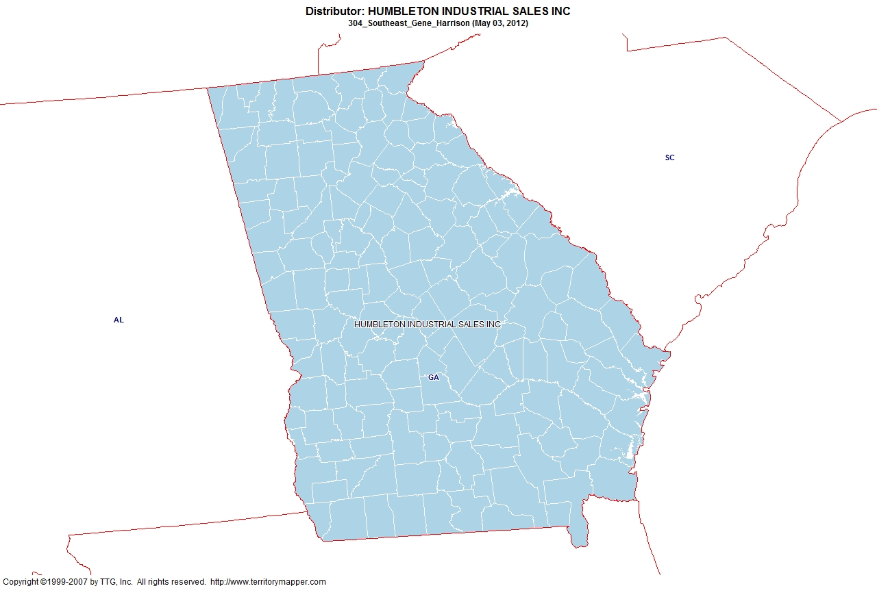
Back to Contents

Slide 18
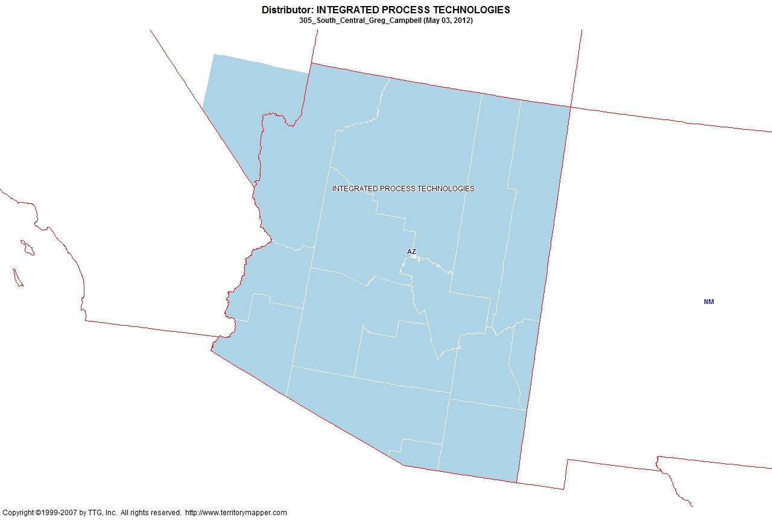
Back to Contents

Slide 19
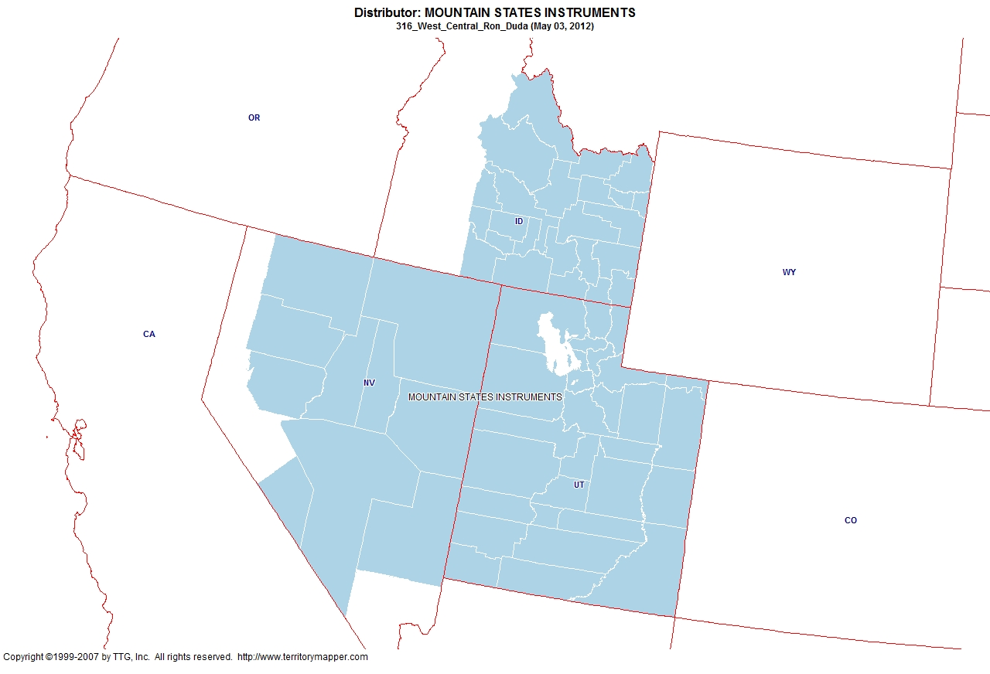
Back to Contents

Slide 20
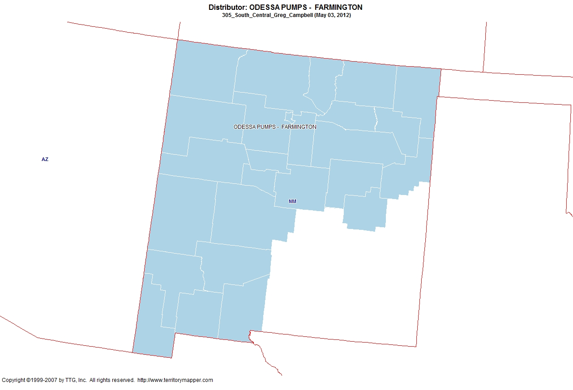
Back to Contents

Slide 21
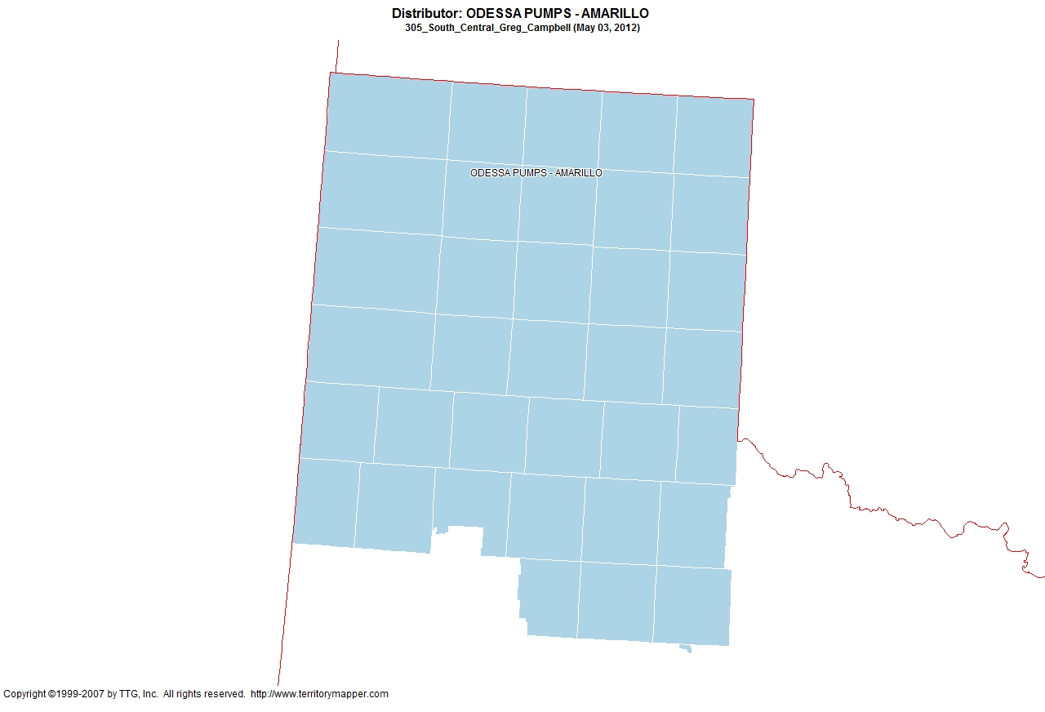
Back to Contents

Slide 22
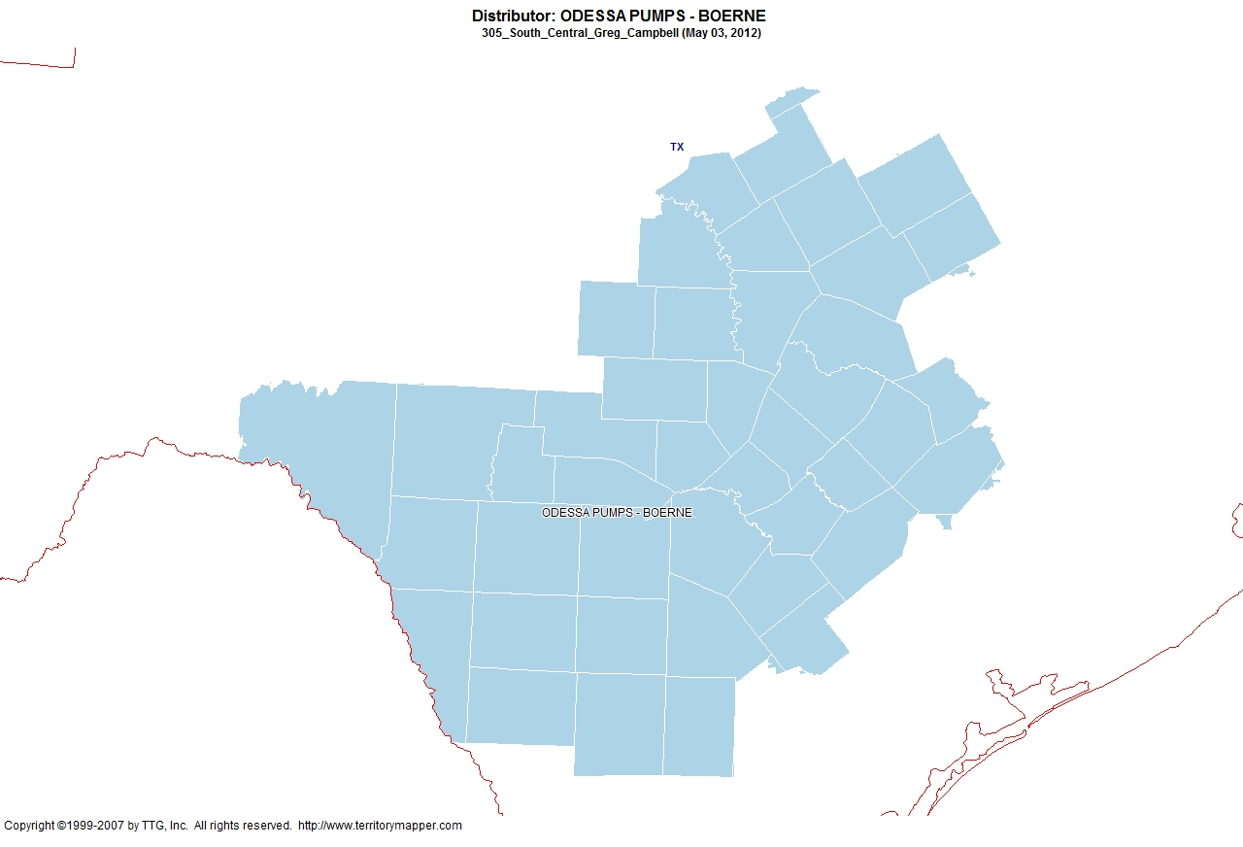
Back to Contents

Slide 23
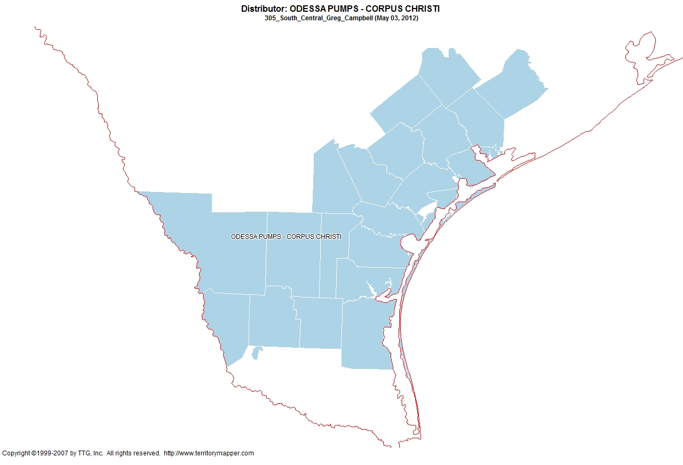
Back to Contents

Slide 24
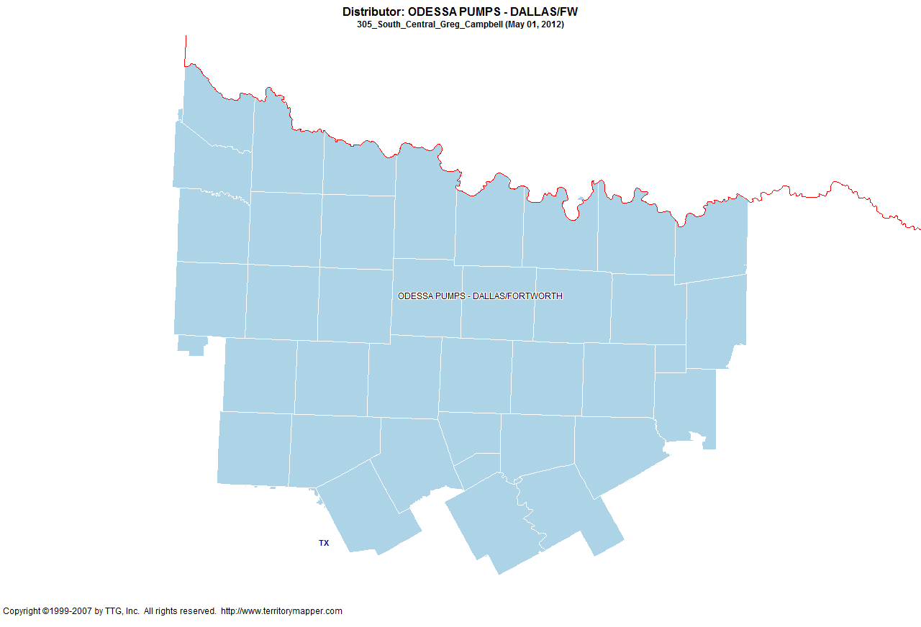
Back to Contents

Slide 25
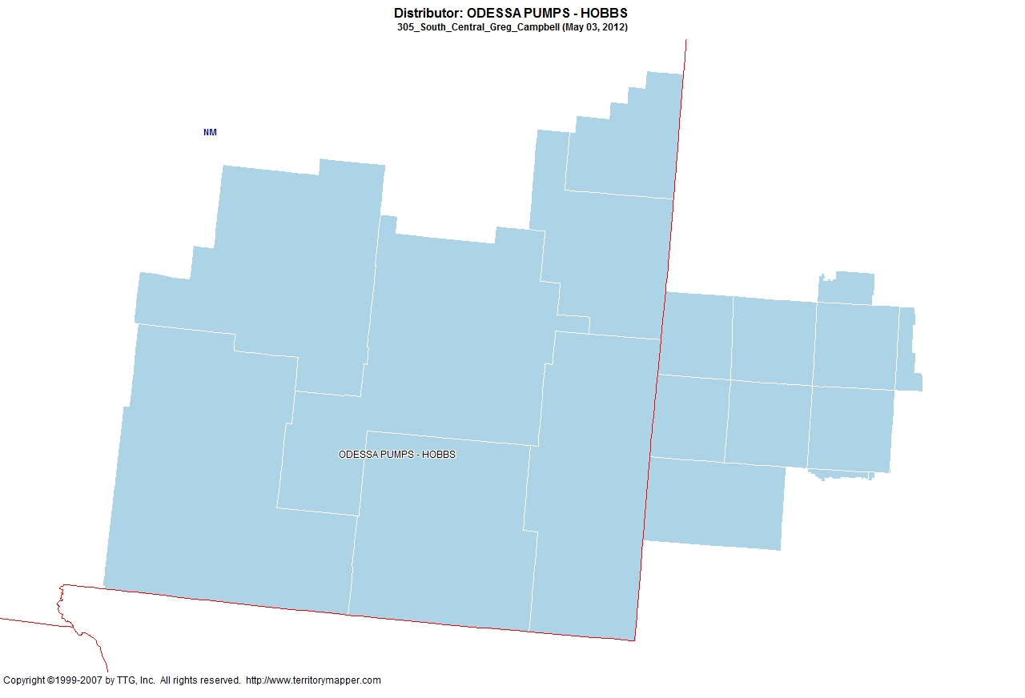
Back to Contents

Slide 26
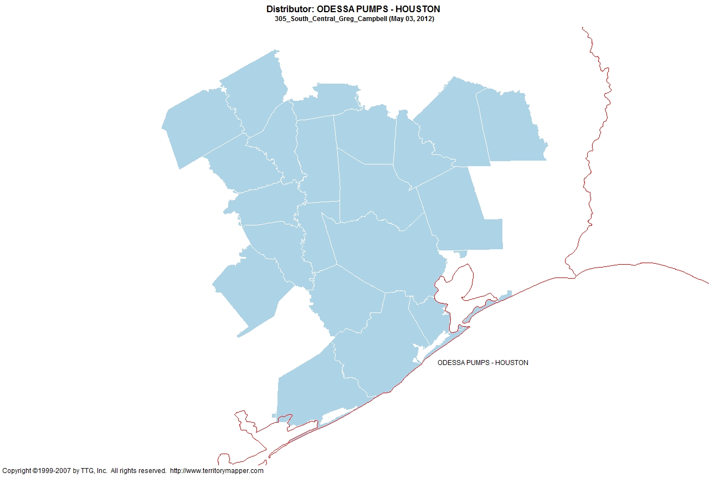
Back to Contents

Slide 27
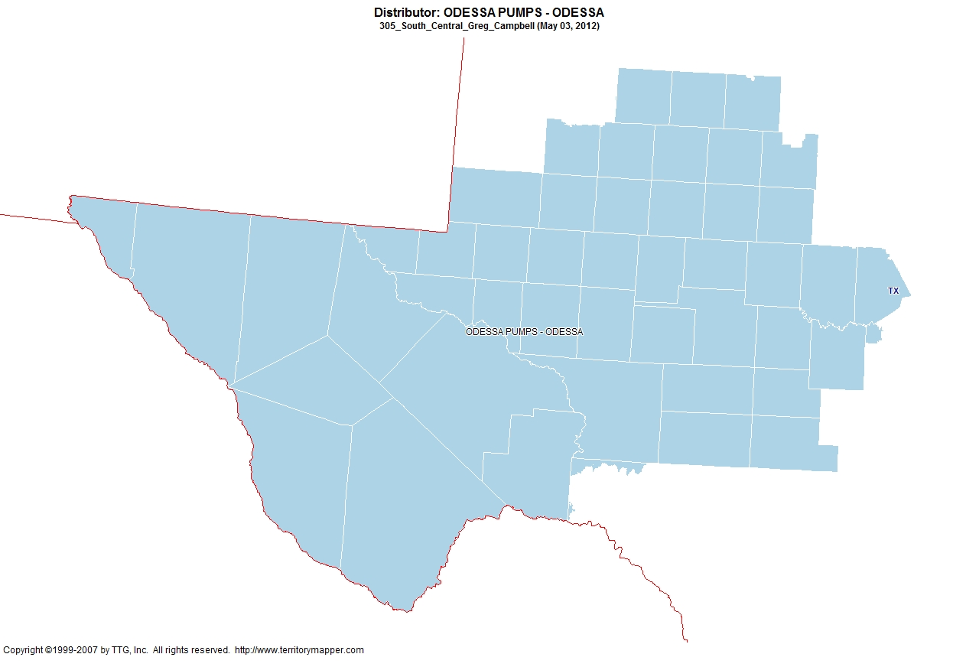
Back to Contents

Slide 28
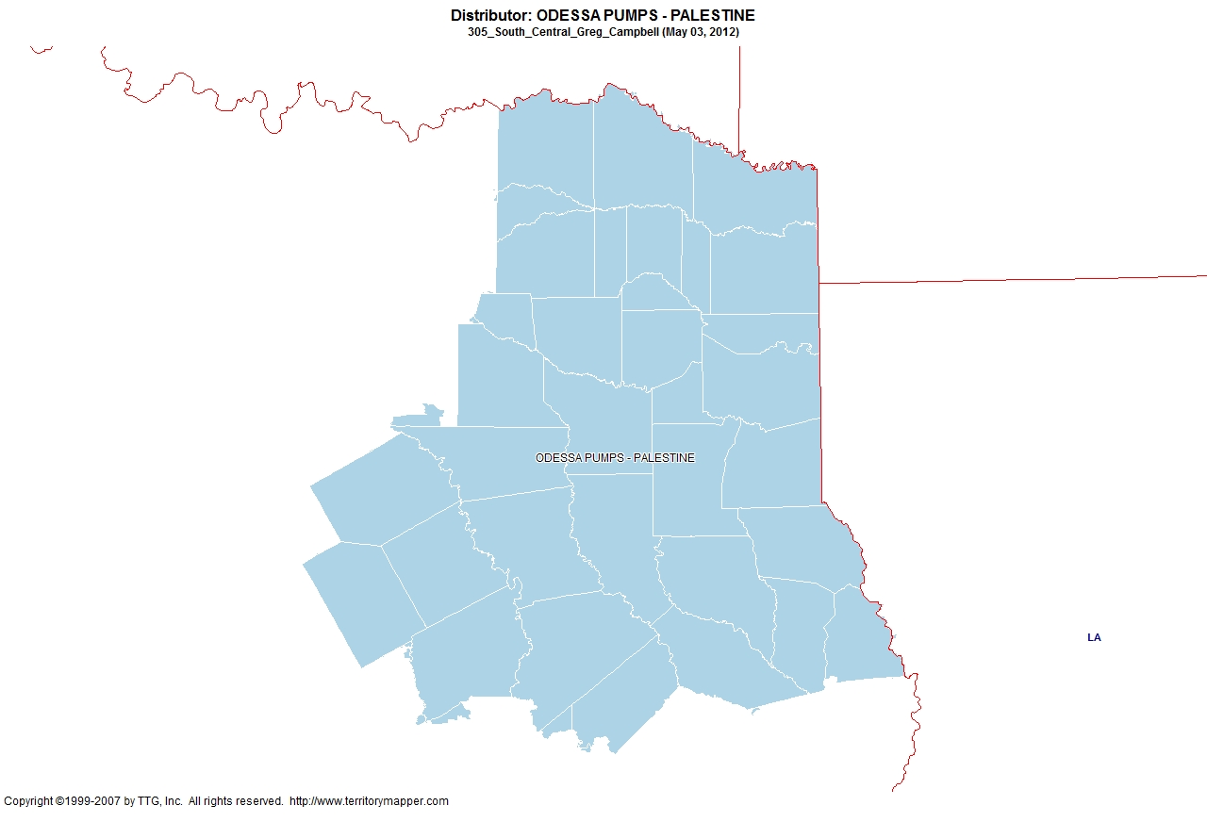
Back to Contents

Slide 29
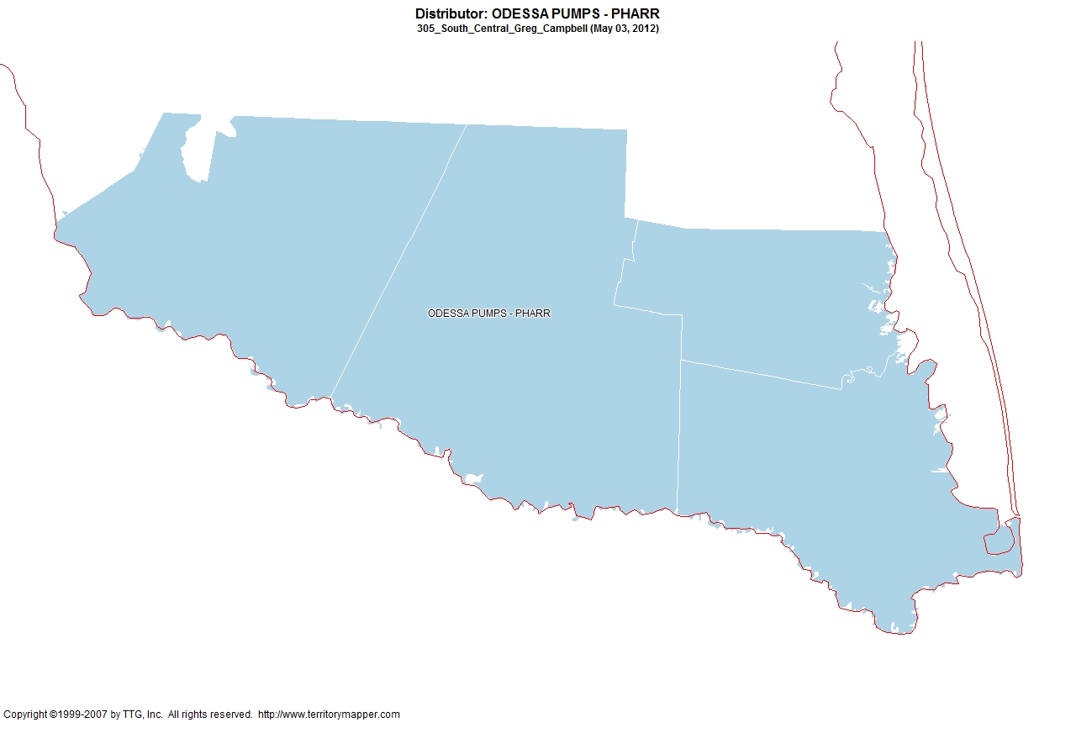
Back to Contents

Slide 30
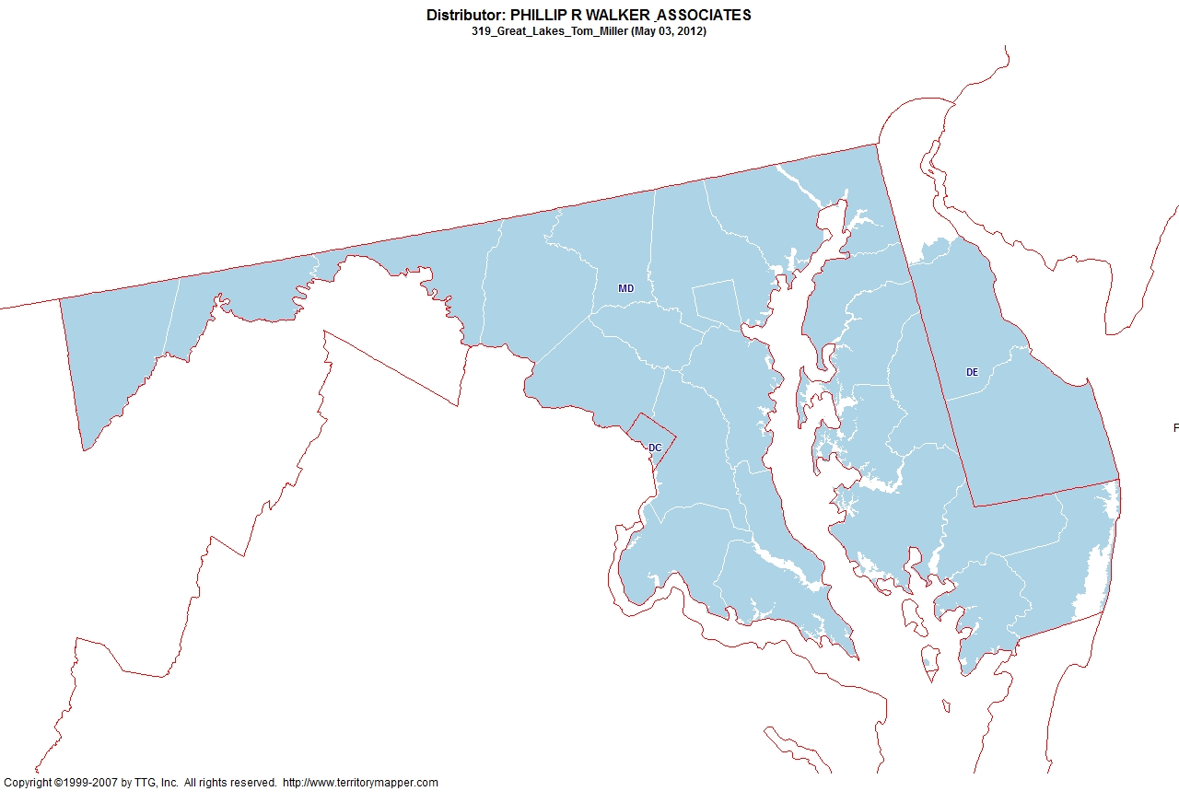
Back to Contents

Slide 31
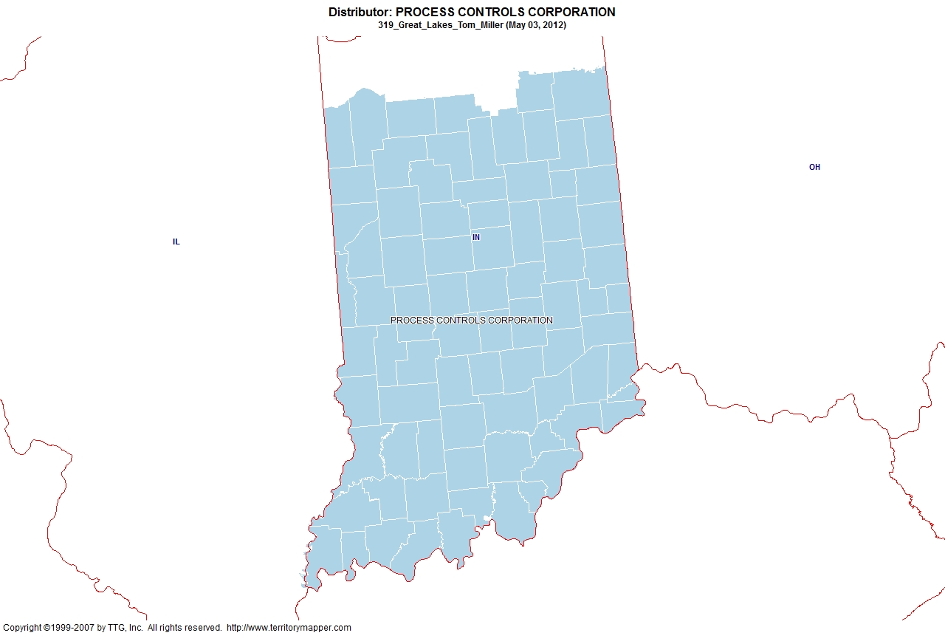
Back to Contents

Slide 32
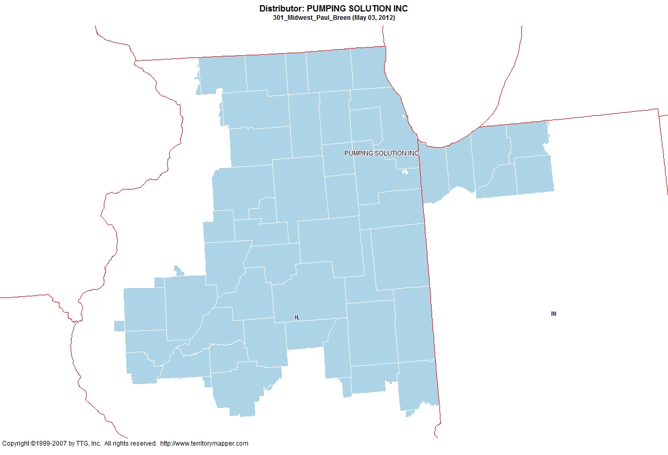
Back to Contents

Slide 33
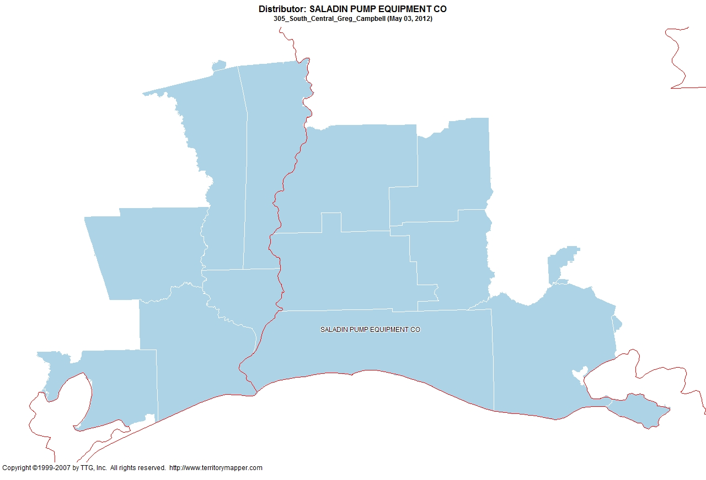
Back to Contents

Slide 34
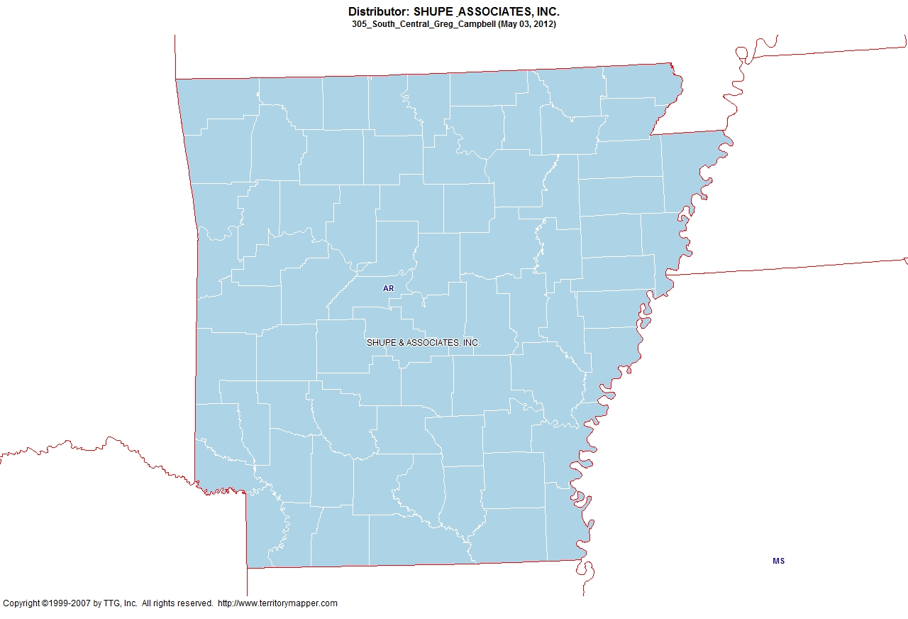
Back to Contents

Slide 35
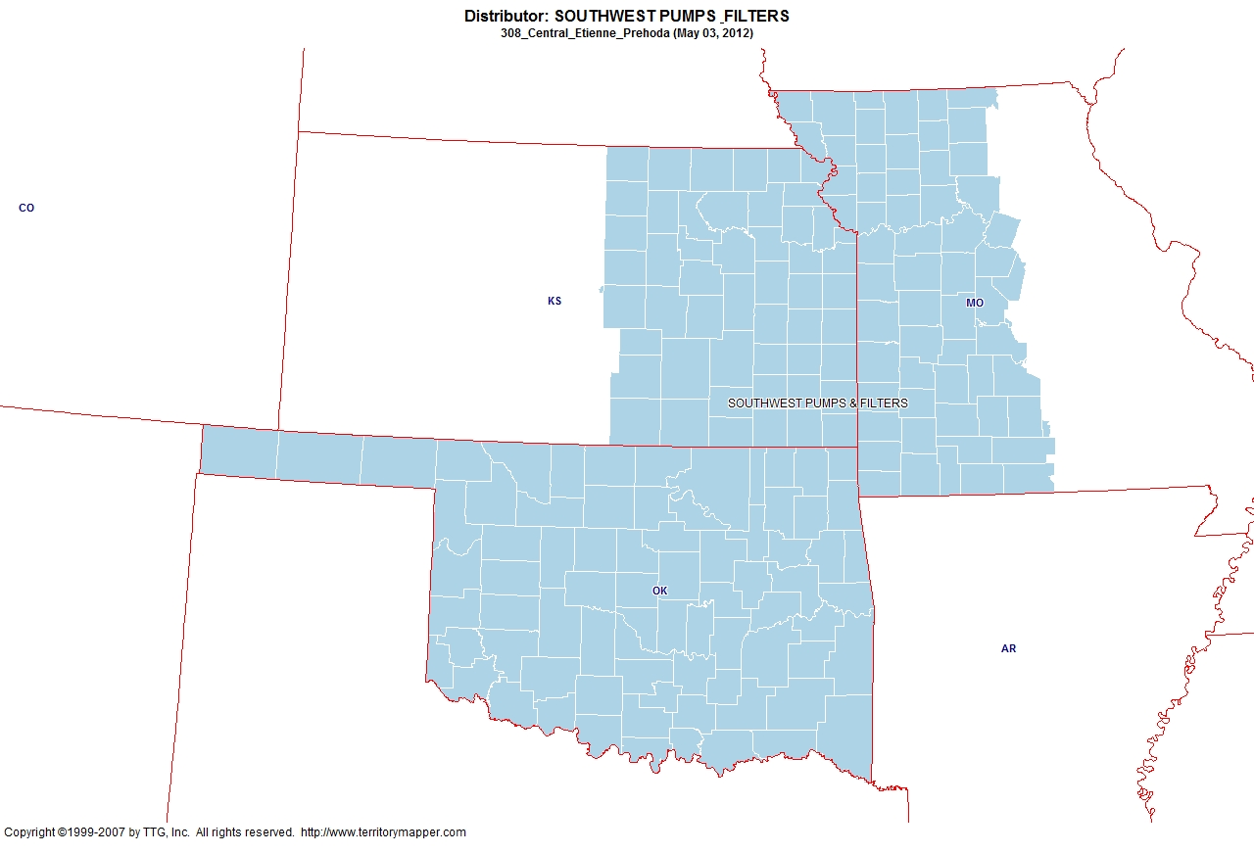
Back to Contents

Slide 36
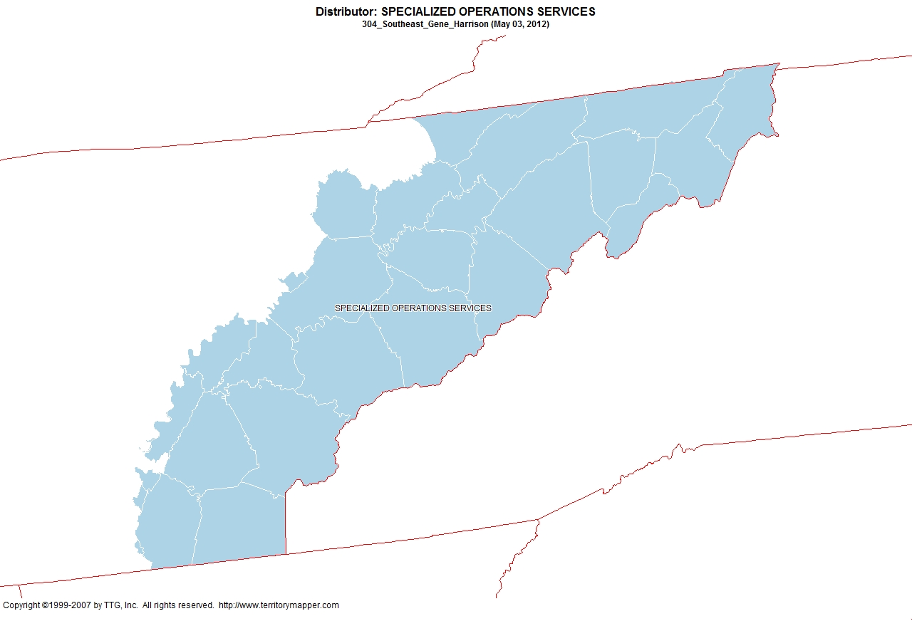
Back to Contents

Slide 37
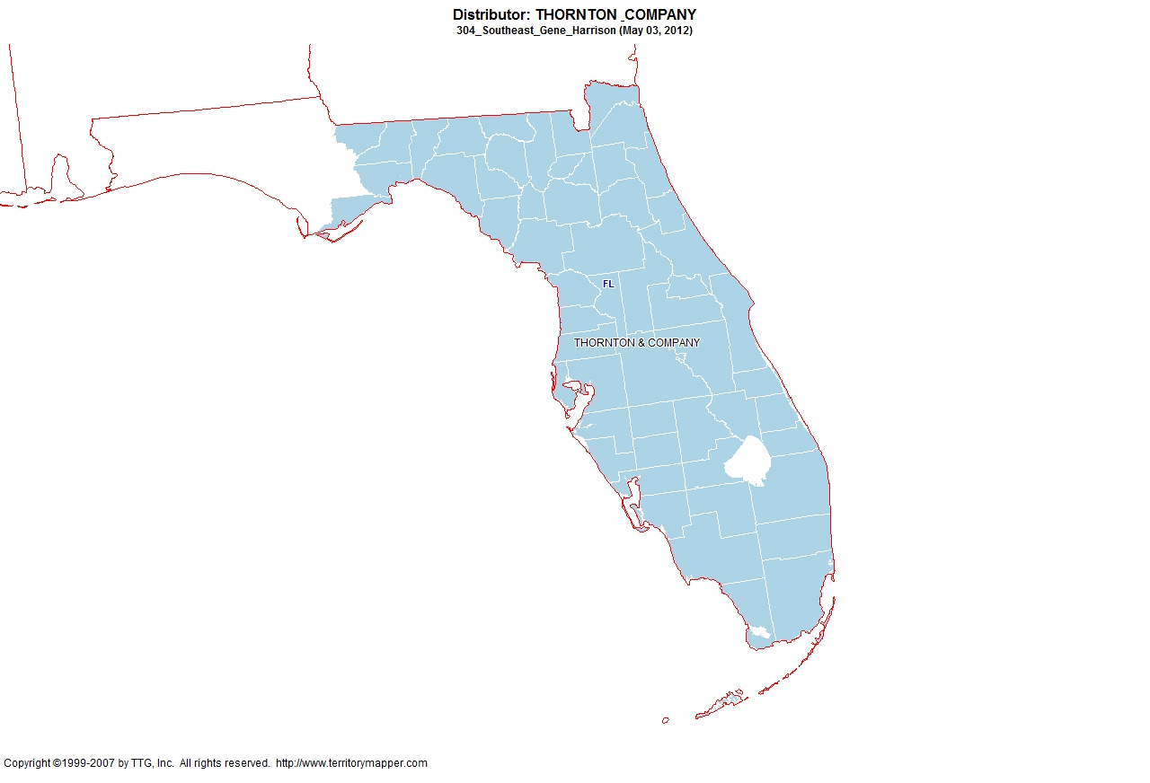
Back to Contents

Slide 38
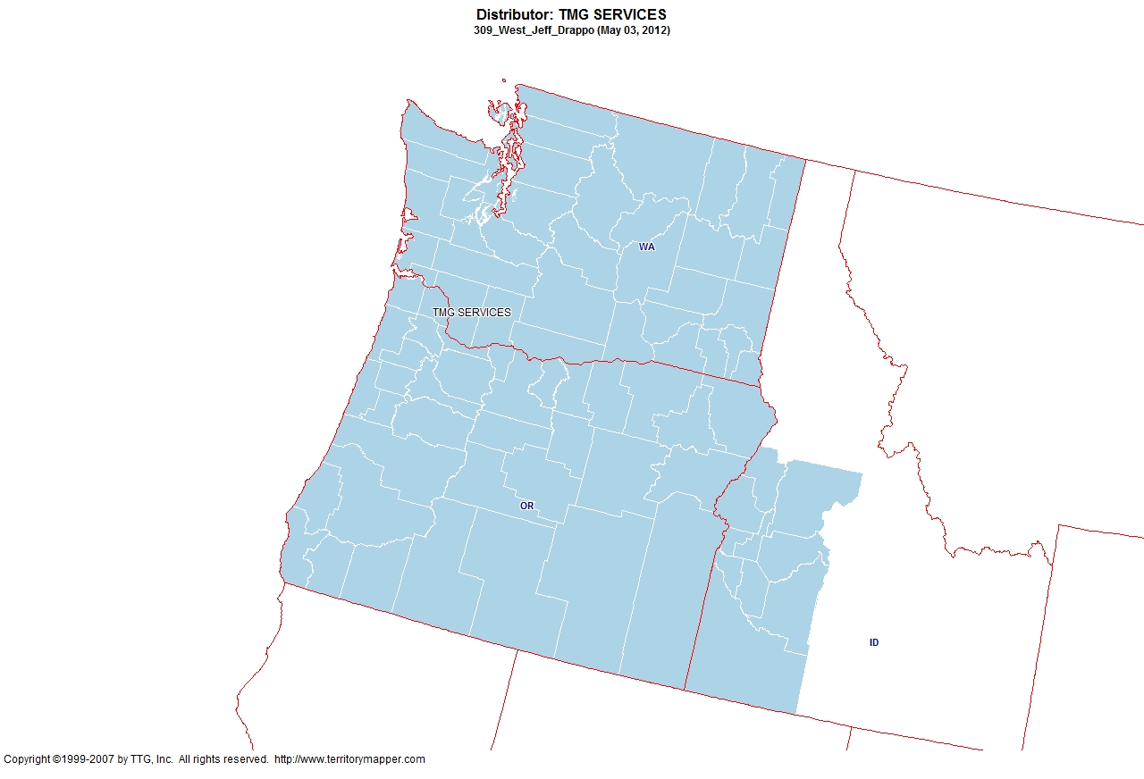
Back to Contents

Slide 39
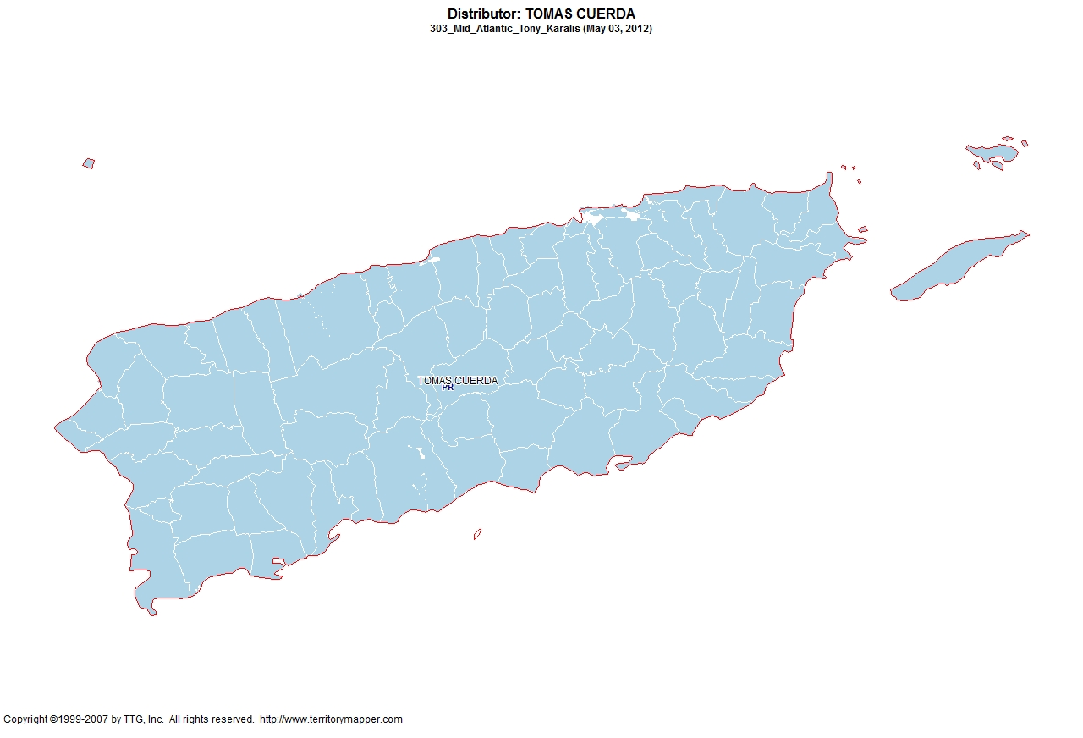
Back to Contents

Slide 40
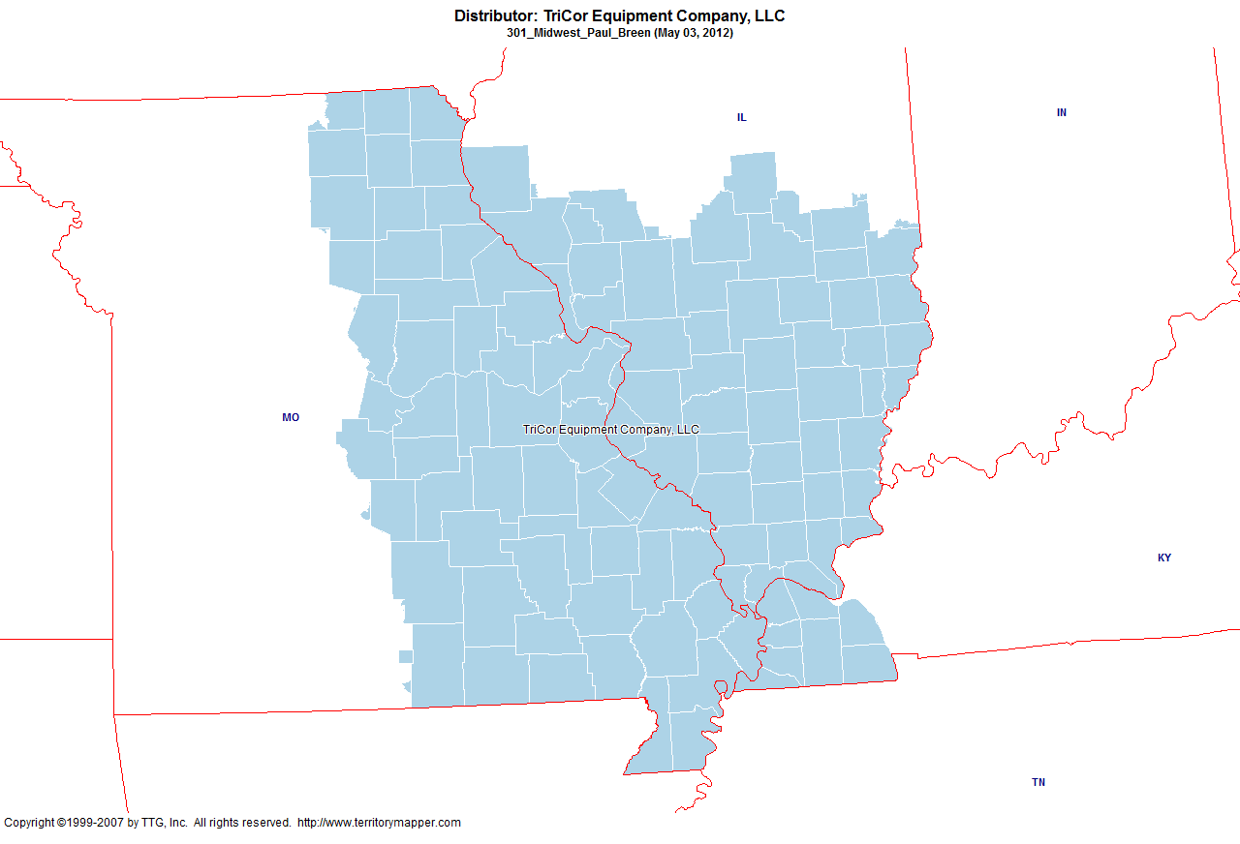
Back to Contents

Slide 41
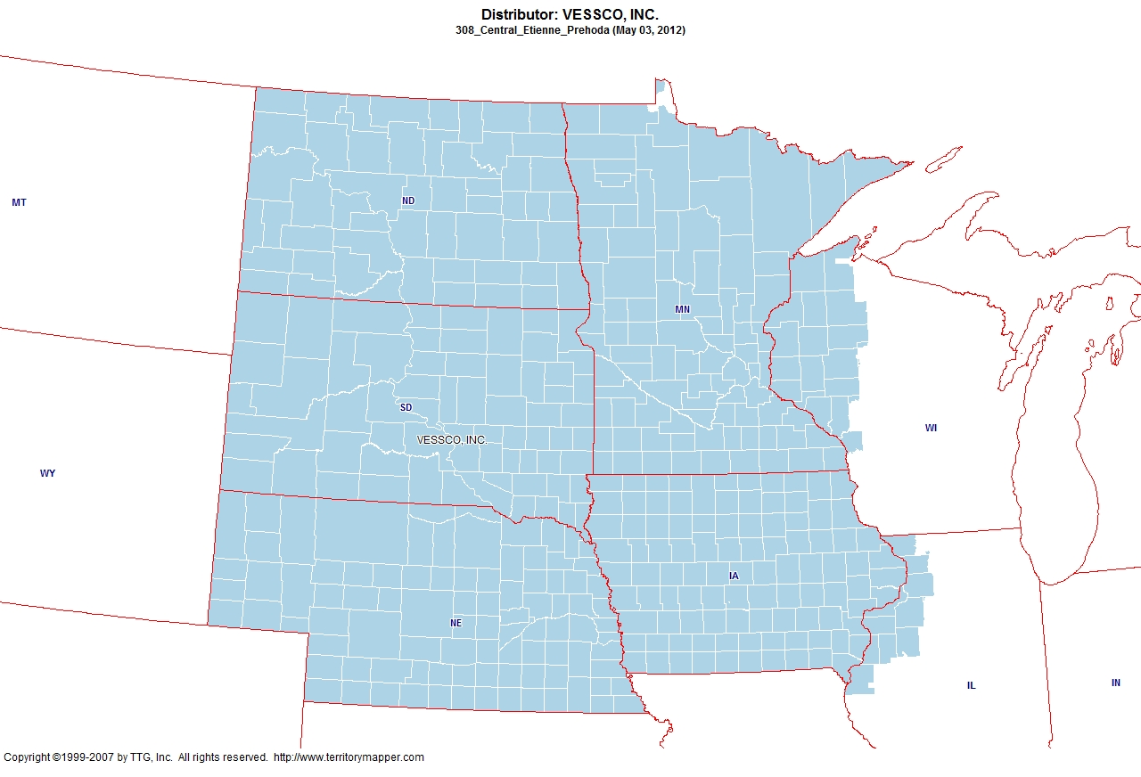
Back to Contents

Slide 42
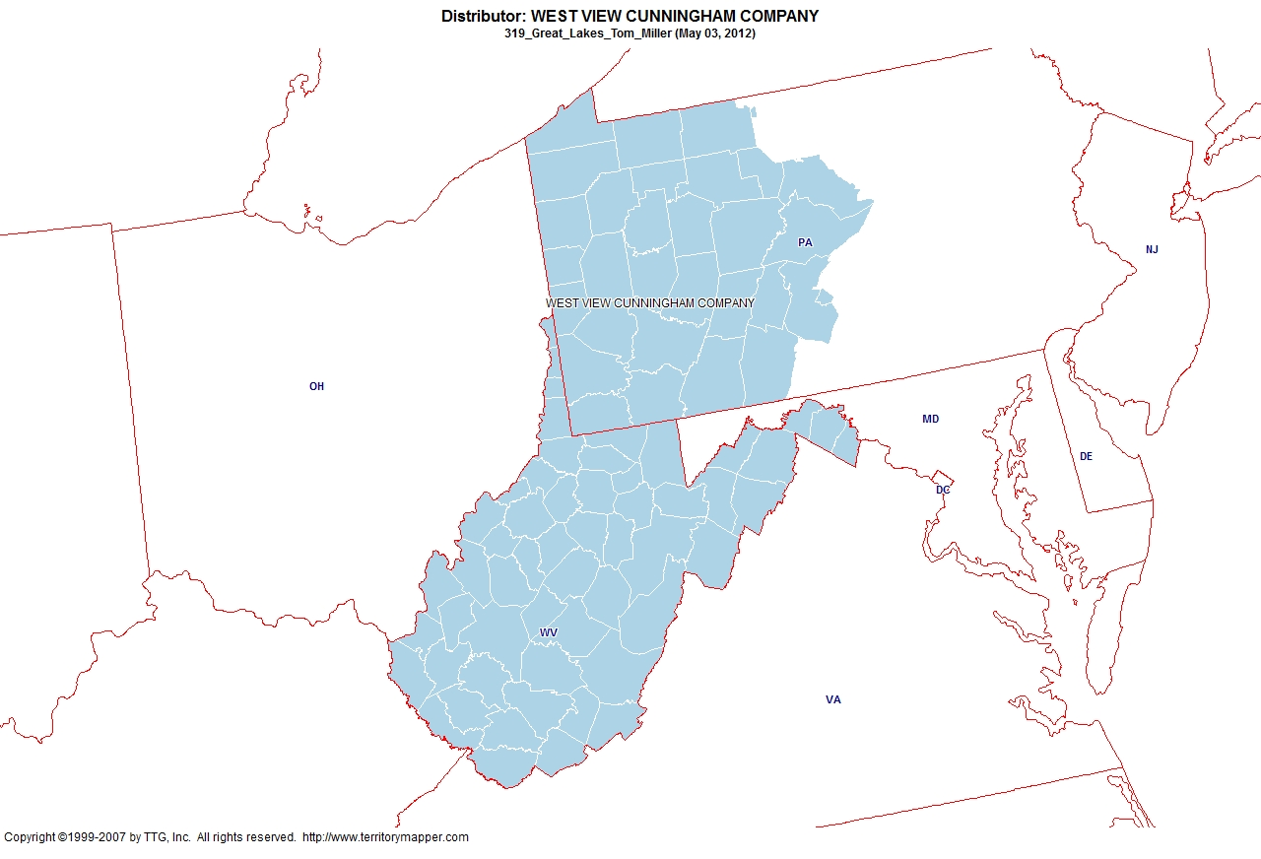
Back to Contents

Slide 43
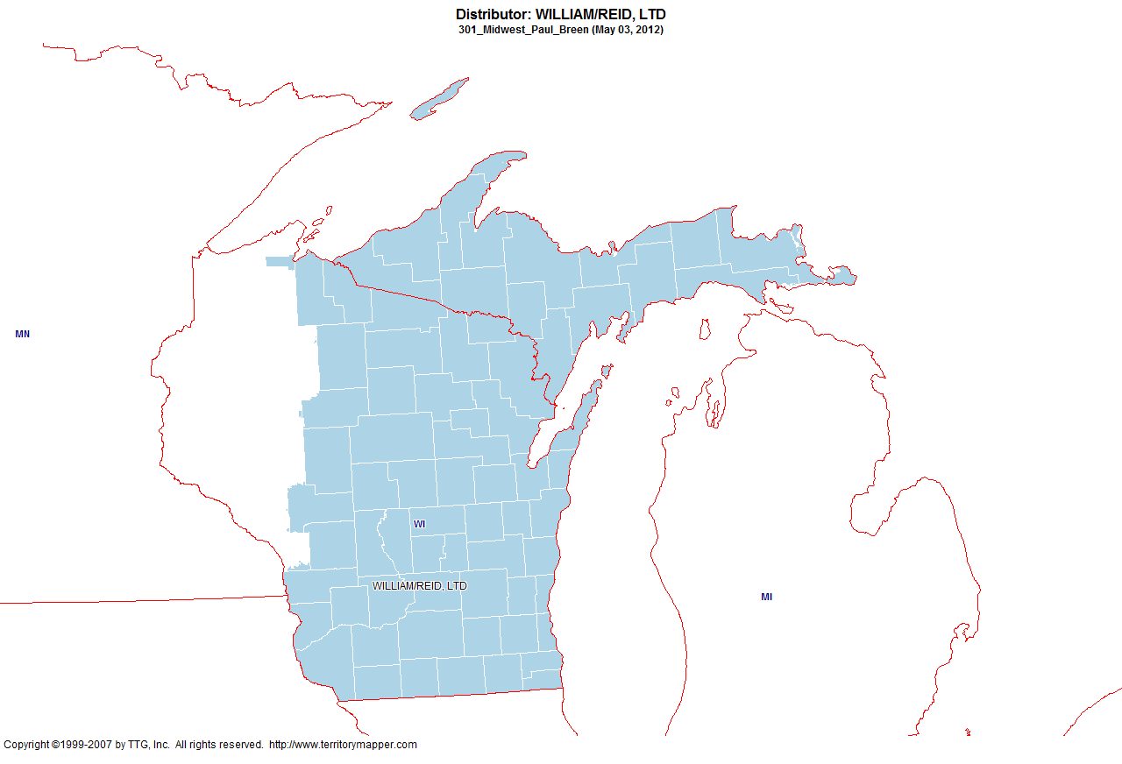
Back to Contents

