Slide 1
Chlorine Dioxide
Technology

Slide 2
Introductions
Walter Weterman – Director of International Sales
Rich Hopkins – Hopkins Technical Products
Fred Bender – Hopkins Technical Products
Greg Cozzi – Hopkins Technical Products
Jeff Drappo – Regional Manager PFC
Janet Berbach – Director of Corporate Events
Ken Gibson – Director of Business Development

Slide 3
Seminar Goal
Educate audience on Chlorine Dioxide disinfection
Why it is preferred over other disinfectants
Why it is a safe method of disinfection
Generating Chlorine Dioxide
Applications

Slide 4
Disinfection Methods
ProMinent
UV-light
Ozone
Peracetic Acid (PAA)
Chlorine gas / Sodium hypochlorite
Chlorine Dioxide

Slide 5
UV-Light
Lower consumption of water
No chemical addition or storage
Safe
Reliable
Attacks DNA of bacteria's
Destroys genetic info
No pH concerns
No THM’s or other DBP’s
No odor or taste concerns

Slide 6
UV-Light
Energy demand is high
Capital costs can be high
Maintenance intensive
Concerns with color, turbidity, dissolved minerals
Must maintain a constant flow
Leaves no residual disinfection power

Slide 7
Ozone
Best disinfectant that is safe to use
Most powerful
Decomposes into oxygen
Generated on-site
No taste or odor problems
Kills bacteria and germs
No chemicals

Slide 8
Ozone
Capital costs can be high
Energy demand is high
Temperature, humidity and pressure can be a factor
Half-life of only 20 minutes
Can breakdown organic components

Slide 9
Peracetic Acid (PAA)
Mixture of Acetic Acid and Hydrogen Peroxide
Strong disinfectant
Penetrates bacteria membranes
Widely used in the F&B market
Minimal capital cost

Slide 10
Advantages of PAA Disinfection
Efficient disinfection at 100-5000 ppm
  wide spectrum of disinfection efficiency:
  bacteria, viruses, fungi, algae, biofilm, mussel-larvs, ...
  rapid killing effect in 5 min
There is only low dependency of disinfection efficiency on
temperature:
also T< 10°C can be applied successfully
There is disinfection efficiency available over a wide pH range:
pH 3-8
All byproducts of disinfection are biologically degradable
3

Slide 11
Peracetic Acid (PAA)
pH and temperature dependent
Can be very corrosive
Expensive
Strong odor
Stored on-site

Slide 12
Chlorine
Comes is gas, liquid and solid forms
Most widely used disinfectant
Good overall disinfectant
Users have a comfort range

Slide 13
Not Chlorine
Chlorine Dioxide is not Chlorine
Chlorine exists in several states:
    Gas (cylinders/rail cars)
    Liquid (sodium hypo/bleach)
    Salt (electrolysis)
    Solid (pellets or pucks)
Chlorine Dioxide is a gas

Slide 14
Chlorine
Very pH dependent
Can produce harmful DBP’s
  THM’s
  Chlorophenols
  Chloramines
Chlorine gas is dangerous
Sodium hypochlorite decomposes
Leaves odor and taste concerns
Need large amounts to kill bacteria's

Slide 15
Dissociation of Chlorine
Chlorine Source
Initial Reaction
Chlorine Gas
Cl₂ + H₂O -> HOCl + H⁺ + Cl⁻
Sodium Hypochlorite
NaOCl + H₂O -> HOCl + Na⁺ + OH⁻
Calcium Hypochlorite
Ca(OCl)₂ + 2H₂O -> 2HOCl + Ca⁺⁺ + (OH)⁼
Secondary (Dissociation) Reaction (pH increases)
HOCl <--> H⁺ + OCl⁻
ProMinent Fluid Controls

Slide 16
Influence of different pH-values

Slide 17
Chlorine Dissociation Curve
0%
10%
20%
30%
OCl⁻
40%
HOCl
Percent of Chlorine as Hypochlorous Acid (HOCl)
Percent of Chlorine as Hypochlorite Ion (OCl⁻)
50%
60%
70%
80%
90%
100%
pH
ProMinent Fluid Controls

Slide 18
Chlorine Dioxide – ClO2
No pH dependency
Leaves no taste or odor concerns
Leaves residual for days
Increases shelf life
Does not form THM’s or other DBP’s
Generated on-site
Penetrates bacteria walls and destroys membranes

Slide 19
Physical Properties of Chlorine Dioxide
yellow-green gas, cannot be stored or compressed, has to be freshly produced
soluble in water as a gas, off-gassing at:
  increasing temperature
  solution’s agitation
aqueous solution is stable for a few days

Slide 20
Properties of Chlorine Dioxide
Cl
Cl
•O
O
O
O•
unpaired electron, considered to be a free radical:
high reactivity for oxidation and disinfection
ClO₂ + e⁻  ClO₂⁻ (Chlorite) E⁰ = 0.95 V
soluble in water as a gas
  reactivity independent of pH
  able to penetrate cellular membranes
  able to kill and remove biofilm
Remains in solution due to low rate of
self-decomposition in water (depending on pH)

Slide 21
Reactions with Organic Substances
chlorine dioxide reacts only as an oxidant
chlorine dioxide does not chlorinate
  no formation of THM´s (trihalomethanes, e.g. chloroform)
  no formation of chlorophenols
  no formation of AOX (absorbable organic halides)
  no reaction with ammonia
  No taste or odor concerns

Slide 22
Reaction with Inorganic Substances
Iron, Manganese precipitates and has to be filtered
  1 mg Iron consumes 1.2 mg ClO₂
  Fe²⁺ + ClO₂ + 3 H₂O  Fe(OH)₃ + ClO₂⁻ + 3 H⁺
  1 mg Manganese consumes 2.5 mg ClO₂
  Mn²⁺ + ClO₂ + 2 H₂O  MnO₂ + ClO₂⁻ + 4 H⁺
Nitrite is oxidized to Nitrate, Sulfide to Sulfate + Sulfur
  1 mg Nitrite consumes 2.9 mg ClO₂
  NO₂⁻ + 2 ClO₂ + H₂O  NO₃⁻ + 2 ClO₂⁻ + 2 H⁺
  1 mg Sulfide consumes 2.1 mg ClO₂
  2 S⁻ + 2 ClO₂  SO₄² ⁻ + S + 2 Cl⁻

Slide 23
Disinfection force of Chlorine Dioxide
  Excellent disinfection even at low concentration

Slide 24
Bacterial Reduction with Chlorine Dioxide

Slide 25
Fungicidal Activity with Chlorine Dioxide

Slide 26
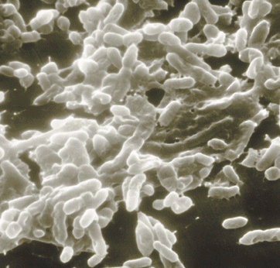
Biofilm - a universal Problem
slimy coatings of microorganism and extracellular compounds in pipelines and tanks
pathogenic germs as E. coli or Legionella are living in biofilms
biofilms are extremely resistant against disinfectants
chlorine dioxide is beside ozone
the only suitable disinfectant,
able to kill and to remove biofilms
in water pipes and tanks

Slide 27
Resistance of Biofilms
coliform germs survive in biofilms even with 12 ppm of free chlorine
4 ppm of free chlorine eliminates only 80% of the biofilm after 8 hours residence time
biofilms have even been found on the interior surface of disinfectants piping such as cooling towers and spray misters

Slide 28
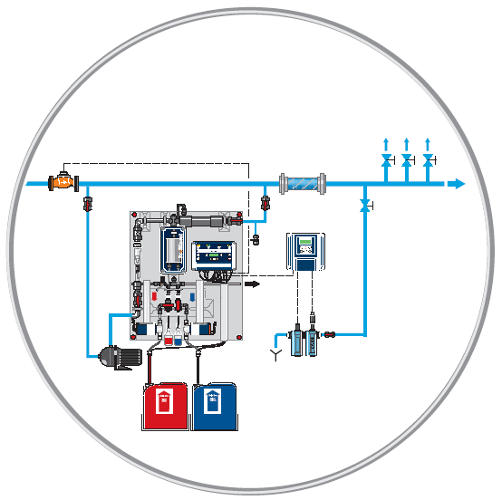
Chlorine Dioxide for Legionella Control
treatment of the complete
cold water
  preventive action
  for sanitized piping
  degradation of the biofilm in
  the piping, thus protection
  against re-infection
  protection against other critical
  germs such as Pseudomonas

Slide 29
Comparison of Disinfectants

Slide 30
THM Formation
River water after slow sand filtration
Bremen Waterworks , Germany (Prof. Sontheimer 1980)

Slide 31
Bello Zon Technology

Slide 32
Bello Zon® ClO2 - Generation Method
Chemicals: sodium chlorite (NaClO2)
        hydrochloric acid (HCl)
4 HCl + 5 NaClO2  4 ClO2 + 5 NaCl + 2 H2O
  85 - 90% yield (purity depends on pre-cursors)
  chlorine-free solution of chlorine dioxide
  by-products: chlorite and chlorate
  no handling of chlorine or chlorine gas
  No other by-products such as peroxides or acetic acid

Slide 33
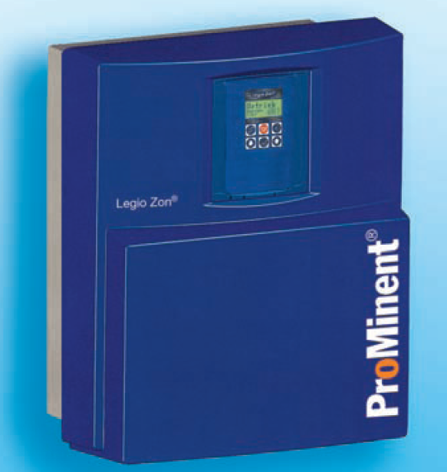
Legio Zon
fold-away wall holder
  plant can be serviced
  without disassembling
Protection hood

Slide 34
Legio Zon Basic Info
capacity: 0–5, 0-10 g/h
operation with Bello Zon standard chemicals
  1 vol. chlorite 7.5 % + 3 vol. HCl 9% + 20 vol. water
  concentration ClO₂: 2 g/l
  never dangerous concentration in the plant
  optimum stability (-15% after 3 days)
  reaction time < 20 minutes
easy operation, low maintenance effort
low price + high level technology

Slide 35
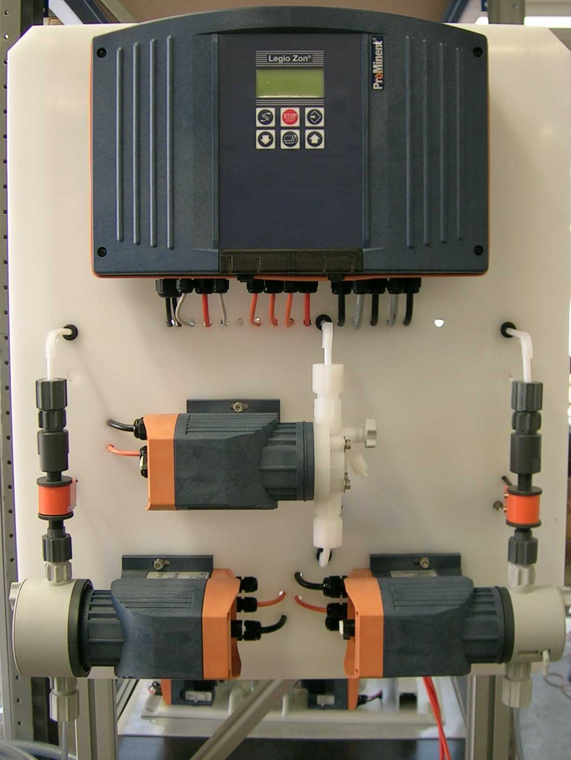
Legio Zon Design: Front
outlet
chlorine dioxide
controller
line cord
Check valve for back pressure
dosing pump chlorine dioxide
flow monitor
dosing pump acid
dosing pump chlorite
input dilution water
draining valve

Slide 36
Bello Zon CDVc (dilute chemicals)
Model | ClO₂ output [g/h] | operating pressure [psi] | operating temperature [°C]
CDVc 20 | 1-20 | 116 | 10-40
CDVc 45 | 2-45 | 116 | 10-40
CDVc 120 | 6-120 | 116 | 10-40
CDVc 240 | 12-240 | 102 | 10-40
CDVc 600 | 30-600 | 73 | 15-40
CDVc 2000 | 100-2,000 | 29 | 15-40

Slide 37
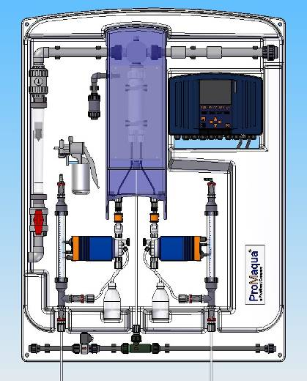
Bello Zon CDVc for Diluted Chemicals
Backpanel for wall mounting
static mixer
controller with data logger and screen recorder
PVDF reactor and reactor-outlet
single stroke
flow sensor
reactor cover for protection
metering pumps in CAN-bus version
calibration and suction aid with vacuum pump (optional)
purge assembly
for reactor (optional)

Slide 38
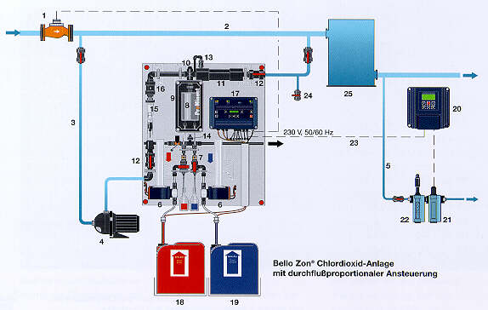
ClO₂–Concentration in Bello Zon®-Systems
water:
0.05-2 ppm
ClO₂
bypass:
200-1000 ppm
ClO₂
reactor:
20,000 ppm
ClO₂

Slide 39
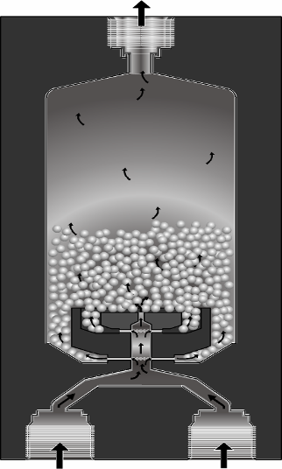
Bello Zon® - Reactor CDV and CDK
perfect mixing of the chemicals causes high yield of ClO2
optimal design guaranties sufficient reaction time of minimum 4 minutes
concentration 20 g/l (2%)
no gas phase

Slide 40
Operation of CDV
Pre-cursor chemicals:
  sodium chlorite: 7.5% (w/v) 95-99% pure
  hydrochloric acid: 9.0% (w/v) 95-99% pure
  design data:
  1 liter NaClO2 + 1 liter HCl = 40 g ClO2
Conditions:
  temperature treated water: 131 °F
  temperature chemicals: 50 - 104 °F
  backpressure: 102 - 145 psi

Slide 41
Operation of CDK
Applied chemicals:
  sodium chlorite: 25% (w/v) 95-99% pure
  hydrochloric acid: 30% (w/v) 95-99% pure
  design data:
  1 liter NaClO2 + 1 liter HCl = 150 g ClO2
Conditions:
  temperature treated water: 131 °F
  temperature chemicals: 50 - 104 °F
  backpressure: 102 - 145 psi

Slide 42
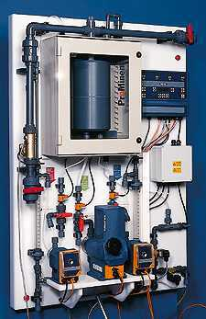
Bello Zon® Type CDKc, (concentrated chemicals)

Slide 43
Chemical Safety
Color coded chemical tanks are suggested
Level switches in chemical tanks
Relays on level switches attach to an audible alarm; generator shuts down if tank is empty
Flow sensors on pumps to ensure the correct proportion of chemical flow
Alarm on flow sensors; generator shuts down if x pulses are missed (programmable)

Slide 44
Reactor Safety
Isolated in an enclosed PVDF reactor housing
Only a 2% solution is generated (20,000 ppm)
Reactor housing is automatically purged via an injector and solenoid valve up to 6 times per hour
The reactor chamber is always full of solution – not gas!!

Slide 45
Additional Safety Features
Flow sensor on bypass water line adjusts the amount of chlorine dioxide generated
Chlorine dioxide is injected into the bypass water flow
Output can be controlled by a ProMinent chlorine dioxide residual controller

Slide 46
Maintenance
CDV: every 6 - 12 months acc. to operating conditions
CDK: every 6 month
  effort:
    spare parts kit CDV/CDK plant
    3 – 4 working hours
  flushing and disassembling reactor
  exchange of gaskets
  maintenance pumps and dosing line with exchange gaskets and diaphragms
  functions‘ check
  calibration

Slide 47
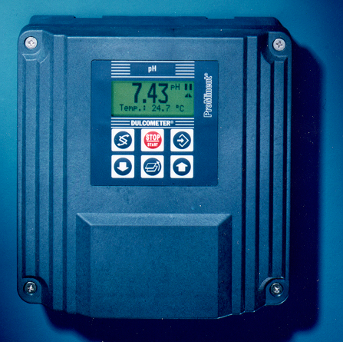
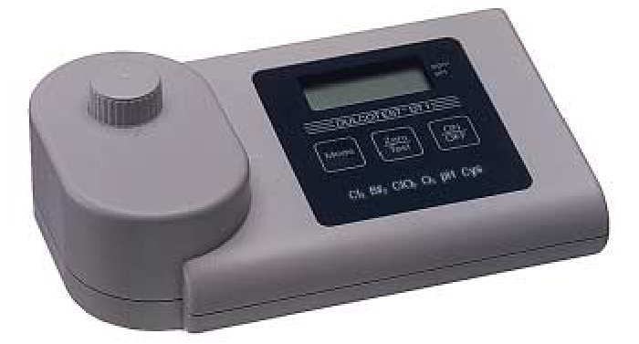
Analysis of Chlorine Dioxide and Chlorite
Online – measurement & control:
Dulcometer® D1C: ClO2, chlorite, pH, ORP
Dulcometer® D2C: ClO2 + pH
Photometer Dulcotest® DT 4
ClO2 + chlorite

Slide 48
Amperometric sensors for ClO2 and Chlorite
CDE 2-mA (ClO2 for clean water)
Measuring ranges (10, 2, 0.5 ppm)
CDP 1-mA-2 ppm (ClO2 for surfactant water)
Measuring range (2 ppm)
CDR 1-mA (ClO2 for dirty water)
Measuring ranges (0.5 and 2 ppm)
CLT 1-mA (chlorite)
  Measuring ranges (0.5 and 2 ppm)

Slide 49
Applications with Chlorine Dioxide
ProMaqua

Slide 50
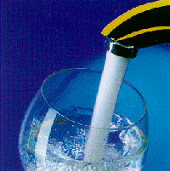
Drinking Water
Maximum dose: 0.4 ppm
0.1 – 0.2 ppm are sufficient for water without steady demand and sufficient reaction time
Old pipe networks with biofilms demand often a higher startup shock dosage
Analyze the amount of chlorine residual until a process stabilization has taken place. In most cases the initial dose can be reduced.

Slide 51
Drinking water disinfection with ClO2
First, need a detailed water analysis
Dosing of ClO2 only flow proportional
Min. reaction time of 15 minutes
Optimum waterflow (no dead legs)
Max. dose 0.4 ppm ClO₂
EPA limit values for ClO₂ and ClO₂⁻

Slide 52
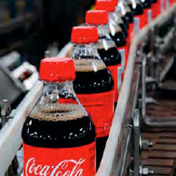

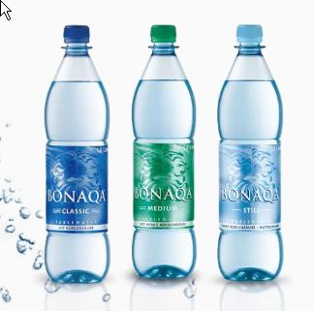
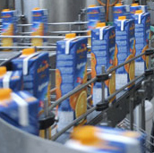
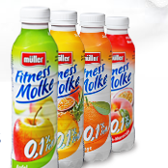
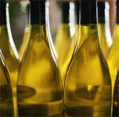
Beverage Industry
Soft drink industry
Brewery industry
Mineral/ table water industry
Juice industry
Dairy industry
Wine industry

Slide 53
ClO2 in Breweries
central water supply
tap water
ClO₂
CIP
bottle washing
rinser
filler
pasteurizer, cooling water
belt lubrification systems

Slide 54
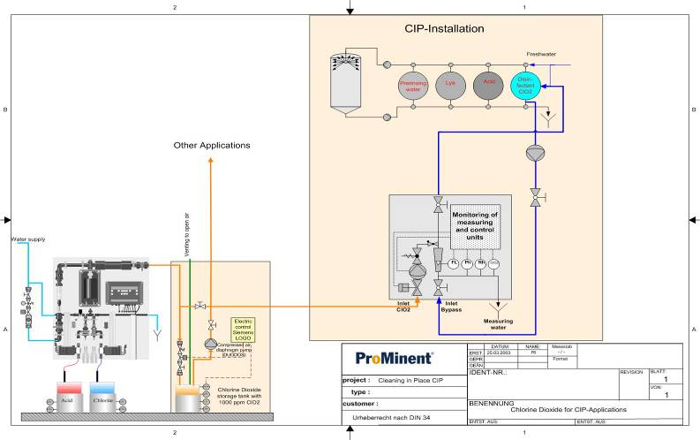
Clean in Place (CIP) with ClO2
Disinfection and cost reduction by one step
2 ppm
ClO₂

Slide 55
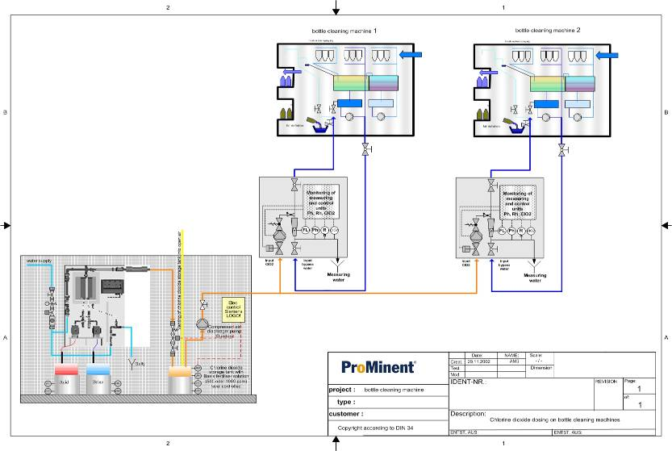
Bottle Washing with ClO2
0.8-2 ppm
ClO₂

Slide 56
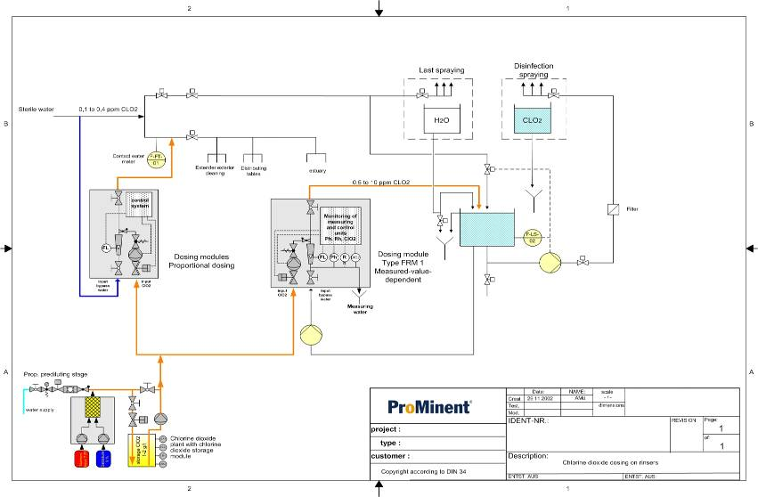
Bottle Rinsing with ClO2
0.5-1.5 ppm
ClO₂

Slide 57
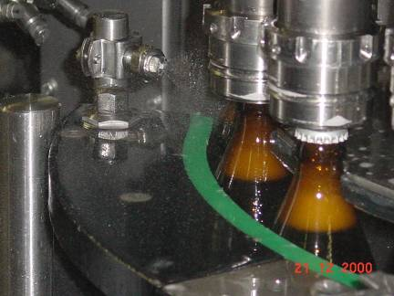
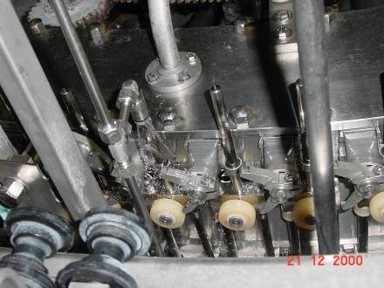
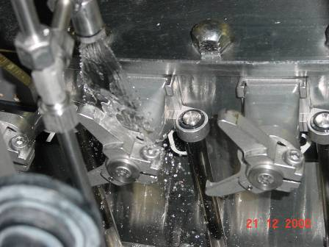
ClO2 in Filling Machines
0.4 ppm
ClO₂

Slide 58
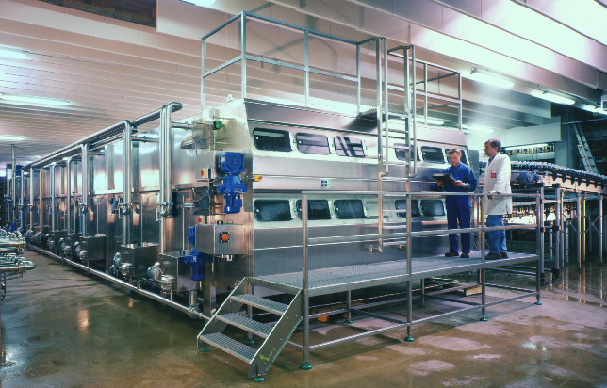
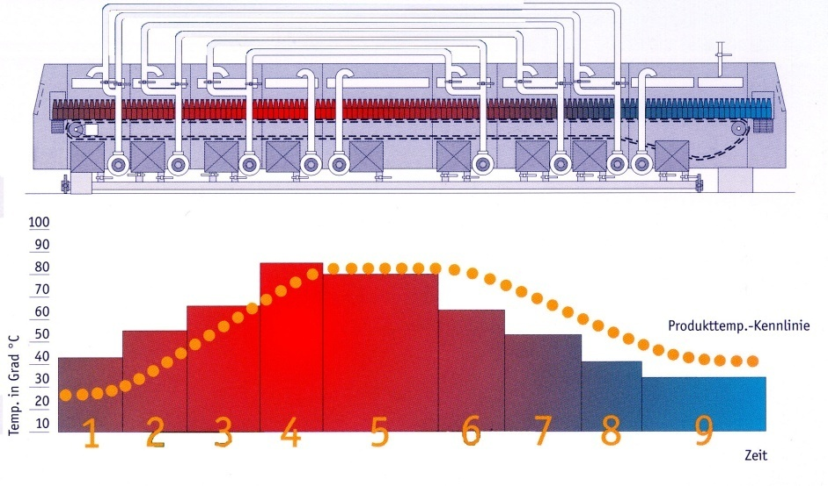
Pasteurization
Tunnel Pasteurizer

Slide 59
ClO2 in the Chicken Industry
0.8 ppm ClO₂ in several rinsing steps and in the prechiller
  reduction of bad smell
  meat and skin natural colored
  biol. effectiveness against
  salmonella is better
Time [min] | without treatment [bacteria / ml] | 200 ppm Cl₂ [bacteria / ml] | 5 ppm Cl0₂ [bacteria / ml]
0 | 220 | ------ | -----
10 | 350 | 76 | 6
20 | 640 | 97 | 6
30 | 2,700 | 540 | 6
60 | 4,800 | 920 | 6
120 | 6,600 | 1,570 | 18

Slide 60
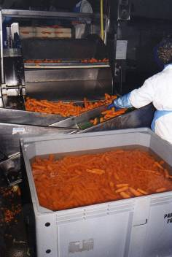
Vegetable Washing with ClO2
Batch washing, water change every 6-8 hrs. typical dosage: 6 ppm
Spraying with ClO₂: typical concentration
  Onion rings 6 ppm
  Carrots 1 ppm
  Lettuce 2 ppm
Benefit:
  Shelf life increased by factor 3

Slide 61
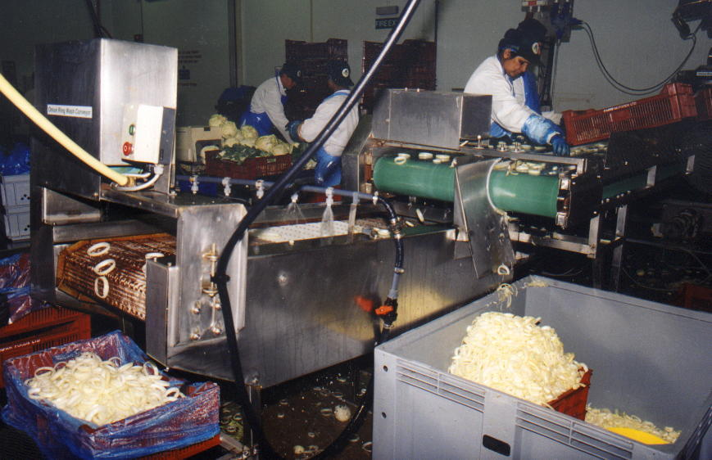
Onion Rings, sprayed with Chlorine Dioxide Wash Water

Slide 62
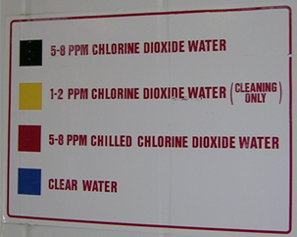
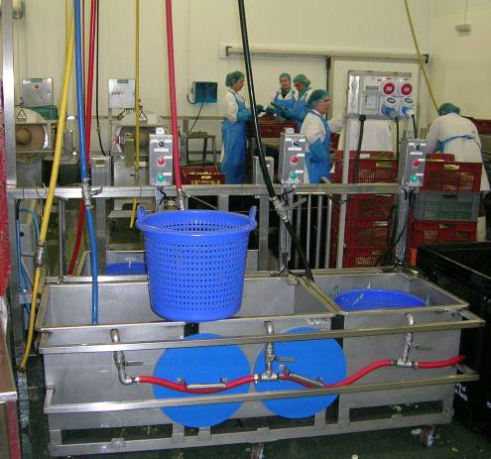
Optimizing the ClO₂-Distribution
4 different lines:
optimized disinfection is managed by variation of reaction time and temperature

Slide 63
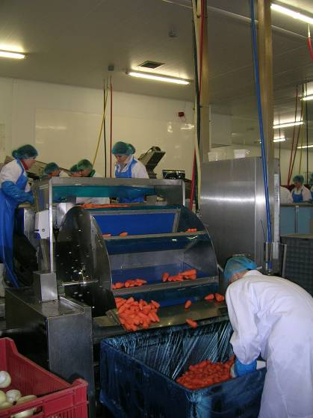
Batch-wise Flume Basins
flume = transport by means of flowing water;
sometimes supported by mechanical tools
product is flumed trough water with 5-8 ppm ClO₂
when to exchange the water?
  fruits with low ClO₂-demand (e.g entire cucumbers):
  at 1-2 ppm
  fruits with high ClO₂-demand
  (e.g. onion rings): at 3-4 ppm

Slide 64
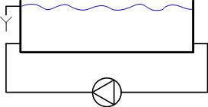
Continuous Flume Basins
refreshing of the ClO₂ by means of spraying 5-8 ppm during product’s transport out of the basin
suitable for products that can be packed wet
(e.g. carrots)
5-8 ppm ClO₂
product in
product out

Slide 65
Continuous Salad Washing
product 5-7 °C: preparation
(cutting, sizing)
drinking water 0 °C
0.5 ppm ClO₂
washing
6-7 °C
disinfection
5 °C
air
2-10 ppm
0.5 ppm
D1C-controller ClO₂
sedimentation
biol. clearance
UF
RO
re-use
50 ppm ClO₂
optimized use of water and energy
  60 % recycling rate
  decreasing temperature from in- to outlet

Slide 66
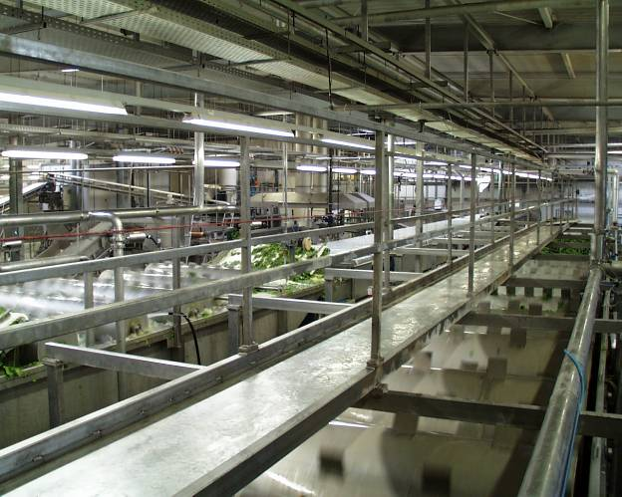
Spinach Processing with ClO2

Slide 67
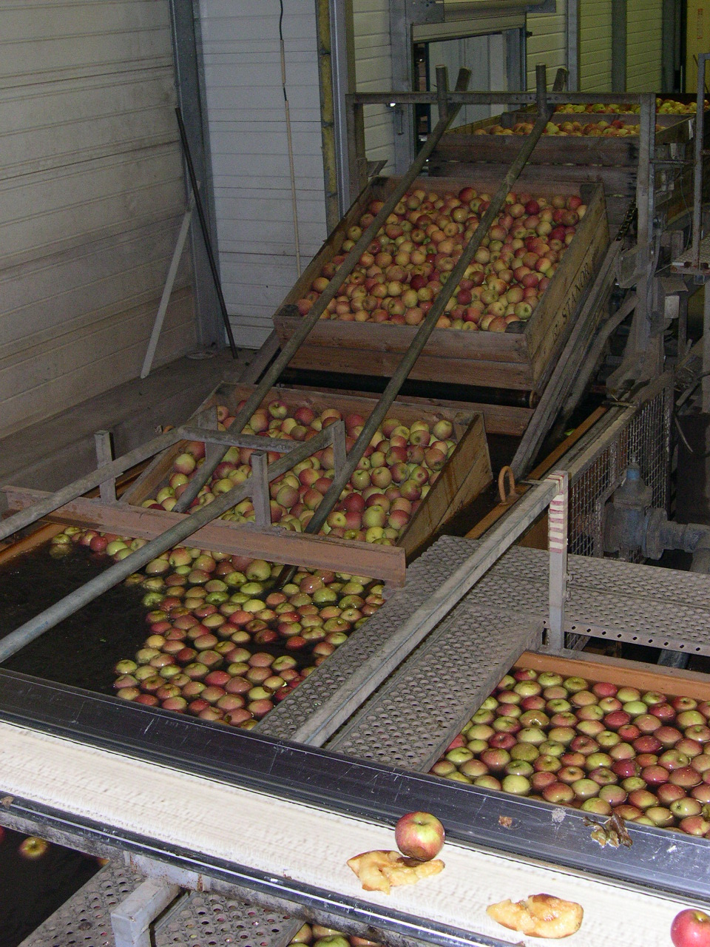
Apple processing
Arrival of the crates
Immersion of the crates
The apples are then transported to the pre-calibration chain by flotation

Slide 68
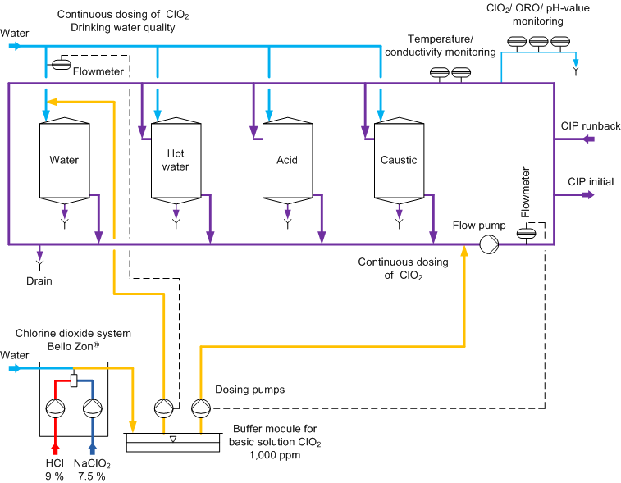
CIP with Chlorine Dioxide
Application example!

Slide 69

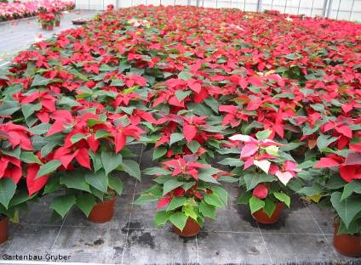
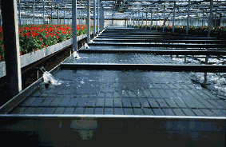
Horticulture Applications
Cut flowers
  ClO2 has been used in improving shelf life time compared to standard additives
Growing of ornamental plants
  water in ebb and flood benches can be recycled by disinfection with ClO₂
  orchids are sprayed with ClO₂ containing water

Slide 70
Legionella Control
Treatment of the complete
cold water
  preventive action
  for sanitized piping
  degradation of the biofilm in
  the piping, thus protection
  against re-infection
  protection against other
  critical germs such as
  Pseudomonas

Slide 71
Cooling Water Treatment with ClO₂
Chlorine
dioxide
alternative: ORP
Cooling
Tower
Heat exchanger
make-up water
Basin
ClO2
continuous dosage for residual of 0.2 – 0.3 ppm or repeated shock dosage 0.5-1.2 ppm

Slide 72
Recent Winery Application
Winery was using bleach (sodium hypo) to clean aging and storage tanks
Concerns about TCA & TCB
ClO2 and PAA were tested
PAA proved to be too expensive
ClO2 was chosen for CIP tank washing and filter cleaning.
Cooling towers were also treated with ClO2
Day tanks were made with 1,000 ppm ClO2
Venturi used to inject in wine tanks

Slide 77
Conclusion
ClO2 is a great choice for disinfection and sanitization for the Municipal, Industrial and F&B markets.
A strong disinfectant which must be generated on-site
Very limited harmful or lasting effects
Safe for operator use with some pre-cautions
Not expensive to operate
Very versatile answer to other competitive products

