Slide 1
ProMinent MunicipalTerritories
Updated: 05/01/12

Slide 2
Table of Contents
Able Wright, Inc.
Allwater L.L.C.
AMJ Engineered Solutions LLC
Aqua Products Inc.
Atlantic Pump & Engineering Inc.
Buckeye Pumps Inc.
Daman Superior LLC.
Dave Heiner Associates
Drydon Equipment Inc.
Etienne Prehoda
Fluid Process Equipment Inc.
G.P. Jager & Associates
GPM Environmental Inc.
Henry P. Thompson Company
Heyward Incorporated NC/SC
Heyward Incorporated VA
Hopkins Technical Products, Inc.
Hydro-Kinetics East
Hydro-Kinetics West
Integrated Process Technologies (IPT)
LRM, Inc.
Macaulay Controls Company
Mountain States Instruments
Sendero South Company
Shupe & Associates, Inc.
Specialized Operations Services, Inc.
Thornton, Musso & Bellemin
TMG Services
Tomas Cuerda
Vessco, Inc.
Wescor Associates
William/Reid LTD, LLC

Slide 3
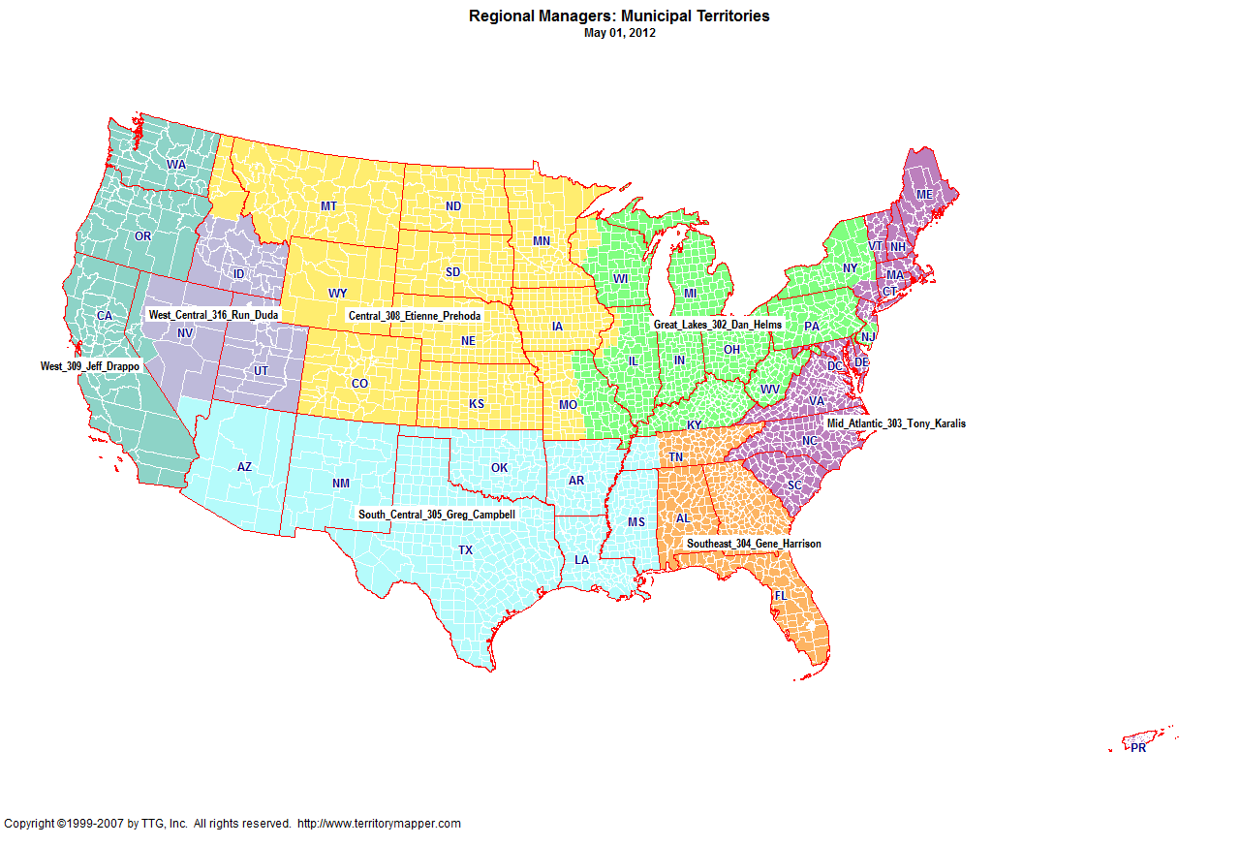
Back to contents

Slide 4
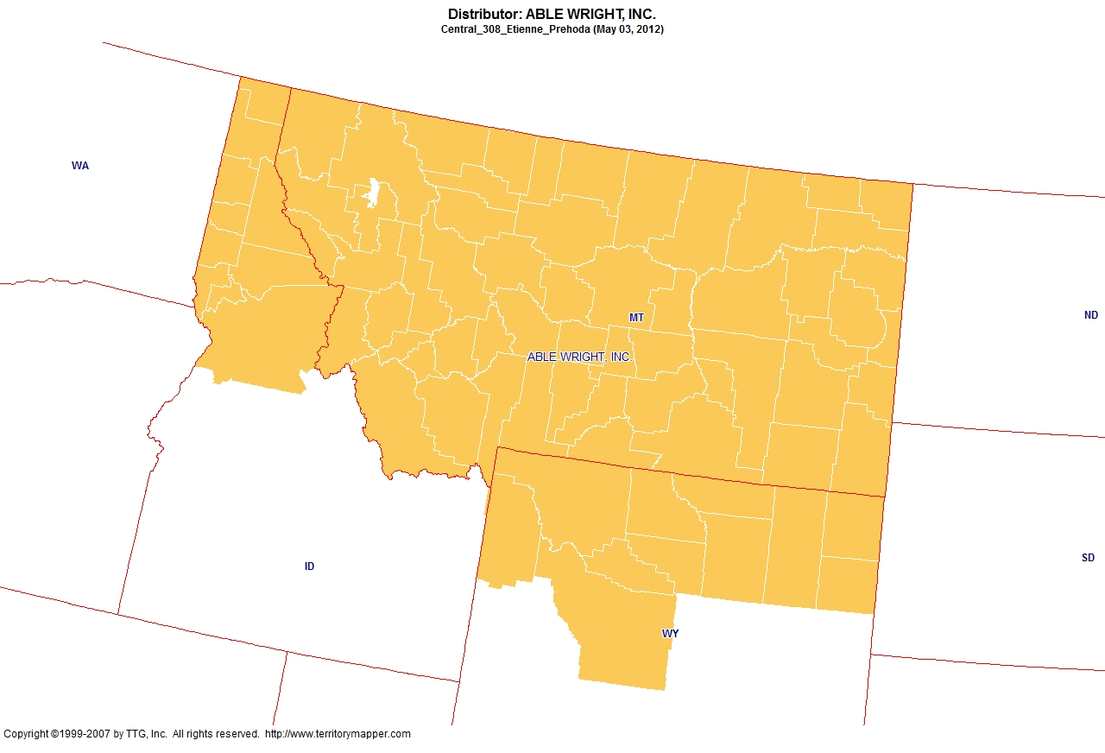
Back to contents

Slide 5
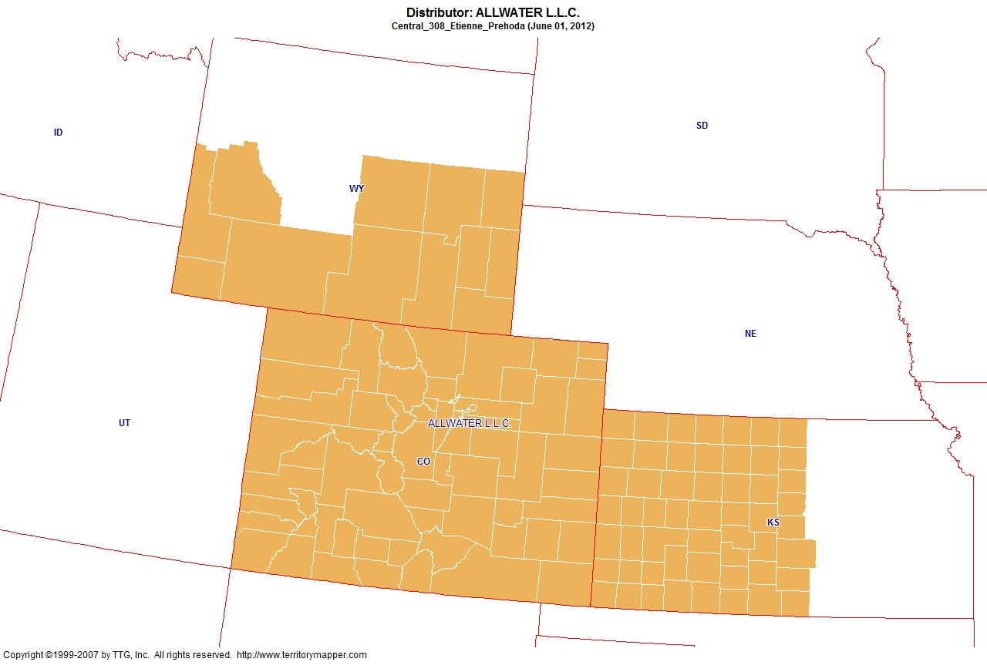
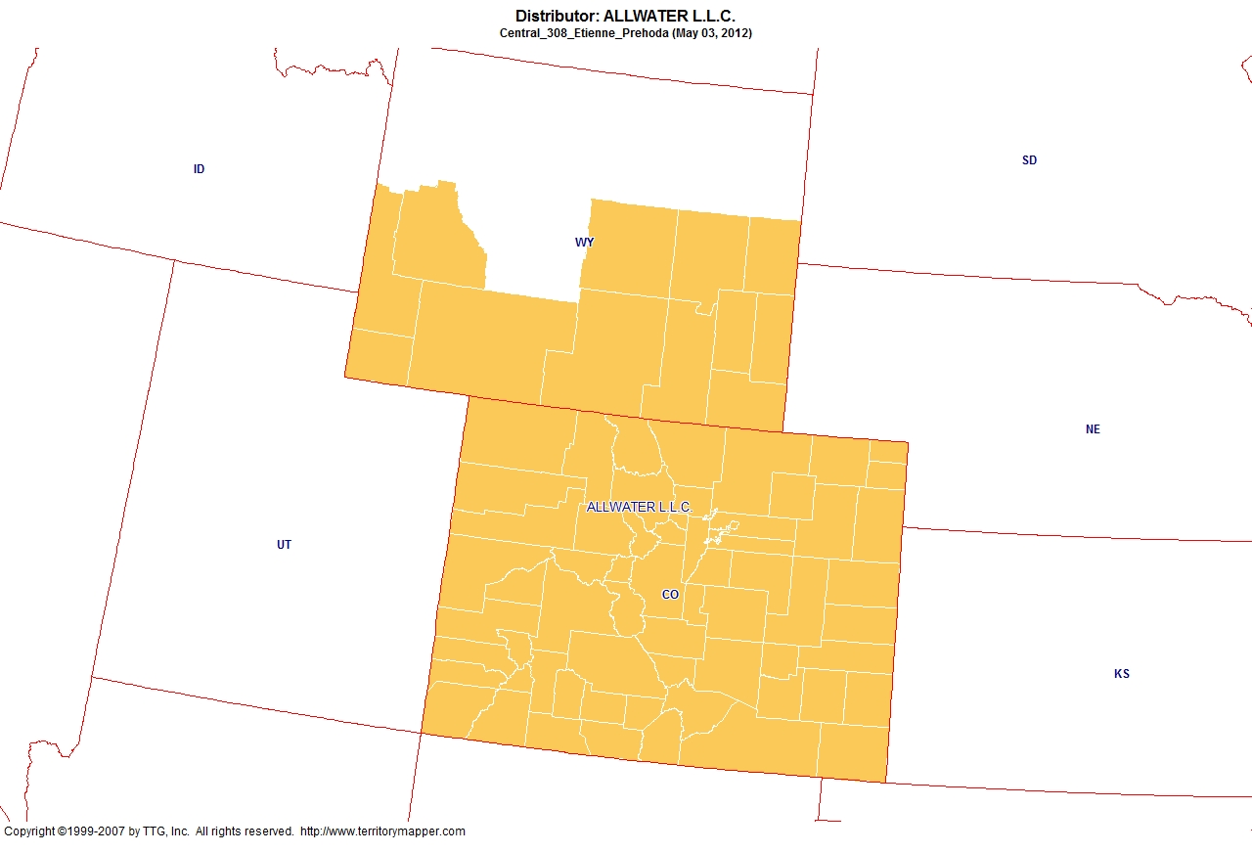
Back to contents

Slide 6
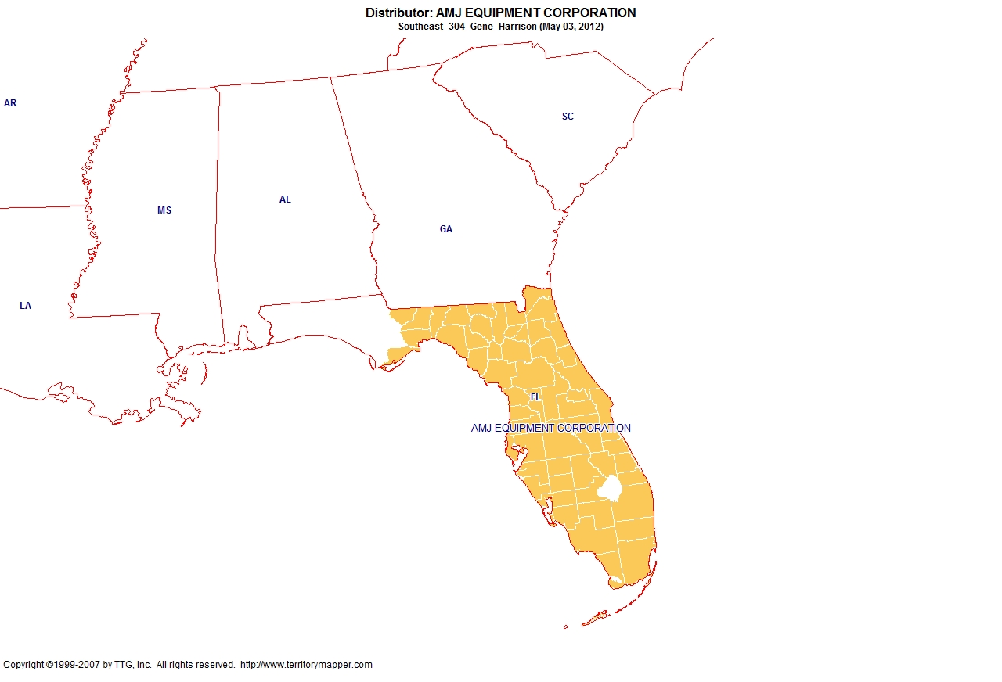
Back to contents

Slide 7
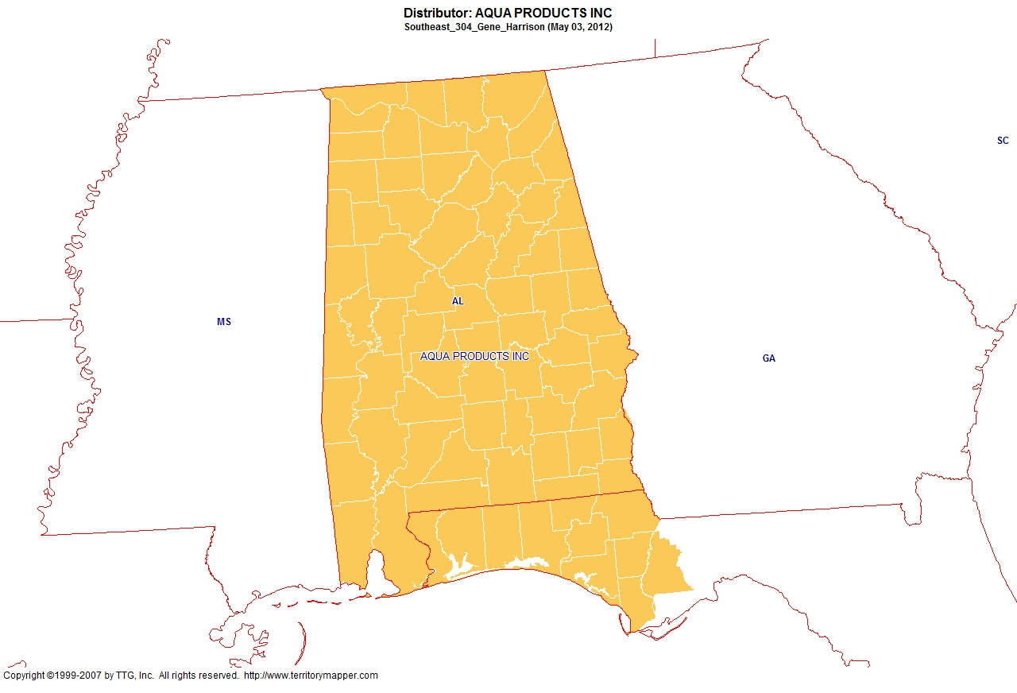
Back to contents

Slide 8
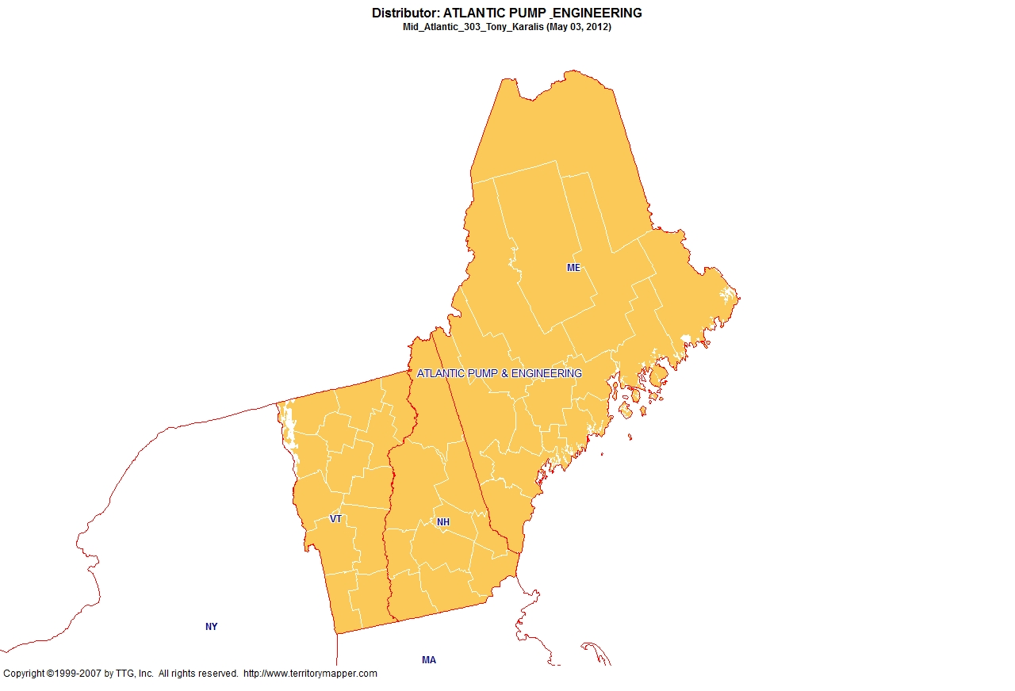
Back to contents

Slide 9
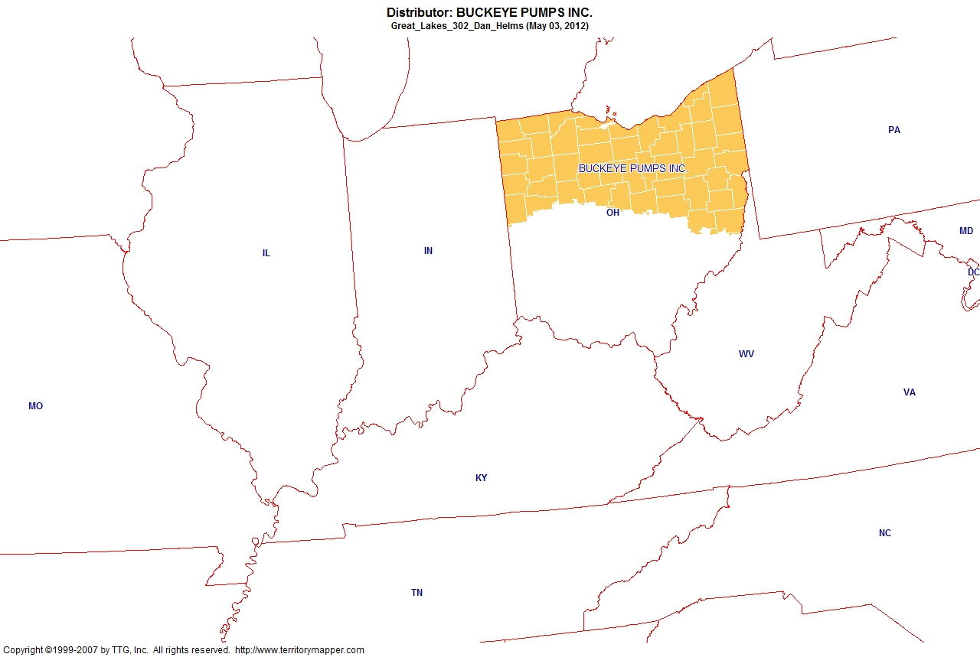
Back to contents

Slide 10
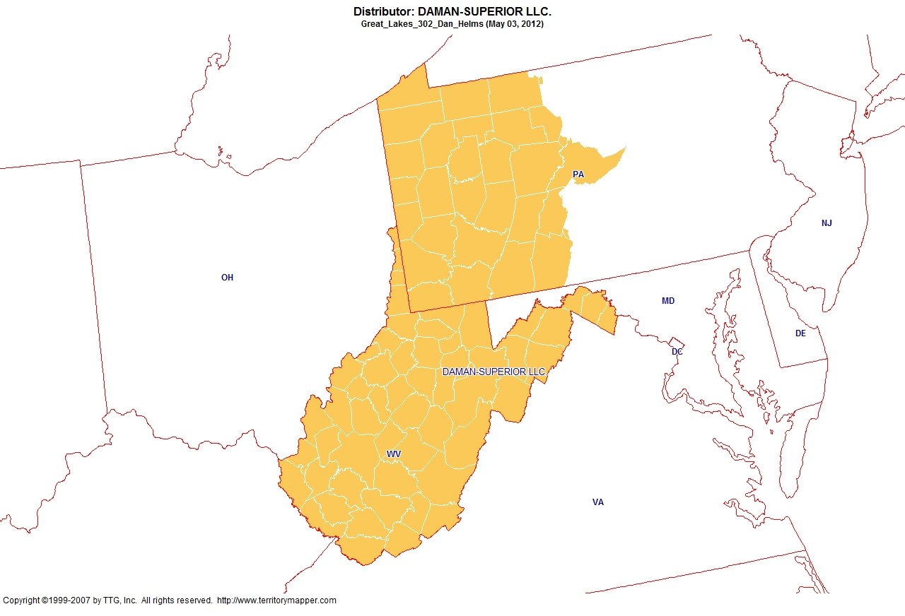
Back to contents

Slide 11
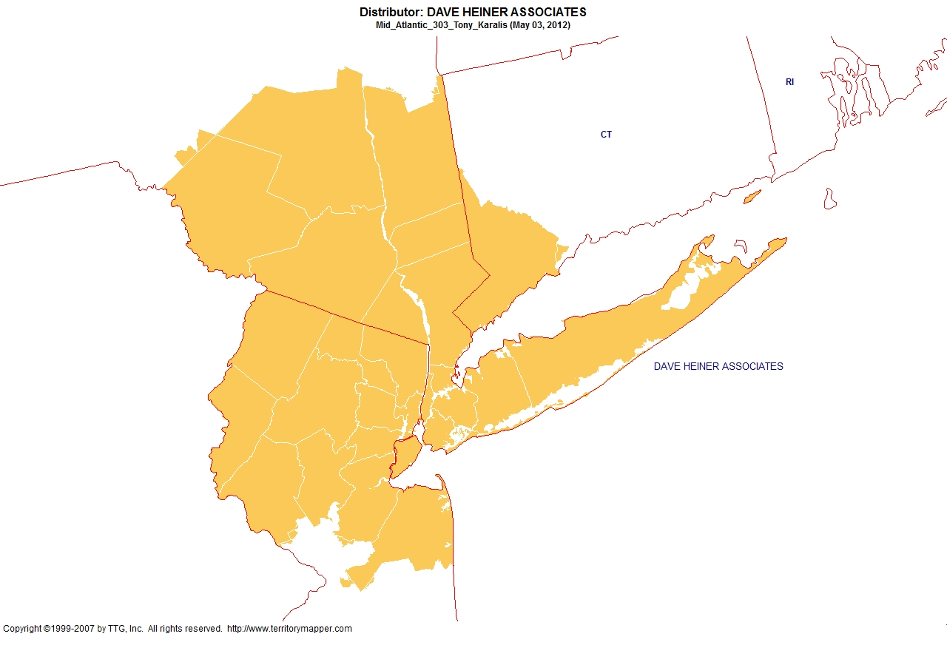
Back to contents

Slide 12
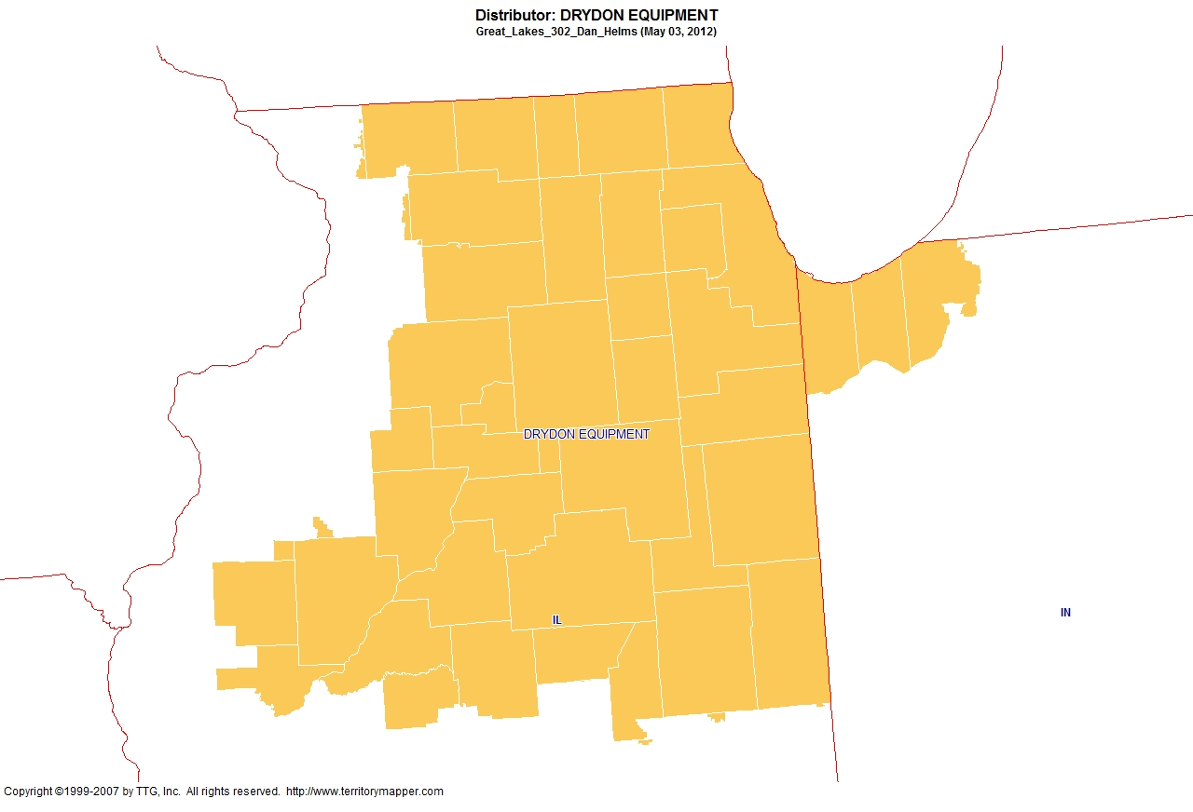
Back to contents

Slide 13
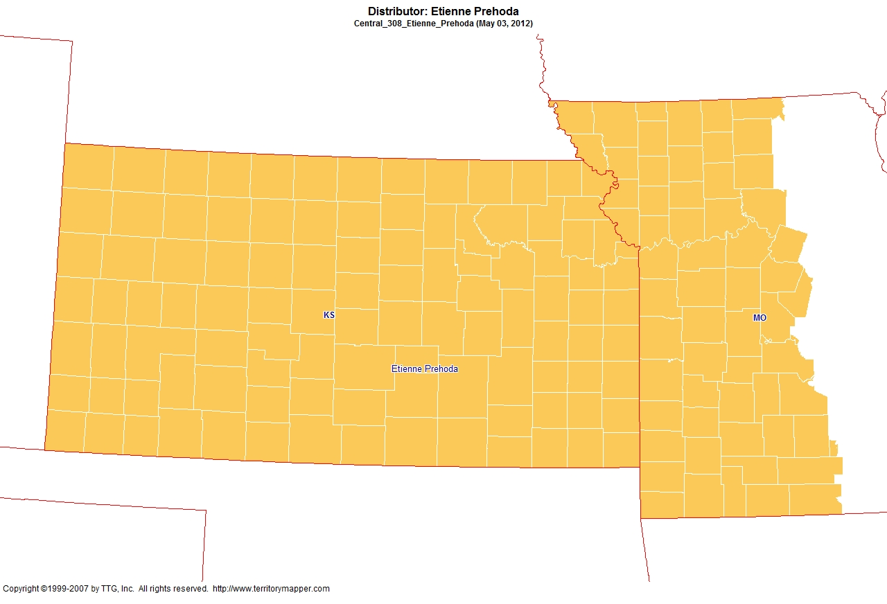
Back to contents

Slide 14
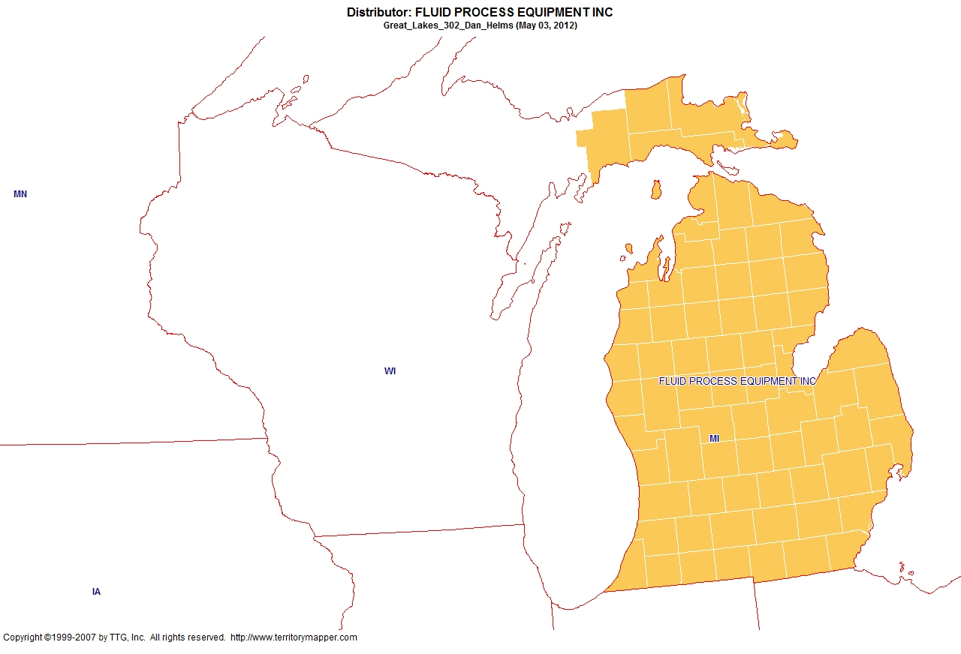
Back to contents

Slide 15
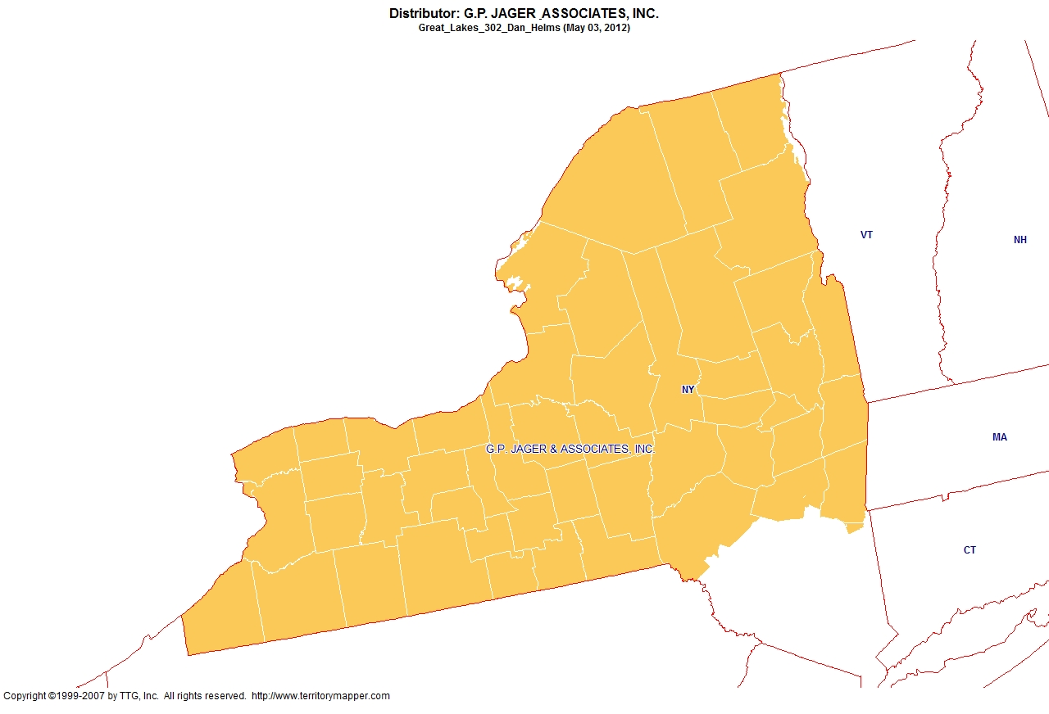
Back to contents

Slide 16
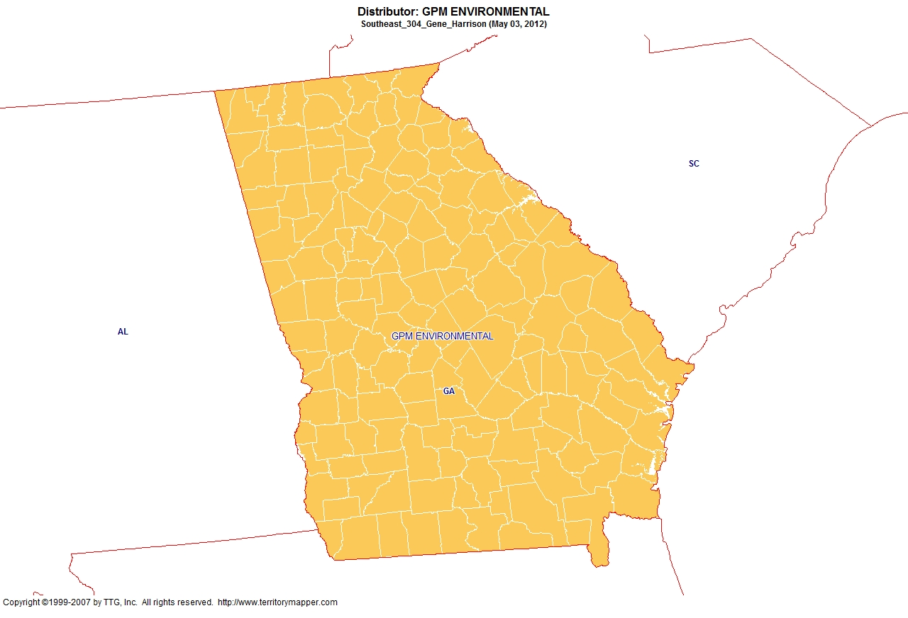
Back to contents

Slide 17
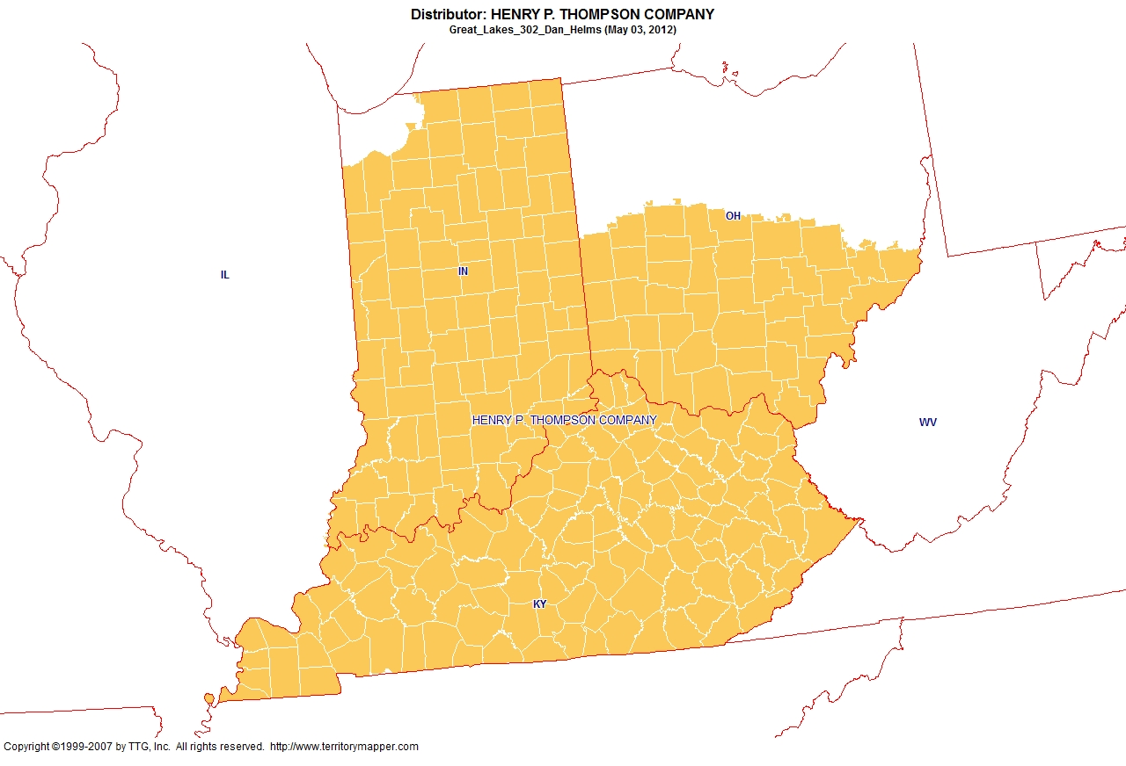
Back to contents

Slide 18
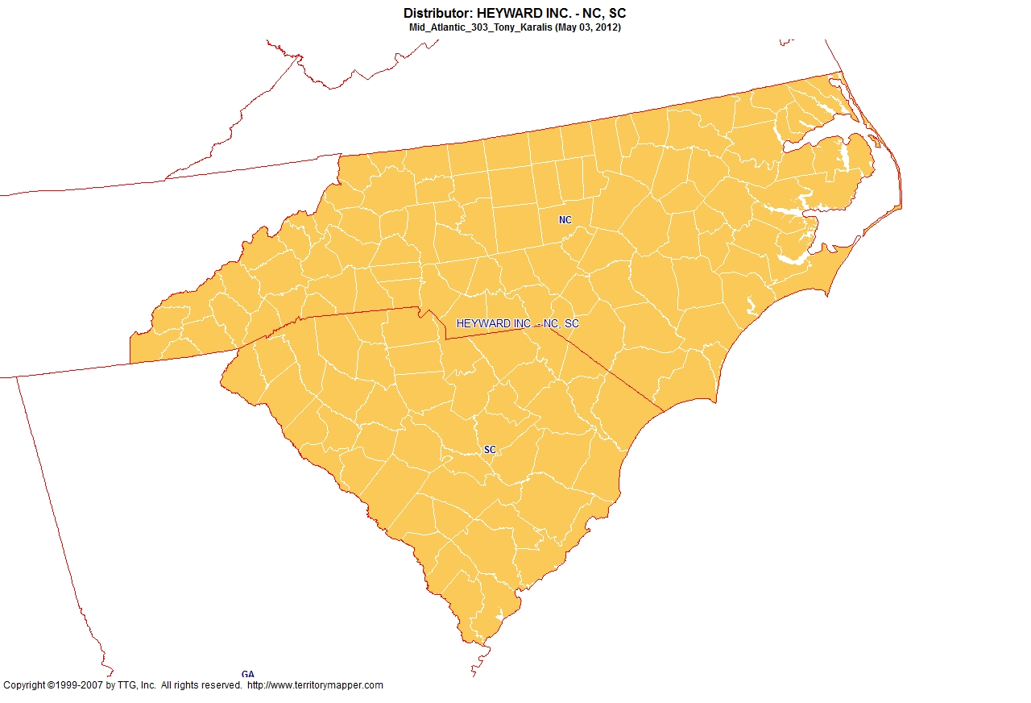
Back to contents

Slide 19
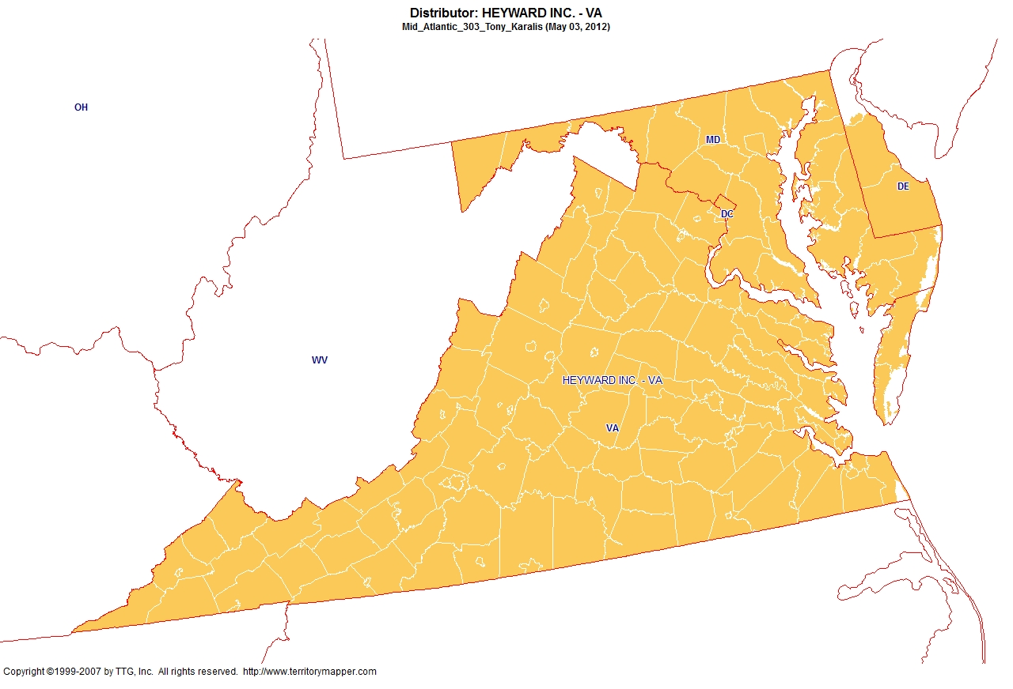
Back to contents

Slide 20
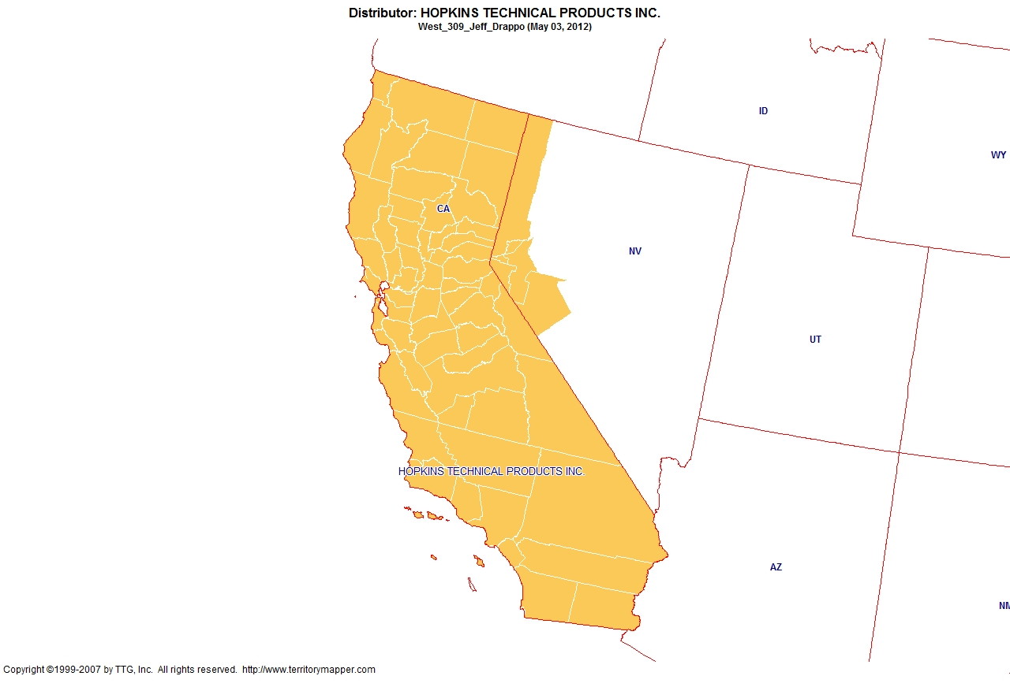
Back to contents

Slide 21
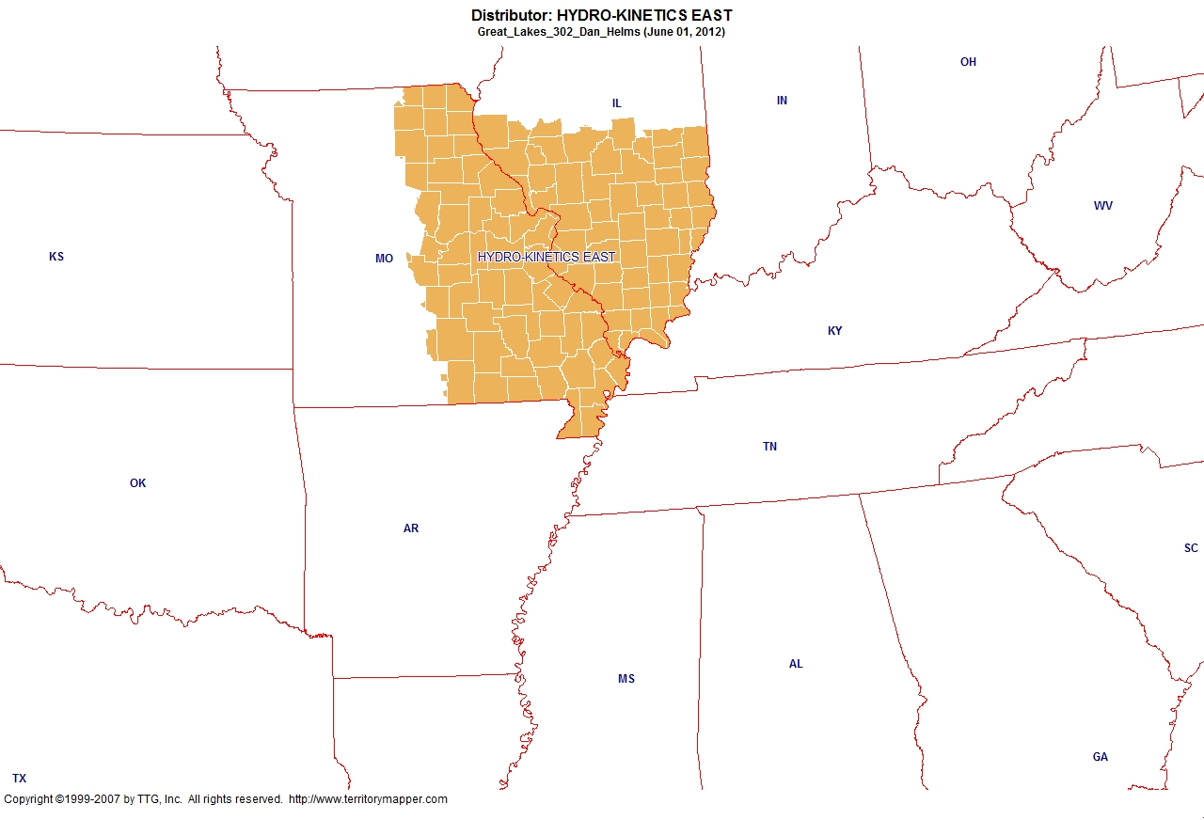
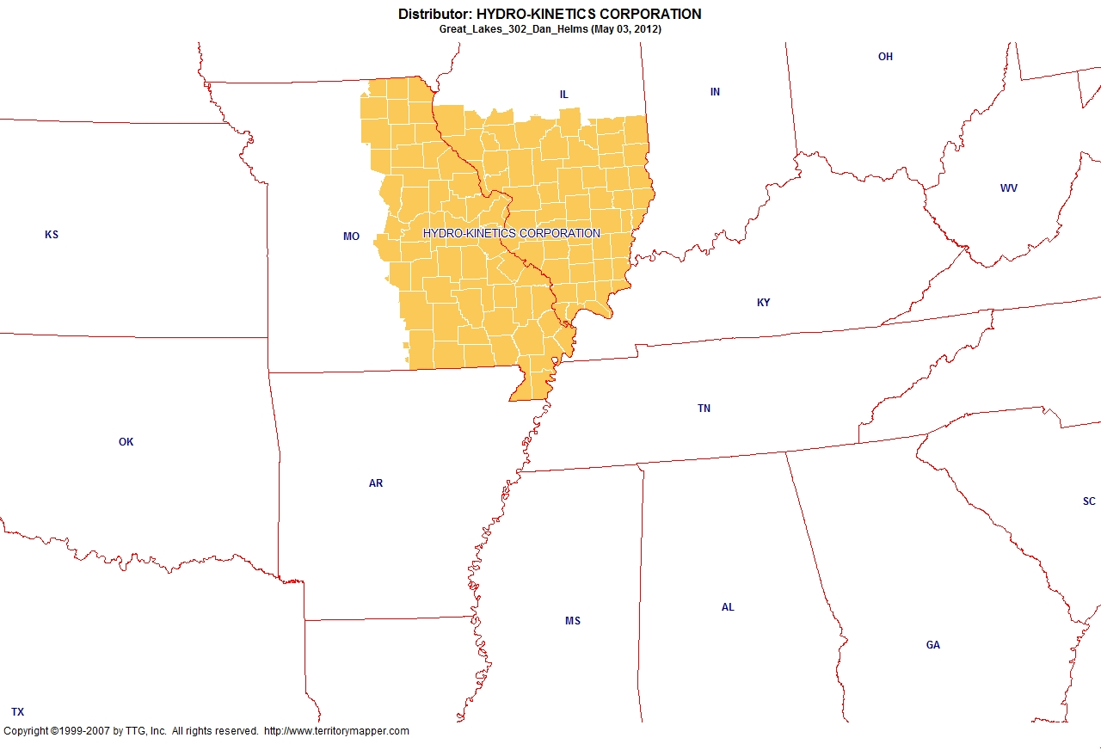
Back to contents

Slide 22
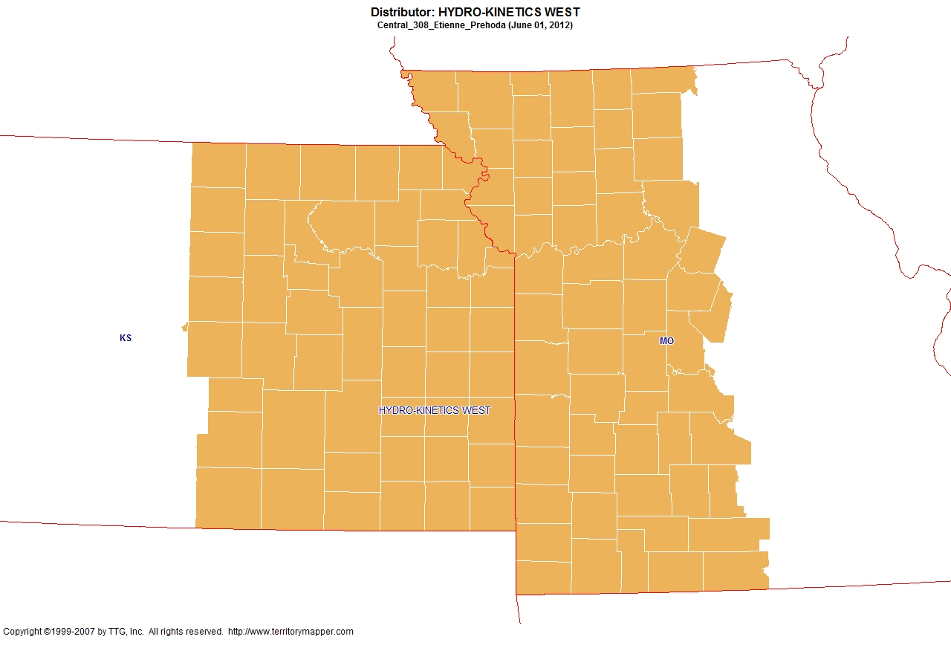
Back to contents

Slide 23
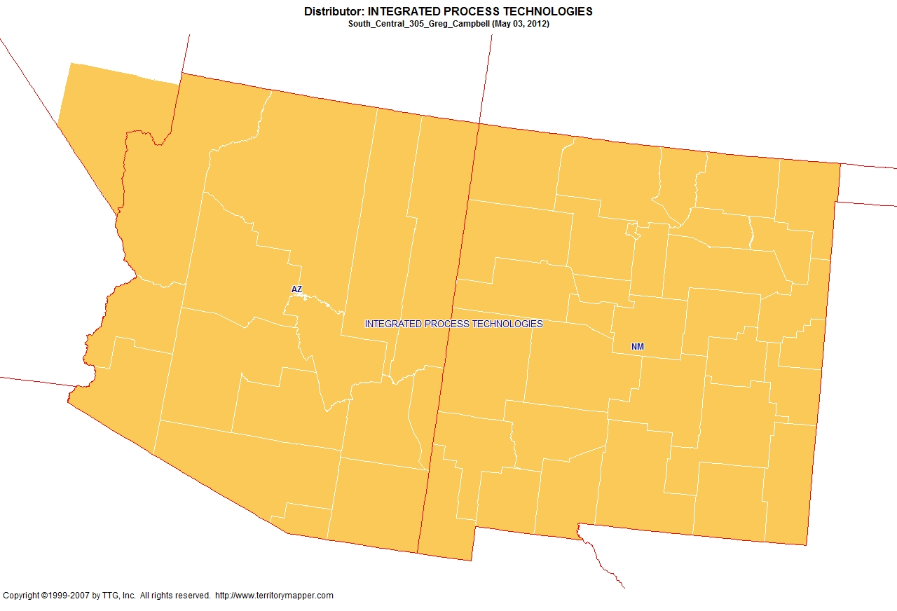
Back to contents

Slide 24
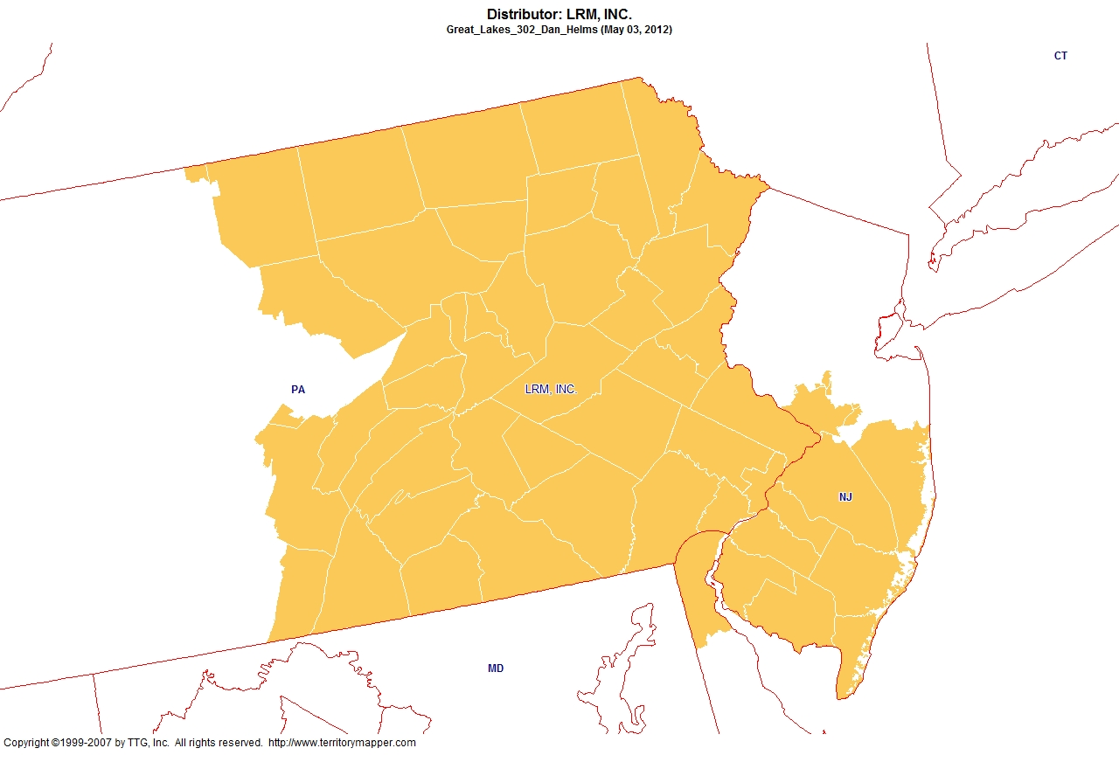
Back to contents

Slide 25
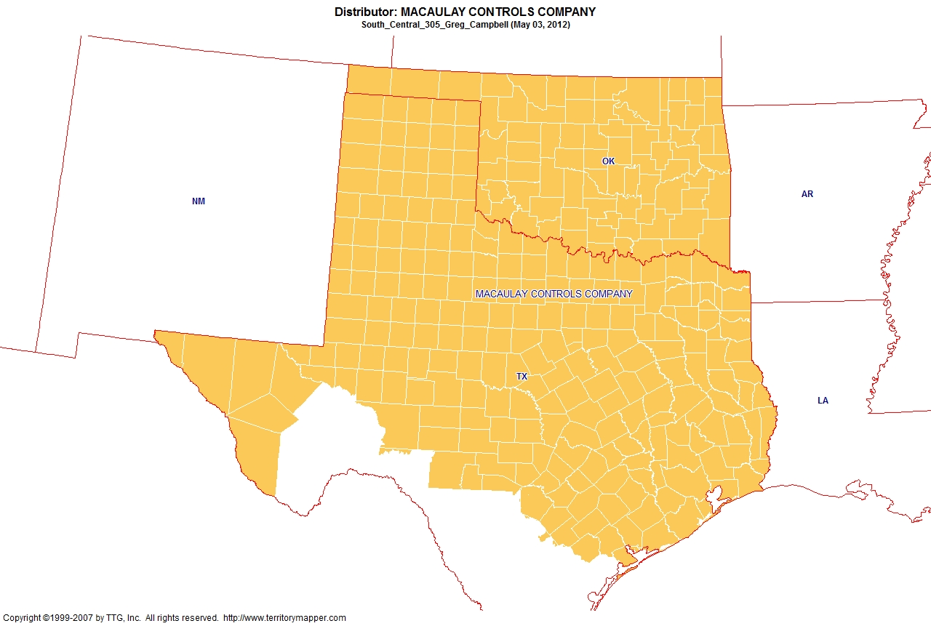
Back to contents

Slide 26
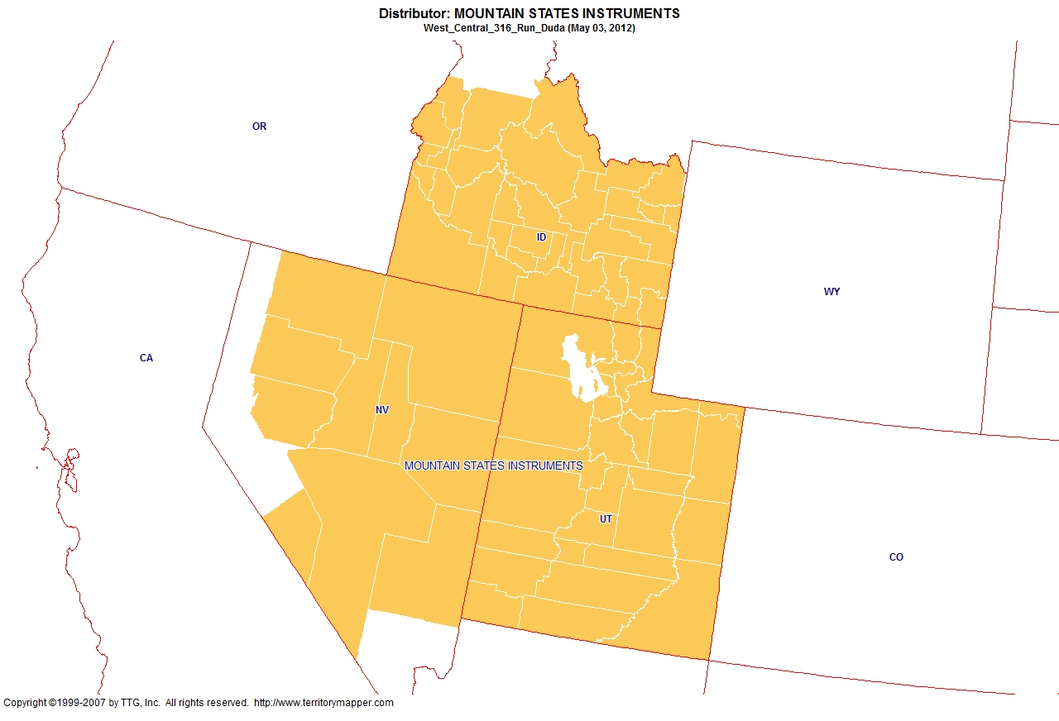
Back to contents

Slide 27
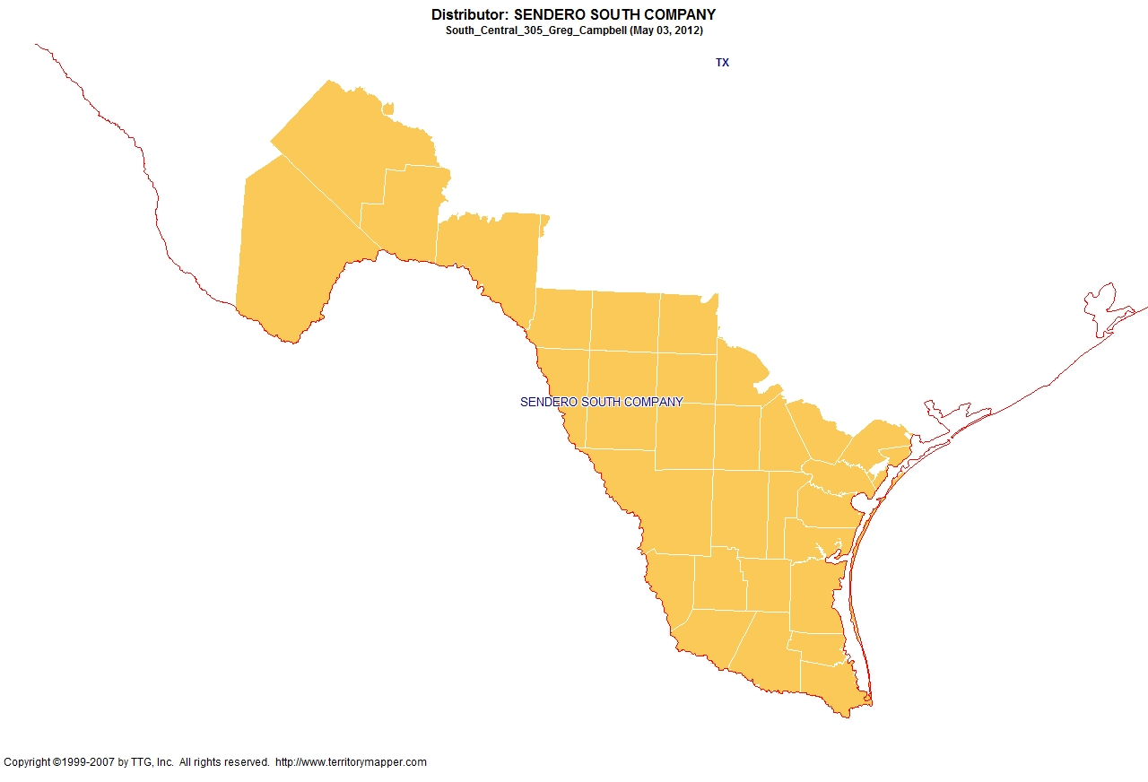
Back to contents

Slide 28
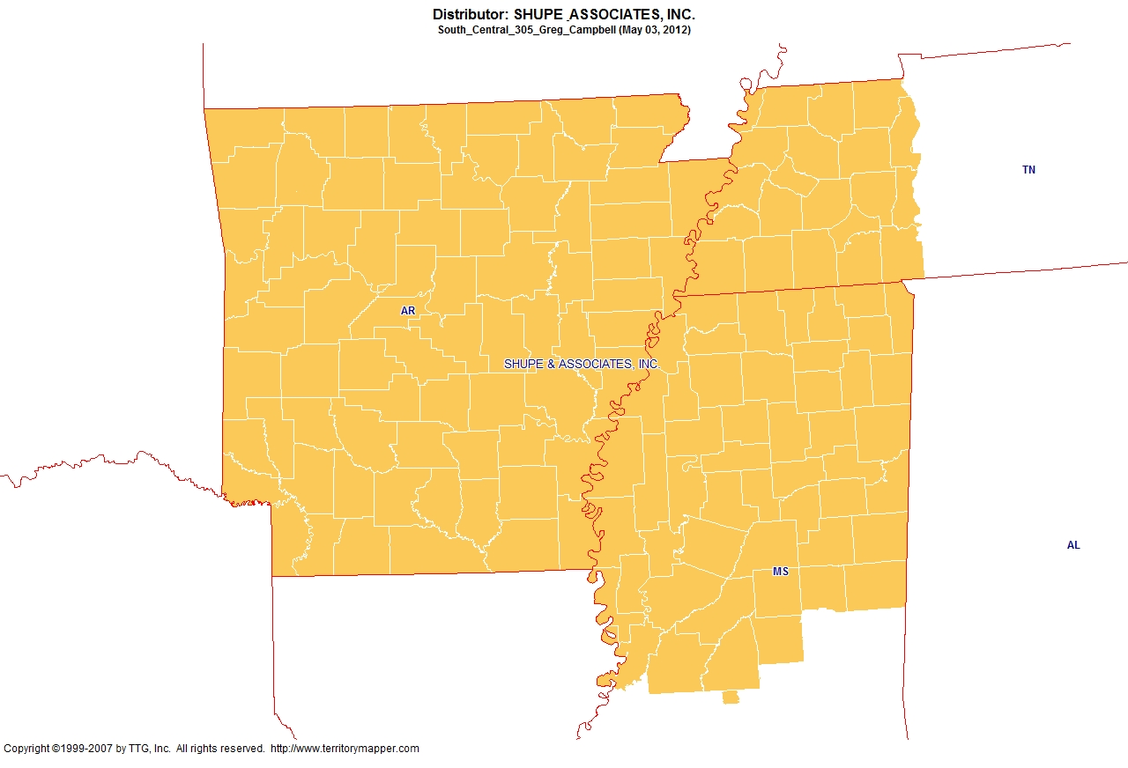
Back to contents

Slide 29
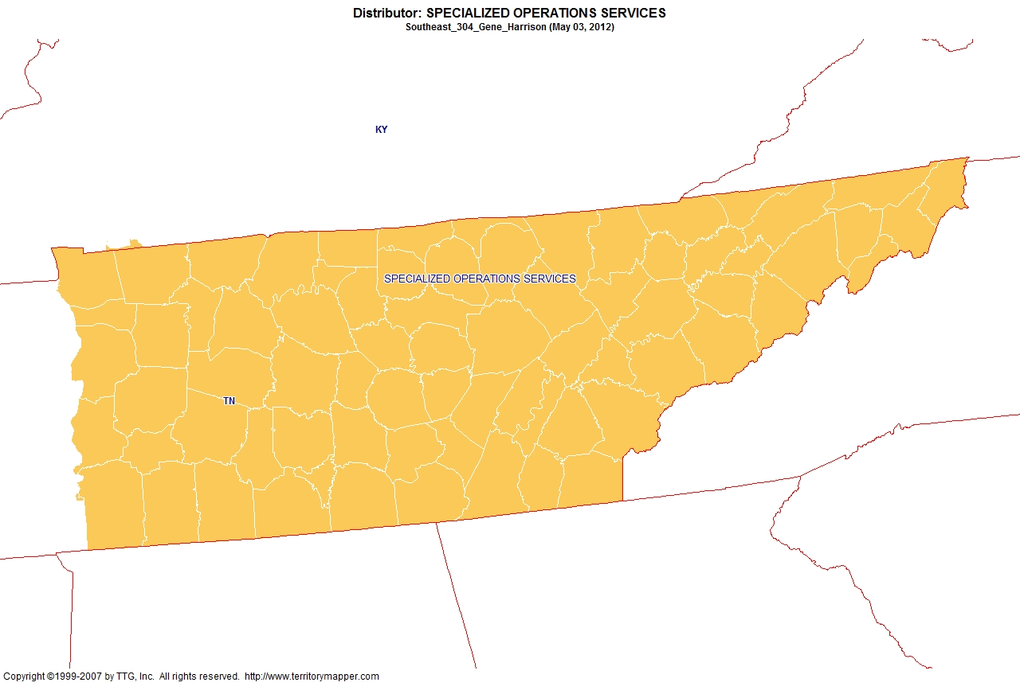
Back to contents

Slide 30
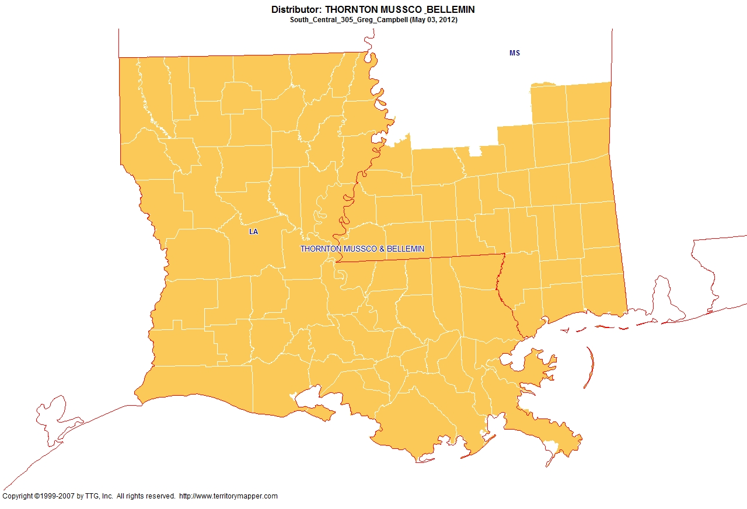
Back to contents

Slide 31
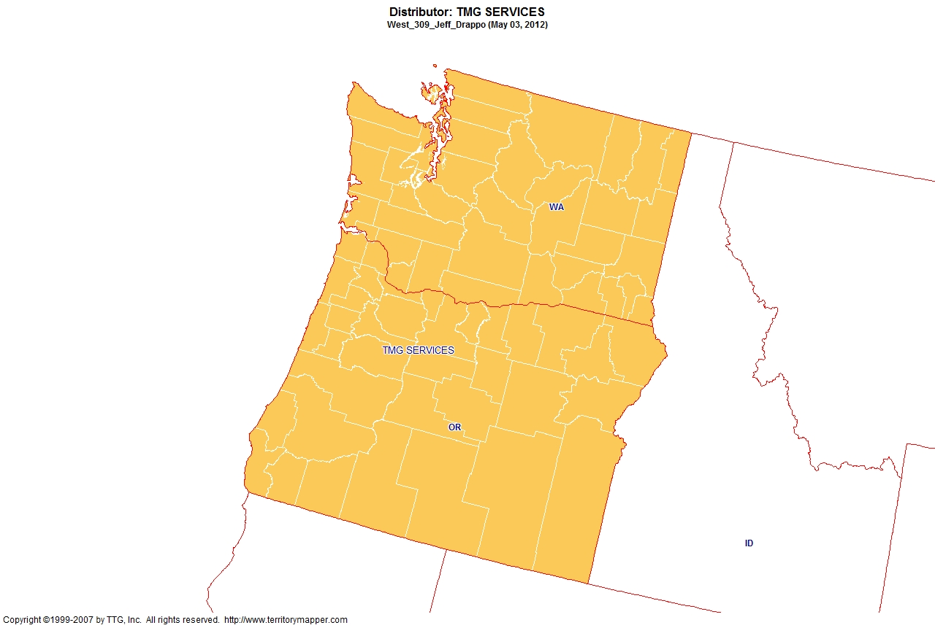
Back to contents

Slide 32
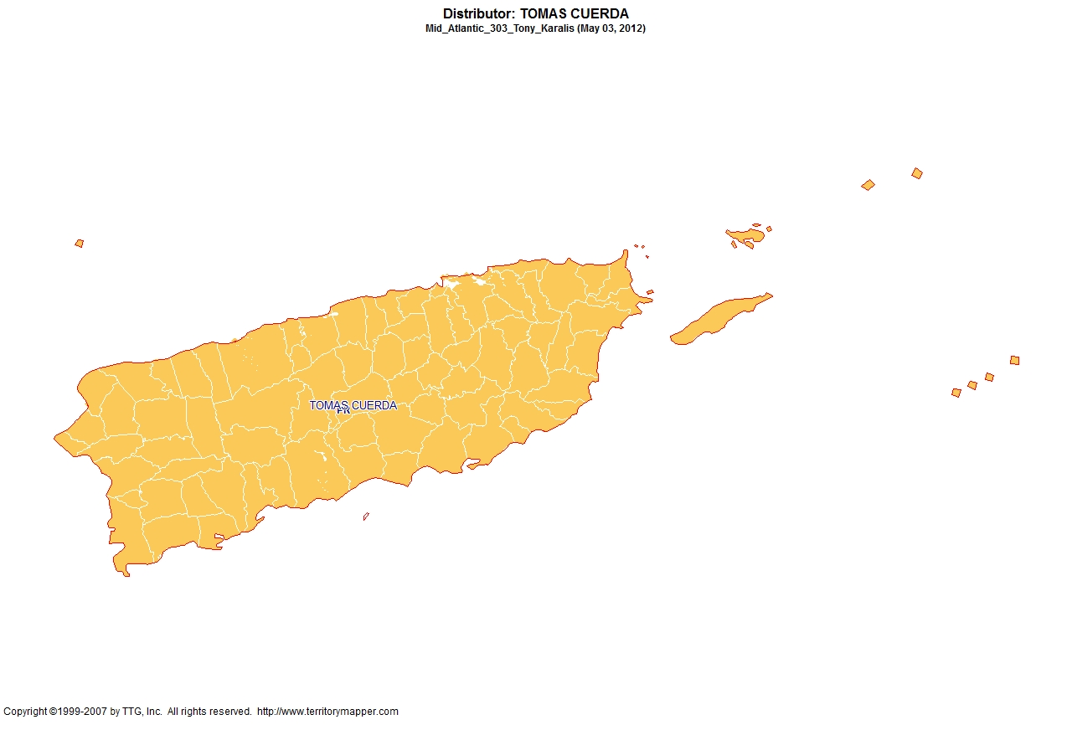
Back to contents

Slide 33
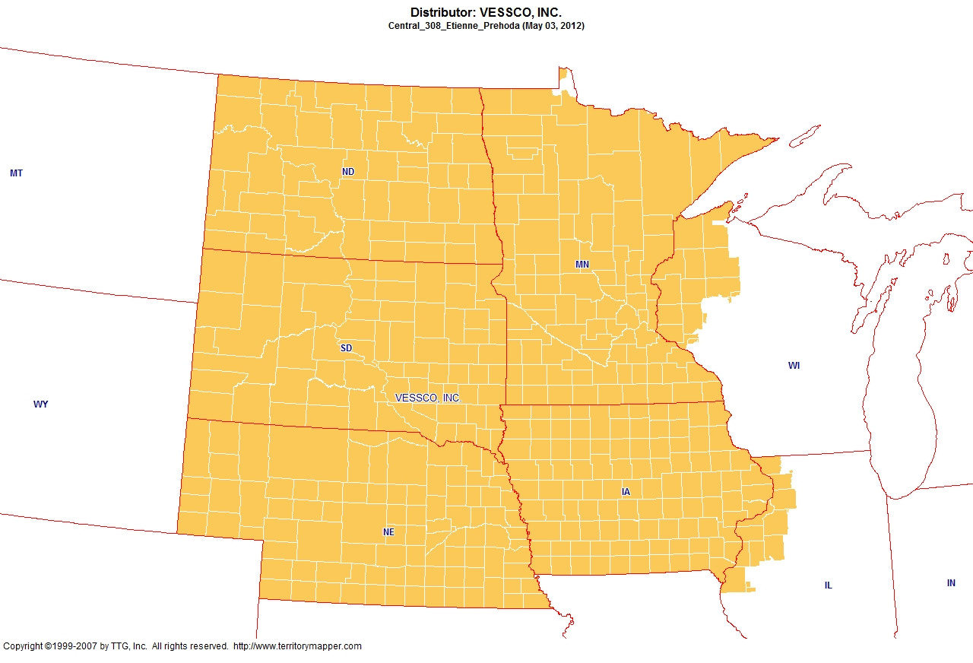
Back to contents

Slide 34
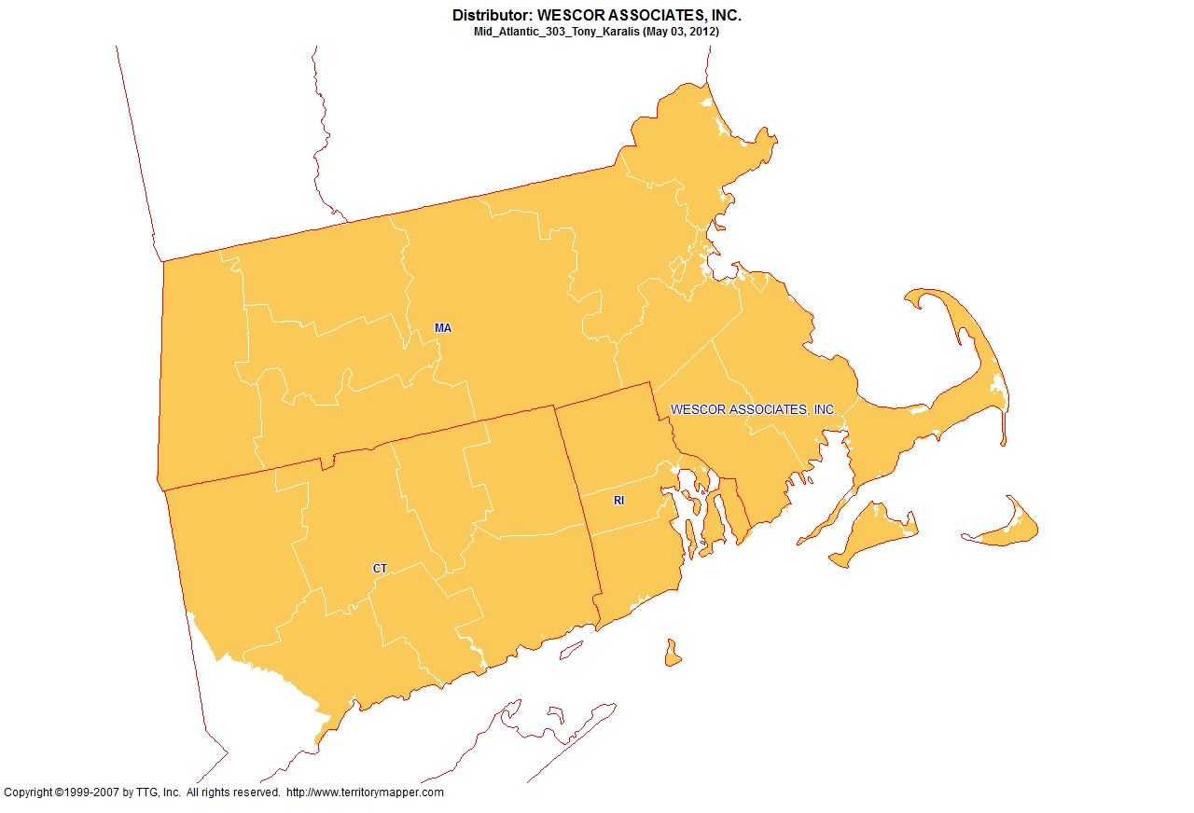
Back to contents

Slide 35
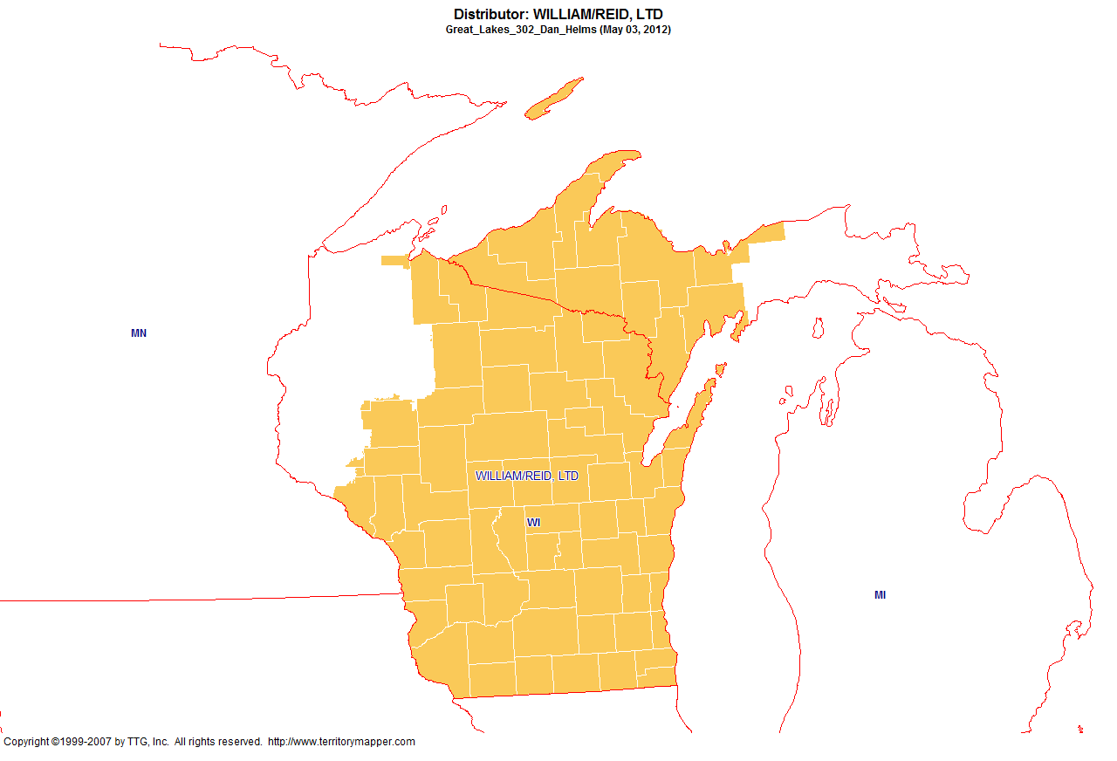
Back to contents

