Slide 1
Chlorine Dioxide Technology

Slide 2
Introductions
Walter Weterman – Director of International Sales
Rich Hopkins – Hopkins Technical Products
Fred Bender – Hopkins Technical Products
Greg Cozzi – Hopkins Technical Products
Jeff Drappo – Regional Manager PFC
Janet Berbach – Director of Corporate Events
Ken Gibson – Director of Business Development

Slide 3
Seminar Goal
Educate audience on Chlorine Dioxide disinfection
Why it is preferred over Free Chlorine, Ozone, UV
Why it is a safe method of disinfection
Generation methods of ClO2
Applications

Slide 4
Disinfection Methods
ProMinent
UV-light
Ozone
Peracetic Acid (PAA)
Chlorine gas / Sodium hypochlorite
Chlorine Dioxide

Slide 5
UV-Light
Lower consumption of water
No chemical addition or storage
Safe
Reliable
Attacks DNA of bacteria's
Destroys genetic info
No pH concerns
No THM’s or other DBP’s
No odor or taste concerns

Slide 6
UV-Light
Energy demand is high
Capital costs can be high
Maintenance intensive
Concerns with color, turbidity, dissolved minerals
Must maintain a constant flow
Leaves no residual disinfection power

Slide 7
Ozone
Best disinfectant that is safe to use
Most powerful
Decomposes into oxygen
Generated on-site
No taste or odor problems
Kills bacteria and germs
No chemicals

Slide 8
Ozone
Capital costs can be high
Energy demand is high
Temperature, humidity and pressure can be a factor
Half-life of only 20 minutes
Can breakdown organic components

Slide 9
Peracetic Acid (PAA)
Mixture of Acetic Acid and Hydrogen Peroxide
Strong disinfectant
Penetrates bacteria membranes
Widely used in the F&B market
Minimal capital cost

Slide 10
Peracetic Acid (PAA)
pH and temperature dependent
Can be very corrosive
Very expensive
Strong odor
Stored on-site

Slide 11
Chlorine
Comes is gas, liquid and solid forms
Most widely used disinfectant
Good overall disinfectant
Users have a comfort range

Slide 12
Not Chlorine
Chlorine Dioxide is not Chlorine
Chlorine exists in several states:
Gas (cylinders/rail cars)
Liquid (sodium hypo/bleach)
Salt (electrolysis)
Solid (pellets or pucks)
Chlorine Dioxide is a gas

Slide 13
Chlorine
Very pH dependent
Can produce harmful DBP’s
THM’s
Chlorophenols
Chloramines
Chlorine gas is dangerous
Sodium hypochlorite decomposes
Leaves odor and taste concerns
Need large amounts to kill bacteria's

Slide 14
Dissociation of Chlorine
Chlorine Source
Initial Reaction
Chlorine Gas
Cl₂ + H₂O -> HOCl + H⁺ + Cl⁻
Sodium Hypochlorite
NaOCl + H₂O -> HOCl + Na⁺ + OH⁻
Calcium Hypochlorite
Ca(OCl)₂ + 2H₂O -> 2HOCl + Ca⁺⁺ + (OH)⁼
Secondary (Dissociation) Reaction (pH increases)
HOCl <--> H⁺ + OCl⁻
ProMinent Fluid Controls

Slide 15
Influence of different pH-values

Slide 16
Chlorine Dissociation Curve
0%
10%
20%
30%
OCl⁻
40%
HOCl
Percent of Chlorine as Hypochlorous Acid (HOCl)
Percent of Chlorine as Hypochlorite Ion (OCl⁻)
50%
60%
70%
80%
90%
100%
pH
ProMinent Fluid Controls

Slide 17
Chlorine Dioxide
No pH dependency
Leaves no taste or odor concerns
Leaves residual for days
Increases shelf life
Does not form THM’s or other DBP’s
Penetrates bacteria walls and destroys membranes
Does not Chlorinate

Slide 18
Physical Properties of Chlorine Dioxide
yellow-green gas, cannot be stored or compressed, has to be freshly produced
soluble in water as a gas, off-gassing at:
increasing temperature
solution’s agitation
aqueous solution is stable for a few days

Slide 19
Properties of Chlorine Dioxide
Cl
Cl
•O
O
O
O•
unpaired electron, considered to be a free radical: high reactivity for oxidation and disinfection ClO₂ + e⁻  ClO₂⁻ (Chlorite) E⁰ = 0.95 V
soluble in water as a gas
reactivity independent of pH
able to penetrate cellular membranes
able to kill and remove biofilm
Remains in solution due to low rate of self-decomposition in water (depending on pH)

Slide 20
Reactions with Organic Substances
chlorine dioxide reacts only as an oxidant
chlorine dioxide does not chlorinate
no formation of THM´s (trihalomethanes, e.g. chloroform)
no formation of chlorophenols
no formation of AOX (absorbable organic halides)
no reaction with ammonia
No taste or odor concerns

Slide 21
Reaction with Inorganic Substances
Iron, Manganese precipitates and has to be filtered
1 mg Iron consumes 1.2 mg ClO₂
Fe²⁺ + ClO₂ + 3 H₂O  Fe(OH)₃ + ClO₂⁻ + 3 H⁺
1 mg Manganese consumes 2.5 mg ClO₂
Mn²⁺ + ClO₂ + 2 H₂O  MnO₂ + ClO₂⁻ + 4 H⁺
Nitrite is oxidized to Nitrate, Sulfide to Sulfate + Sulfur
1 mg Nitrite consumes 2.9 mg ClO₂
NO₂⁻ + 2 ClO₂ + H₂O  NO₃⁻ + 2 ClO₂⁻ + 2 H⁺
1 mg Sulfide consumes 2.1 mg ClO₂
2 S⁻ + 2 ClO₂  SO₄² ⁻ + S + 2 Cl⁻

Slide 22
Disinfection force of Chlorine Dioxide
Excellent disinfection even at low concentration

Slide 23
Bacterial Reduction with Chlorine Dioxide

Slide 24
Fungicidal Activity with Chlorine Dioxide

Slide 25
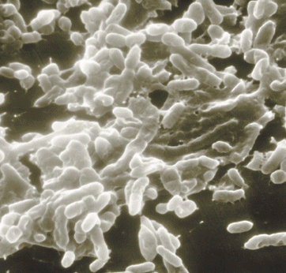
Biofilm - a universal Problem
slimy coatings of microorganism and extracellular compounds in pipelines and tanks
pathogenic germs as E. coli or Legionella are living in biofilms
biofilms are extremely resistant against disinfectants
chlorine dioxide is beside ozone the only suitable disinfectant, able to kill and to remove biofilms in water pipes and tanks

Slide 26
Resistance of Biofilms
coliform germs survive in biofilms even with 12 ppm of free chlorine
4 ppm of free chlorine eliminates only 80% of the biofilm after 8 hours residence time
biofilms have even been found on the interior surface of disinfectants piping such as cooling towers and spray misters

Slide 27
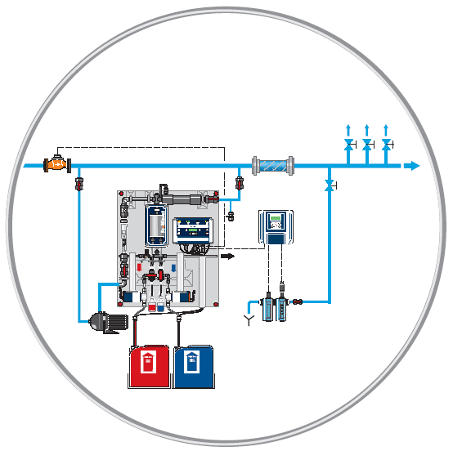
Chlorine Dioxide for Legionella Control
treatment of the complete cold water
preventive action for sanitized piping
degradation of the biofilm in the piping, thus protection against re-infection
protection against other critical germs such as Pseudomonas

Slide 28
Comparison of Disinfectants

Slide 29
THM Formation
River water after slow sand filtration Bremen Waterworks , Germany (Prof. Sontheimer 1980)

Slide 30
ProMinent ClO2 Technology

Slide 31
ProMinent ClO2 - Generation Method
Chemicals: sodium chlorite (NaClO2)
hydrochloric acid (HCl)
4 HCl + 5 NaClO2  4 ClO2 + 5 NaCl + 2 H2O
85 - 90% yield (purity depends on pre-cursors)
chlorine-free solution of chlorine dioxide
by-products: chlorite and chlorate
no handling of chlorine or chlorine gas
No other by-products such as peroxides or acetic acid

Slide 32
Other Generation Methods
Chlorite and Chlorine Gas
Adding chlorine into process
Store chlorine gas
Chlorite, HCl, and Sodium Hypochlorite
Adding chlorine into process
Buy 3-chemicals
Stabilized ClO2
Sodium chlorite solution – weak
No such thing as “stabilized ClO2”

Slide 33
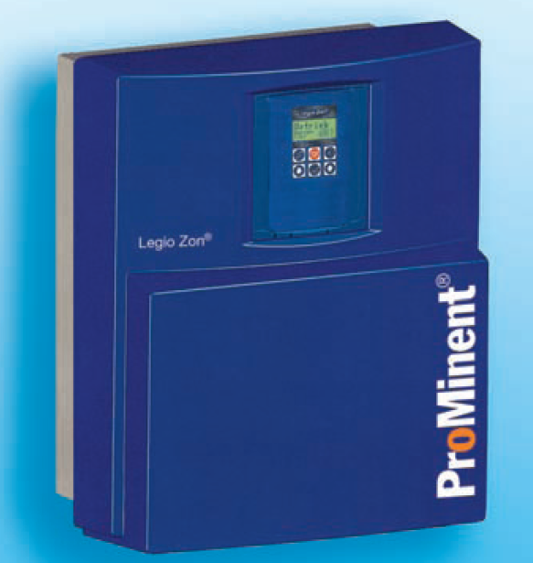
Legio Zon
fold-away wall holder
plant can be serviced without disassembling
Protection hood

Slide 34
Legio Zon Basic Info
capacity: 0–5, 0-10 g/h
operation with Bello Zon standard chemicals
1 vol. chlorite 7.5 % + 3 vol. HCl 9% + 20 vol. water
concentration ClO₂: 2 g/l
never dangerous concentration in the plant
optimum stability (-15% after 3 days)
reaction time < 20 minutes
easy operation, low maintenance effort
low price + high level technology

Slide 35
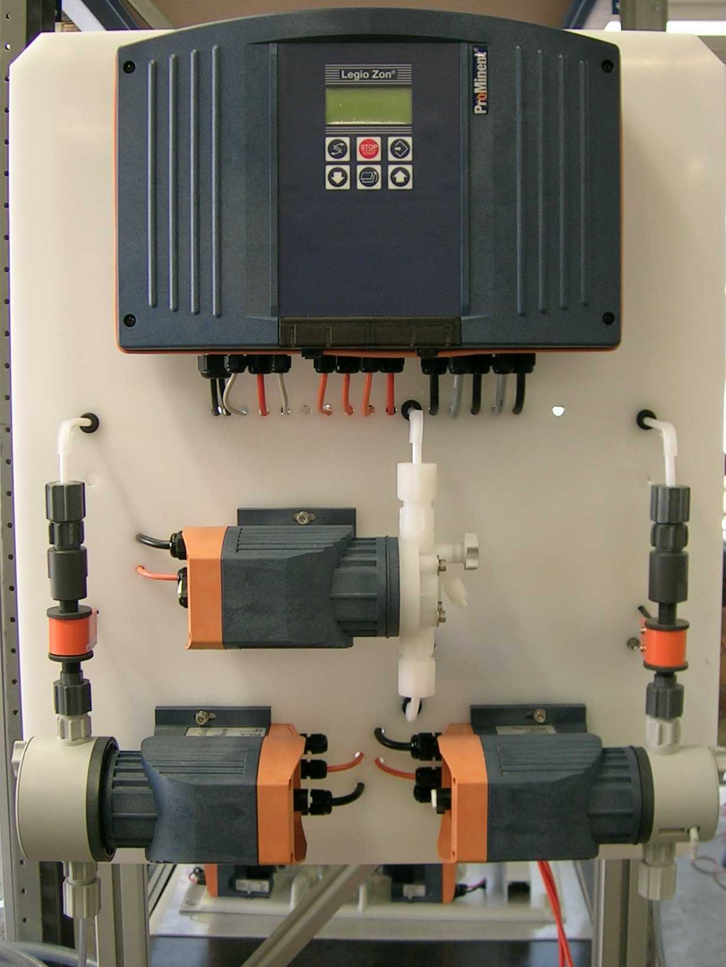
Legio Zon Design: Front
outlet chlorine dioxide
controller
line cord
Check valve for back pressure
dosing pump chlorine dioxide
flow monitor
dosing pump acid
dosing pump chlorite
input dilution water
draining valve

Slide 36
Bello Zon CDVc (dilute chemicals)
Model | ClO₂ output [g/h] | operating pressure [psi] | operating temperature [°C]
CDVc 20 | 1-20 | 116 | 10-40
CDVc 45 | 2-45 | 116 | 10-40
CDVc 120 | 6-120 | 116 | 10-40
CDVc 240 | 12-240 | 102 | 10-40
CDVc 600 | 30-600 | 73 | 15-40
CDVc 2000 | 100-2,000 | 29 | 15-40

Slide 37
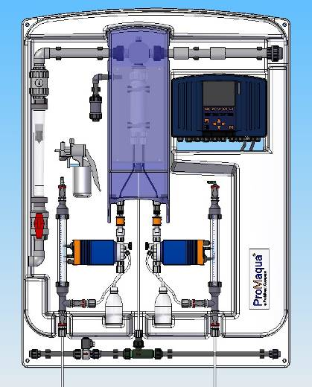
Bello Zon CDVc for Diluted Chemicals
Backpanel for wall mounting
static mixer
controller with data logger and screen recorder
PVDF reactor and reactor-outlet
single stroke flow sensor
reactor cover for protection
metering pumps in CAN-bus version
calibration and suction aid with vacuum pump (optional)
purge assembly for reactor (optional)

Slide 38
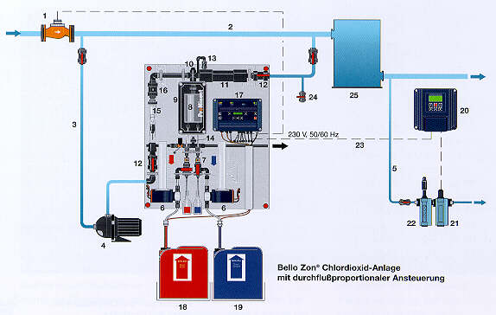
ClO₂–Concentration in Bello Zon®-Systems
water:
0.05-2 ppm
ClO₂
bypass:
200-1000 ppm
ClO₂
reactor:
20,000 ppm
ClO₂

Slide 39
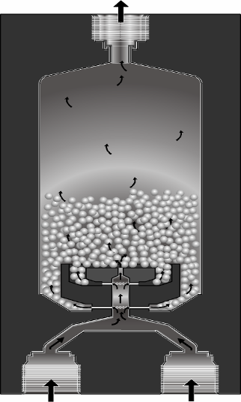
Bello Zon® - Reactor CDV and CDK
perfect mixing of the chemicals causes high yield of ClO2
optimal design guaranties sufficient reaction time of minimum 4 minutes
concentration 20 g/l (2%)
no gas phase

Slide 40
Operation of CDV
Pre-cursor chemicals:
sodium chlorite: 7.5% (w/v) 95-99% pure
hydrochloric acid: 9.0% (w/v) 95-99% pure
design data: 1 liter NaClO2 + 1 liter HCl = 40 g ClO2
Conditions:
temperature treated water: 131 °F
temperature chemicals: 50 - 104 °F
backpressure: 102 - 145 psi

Slide 41
Operation of CDK
Applied chemicals:
sodium chlorite: 25% (w/v) 95-99% pure
hydrochloric acid: 30% (w/v) 95-99% pure
design data: 1 liter NaClO2 + 1 liter HCl = 150 g ClO2
Conditions:
temperature treated water: 131 °F
temperature chemicals: 50 - 104 °F
backpressure: 102 - 145 psi

Slide 42
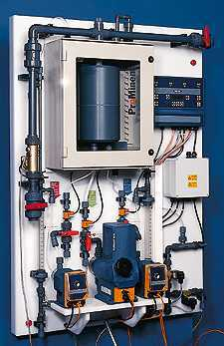
Bello Zon® Type CDKc, (concentrated chemicals)

Slide 43
Chemical Safety
Color coded chemical tanks are suggested
Level switches in chemical tanks
Relays on level switches attach to an audible alarm; generator shuts down if tank is empty
Flow sensors on pumps to ensure the correct proportion of chemical flow
Alarm on flow sensors; generator shuts down if x pulses are missed (programmable)

Slide 44
Reactor Safety
Isolated in an enclosed PVDF reactor housing
Only a 2% solution is generated (20,000 ppm)
Reactor housing is automatically purged via an injector and solenoid valve up to 6 times per hour
The reactor chamber is always full of solution – not gas!!

Slide 45
Additional Safety Features
Flow sensor on bypass water line adjusts the amount of chlorine dioxide generated
Chlorine dioxide is injected into the bypass water flow
Output can be controlled by a ProMinent chlorine dioxide residual controller

Slide 46
Maintenance
CDV: every 6 - 12 months acc. to operating conditions
CDK: every 6 month
effort:
spare parts kit CDV/CDK plant
3 – 4 working hours
flushing and disassembling reactor
exchange of gaskets
maintenance pumps and dosing line with exchange gaskets and diaphragms
functions‘ check
calibration

Slide 47
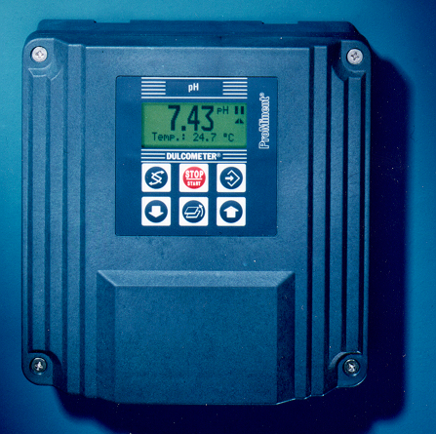
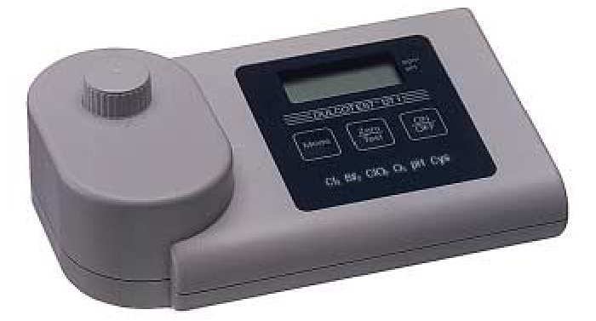
Analysis of Chlorine Dioxide and Chlorite
Online – measurement & control: Dulcometer® D1C: ClO2, chlorite, pH, ORP
Dulcometer® D2C: ClO2 + pH
Photometer Dulcotest® DT 4 ClO2 + chlorite

Slide 48
Sensors for Chlorine Dioxide and Chlorite
CDE 2-mA (ClO2 for clean water) Measuring ranges (10, 2, 0.5 ppm)
CDP 1-mA-2 ppm (ClO2 for surfactant water)
Measuring range (2 ppm)
CDR 1-mA (ClO2 for dirty water)
Measuring ranges (0.5 and 2 ppm)
CLT 1-mA (chlorite)
Measuring ranges (0.5 and 2 ppm)

Slide 49
Wine Applications with Chlorine Dioxide
ProMaqua

Slide 50
Recent Application
Winery was using bleach (sodium hypo) to clean aging and storage tanks
Concerns about TCA & TCB
ClO2 and PAA were tested
PAA proved to be too expensive
ClO2 was chosen for CIP tank washing and filter cleaning.
Cooling towers were also treated with ClO2
Day tanks were made with 1,000 ppm ClO2
Venturi used to inject in wine tanks

Slide 51
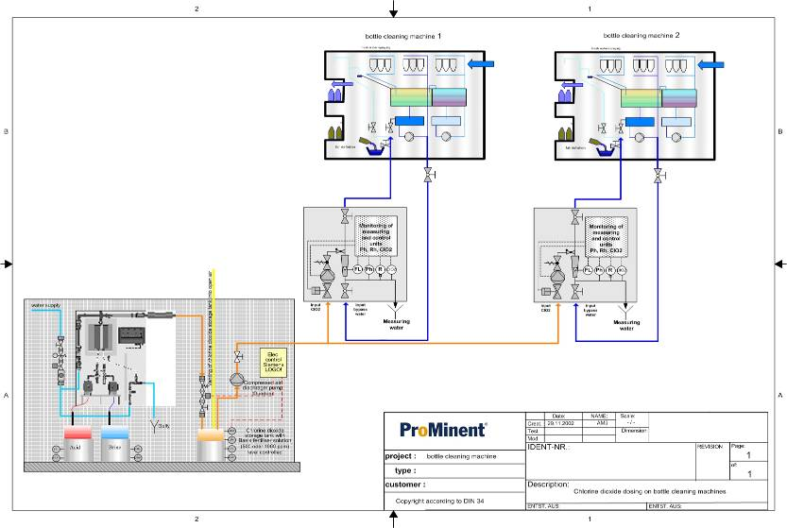
Bottle Washing with ClO₂
0.8-2 ppm
ClO₂

Slide 52
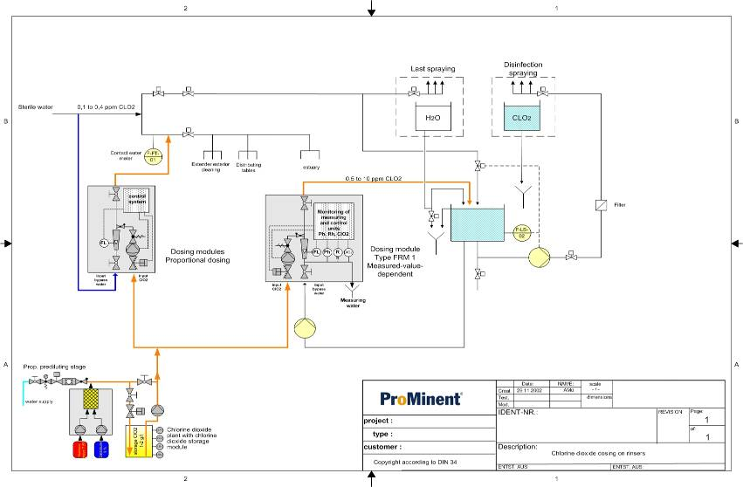
Bottle Rinsing with ClO₂
0.5-1.5 ppm
ClO₂

Slide 53
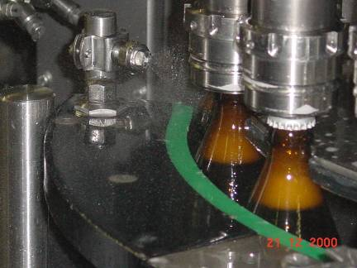
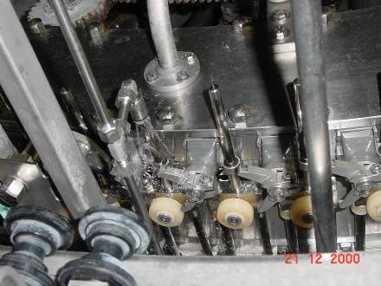
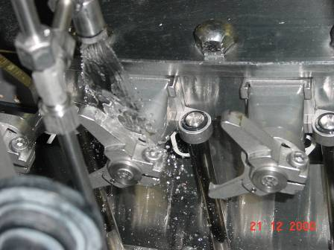
ClO₂ in the Area of Filling Machines
0.4 ppm
ClO₂

Slide 58
Recent Application
Winery was using bleach (sodium hypo) to clean aging and storage tanks
Concerns about TCA & TCB
ClO2 and PAA were tested
PAA proved to be too expensive
ClO2 was chosen for CIP tank washing and filter cleaning.
Cooling towers were also treated with ClO2
Day tanks were made with 1,000 ppm ClO2
Venturi used to inject in wine tanks

Slide 59
Conclusion
ClO2 is a great choice for disinfection and sanitization for the Municipal, Industrial and F&B markets.
A strong disinfectant which must be generated on-site
Very limited harmful or lasting effects
Safe for operator use with some pre-cautions
Not expensive to operate
Very versatile answer to other competitive products

