Slide 1
Chlorine Dioxide
Seminar

Slide 2
Introductions
Rich Hopkins – Hopkins Technical Products
Fred Bender – Hopkins Technical Products
Greg Cozzi – Hopkins Technical Products
Patrick Teel – Hopkins Technical Products
Jeff Drappo – PFC Regional Manager
Janet Berbach – Director of Corporate Events PFC
Ken Gibson – Director PFC

Slide 3
Seminar Goal
Educate audience on Chlorine Dioxide disinfection for wineries
Why it is preferred over Chlorine, PAA, Ozone, UV
Generation methods of ClO2
Safety Concerns
Applications

Slide 4
Hopkins Technical Products
Address:
    2155-A Elkins Way
    Brentwood, CA 94513
Phone: 925-240-2160
Fax : 925-240-2166

Slide 5
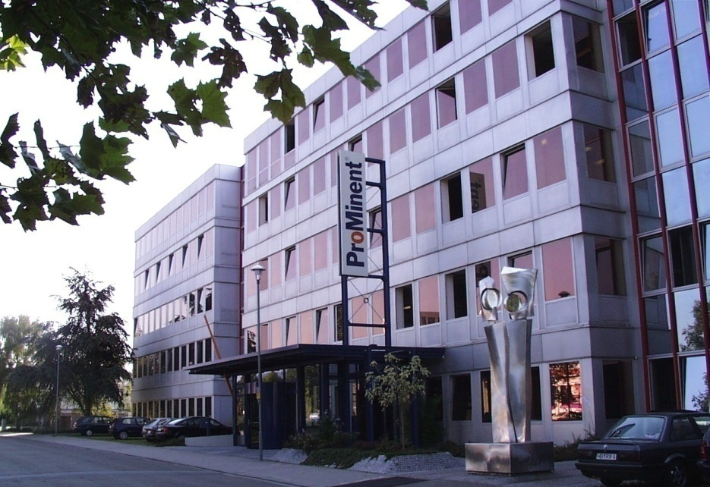
Introduction to ProMinent Global
$450 million corporation
2100 employees
60 affiliated subsidiaries
12 manufacturing sites
Privately owned since 1960
HQ in Heidelberg, Germany

Slide 6
Product Line
Low flow/high flow metering pumps
Process pumps (hose pumps)
Process monitoring and control
Polymer systems – wet and dry
Dry product screw feeders
Pre-Engineered chemical feed systems
ClO2 and O3 generators
UV systems
Service and Support

Slide 7
ProMinent USA
Headquartered in Pittsburgh, PA
Offices in Brentwood, CA and Ontario, CA
Manufacturing and assembly (Made in USA)
114 employees
NSF/ANSI 61 approval for PVDF & Acrylic liquid ends!!
EPA 334.0 acceptance for amperometric sensors
UL 508A approved Panel Shop
Custom water treatment systems

Slide 8
Disinfection Technologies

Slide 9
Disinfection Technologies
ProMinent
UV-light
Ozone
Peracetic Acid (PAA)
Chlorine gas / Sodium hypochlorite
Chlorine Dioxide

Slide 10
UV-Light Advantages
Lower consumption of water
No chemical addition or storage
Safe
Reliable
Attacks DNA of bacteria's
Destroys genetic info
No pH concerns
No THM’s or other DBP’s
No odor or taste concerns

Slide 11
UV-Light Disadvantages
Energy demand is high
Capital costs can be high
Maintenance intensive
Concerns with color, turbidity, dissolved minerals
Must maintain a constant flow
Leaves no residual disinfection power

Slide 12
Ozone Advantages
Strongest disinfectant that is safe to use
Decomposes into oxygen
Generated on-site
No taste or odor problems
Kills bacteria, germs, biofilms
Chemical-free

Slide 13
Ozone Disadvantages
Capital costs can be high
Energy demand is high
Temperature, humidity and pressure can be a factor
Half-life of only 20 minutes
Can breakdown organic components
Short residual disinfecting power

Slide 14
Peracetic Acid (PAA) Advantages
Mixture of Acetic Acid and Hydrogen Peroxide
Strong disinfectant
Penetrates bacteria membranes
Widely used in the F&B market
Minimal capital cost (pumps/analyzers)

Slide 15
Peracetic Acid (PAA) Disadvantages
pH and temperature dependent
Can be very corrosive
Very expensive (compared to others)
Strong odor
Stored on-site

Slide 16
Chlorine

Slide 17
Chlorine Advantages
Comes in gas, liquid and solid forms
Most widely used disinfectant
Good overall disinfectant
Users have a comfort range
Inexpensive (compared to others)
Stored or generated on site

Slide 18
Chlorine Disadvantages
Has odor and taste concerns
Can form THM’s, TCA, HAA, other DPB’s
>10 times larger molecule than ClO2
Forms H2S and HCl which corrode metal
Very pH dependent
Chlorine gas is a hazard!!
Sodium hypochlorite decomposes
Need large amounts to kill bacterias
Can form TCA’s

Slide 19
Comparison of Disinfectants

Slide 20
Disinfection By-Products
ProMinent

Slide 21
THM Formation

Slide 22
Chlorine
Reactions after dosage in water:
  Chlorine gas forms Hypochlorous Acid, HOCl
  the pH of the water is lowered
  Bleach, Sodium Hypochlorite, also forms Hypochlorous Acid, HOCl, but
  the pH of the water rises, due to its alkalinity

Slide 23
Chlorine at High pH-Values
Above pH 7 Hypochlorous acid, HOCl starts decomposing and the Hypochlorite ion, ClO- is formed:
HOCl (50%) H+ + ClO- (50%)
pH 7.5

Slide 24
Dissociation of Chlorine
Initial Reaction
Chlorine Source
Chlorine Gas
Cl₂ + H₂O -> HOCl + H⁺ + Cl⁻
Sodium Hypochlorite
NaOCl + H₂O -> HOCl + Na⁺ + OH⁻
Calcium Hypochlorite
Ca(OCl)₂ + 2H₂O -> 2HOCl + Ca⁺⁺ + (OH)⁼
Secondary (Dissociation) Reaction (pH increases)
HOCl <--> H⁺ + OCl⁻

Slide 25
Hypochlorite-Ion ClO-
Due to its electric charge, water molecules form a hydrate layer around it
The Hypochlorite ion, ClO- gets bigger
The chances are very small that it will enter the cellular membrane of a micro-organism (such as biofilm)

Slide 26
Influence of different pH-values

Slide 27
Chlorine Dissociation Curve
0%
10%
20%
30%
OCl⁻
40%
HOCl
Percent of Chlorine as Hypochlorous Acid (HOCl)
Percent of Chlorine as Hypochlorite Ion (OCl⁻)
50%
60%
70%
80%
90%
100%
pH
ProMinent Fluid Controls

Slide 28
TCP
TCP – Trichlorophenols
  Traced to chlorine
  Not naturally occurring
TCA – 2,4,6 Trichloroanisole
  Causes must and mold
  Cork Taint
  Causes loss of fruit intensity and aroma
  Comes from chlorine compounds
Part of Haloanisoles or Methoxybenzenes

Slide 29
TCP
TeCA – 2,3,4,6 Tetrachloroanisole
PCA – Pentachloroanisole
HAA – Haloaceticacids
All formed from chlorine or chlorine compounds!

Slide 30
TBA
TBP – Tribromophenols
  Traced to bromine
  Not naturally occurring
TBA – 2,4,6 Tribromoanisole
  Causes must and mold
  Causes loss of fruit intensity and aroma
  Comes from bromine compounds
ClO2 does not form TCA, TBA, or any TCP’s

Slide 31
Chlorine Dioxide

Slide 32
Chlorine Dioxide is not Chlorine
No pH dependency
Leaves no taste or odor concerns
Leaves residual for days
Increases shelf life of food products
Does not form THM’s or other DBP’s
Penetrates bacteria walls and destroys membranes and biofilms
Does not chlorinate
Does not react with water

Slide 33
Physical Properties of Chlorine Dioxide
Yellow-green gas, cannot be stored or compressed, has to be freshly produced
Soluble in water as a gas, off-gassing at:
  increasing temperature
  solution’s agitation
Aqueous solution is stable for a few days
Detect odor at 1.4-1,7 ppm
Can be an irritant >4.5 ppm

Slide 34
Properties of Chlorine Dioxide
Cl
Cl
•O
O
O
O•
Unpaired electron, considered to be a free radical:
high reactivity for oxidation and disinfection
ClO₂ + e⁻  ClO₂⁻ (Chlorite) E⁰ = 0.95 V
Soluble in water as a gas
  reactivity independent of pH
  able to penetrate cellular membranes
  able to kill and remove biofilm
Much smaller molecule than chlorine

Slide 35
Reactions with Organic Substances
Chlorine dioxide reacts only as an oxidant
Chlorine dioxide does not chlorinate
  no formation of THM´s (trihalomethanes, e.g. chloroform)
  no formation of chlorophenols
  no formation of AOX (absorbable organic halides)
  no reaction with ammonia
  no taste or odor concerns

Slide 36
Reaction with Inorganic Substances
Iron, Manganese precipitates and has to be filtered
  1 mg Iron consumes 1.2 mg ClO₂
  Fe²⁺ + ClO₂ + 3 H₂O  Fe(OH)₃ + ClO₂⁻ + 3 H⁺
  1 mg Manganese consumes 2.5 mg ClO₂
  Mn²⁺ + ClO₂ + 2 H₂O  MnO₂ + ClO₂⁻ + 4 H⁺
Nitrite is oxidized to Nitrate, Sulfide to Sulfate + Sulfur
  1 mg Nitrite consumes 2.9 mg ClO₂
  NO₂⁻ + 2 ClO₂ + H₂O  NO₃⁻ + 2 ClO₂⁻ + 2 H⁺
  1 mg Sulfide consumes 2.1 mg ClO₂
  2 S⁻ + 2 ClO₂  SO₄² ⁻ + S + 2 Cl⁻

Slide 37
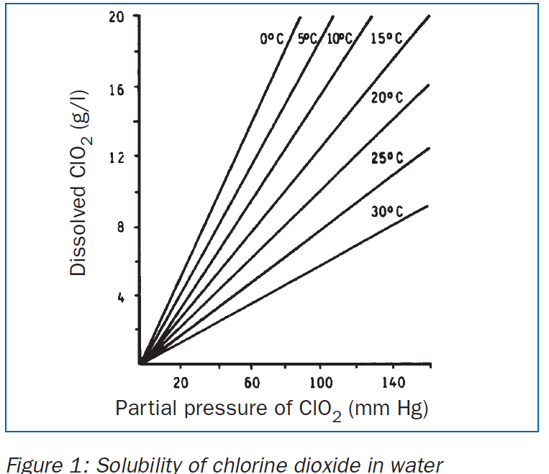
Solubility of chlorine dioxide in water

Slide 38
Disinfection force of Chlorine Dioxide
  Excellent disinfection even at low concentration

Slide 39
Bacterial Reduction with Chlorine Dioxide

Slide 40
Fungicidal Activity with Chlorine Dioxide

Slide 41
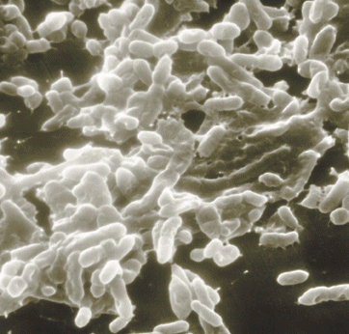
Biofilm - a Universal Problem
Slimy coatings of microorganism and extracellular compounds in pipelines and tanks
Pathogenic germs as e.coli, Staph and Legionella are living in biofilms
Biofilms are extremely resistant against disinfectants
Protective cover allows growth
Chlorine dioxide is besides ozone,
the only suitable disinfectant,
able to kill and to remove biofilms
in water pipes and tanks

Slide 42
Biofilm - a universal Problem
Biofilms create H2S and HCl
The HCl corrodes pipe walls, forming tubercles (blisters)
Tubercles create more incubation sites
Biofilm is spread through aspiration

Slide 43
Resistance of Biofilms
Coliform germs survive in biofilms even with 12 ppm of free chlorine
4 ppm of free chlorine eliminates only 80% of the biofilm after 8 hours residence time
Biofilms have even been found on the interior surface of disinfectants piping such as cooling towers and spray misters
Chlorine dioxide destroys biofilm in hours
ClO2 excellent Bactericidal, Virucidal, Sporicidal, Algicidal

Slide 44
ProMinent ClO2 Technology
Over 8,000 generators sold!!!

Slide 45
ProMinent ClO2 - Generation Method
Chemicals: sodium chlorite (NaClO2)
  hydrochloric acid (HCl)
4 HCl + 5 NaClO2  4 ClO2 + 5 NaCl + 2 H2O
  85 - 90% yield (purity depends on pre-cursors)
  chlorine-free solution of chlorine dioxide
  by-products: chlorite and chlorate
  no handling of chlorine or chlorine gas
  no other by-products such as peroxides or acetic acid
  does not react with bromides (Cl and O3 do)

Slide 46
Bello Zon CDVc (dilute chemicals)
Model | ClO₂ output [g/h] | operating pressure [psi] | operating temperature [°C]
CDVc 20 | 1-20 | 116 | 10-40
CDVc 45 | 2-45 | 116 | 10-40
CDVc 120 | 6-120 | 116 | 10-40
CDVc 240 | 12-240 | 102 | 10-40
CDVc 600 | 30-600 | 73 | 15-40
CDVc 2000 | 100-2,000 | 29 | 15-40

Slide 47
Comparison
A 400 gram/hour unit = 21 lbs/day of ClO2
A 2,000 gram/hour unit = 106 lbs/day of ClO2
Calculation:
Flow (gpm) X ppm residual/4.4 = grams/hour ClO2

Slide 48
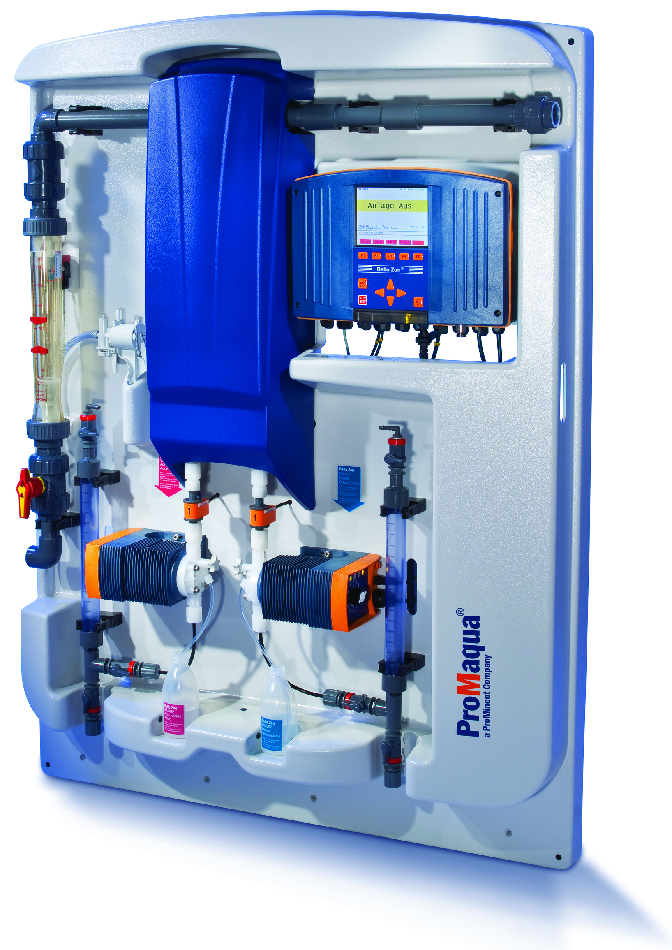
CDVc Photo

Slide 49
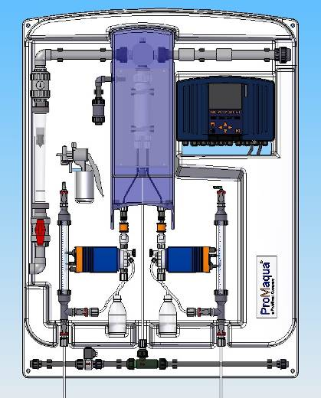
Bello Zon CDVc for Diluted Chemicals
Backpanel for wall mounting
static mixer
controller with data logger and screen recorder
PVDF reactor and reactor-outlet
single stroke
flow sensor
reactor cover for protection
metering pumps in CAN-bus version
calibration and suction aid with vacuum pump (optional)
purge assembly
for reactor (optional)

Slide 50
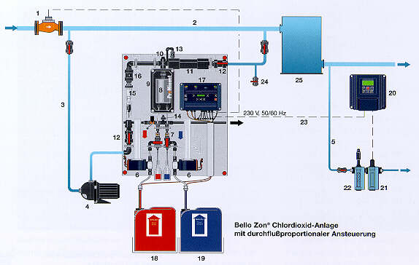
ClO2–Concentration in Bello Zon®-Systems
water:
0.05-2 ppm
ClO₂
bypass:
200-1000 ppm
ClO₂
reactor:
20,000 ppm
ClO₂

Slide 51
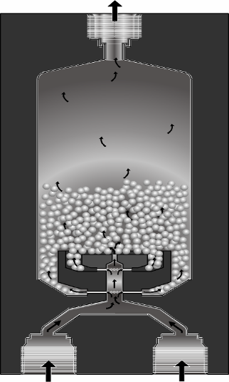
Bello Zon® - Reactor CDV
perfect mixing of the chemicals causes high yield of ClO2
optimal design guaranties sufficient reaction time of minimum 4 minutes
concentration 20 g/l (2%)
no gas phase

Slide 52
Operation of CDV
Pre-cursor chemicals:
  sodium chlorite: 7.5% (w/v) 95-99% pure
  hydrochloric acid: 9.0% (w/v) 95-99% pure
  design data:
  1 liter NaClO2 + 1 liter HCl = 40 g ClO2
Conditions:
  temperature treated water: 131 °F
  temperature chemicals: 50 - 104 °F
  backpressure: 102 - 145 psi

Slide 53
Operation of CDK
Pre-cursor chemicals:
  sodium chlorite: 25% (w/v) 95-99% pure
  hydrochloric acid: 30% (w/v) 95-99% pure
  design data:
  1 liter NaClO2 + 1 liter HCl = 150 g ClO2
Conditions:
  temperature treated water: 131 °F
  temperature chemicals: 50 - 104 °F
  backpressure: 102 - 145 psi

Slide 54
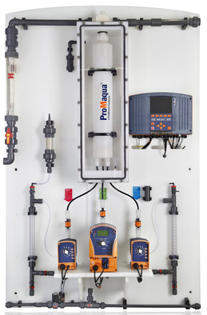
Bello Zon® Type CDKc
(concentrated chemicals)

Slide 55
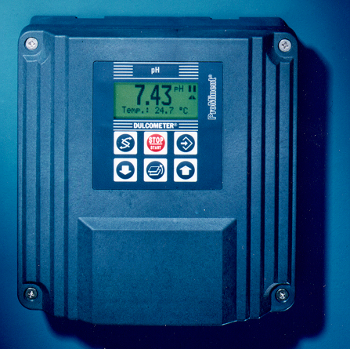
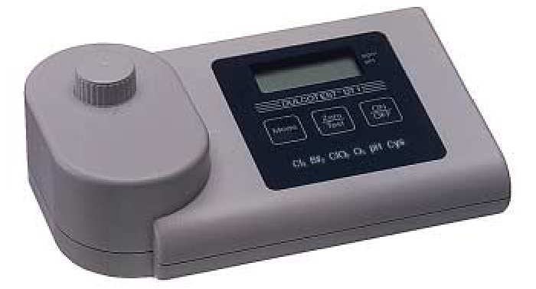
Analysis of Chlorine Dioxide and Chlorite
Online – measurement & control:
Dulcometer® D1C: ClO2, chlorite, pH, ORP
Dulcometer® D2C: ClO2 + pH
Photometer Dulcotest® DT 4
ClO2 + chlorite

Slide 56
Sensors for Chlorine Dioxide and Chlorite
CDE 2-mA (ClO2 for clean water)
Measuring ranges (10, 2, 0.5 ppm)
CDP 1-mA-2 ppm (ClO2 for surfactant water)
Measuring range (2 ppm)
CDR 1-mA (ClO2 for dirty water)
Measuring ranges
(0.5 and 2 ppm)
CLT 1-mA (chlorite)
Measuring ranges
(0.5 and 2 ppm)

Slide 57
Other Generation Methods

Slide 58
Other Generation Methods
Sodium Chlorite and Chlorine Gas
  Adding chlorine into process
  Chance for THM, DBP, TCA formation
  Store chlorine gas
Sodium Chlorite, HCl, and Sodium Hypochlorite
  Adding chlorine into process
  Chance for THM, DBP, TCA formation
  Purchase 3-chemicals

Slide 59
Other Generation Methods
Stabilized Chlorine Dioxide
  Buffered sodium chlorite solution
  Weak disinfectant
  No such thing as “stabilized ClO2”
  ClO2 is a gas
Chlorine Dioxide Sachets (tea bags)
  Affected by impurities in water
  Only good for specific quantities of water
  Can explode
  PPM concentration suspect and not adjustable

Slide 60
Other Generation Methods
Purate Method
  Uses sodium chlorate, sulfuric acid and H2O2
  Good for large quantities of ClO2
  Generator is expensive (PVDF)
Electro-Chemical
  Generates ClO2 on-site
  Need pure water to work
  Undesired by-products (hydrogen, caustic)
  Maintenance is high
  Replacing cell is expensive

Slide 61
ClO2 Safety & Maintenance

Slide 62
Chemical Safety
Color coded chemical tanks are suggested
Chemicals need to be separated
Level switches in chemical tanks
Relays on level switches attach to an alarm; generator shuts down if tank is empty
Flow sensors on pumps to ensure the correct proportion of chemical flow
Alarm on flow sensors; generator shuts down if “x” pulses are missed (programmable)

Slide 63
Reactor Safety
Isolated in an enclosed PVDF reactor housing
Only a 2% solution is generated (20,000 ppm)
Reactor housing is automatically purged via an injector and solenoid valve up to 6 times per hour
The reactor chamber is always full of solution – not gas!!

Slide 64
Additional Safety Features
Flow sensor on bypass water line adjusts the amount of chlorine dioxide generated
Chlorine dioxide is injected into the bypass water flow
Output can be controlled by a ProMinent chlorine dioxide residual controller

Slide 65
Maintenance
CDV: every 6 - 12 months acc. to operating conditions
CDK: every 6 month
    spare parts kit CDV/CDK plant
    3 – 4 working hours
  Flushing and disassembling reactor
  Exchange of gaskets
  Service pumps, piping and replace gaskets and diaphragms
  Check system functionality
  Calibration

Slide 66
Wine Applications with Chlorine Dioxide

Slide 67
General Applications
Well water
Feed water
Wash water
Cooling water
Process water
CIP
Filter cleaning
Wastewater
Tank/barrel cleaning
  Indoor/outdoor tank farms
  Foaming

Slide 68
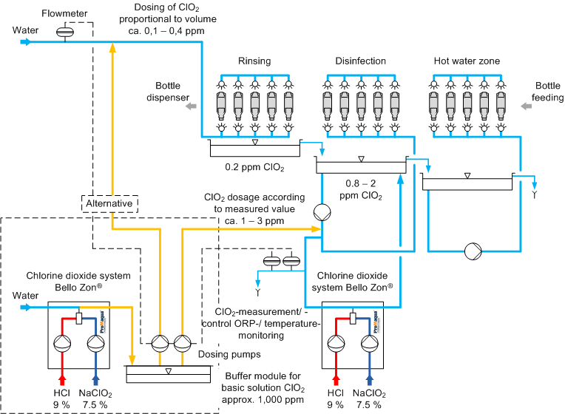
Bottle Washing with Chlorine Dioxide
Application example!

Slide 69
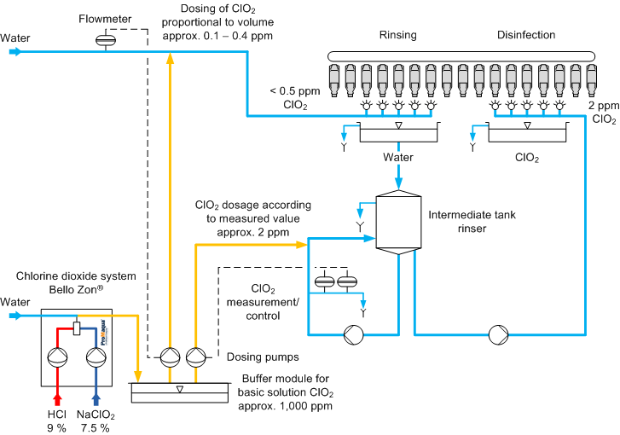
Bottle Rinsing with Chlorine Dioxide
Application example!

Slide 70
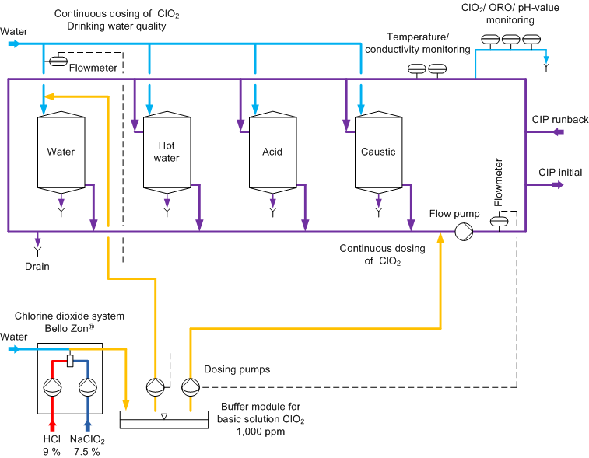
CIP with Chlorine Dioxide
Application example!

Slide 71
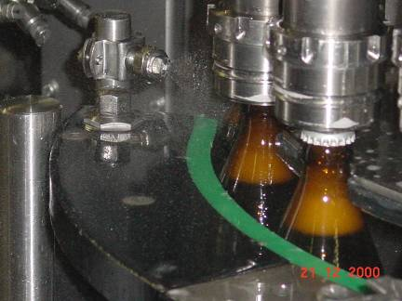
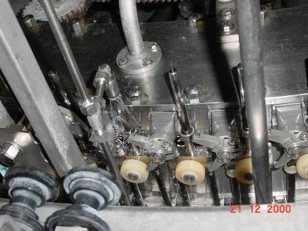
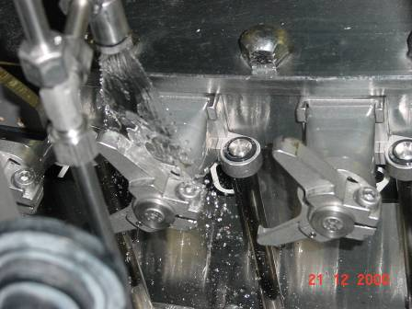
ClO2 for Filling Machines
0.4 ppm
ClO₂

Slide 72
ClO2 Application
Winery was using bleach (sodium hypo) to clean aging and storage tanks
Concerns about TCA’s
ClO2 and PAA were tested
PAA proved to be too expensive
ClO2 was chosen for CIP tank washing and filter cleaning.
Cooling towers were also treated with ClO2
Day tanks were made with 1,000 ppm ClO2
Venturi used to inject ClO2 in wine tanks

Slide 73
Conclusion
ClO2 is the best choice for disinfection and sanitization for the Wine Industry (chlorine-free)
A strong disinfectant which must be generated on-site
Eliminates biofilms
Won’t form TCA or TBA compounds
Safe for operator use with some pre-cautions
Not expensive to operate
Saves water and money
Very versatile answer to other competitive products

