Slide 1
ProMinent Industrial
Territory Maps January 1, 2013

Slide 2
Industrial Distribution by Region
Region 302 Dan Helms
Region Map
Pumping Solutions, Inc
William/Reid LTD, LLC
AFTEK, Inc
Region 303 Tony Karalis
Region Map
State of Florida
Tomas Cuerda
Region 303 Greg Campbell
Region Map
Delta Process
McCarthy Integrated Systems, LLC
Odessa Pumps, Amarillo Office
Odessa Pumps, Boerne Office
Odessa Pumps, Corpus Christi Office
Odessa Pumps, Farmington Office
Odessa Pumps, Hobbs Office
Odessa Pumps, Houston Office
Odessa Pumps, Odessa Office
Odessa Pumps, Palestine Office
Odessa Pumps, Pharr Office
Saladin Pump & Equipment Company
Region 308 Etienne Prehoda
Region Map
Able Wright, Inc.
Allwater L.L.C.
Southwest Pumps & Filters
TriCor Equipment Co., LLC
Vessco, Inc.
Region 319 Tom Miller
Region Map
Atlantic Pump & Engineering Inc.
ALEDco Inc
Atlantic Equipment Resources, LLC
Brown & Morrison, LTD
Buckeye Pumps, Inc.
Hayes Pump Inc.
Humbleton Industrial Sales
Mountain States Instruments
Process Controls Corp.
TMG Services
Region 315 John Strack
Region Map
Fluid Engineering
Hopkins Technical Products, Inc.
Shupe & Associates
Specialized Operations Services Inc
Phillip R. Walker Associates
West View Cunningham

Slide 3
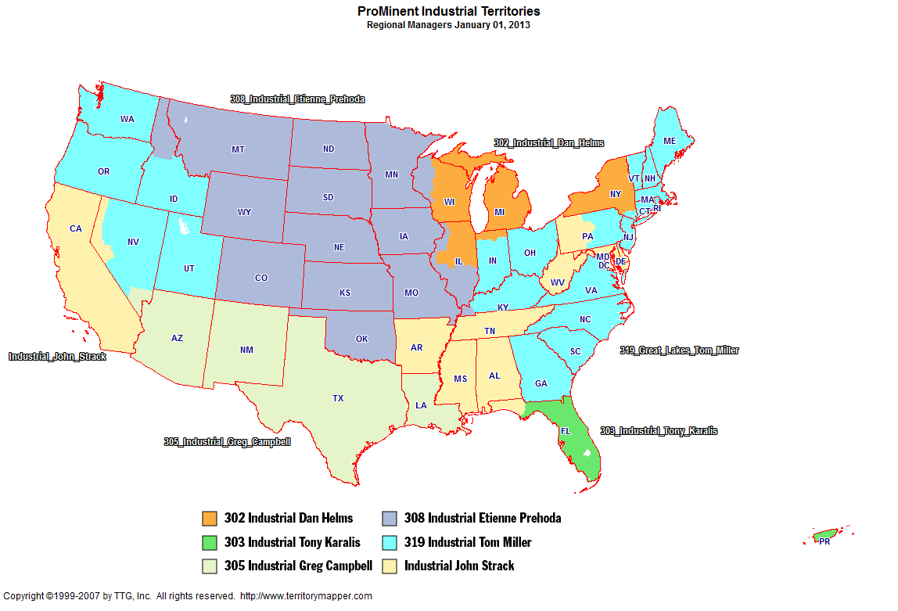
Back to Contents

Slide 4
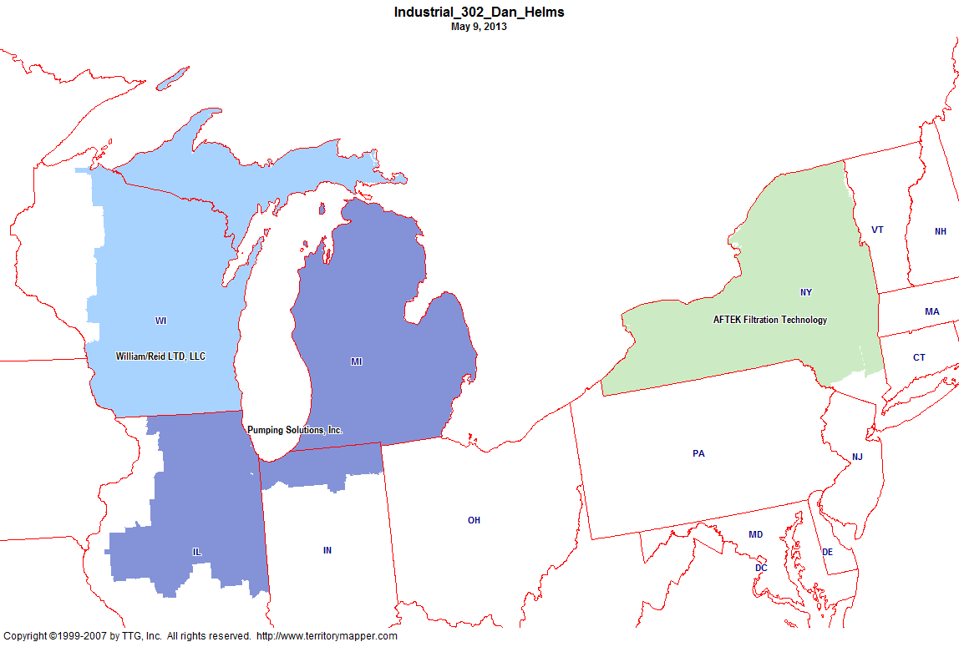
Back to Contents

Slide 5
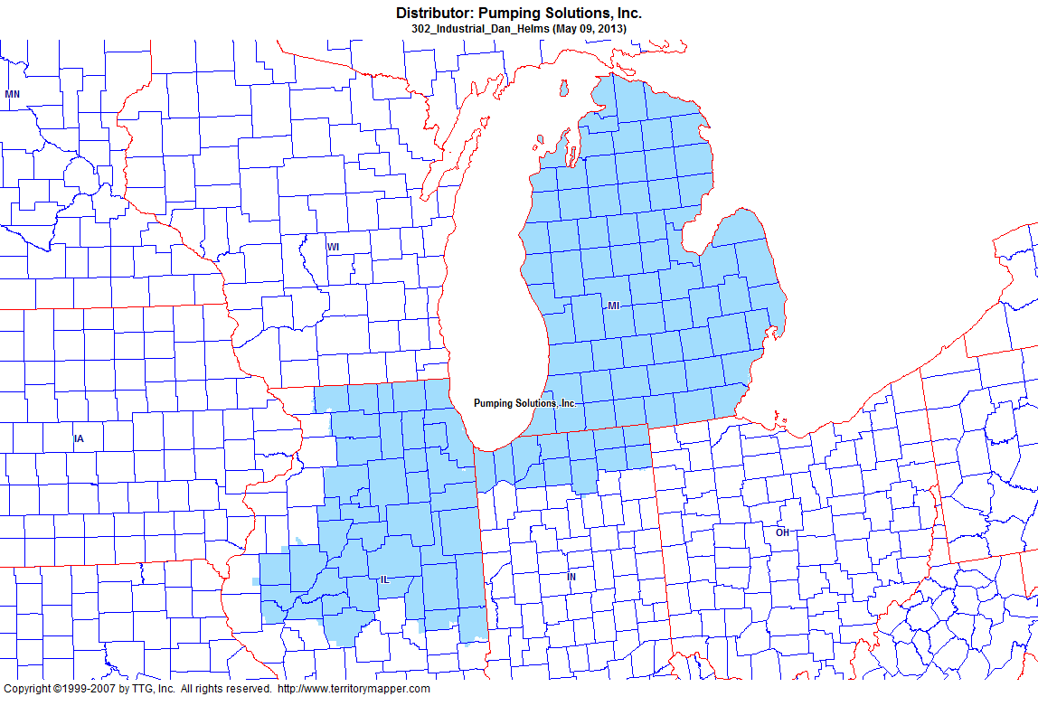
Back to Contents

Slide 6
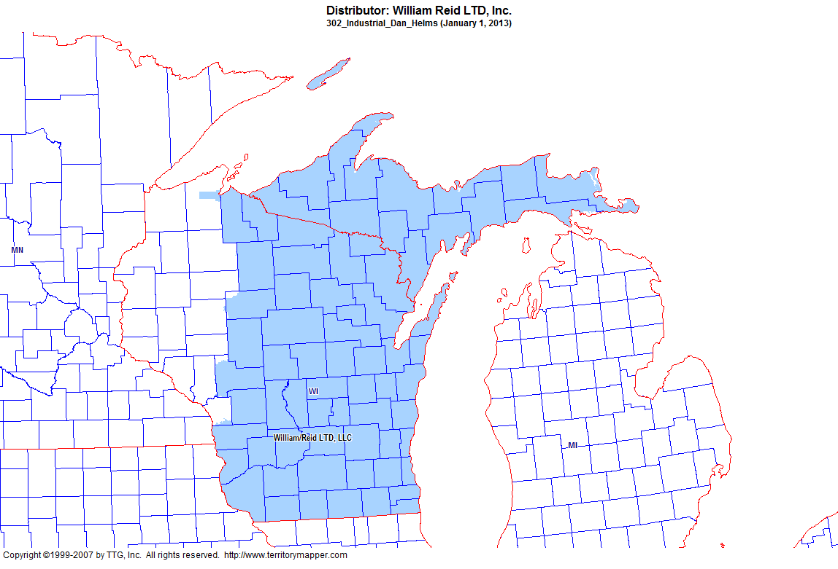
Back to Contents

Slide 7
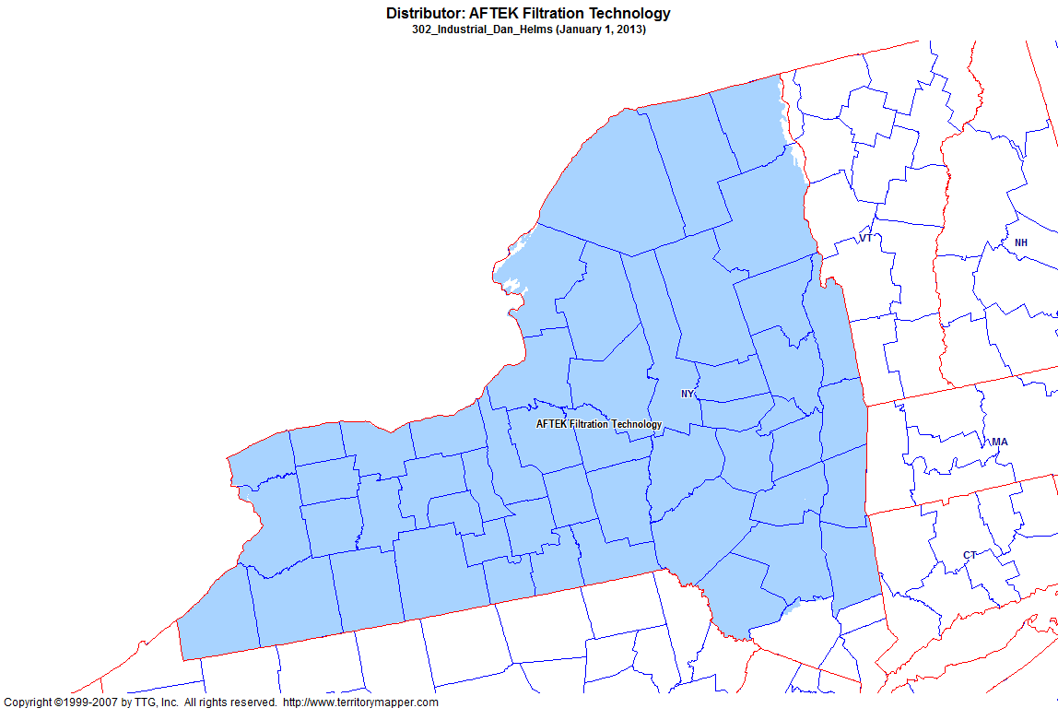
Back to Contents

Slide 8
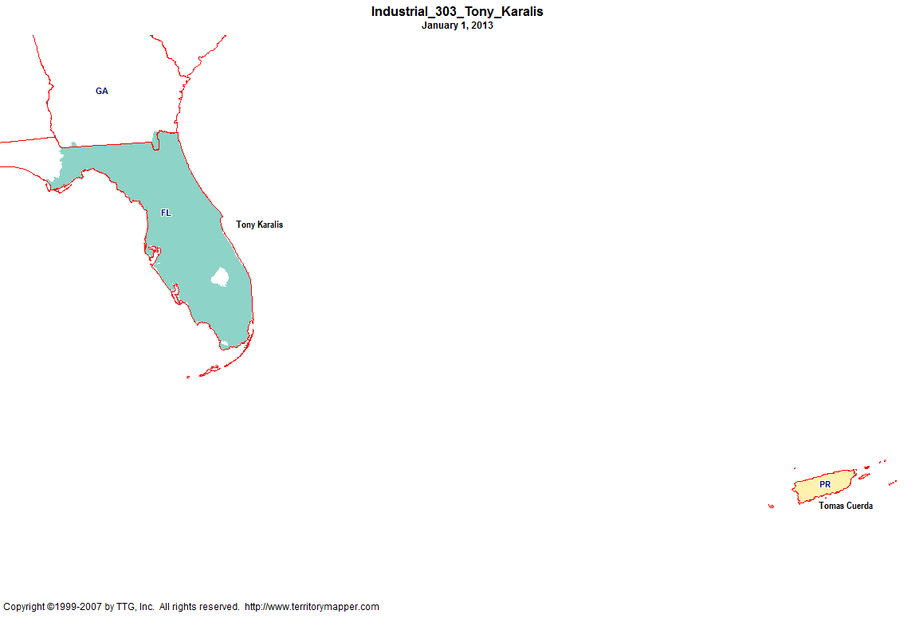
Back to Contents

Slide 9
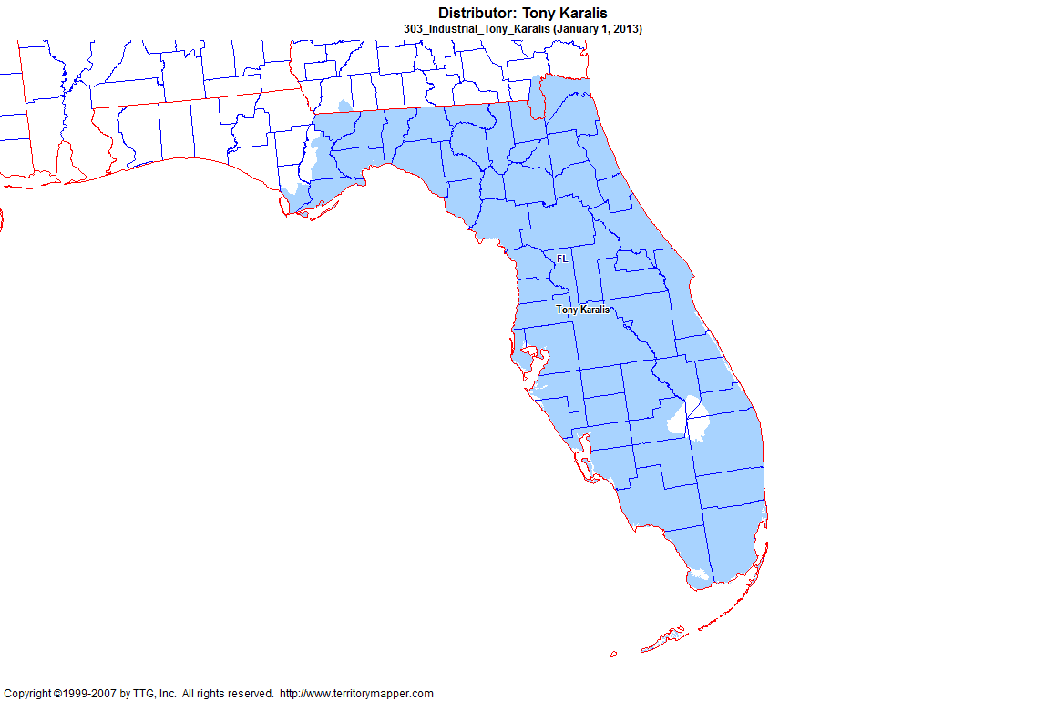
Back to Contents

Slide 10
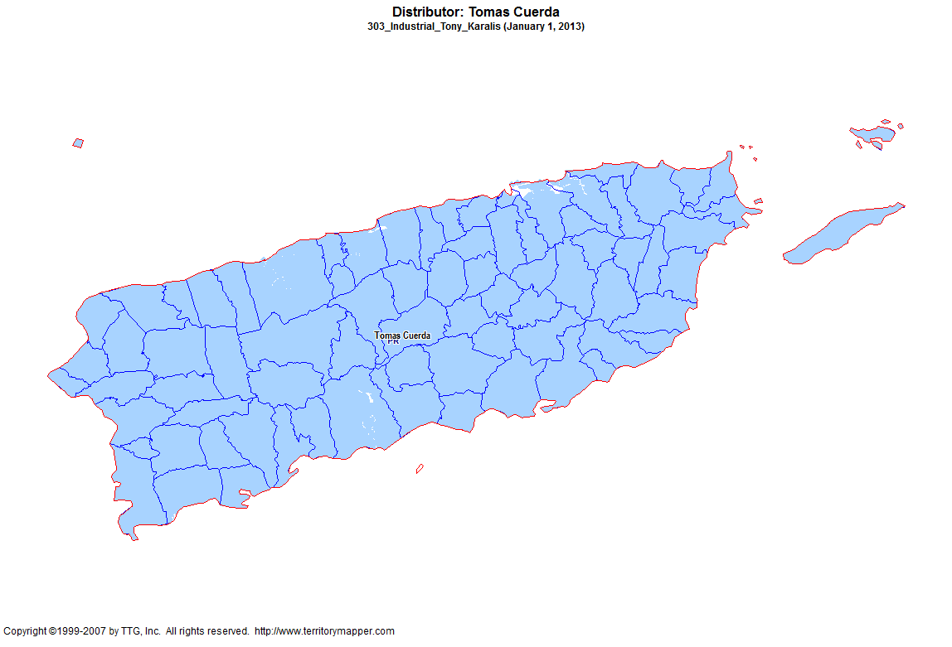
Back to Contents

Slide 11
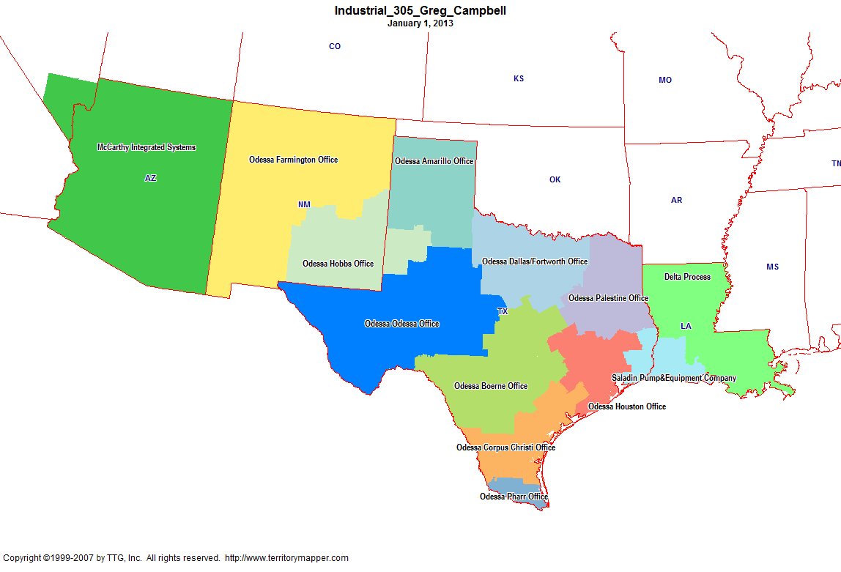
Back to Contents

Slide 12
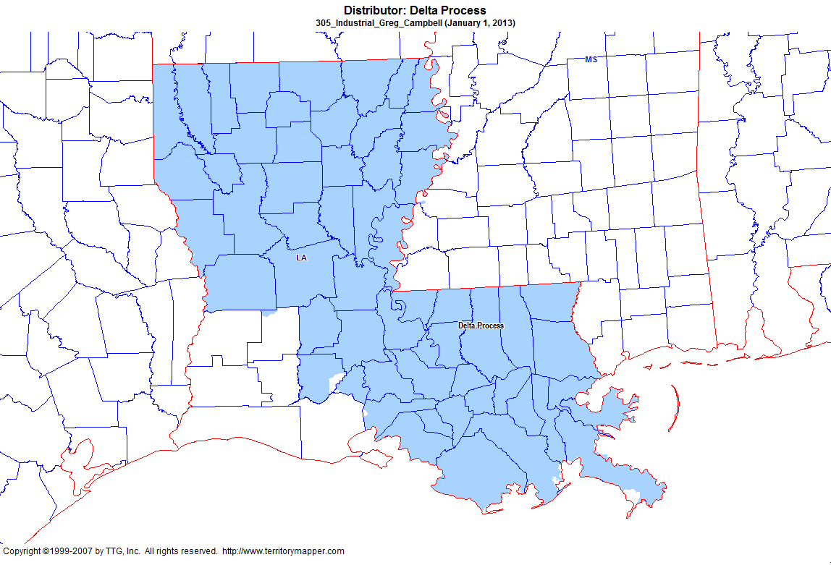
Back to Contents

Slide 13
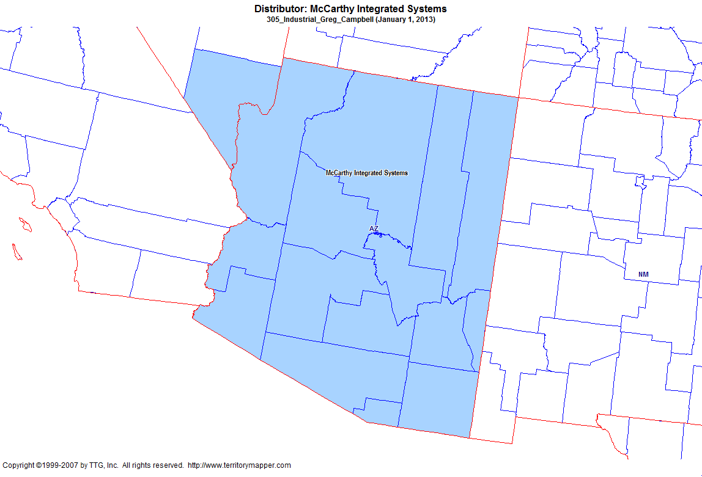
Back to Contents

Slide 14
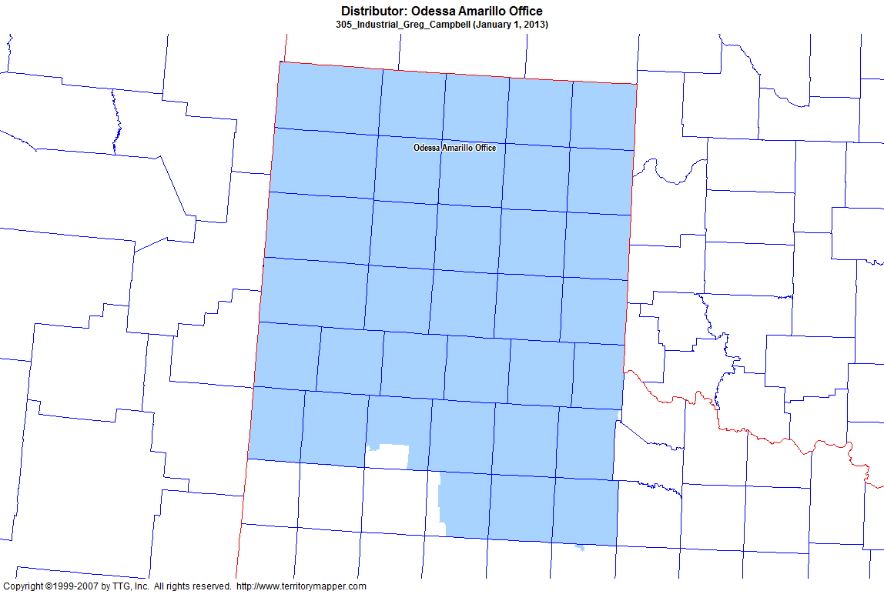
Back to Contents

Slide 15
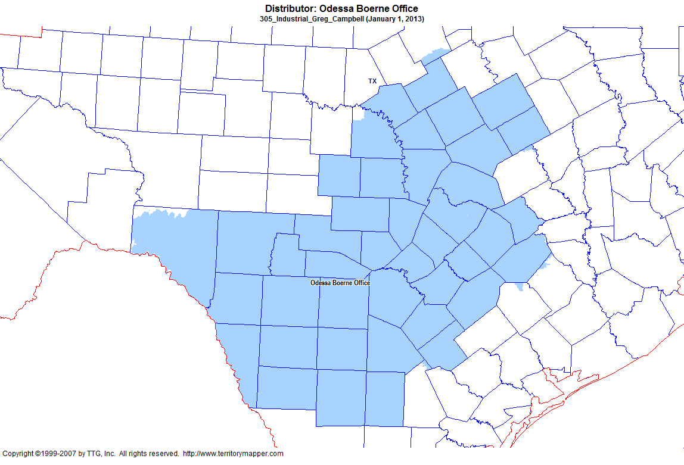
Back to Contents

Slide 16
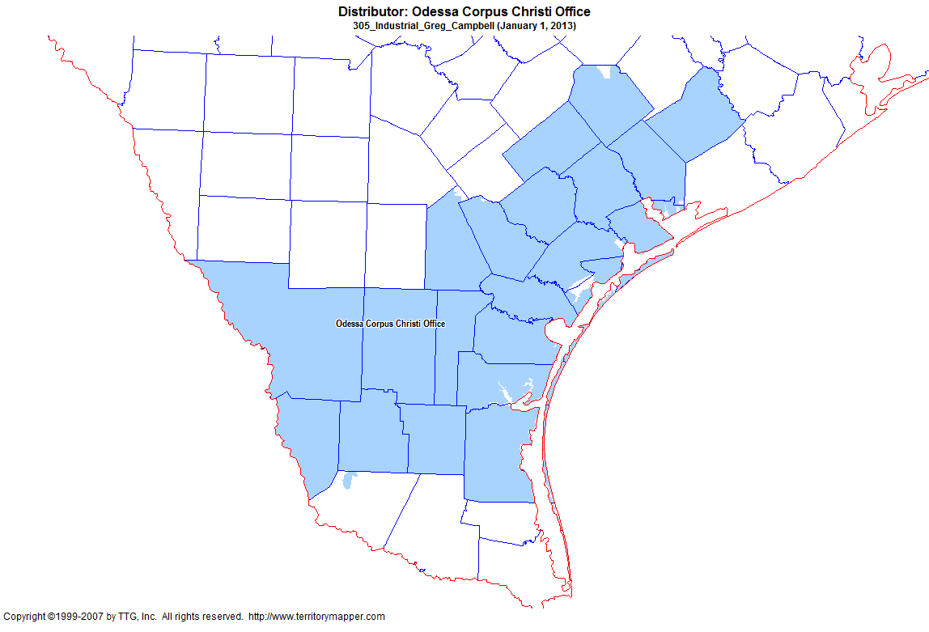
Back to Contents

Slide 17
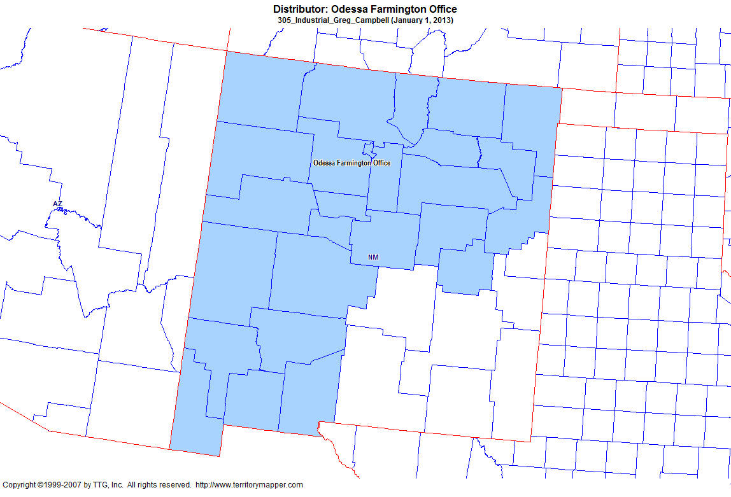
Back to Contents

Slide 18
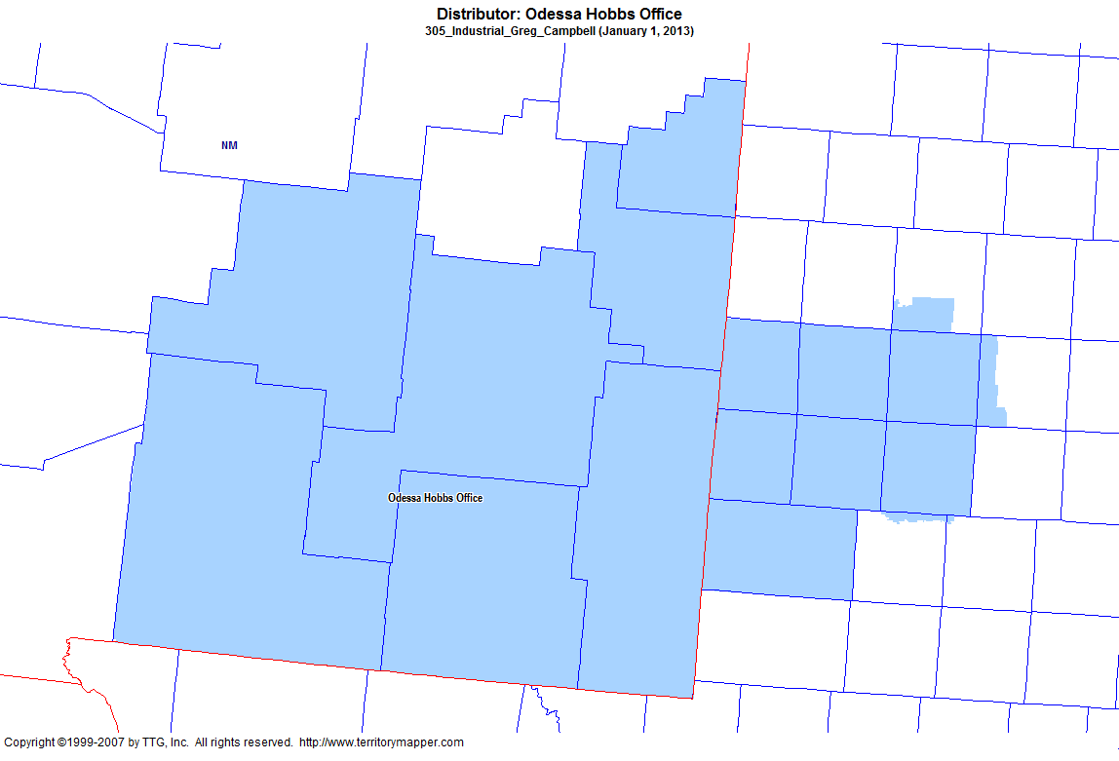
Back to Contents

Slide 19
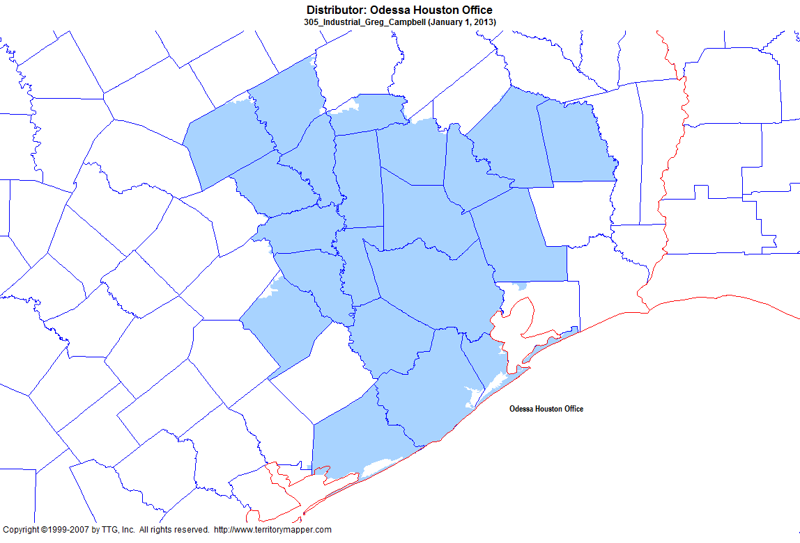
Back to Contents

Slide 20
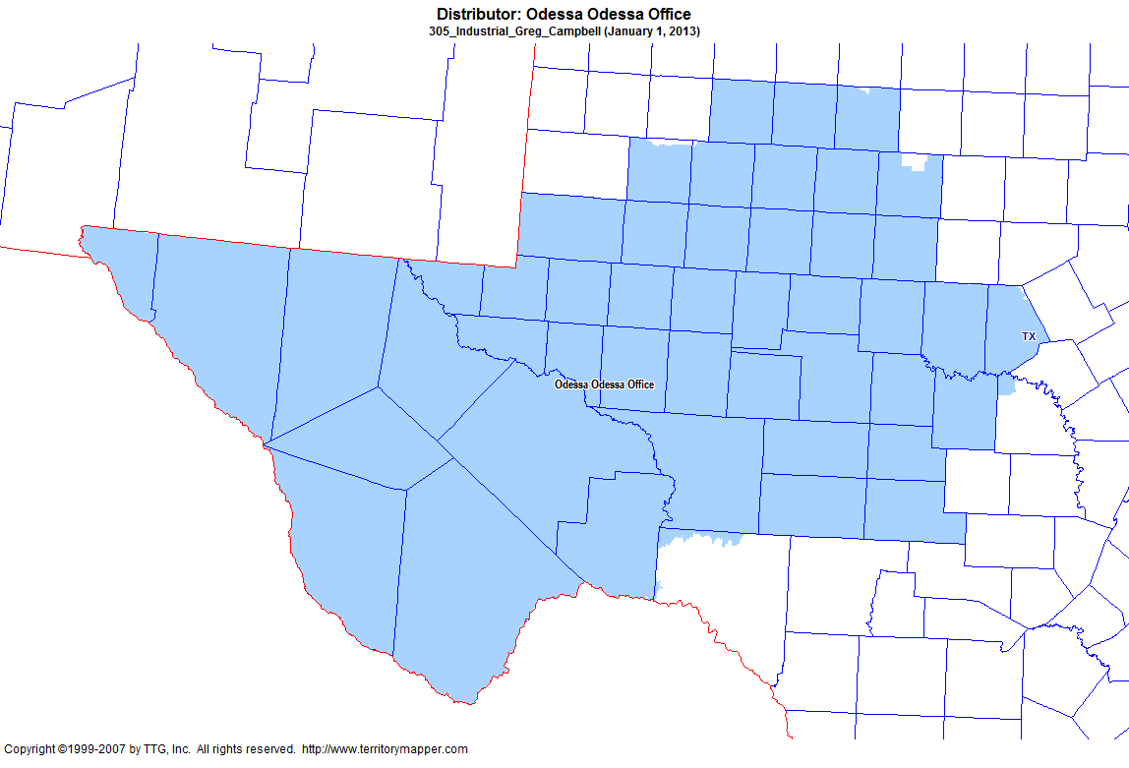
Back to Contents

Slide 21
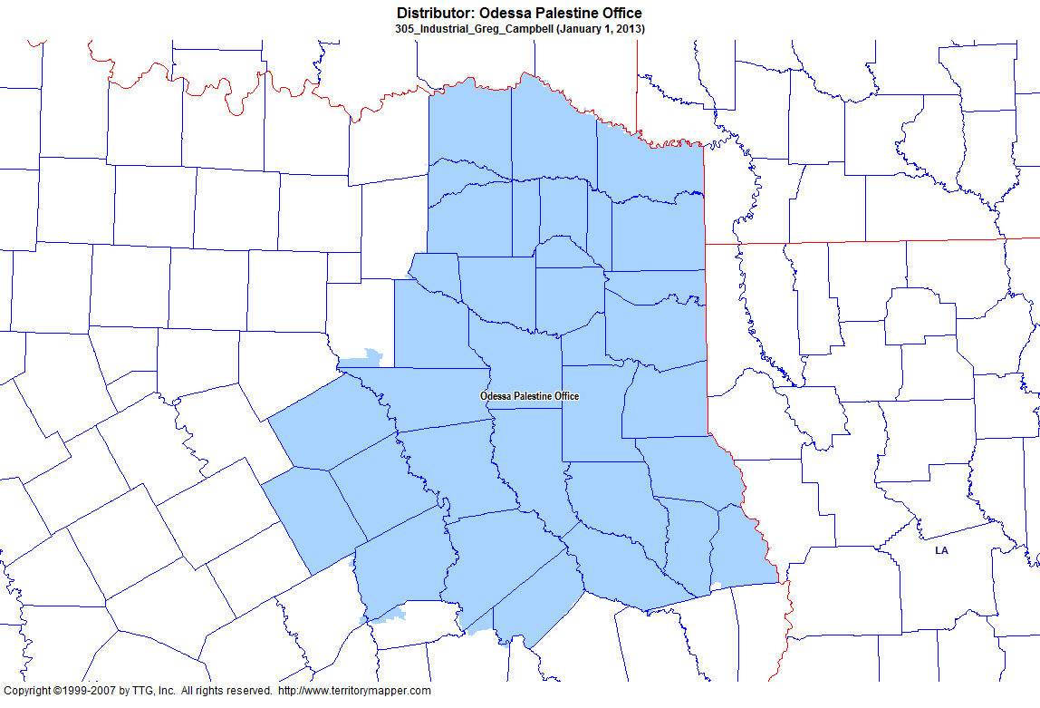
Back to Contents

Slide 22
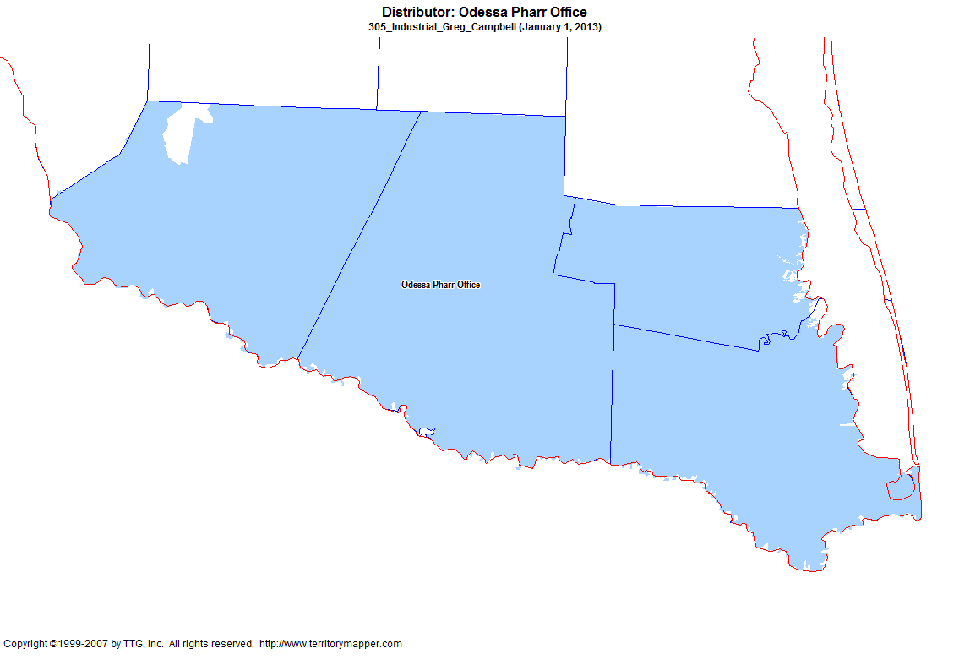
Back to Contents

Slide 23
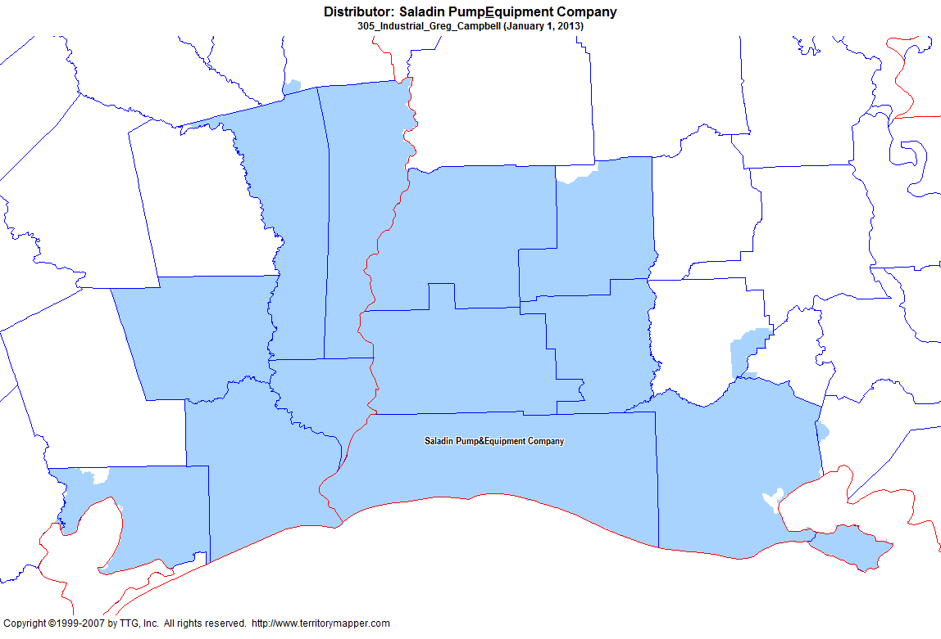
Back to Contents

Slide 24
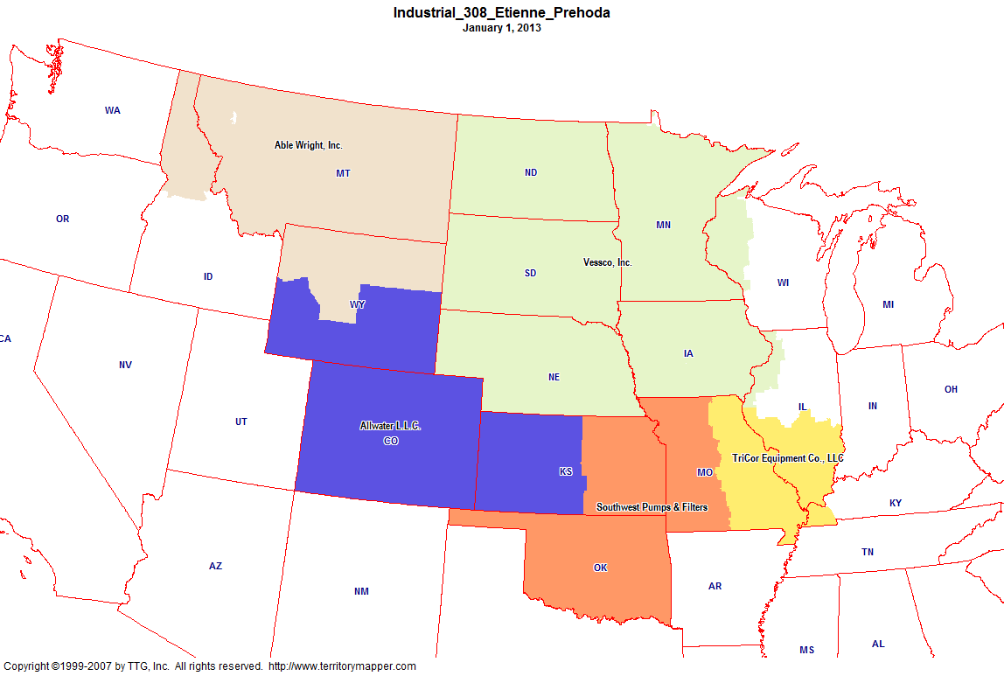
Back to Contents

Slide 25
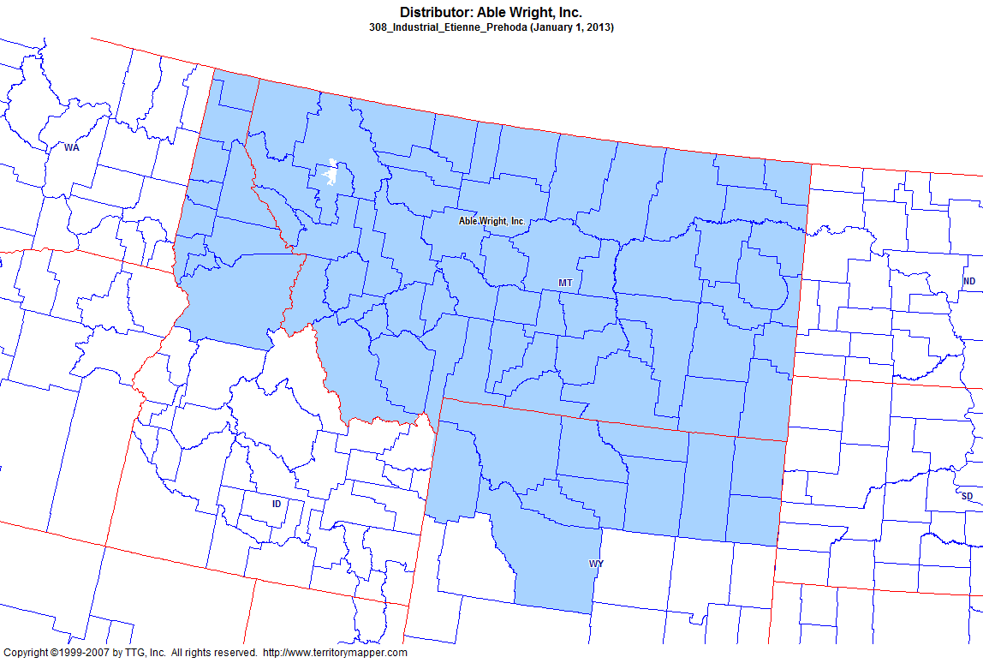
Back to Contents

Slide 26
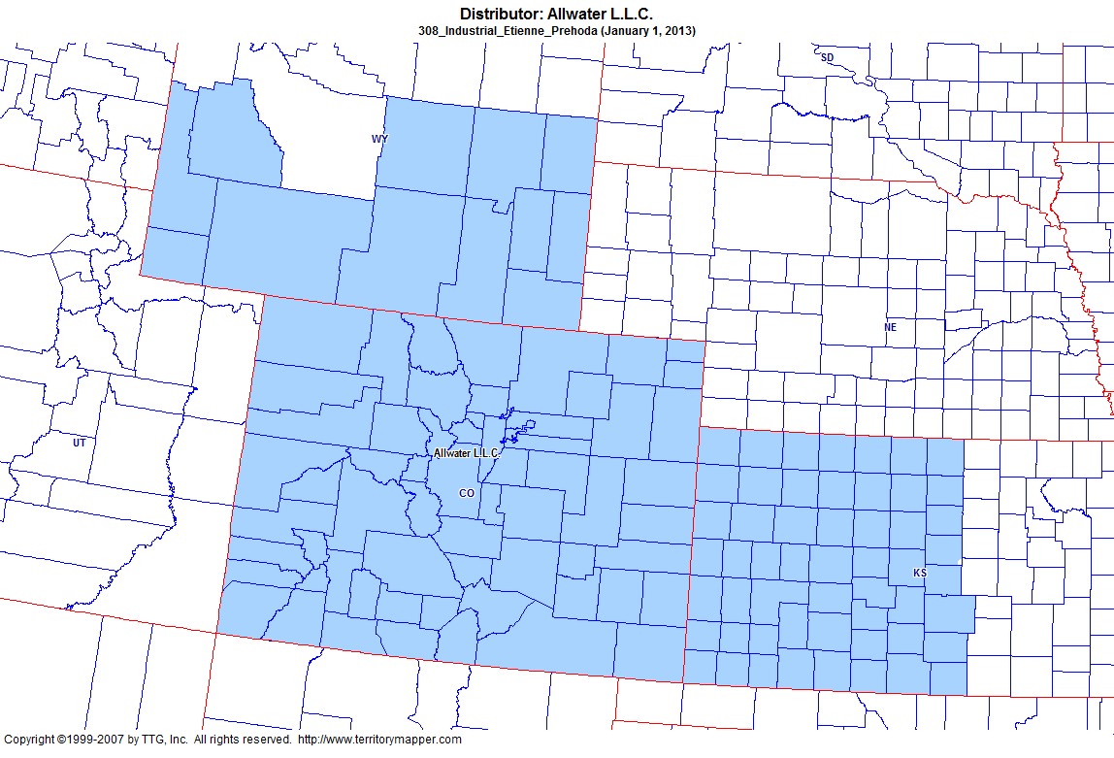
Back to Contents

Slide 27
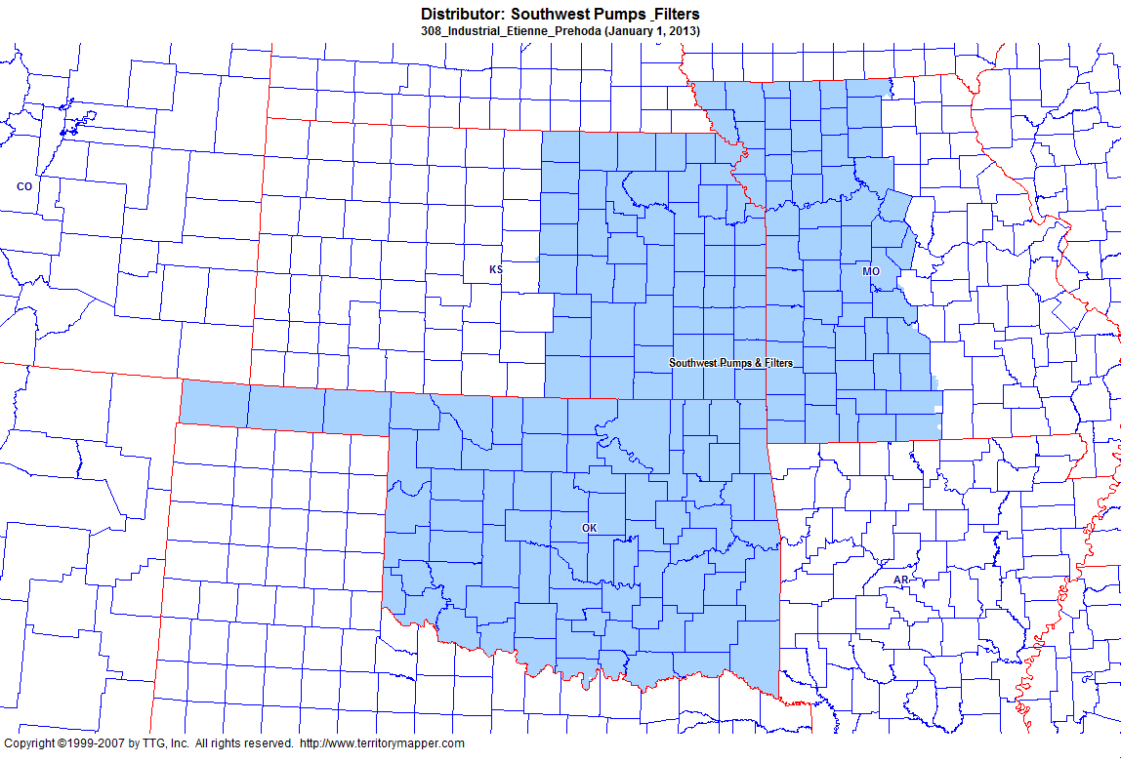
Back to Contents

Slide 28
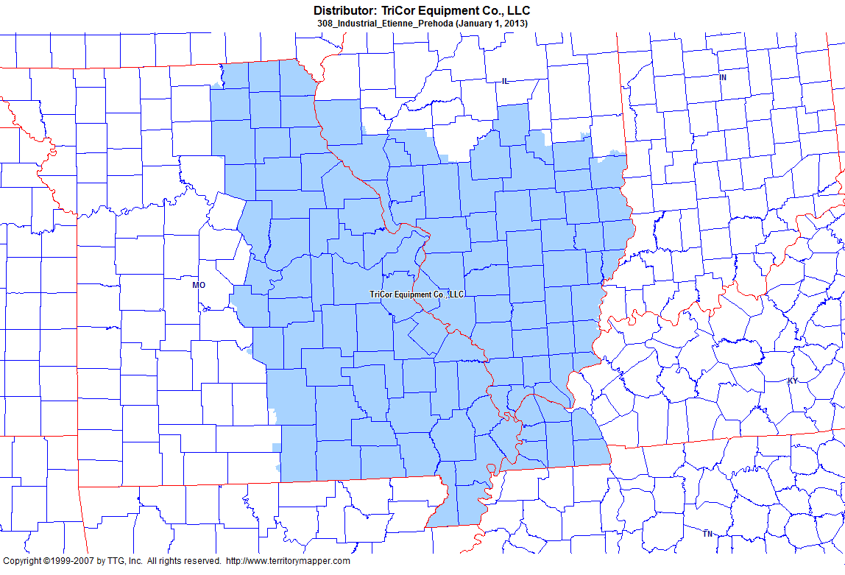
Back to Contents

Slide 29
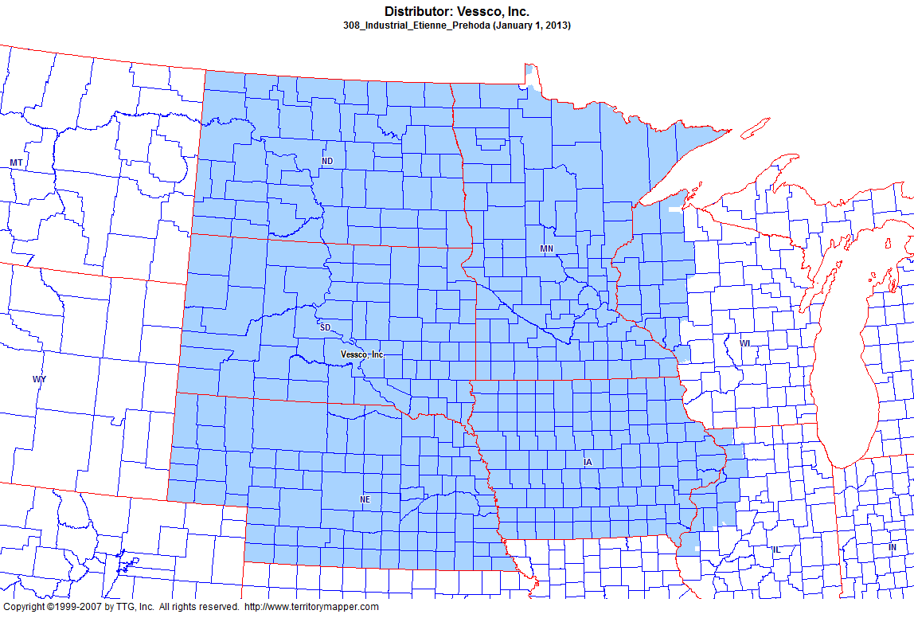
Back to Contents

Slide 30
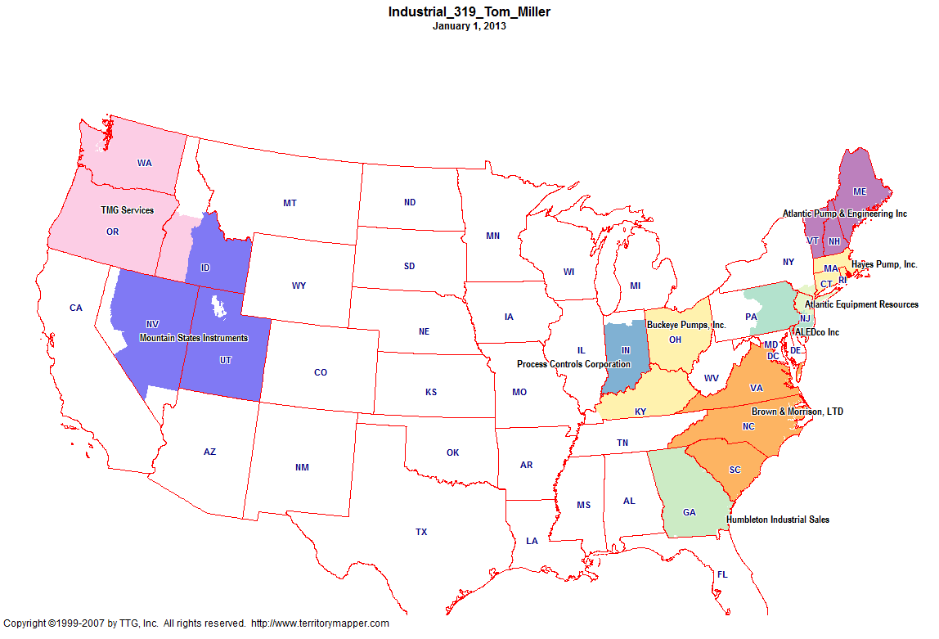
Back to Contents

Slide 31
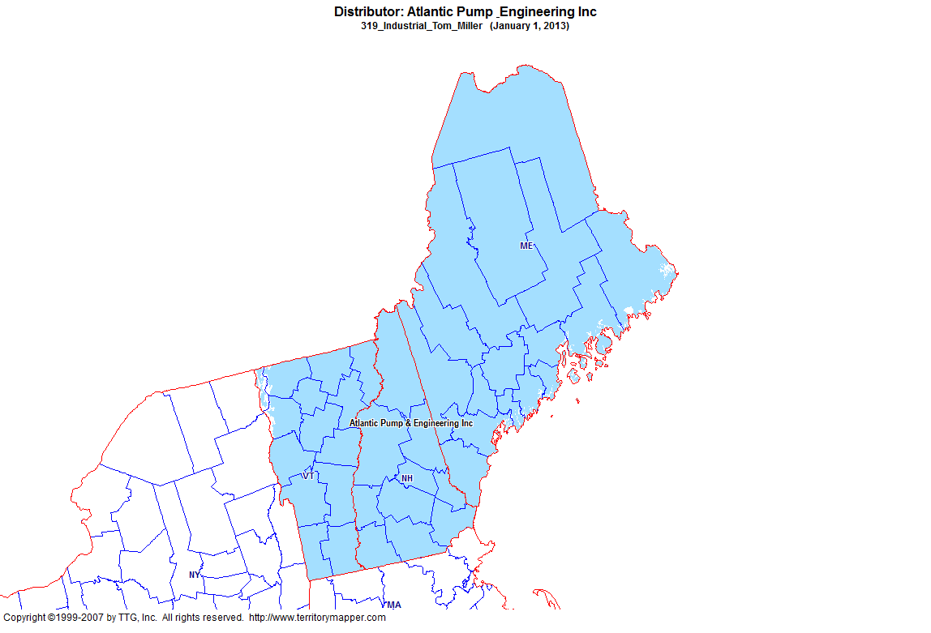
Back to Contents

Slide 32
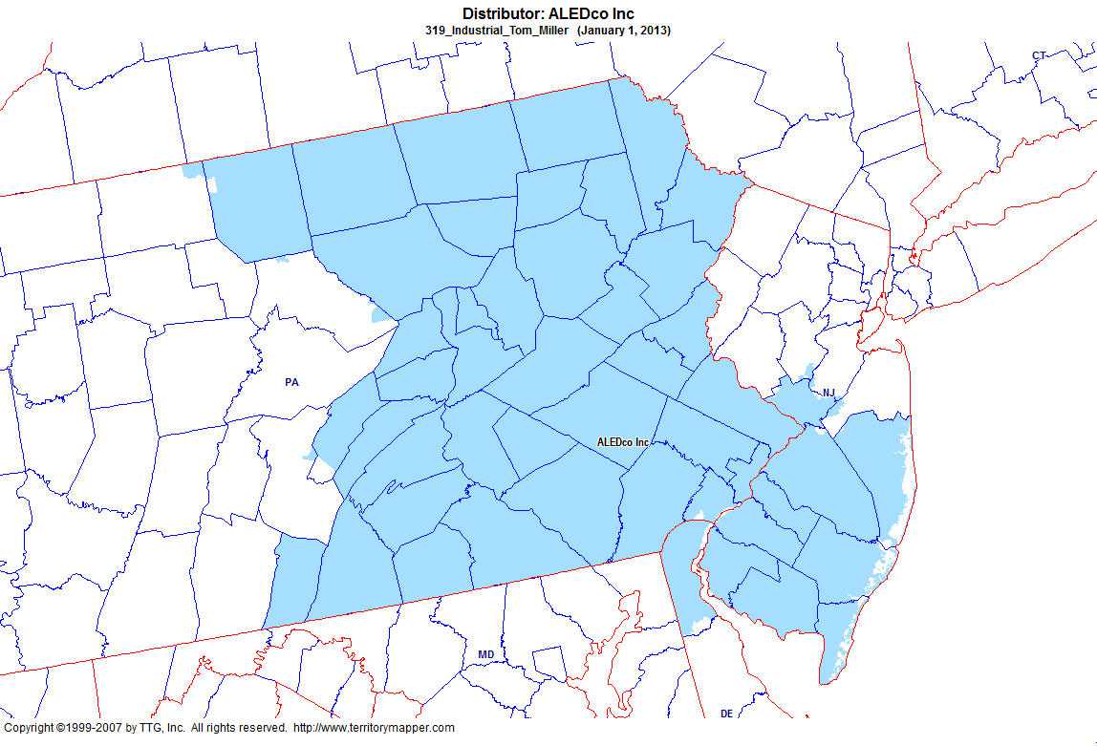
Back to Contents

Slide 33
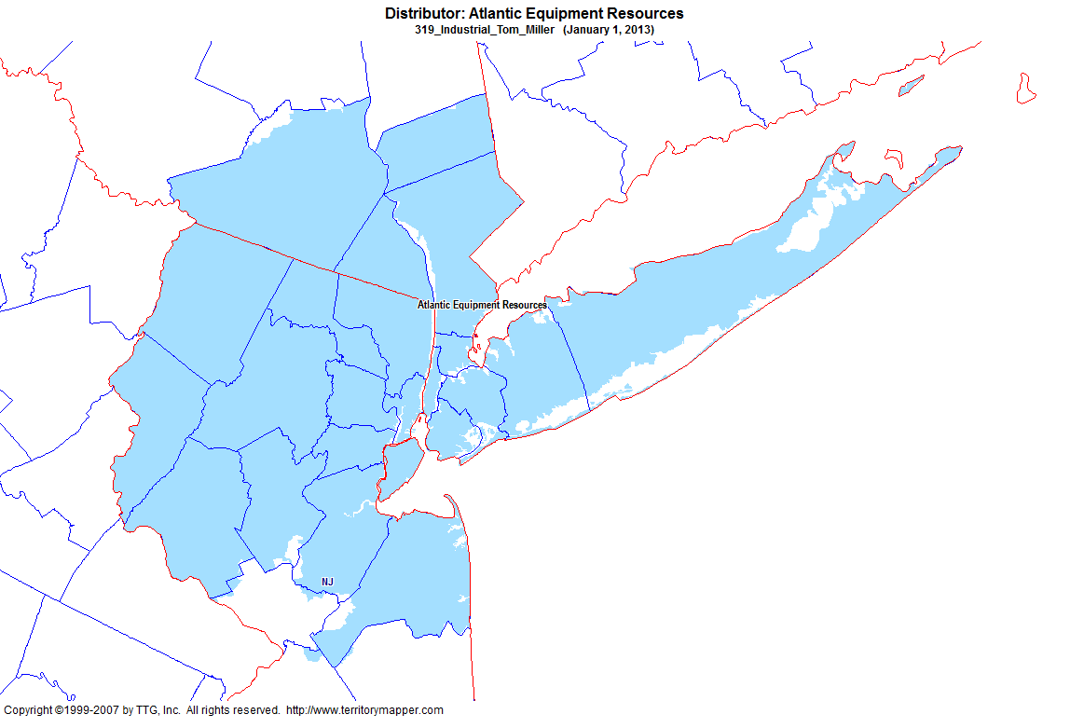
Back to Contents

Slide 34
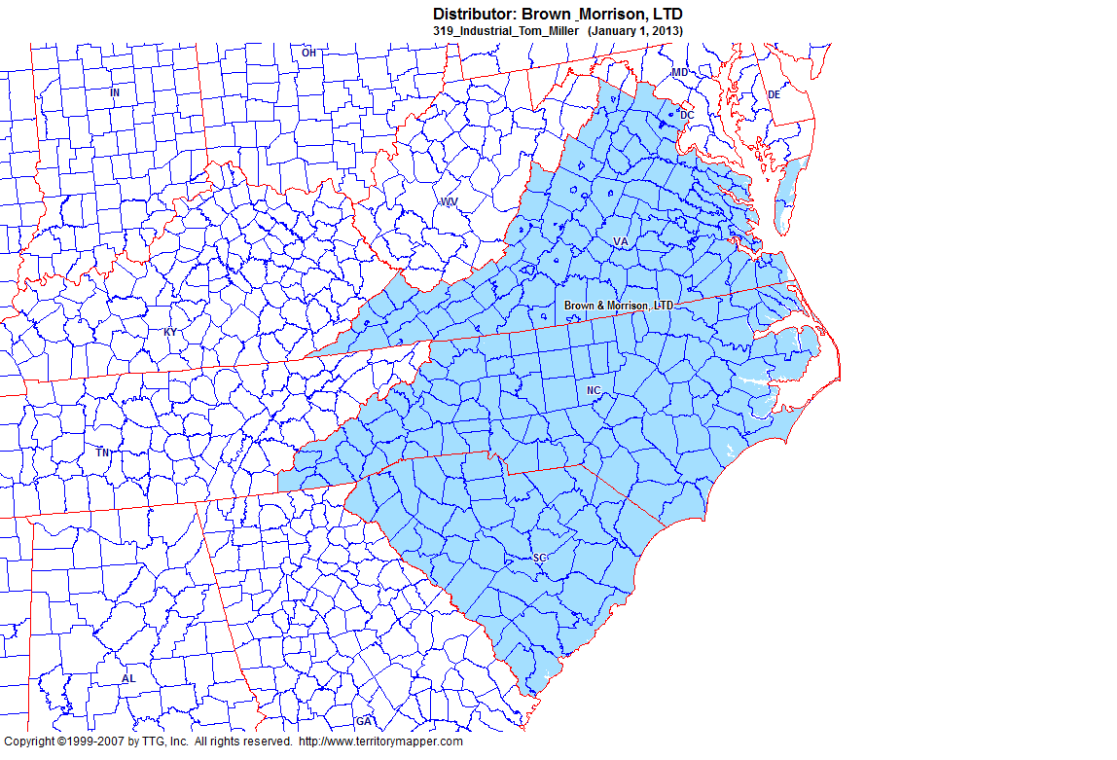
Back to Contents

Slide 35
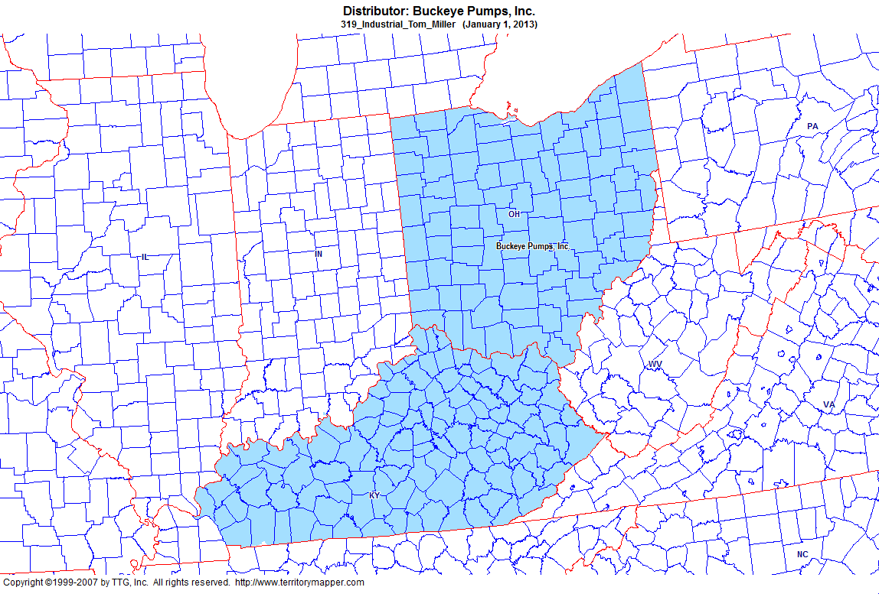
Back to Contents

Slide 36
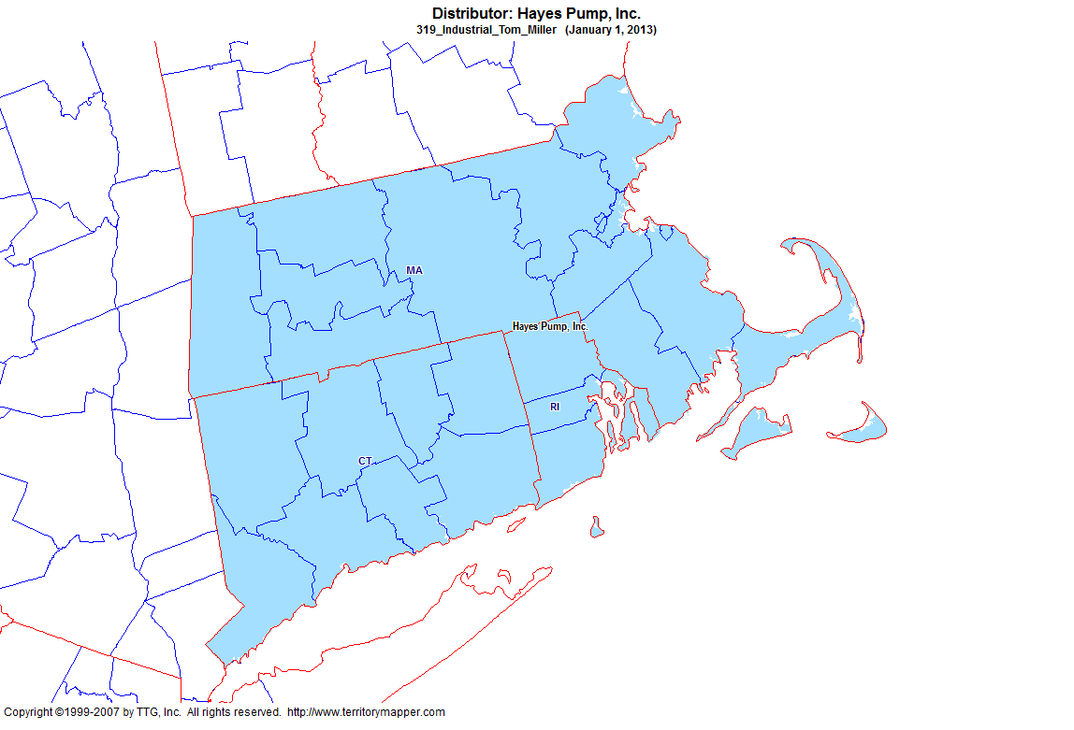
Back to Contents

Slide 37
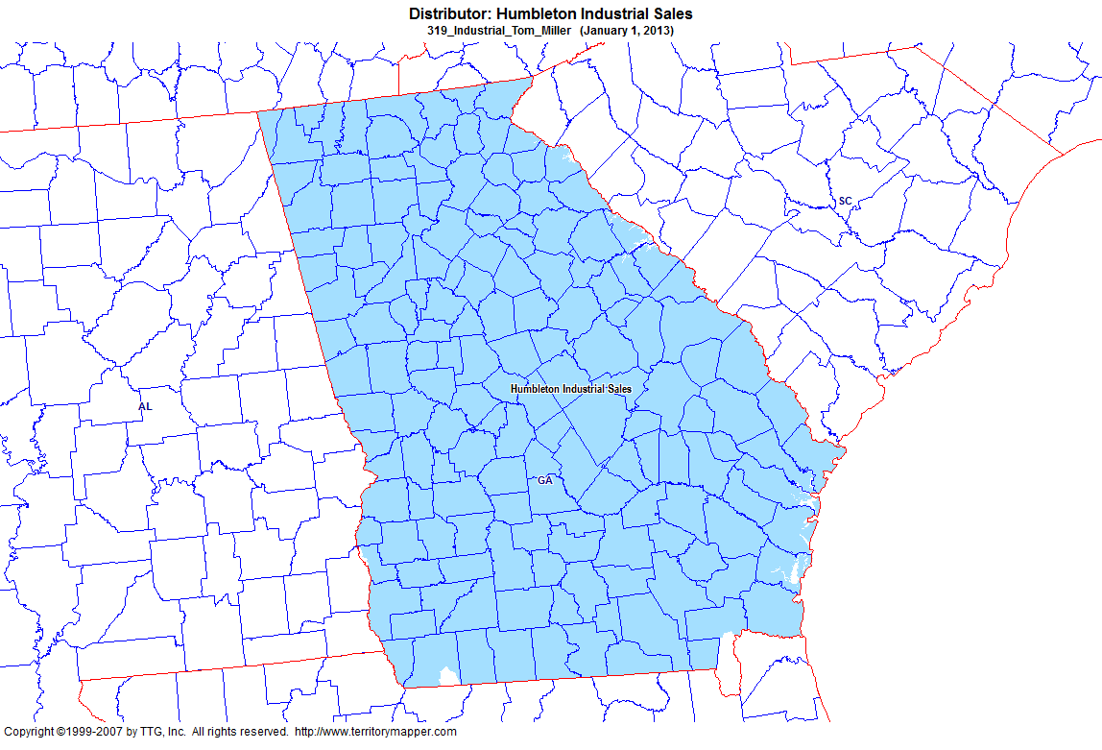
Back to Contents

Slide 38
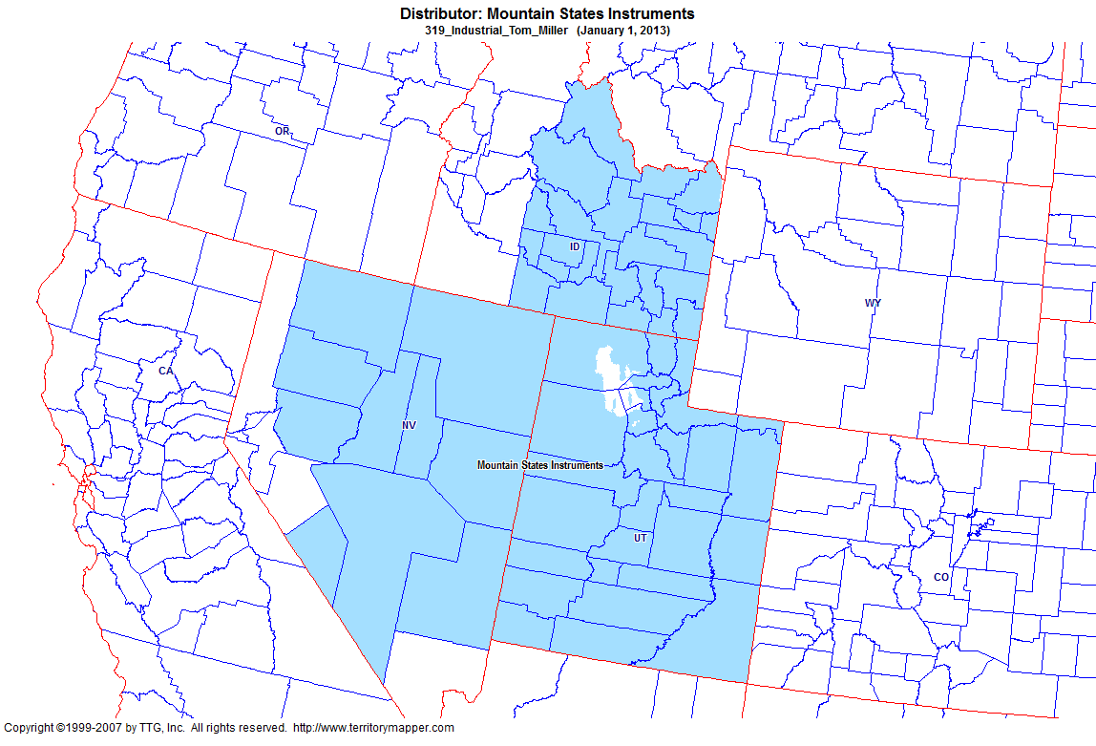
Back to Contents

Slide 39
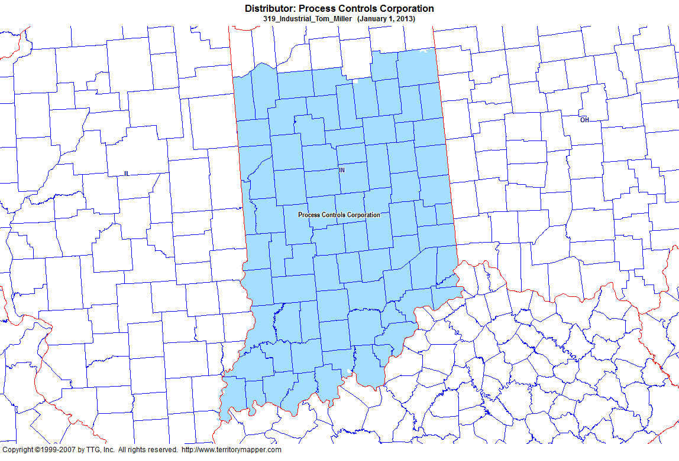
Back to Contents

Slide 40
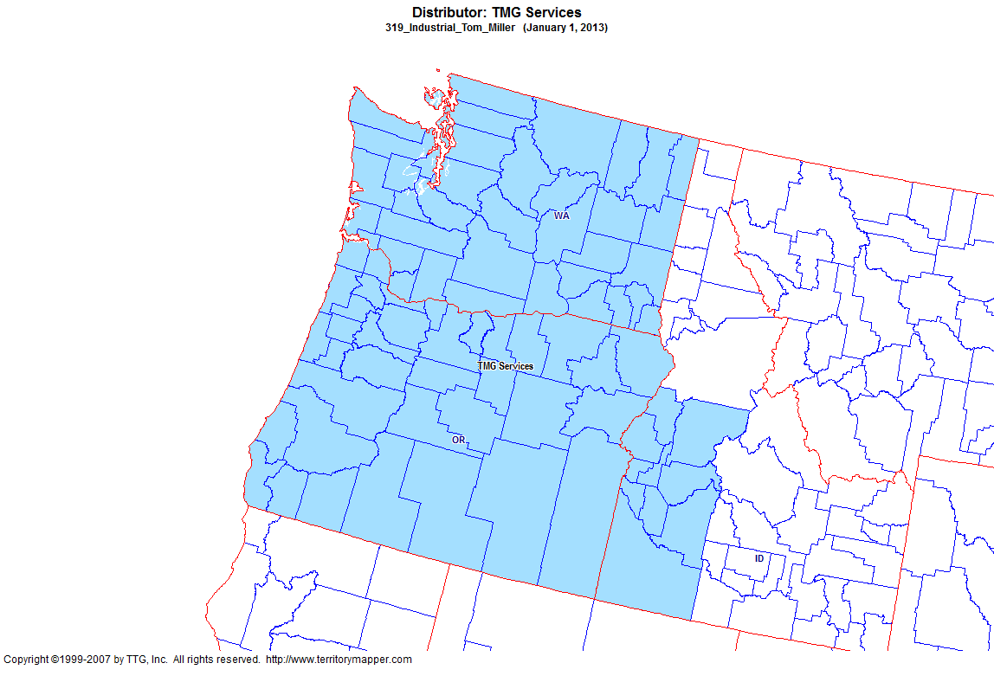
Back to Contents

Slide 41
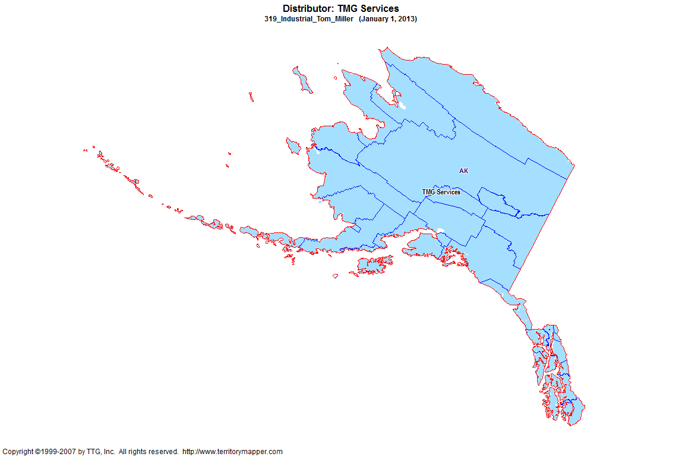
Back to Contents

Slide 42
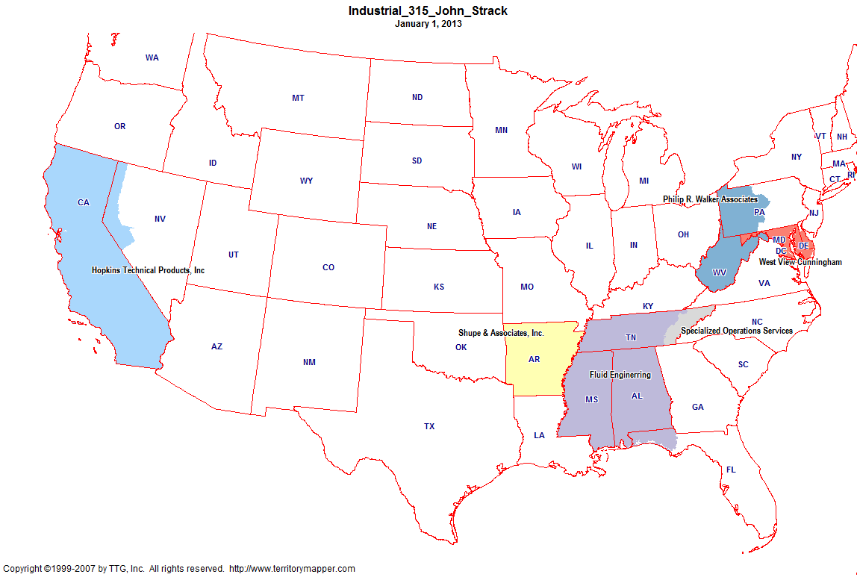
Back to Contents

Slide 43
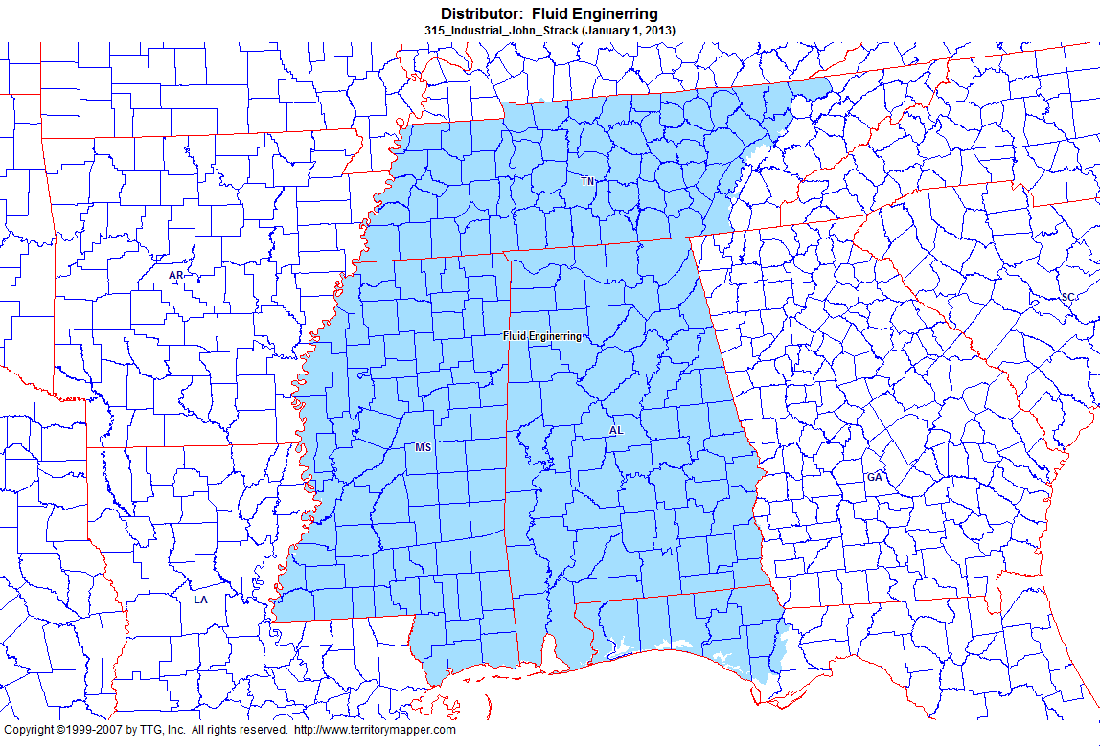
Back to Contents

Slide 44
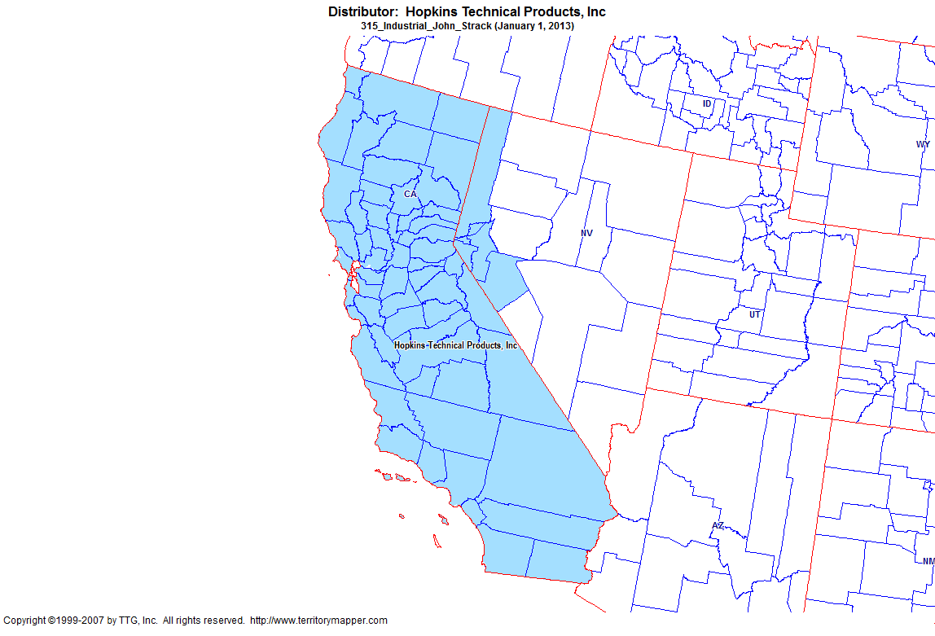
Back to Contents

Slide 45
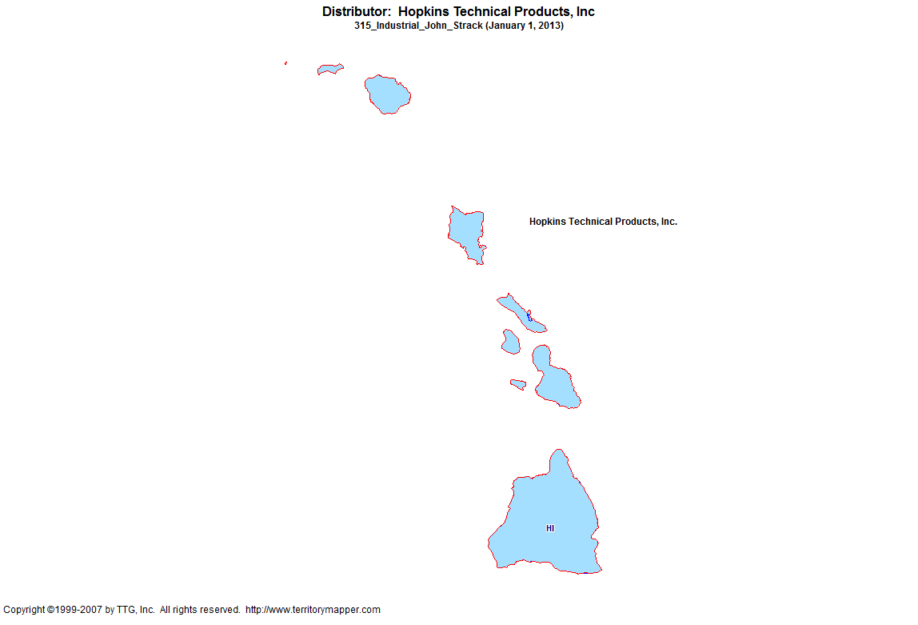
Back to Contents

Slide 46
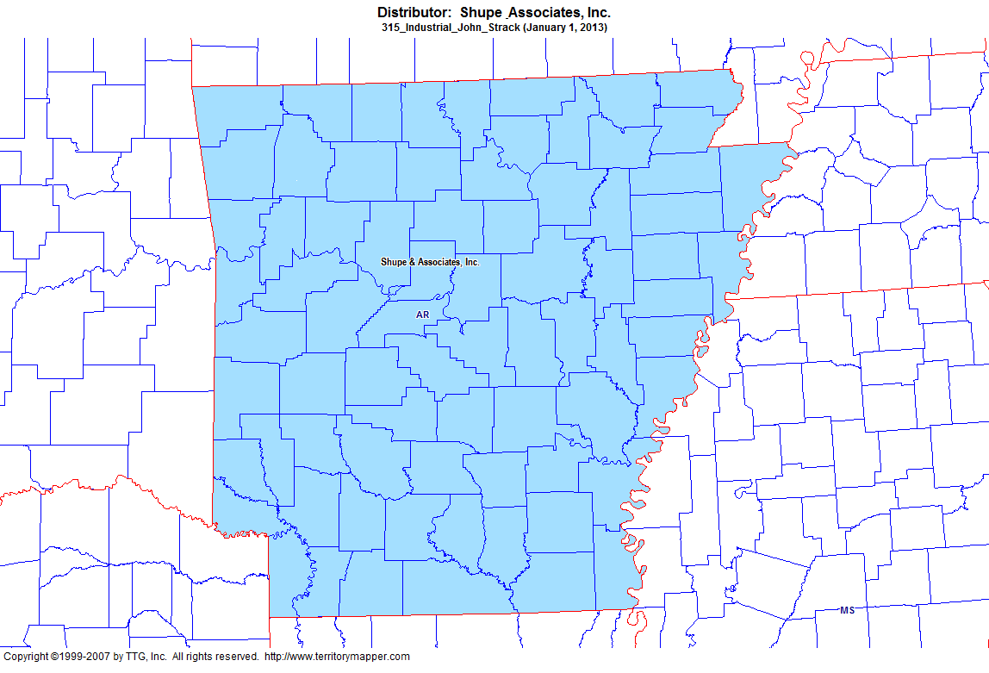
Back to Contents

Slide 47
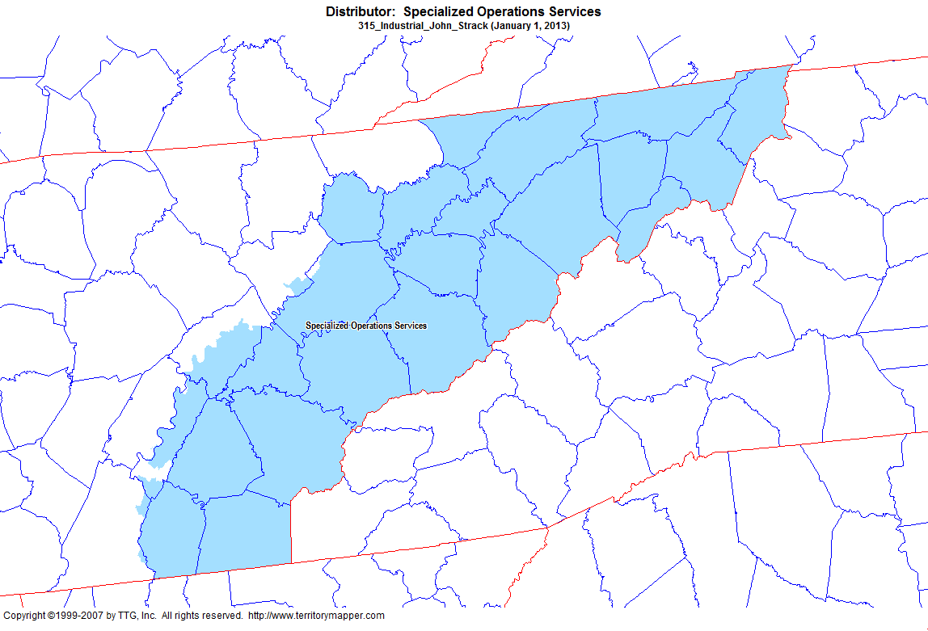
Back to Contents

Slide 48
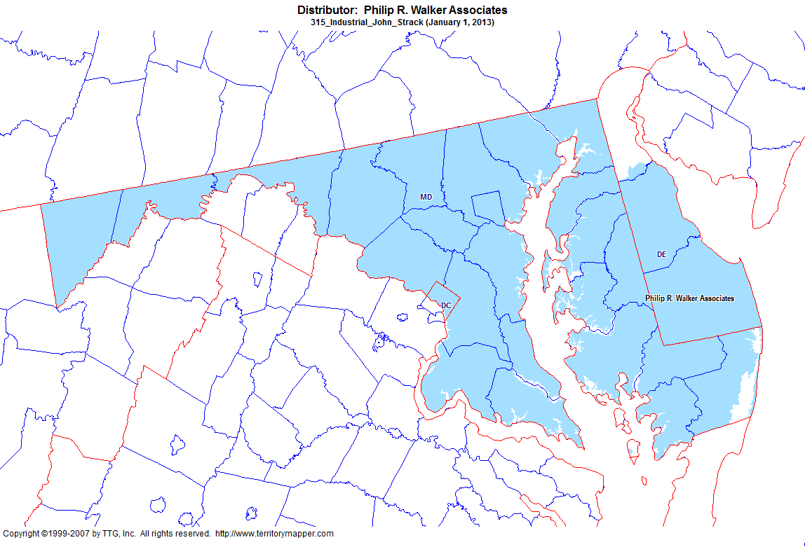
Back to Contents

Slide 49
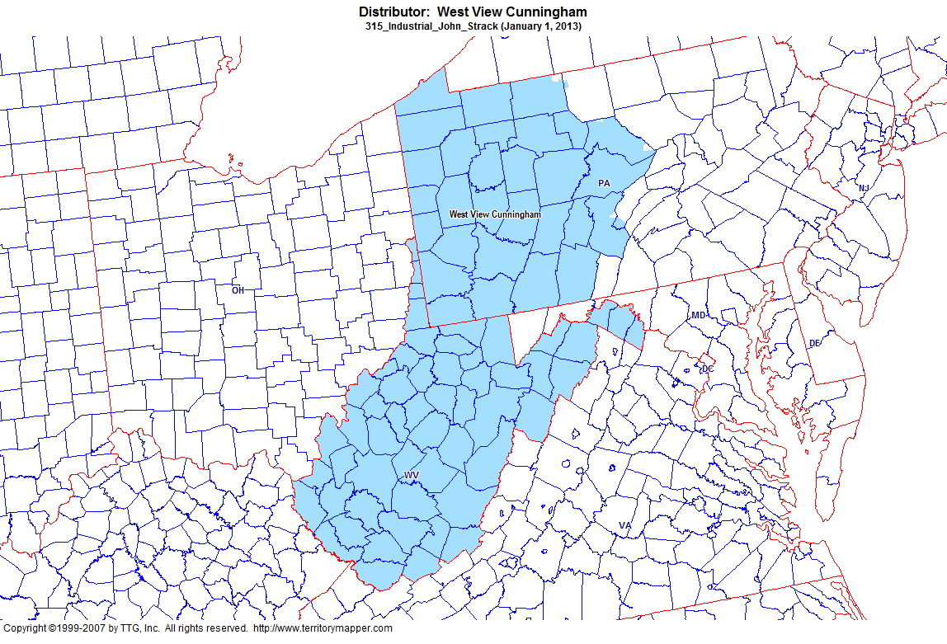
Back to Contents

