Slide 1
ProMinent Municipal
Territory Maps January 1, 2013

Slide 2
Municipal Distribution by Region
Region 302 Dan Helms
Region Map
Daman Superior LLC.
Drydon Equipment Inc.
Pumping Solutions, Inc.
G.P. Jager & Associates
Henry P. Thompson Company
LRM, Inc.
William/Reid LTD, LLC
Region 303 Tony Karalis
Region Map
AMJ Engineered Solutions LLC
Dave Heiner Associates
Heyward Incorporated NC/SC
Heyward Incorporated VA
Tomas Cuerda
Region 305 Greg Campbell
Region Map
McCarthy Integrated Systems, LLC
Macaulay Controls Company
Sendero South Company
Thornton, Musso & Bellemin
Region 308 Etienne Prehoda
Region Map
Able Wright, Inc.
Allwater L.L.C.
Hydro-Kinetics
Vessco, Inc.
Region 319 Tom Miller
Region Map
Atlantic Pump & Engineering Inc.
Buckeye Pumps Inc.
GPM Environmental
Mountain States Instruments
TMG Services
Wescor Associates
Region 315 John Strack
Region Map
Aqua Products Inc.
Bar Environmental Supply, Inc.
Hopkins Technical Products, Inc.
Shupe & Associates

Slide 3
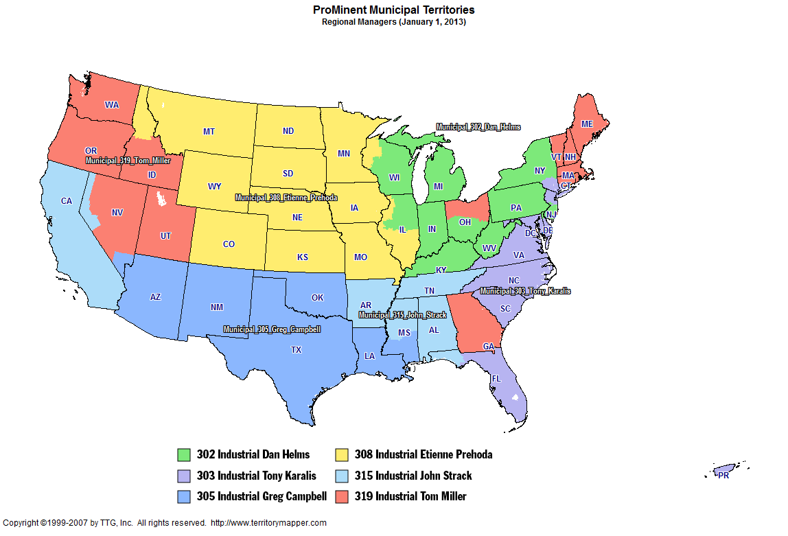
Back to Contents

Slide 4
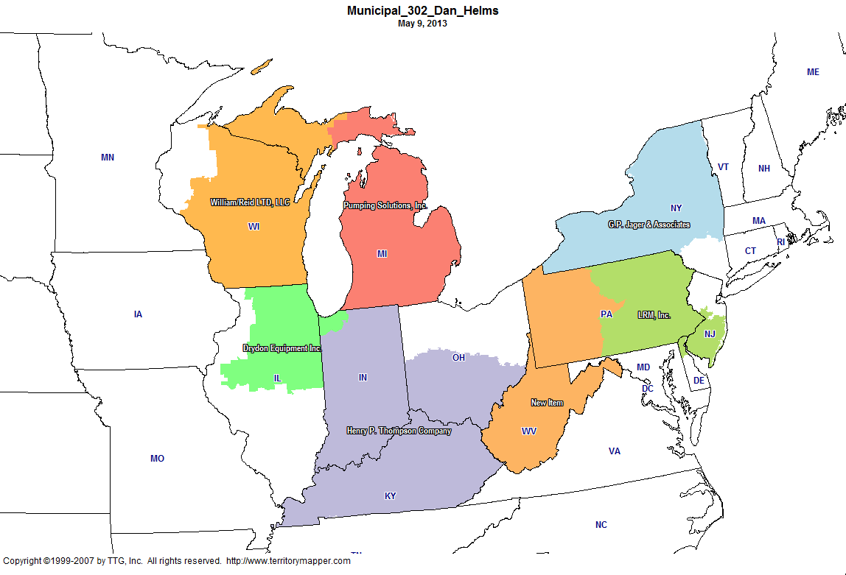
Back to Contents

Slide 5
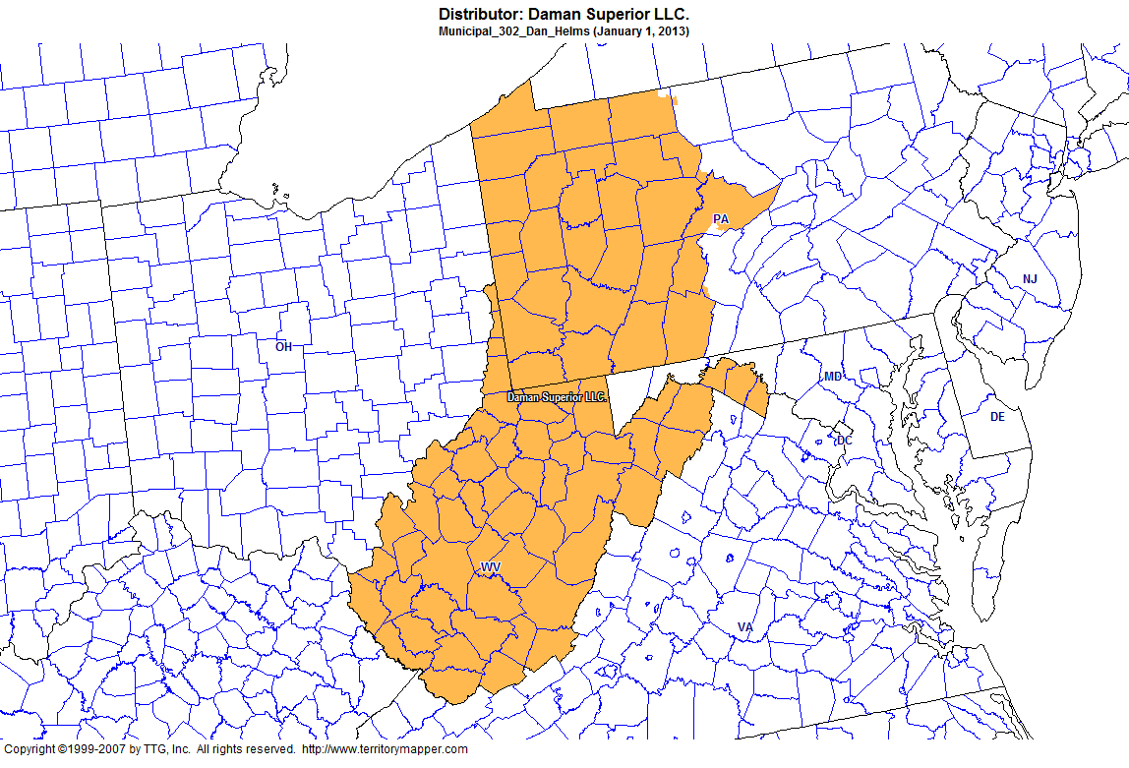
Back to Contents

Slide 6
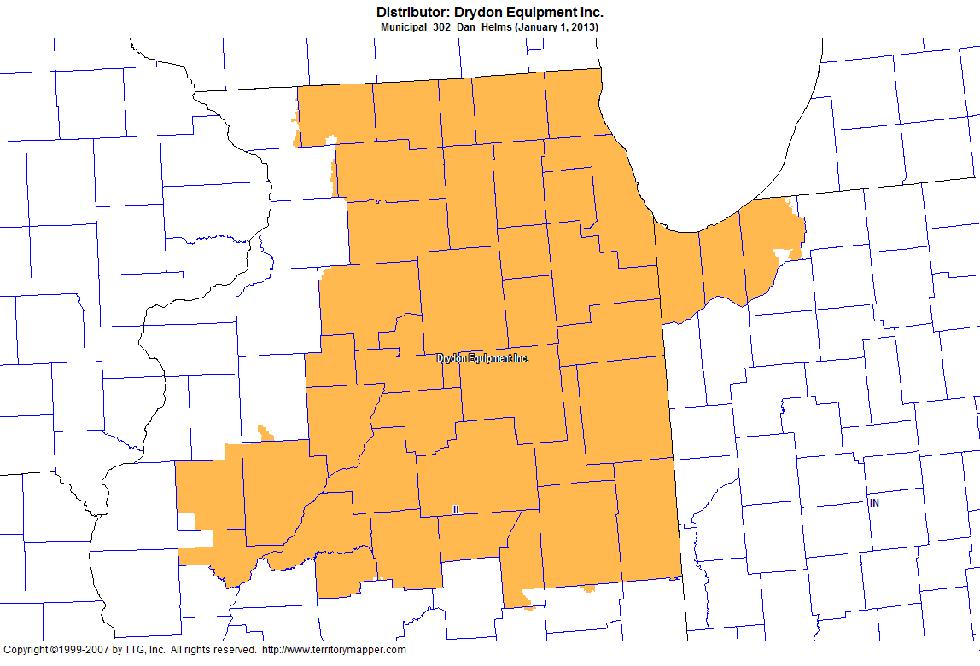
Back to Contents

Slide 7
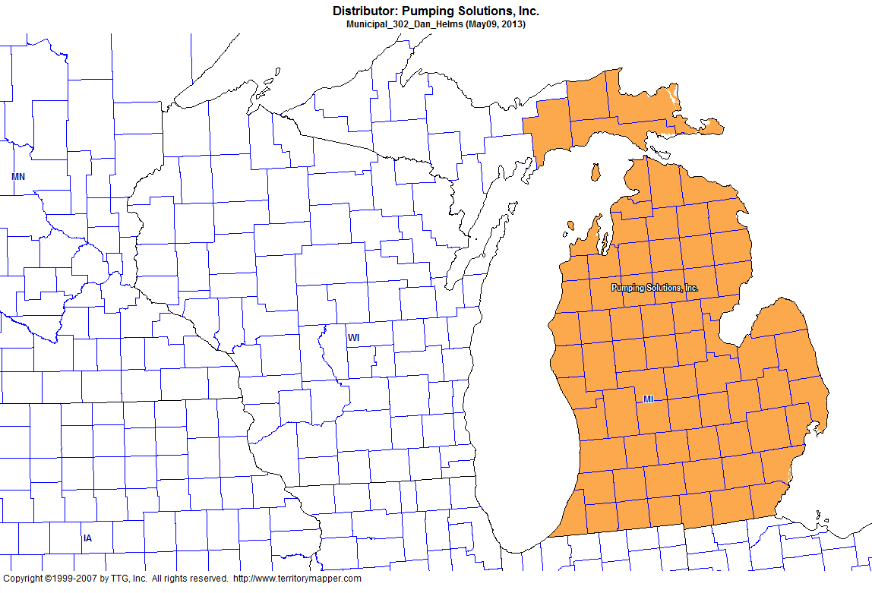
Back to Contents

Slide 8
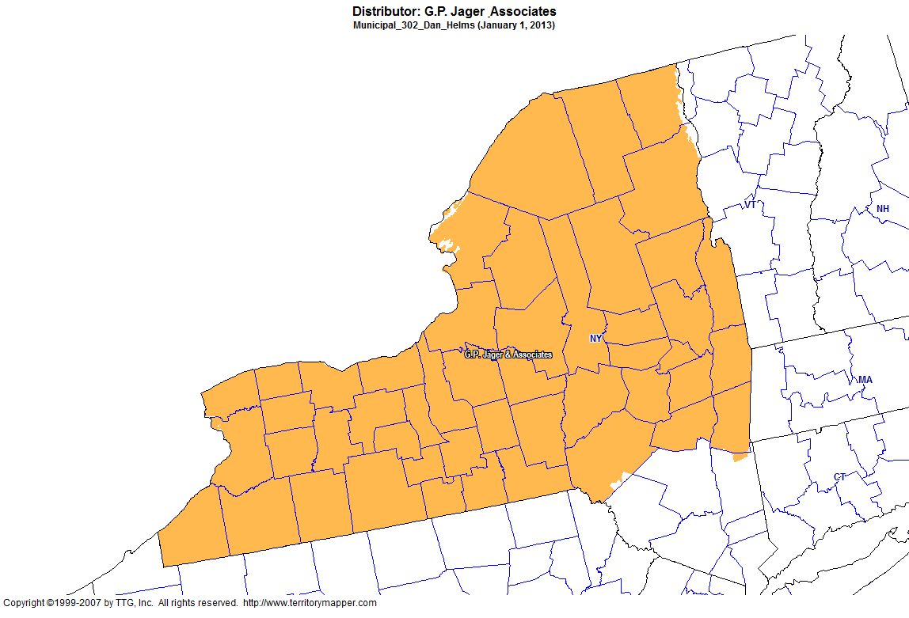
Back to Contents

Slide 9
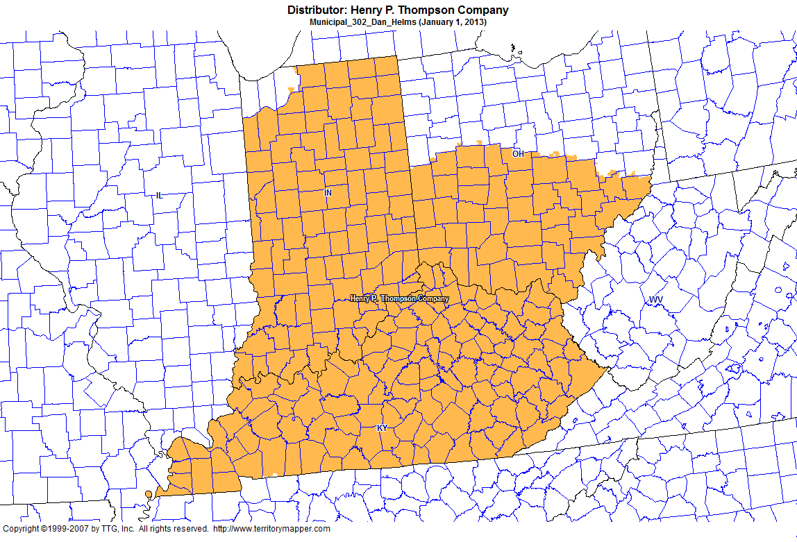
Back to Contents

Slide 10
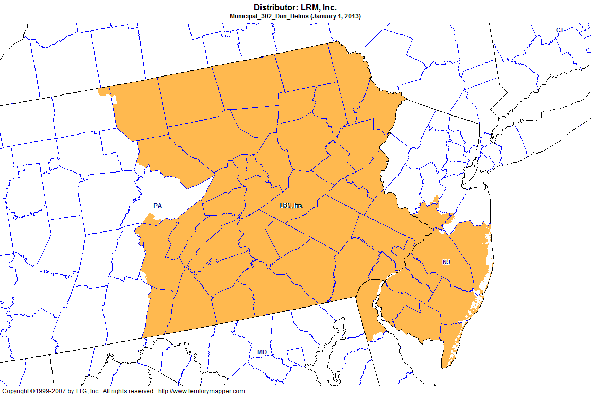
Back to Contents

Slide 11
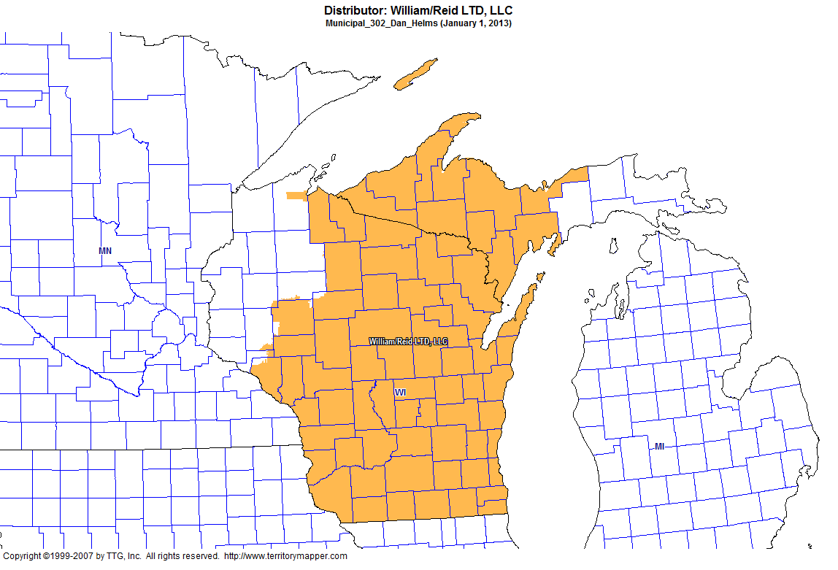
Back to Contents

Slide 12
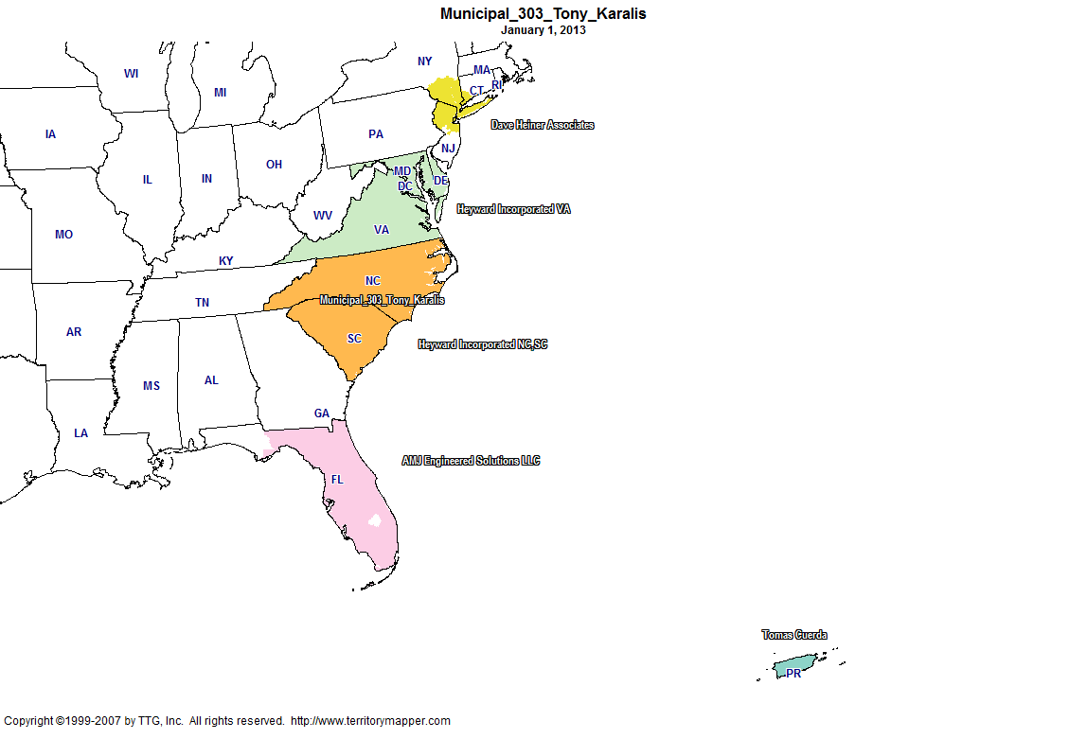
Back to Contents

Slide 13
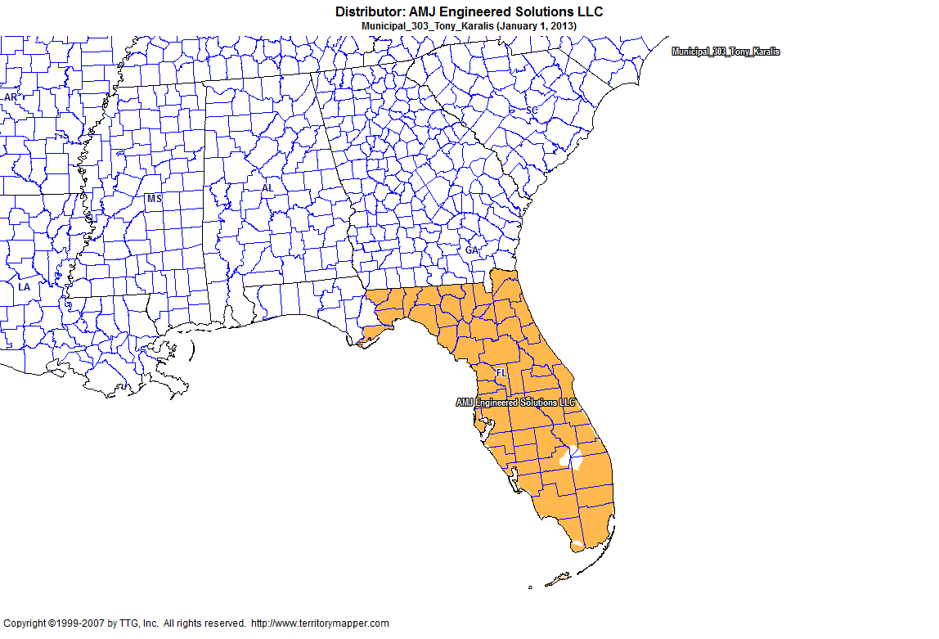
Back to Contents

Slide 14
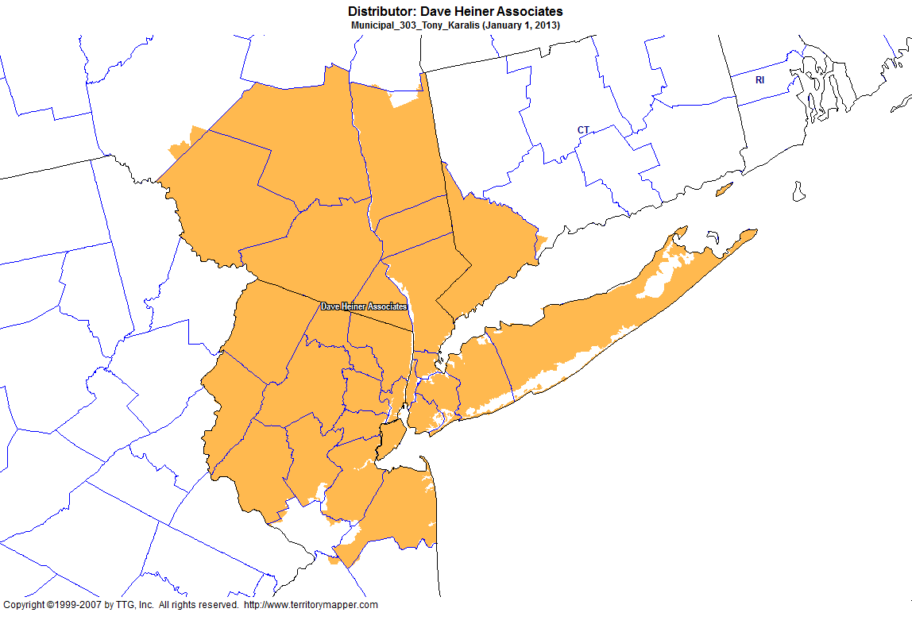
Back to Contents

Slide 15
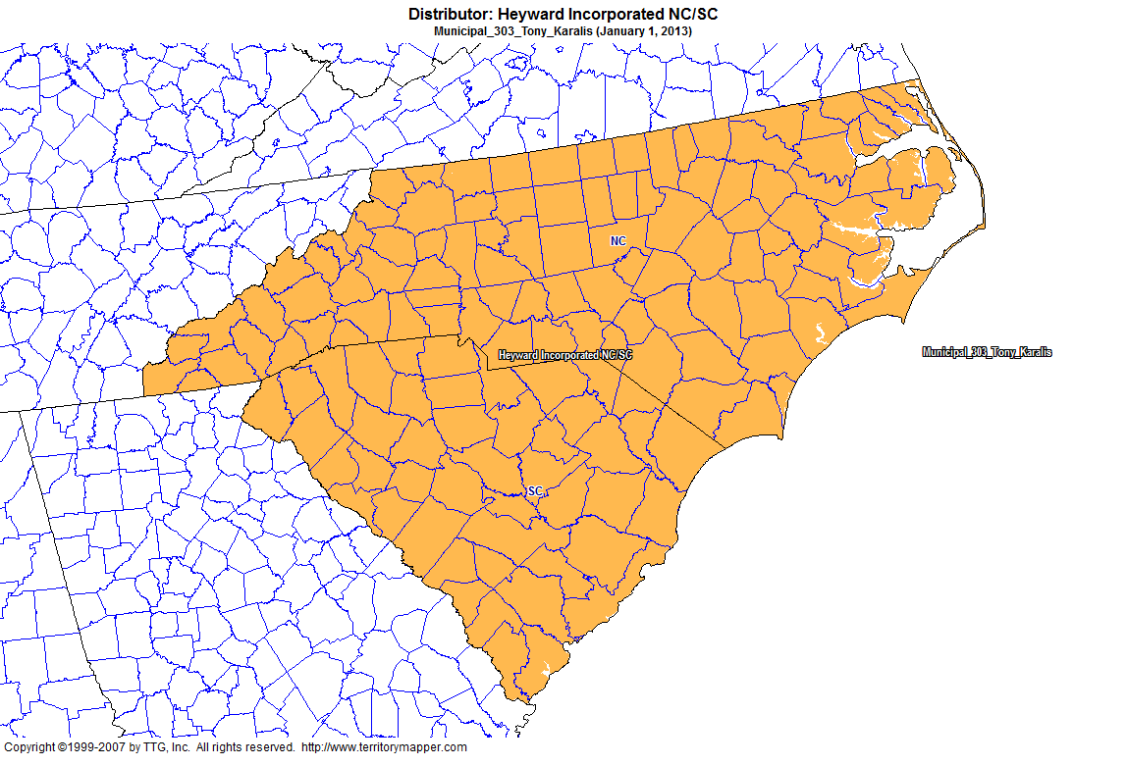
Back to Contents

Slide 16
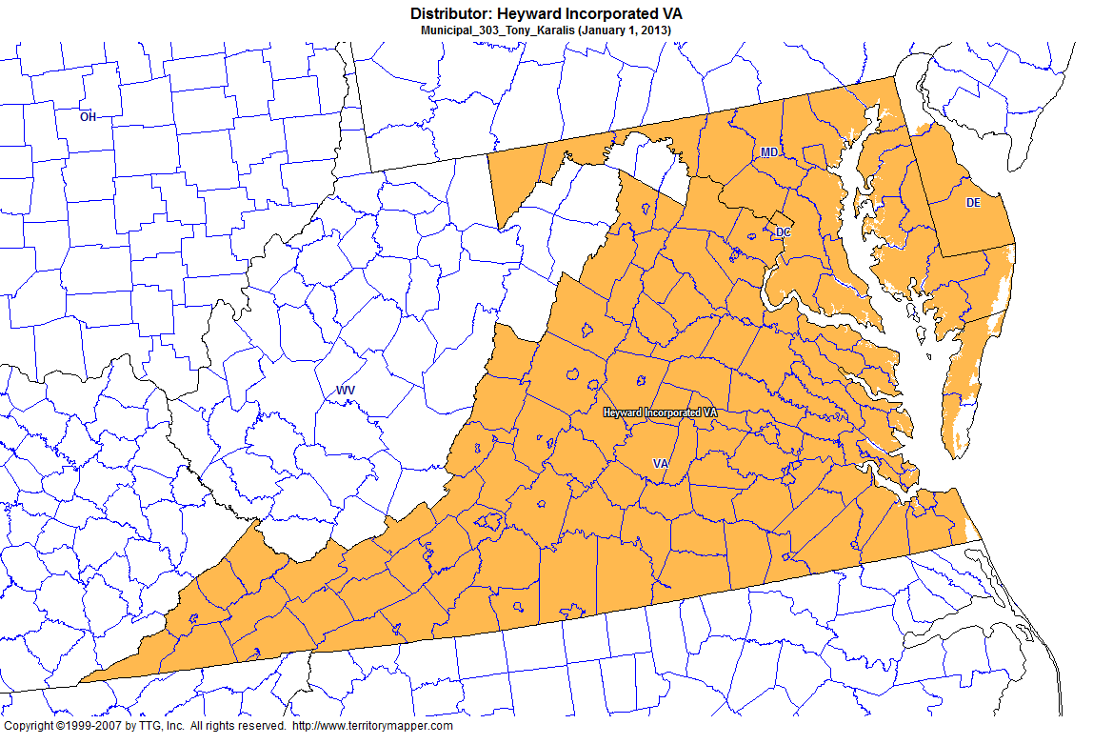
Back to Contents

Slide 17
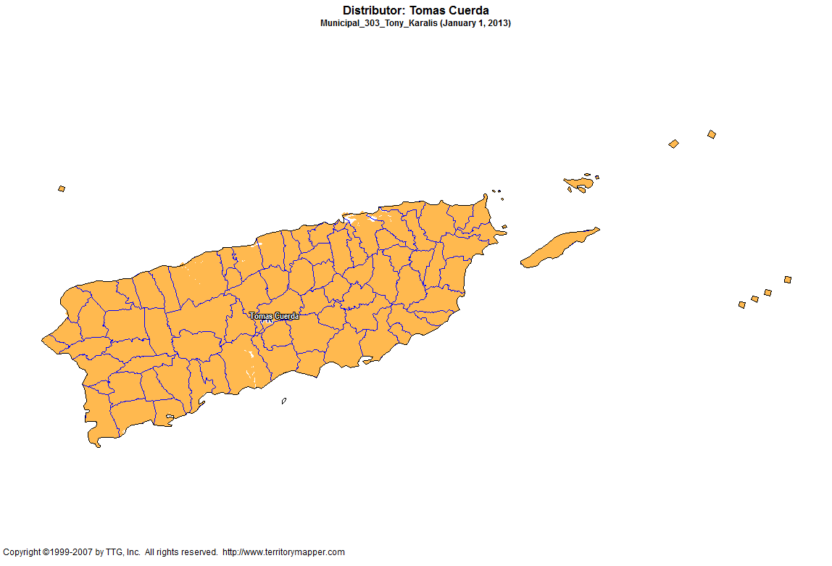
Back to Contents

Slide 18
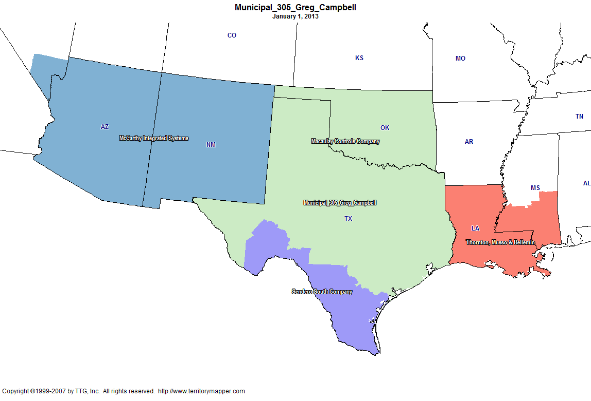
Back to Contents

Slide 19
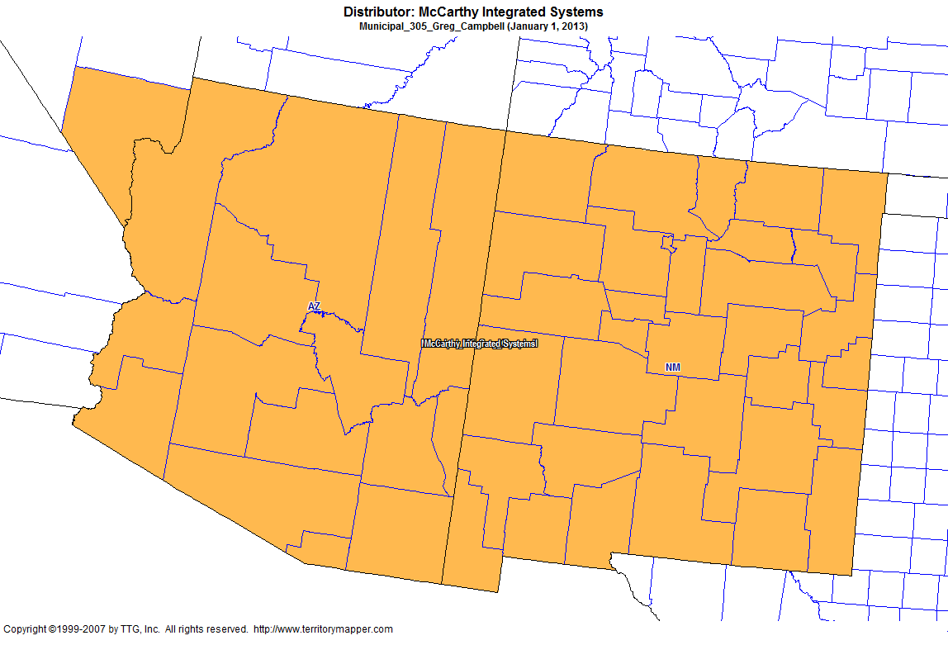
Back to Contents

Slide 20
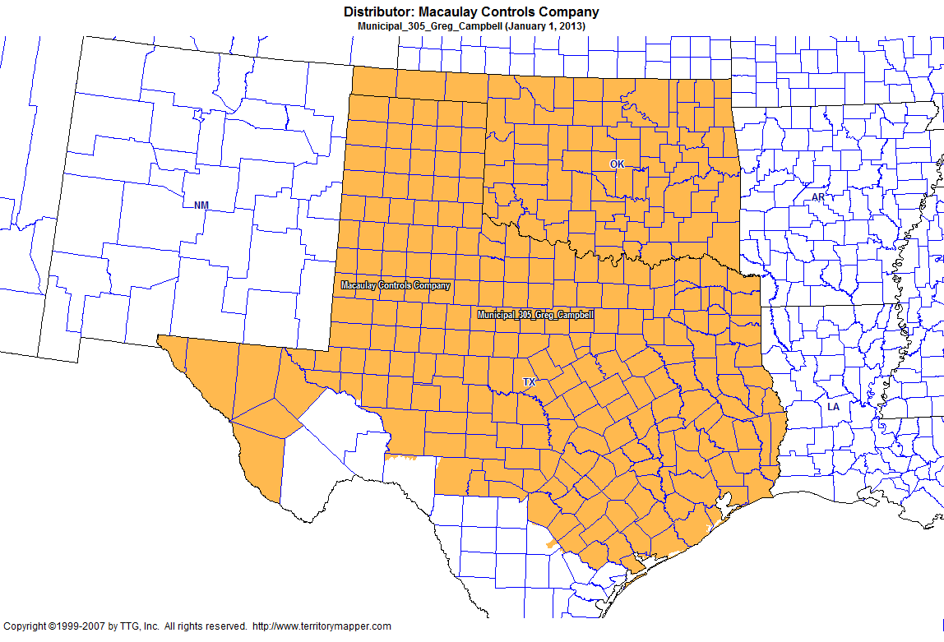
Back to Contents

Slide 21
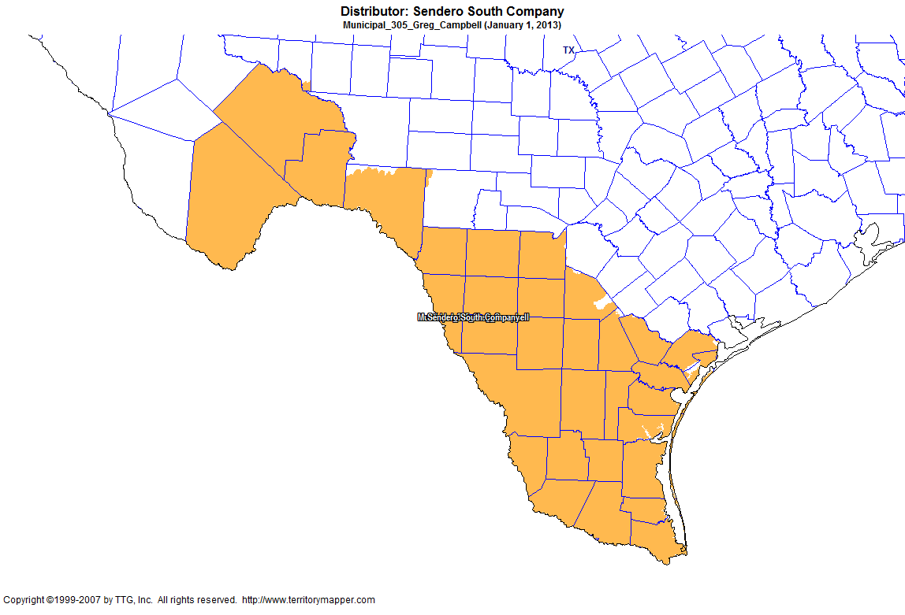
Back to Contents

Slide 22
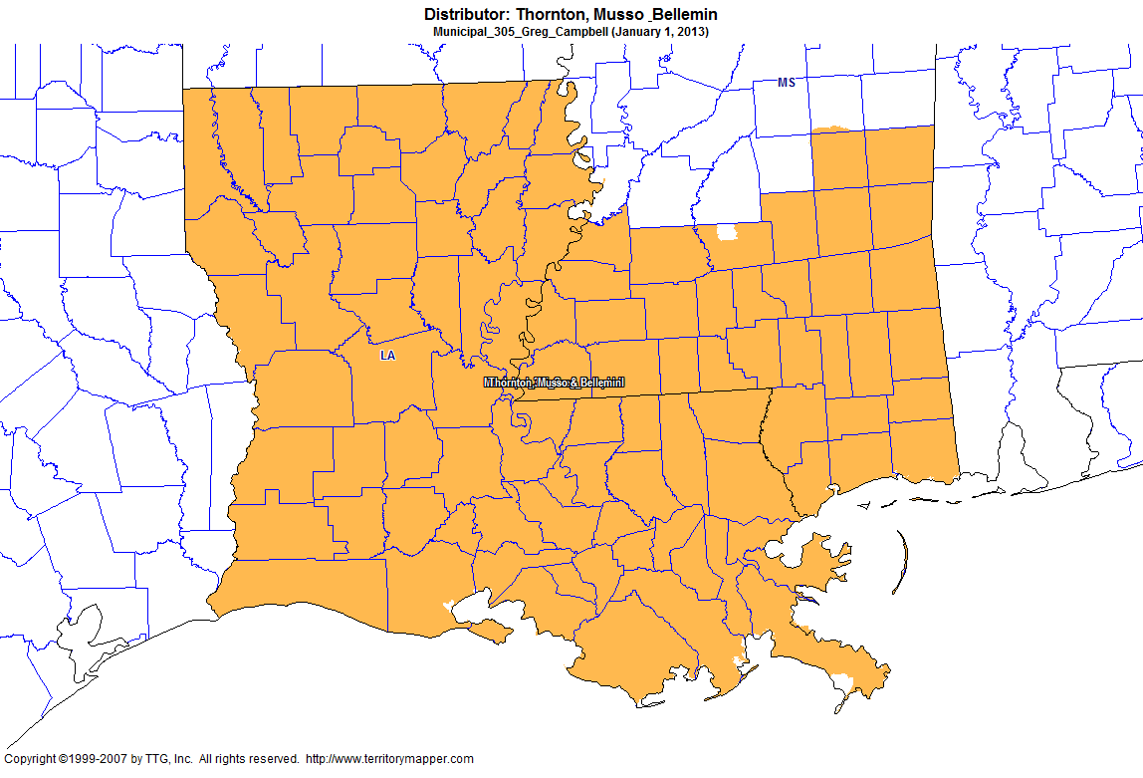
Back to Contents

Slide 23
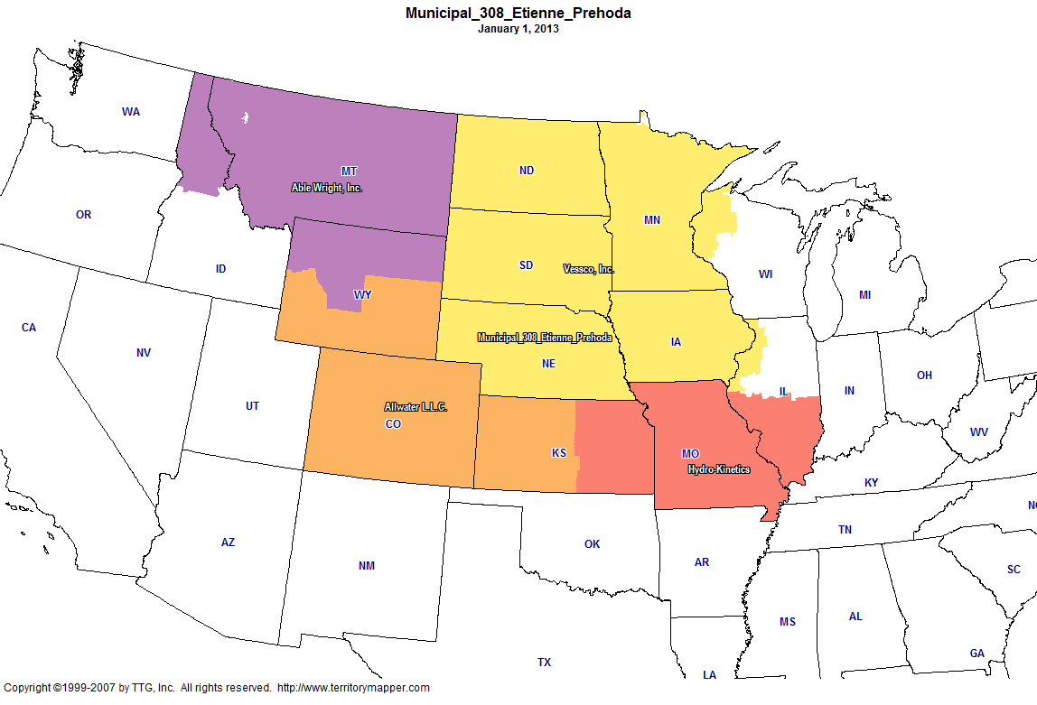
Back to Contents

Slide 24
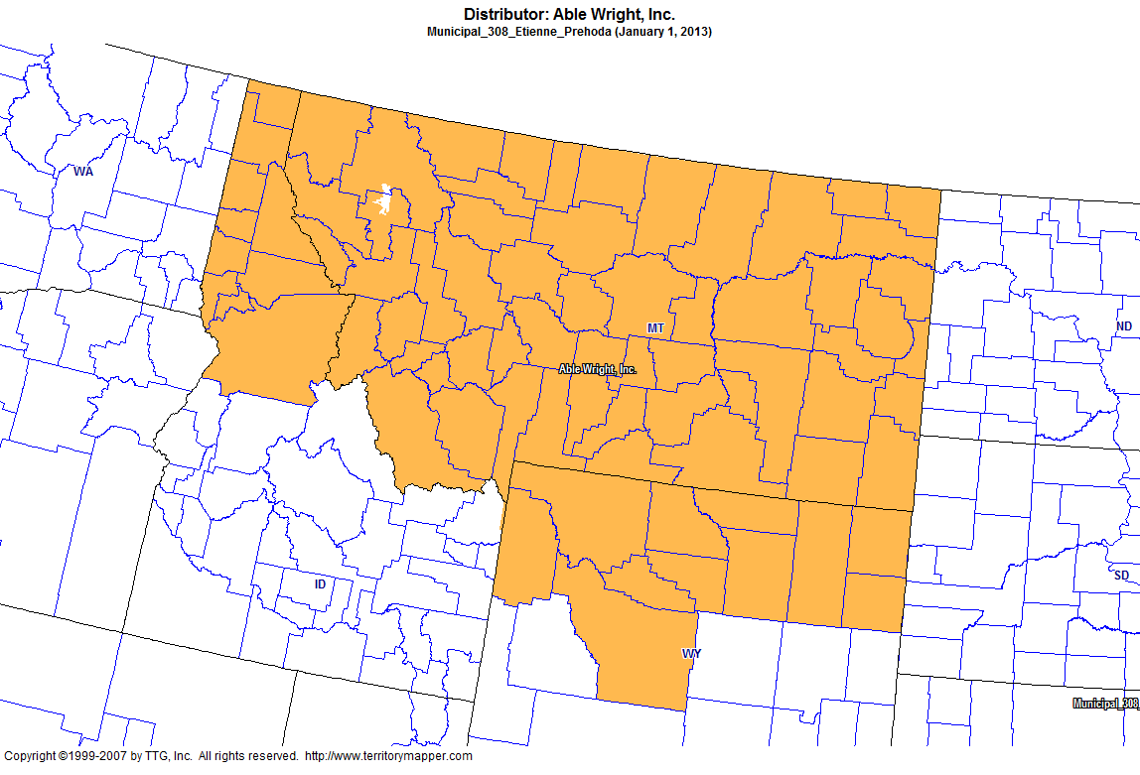
Back to Contents

Slide 25
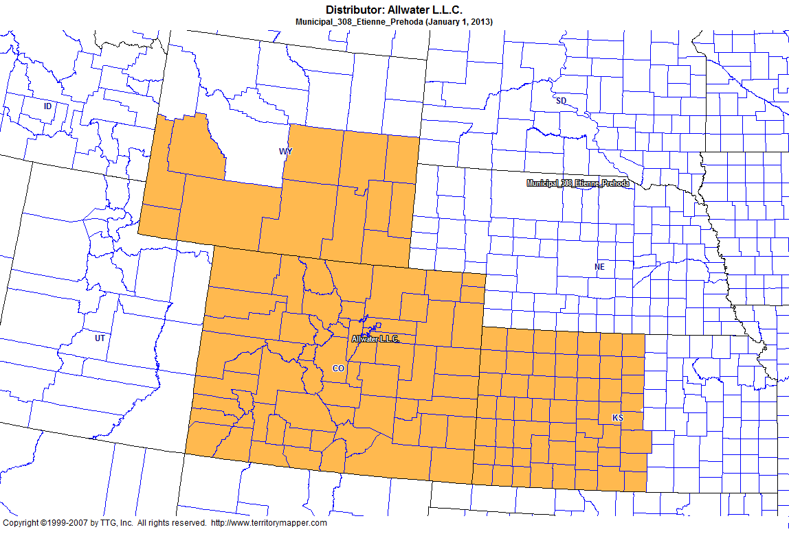
Back to Contents

Slide 26
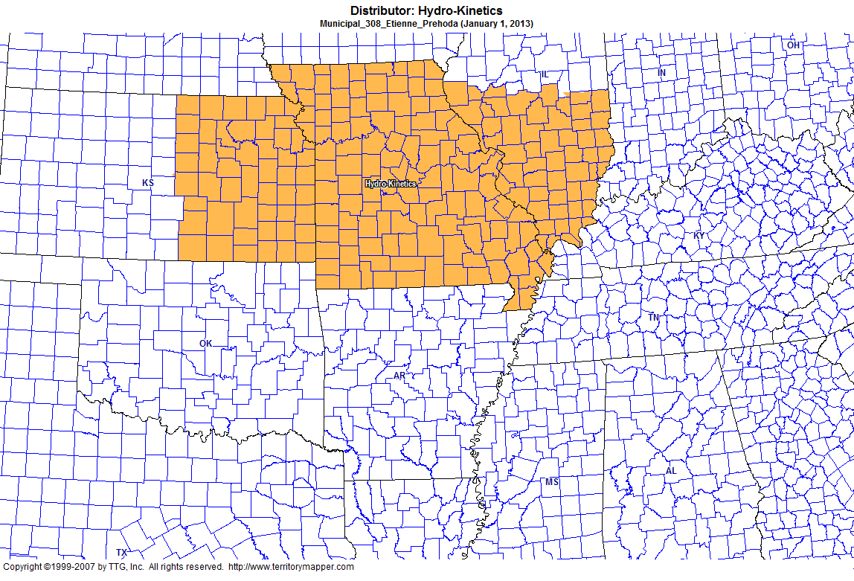
Back to Contents

Slide 27
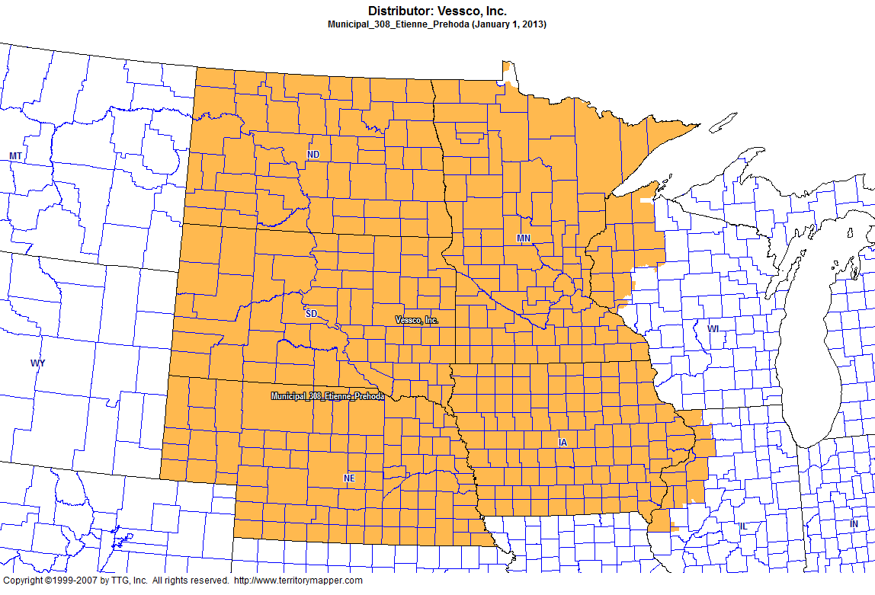
Back to Contents

Slide 28
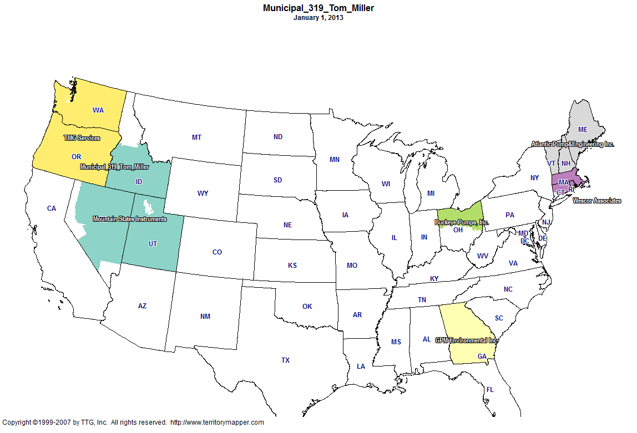
Back to Contents

Slide 29
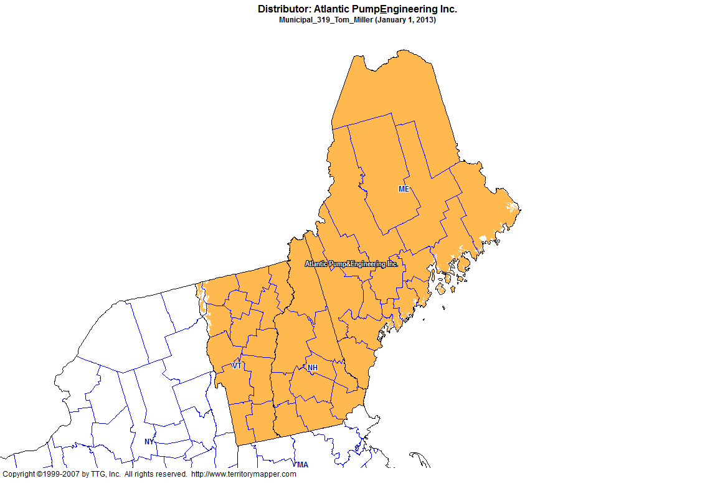
Back to Contents

Slide 30
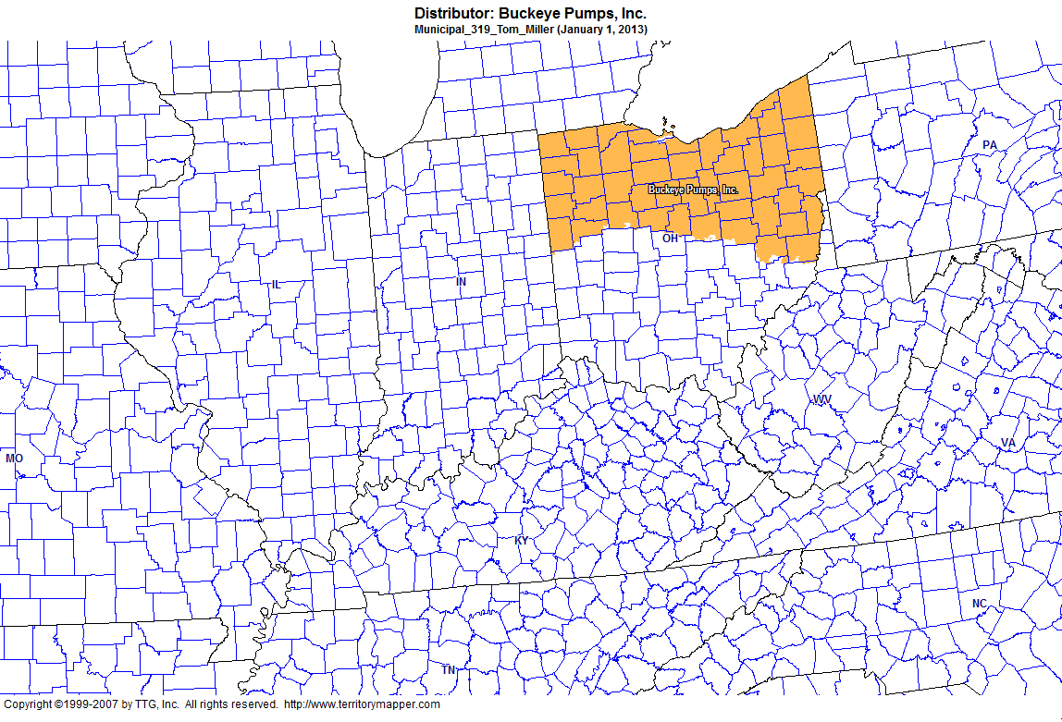
Back to Contents

Slide 31
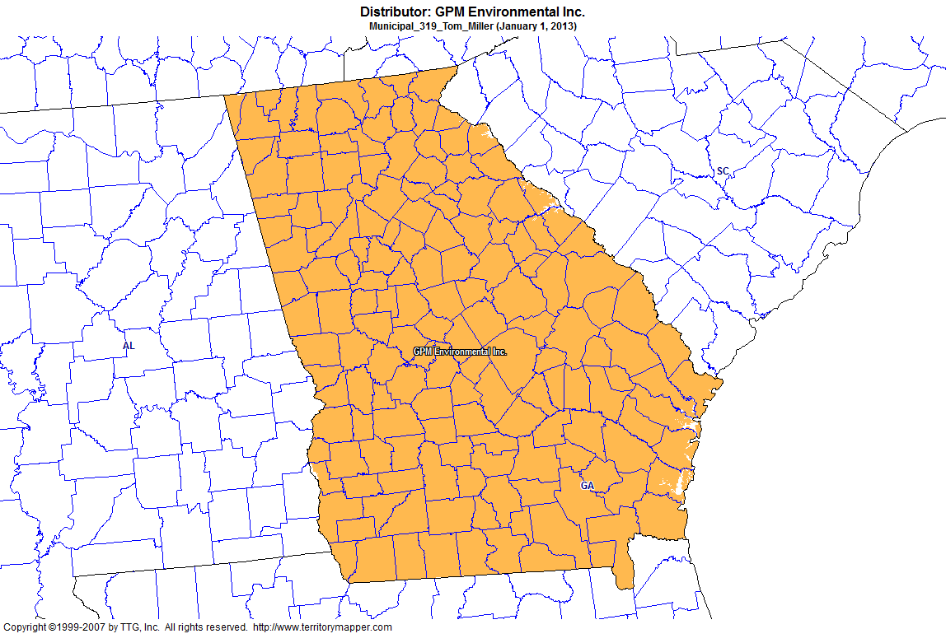
Back to Contents

Slide 32
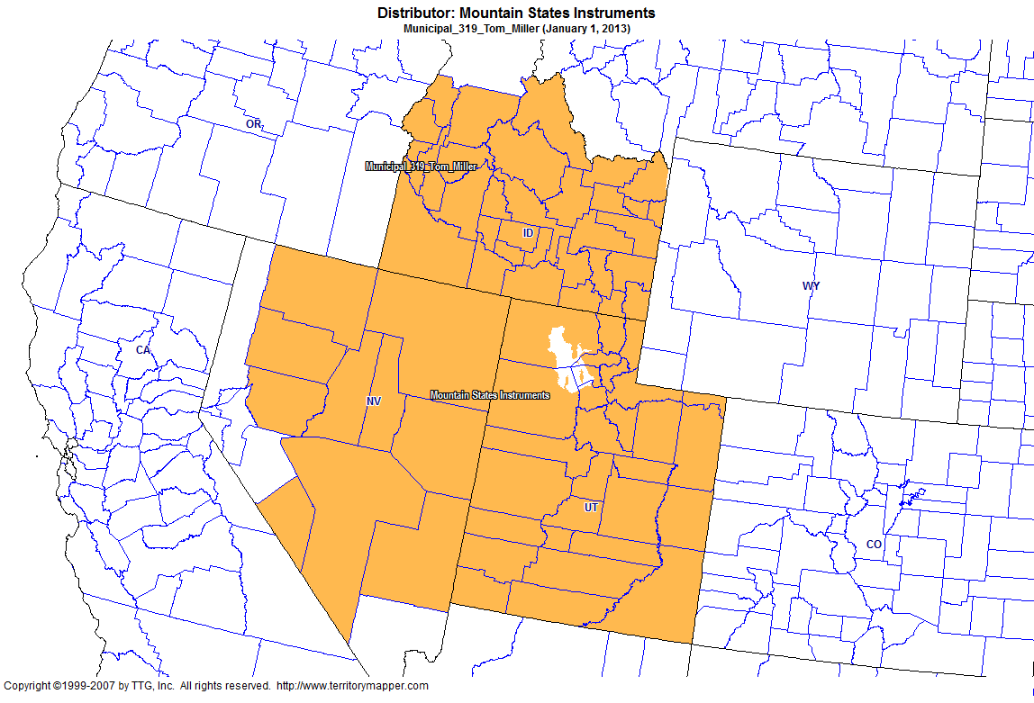
Back to Contents

Slide 33
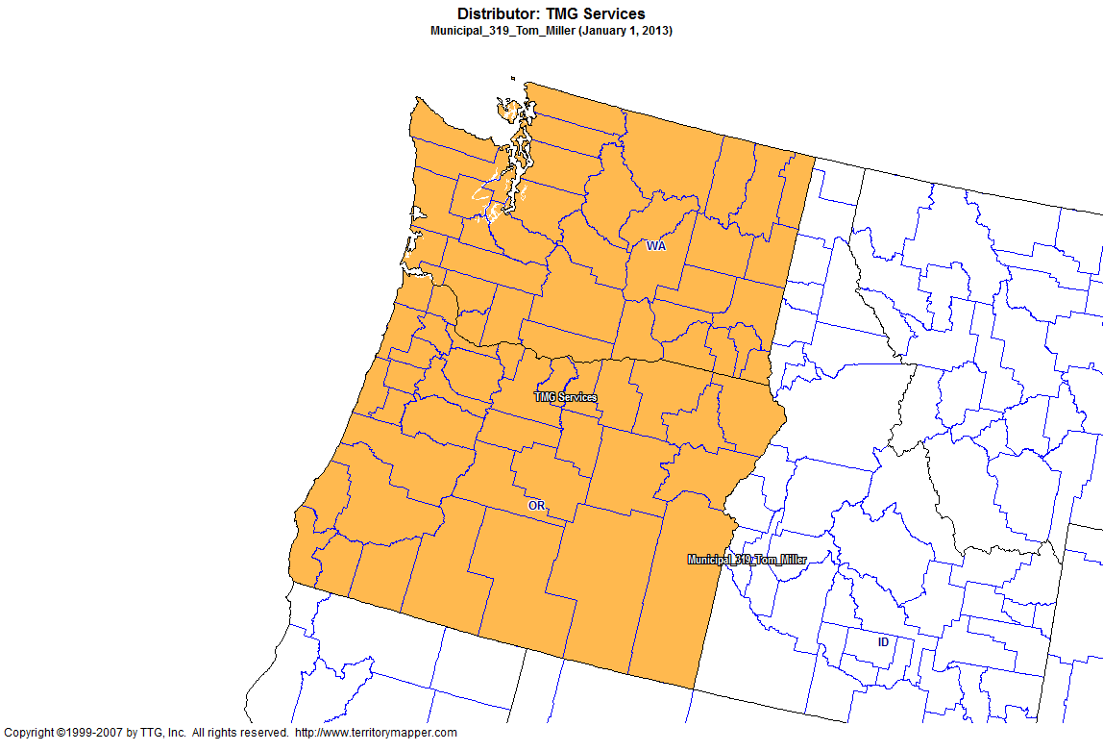
Back to Contents

Slide 34
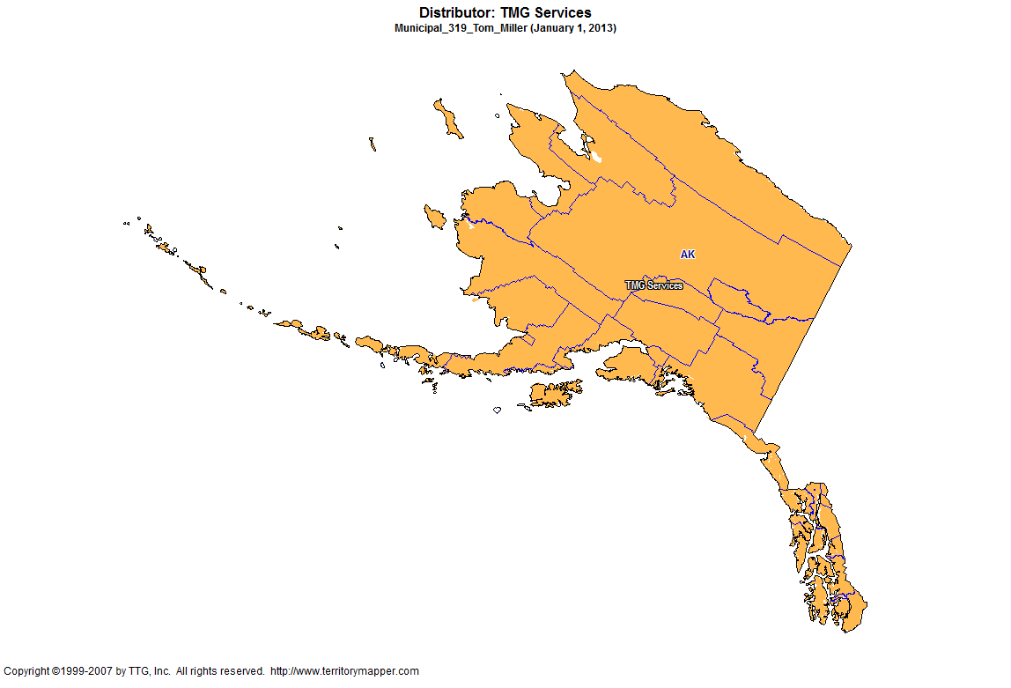
Back to Contents

Slide 35
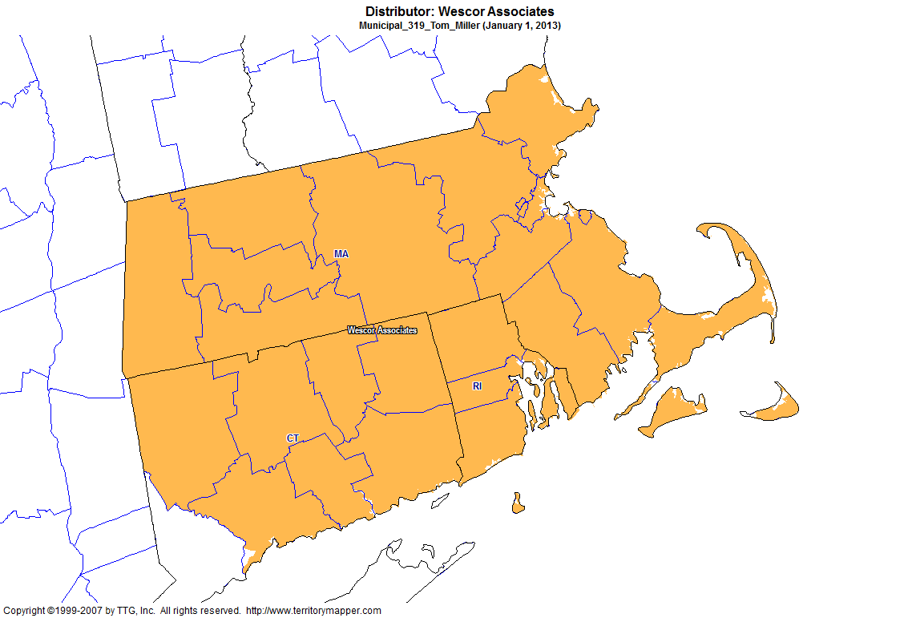
Back to Contents

Slide 36
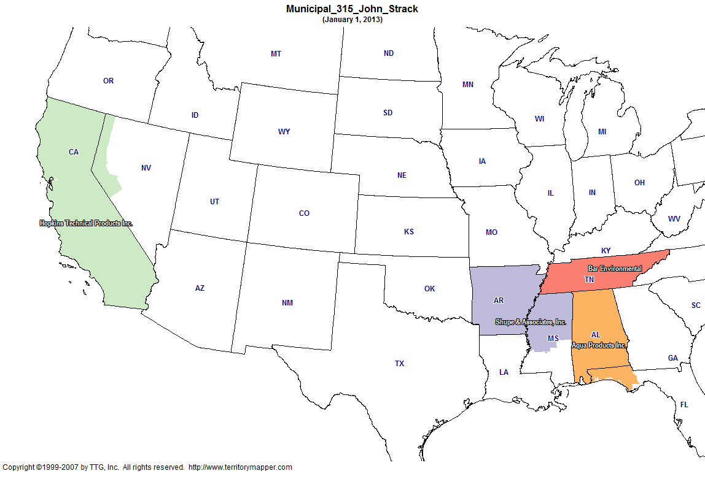
Back to Contents

Slide 37
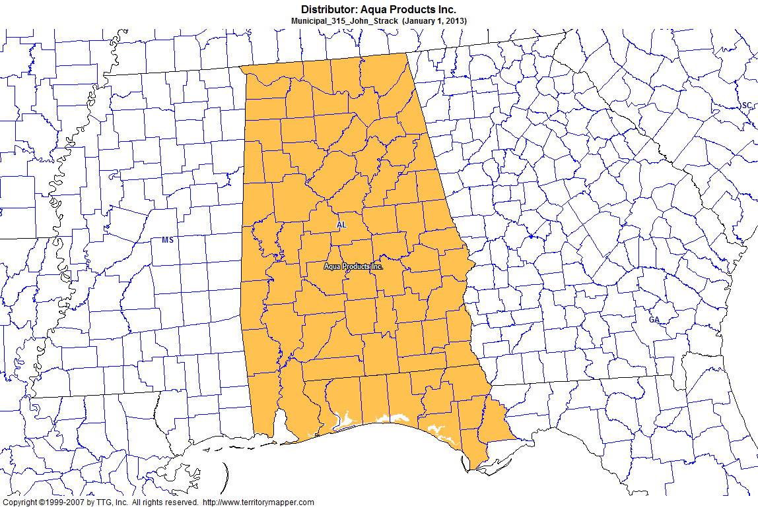
Back to Contents

Slide 38
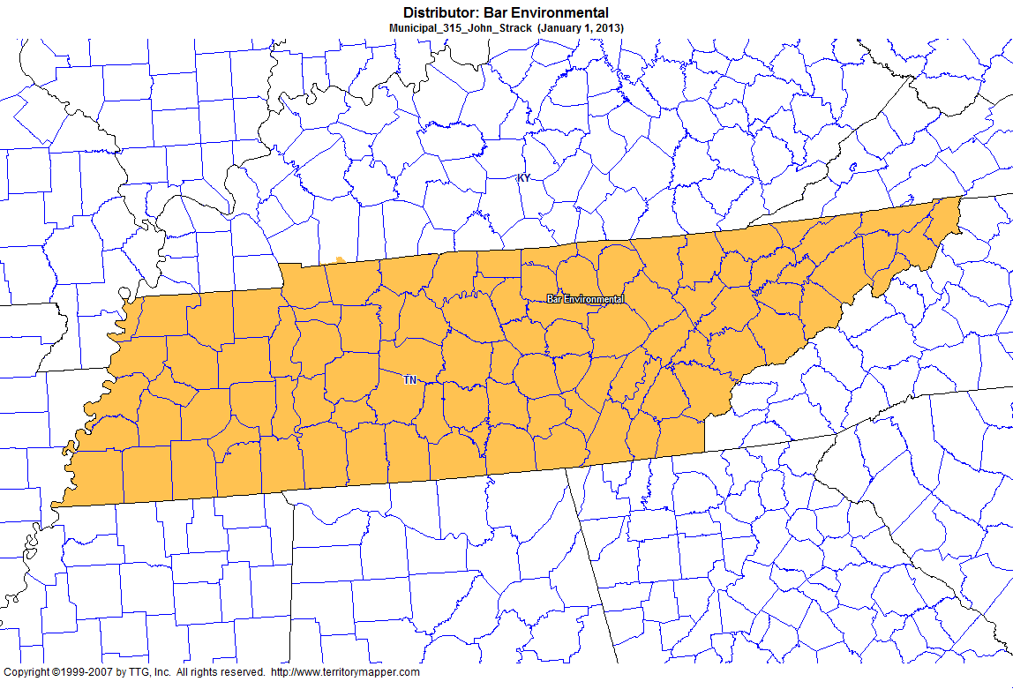
Back to Contents

Slide 39
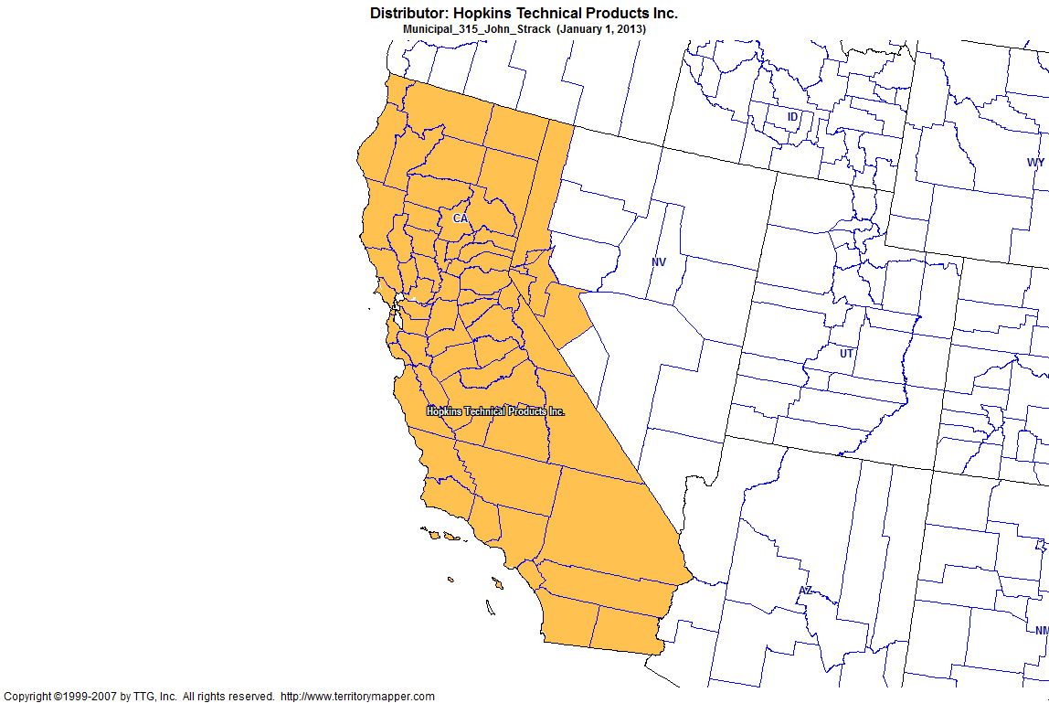
Back to Contents

Slide 40
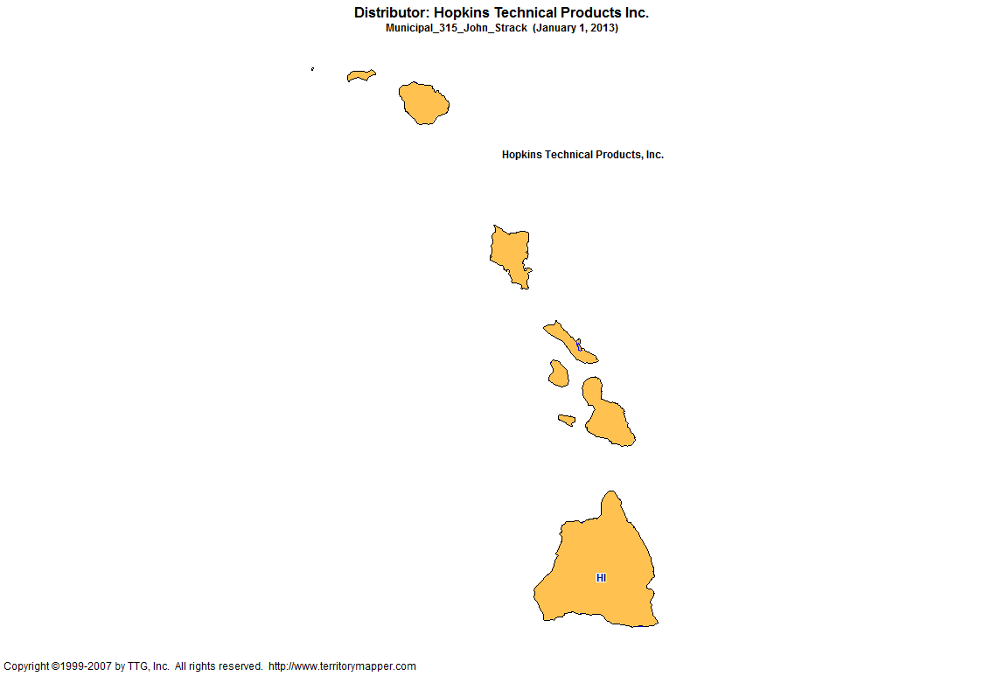
Back to Contents

Slide 41
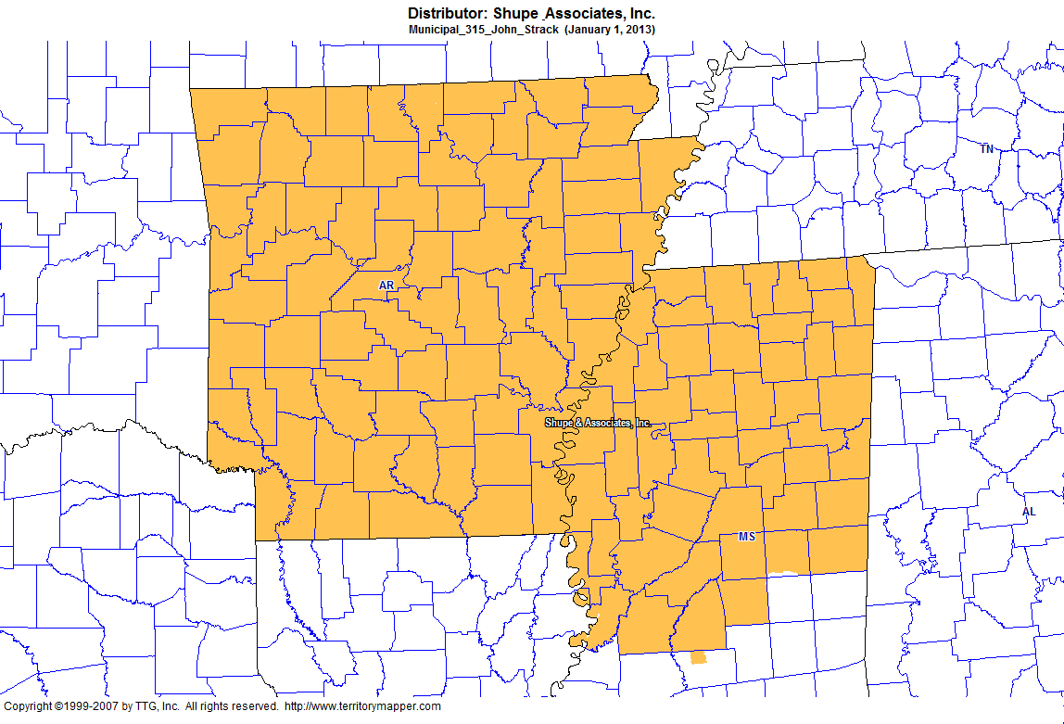
Back to Contents

