Slide 1
28 February 2018, Ulrich Markmann
CHLORINSITU® IIa

Slide 2
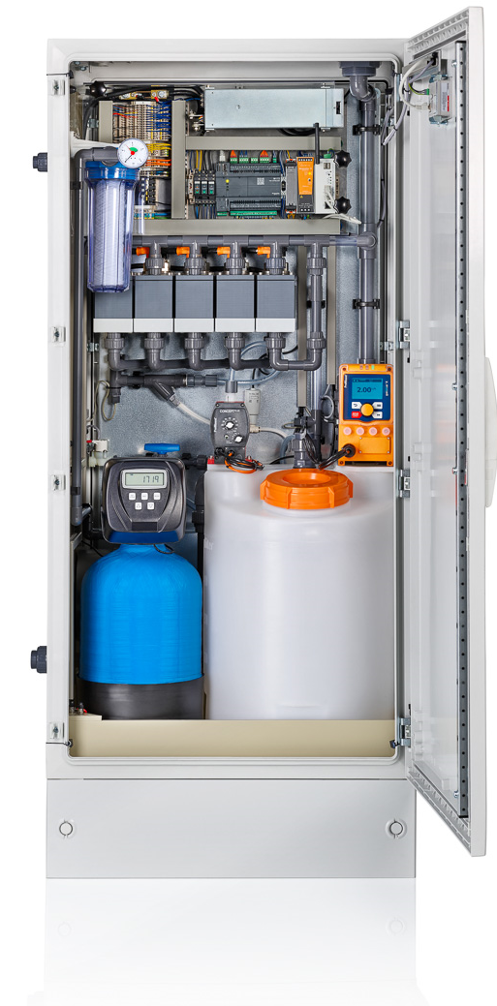
Presentation Content
Description
Product Positioning
USPs
Functions
Specifications
Maintenance
Chlorinsitu® IIa

Slide 3
Description new Chlorinsitu® IIa
The new Chlorinsitu® IIa combines well tried and robust technology with innovative compact design.
Except for the brine tank, all components could be integrated into one compact, space saving cabinet. The elaborate hydrogen discharge system allows an installation without additional requirements for a room ventilation (no ATEX requirements).
With the Plug & Play concept the system is ready for operation in no time and enables even untrained personnel to safely run the production.
The unit will automatically produce a sodium hypochlorite solution into the integrated storage tank. From this tank it can be drawn via the externally controlled chlorine pump and applied to the process.
The system will automatically start production and refill the product tank whenever it falls below a certain level.
The chlorate content of the product is well below the legal limits defined in EN 901.

Slide 4
Chlorinsitu® IIa 60 g/h – 300 g/h
New range of open cell electrolysis
Replaces Chlorinsitu® II
Development started 06/2016
Launch 03/2018
Unique selling points (USPs)
Low investment electrolysis
Plug & Play concept
Simple controller with colour touch panel
> 9 g/l FAC
Low Salt Consumption ~3.0 kg/kg FAC
Low Energy Consumption ~ 4.0 kWh/kg FAC
Safe Integrated hydrogen discharge without ATEX requirements

Slide 5
Product positioning CHLORINSITU® IIa
Type | Cell | Disinfectant | Capacity (g/h) | Main Applications
Chlorinsitu® II | Open-Cell | Hypochlorite (Bleach) 5 g/l | 400 – 2.400 | Low-end pools Potable water
Chlorinsitu® IIa | Open-Cell | Hypochlorite (Bleach) 9 g/l | 60 – 300 | Potable water Swimming pools
Chlorinsitu® III | Membrane | Hypochlorite (Bleach) 20-25 g/l | 50 – 10.000 | High-end pools Potable water Waste water Cooling water
Chlorinsitu® III Compact | Membrane | Hypochlorite (Bleach) 25 g/l | 25 and 50 | Small pools Potable water
Chlorinsitu® IV Compact | Membrane | Cl₂ gas Caustic | 25 and 50 | Small pools Potable water
Chlorinsitu® V | Membrane | Cl₂ gas Caustic | 25 – 3.700 | High-end pools Potable water Waste water
Chlorinsitu® V PLUS | Membrane | Cl₂ gas Caustic Bleach 5-25 g/l (Plus) | 25 – 3.700 | High-end pools Potable water Waste water
DULCO®Lyse | Membrane | Hypochlorous acid 400ppm pH 6.5 | 100 - 300 | F&B industry CIP Inlet water treatment

Slide 6
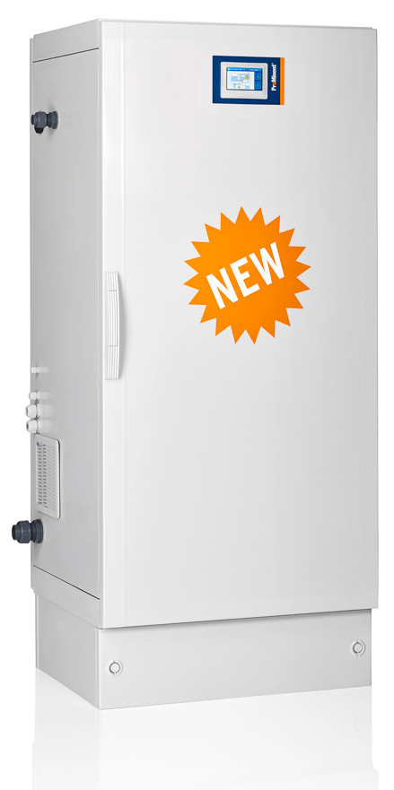
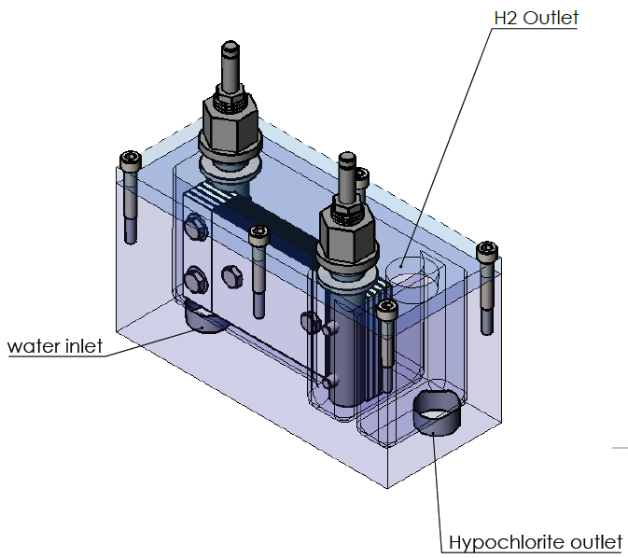
Unique Selling Points Chlorinsitu® IIa
Easy operation
Fully automatic operation
Only topping up of salt
Colour touch HMI with clean menu structure
Cabinet Plug & Play concept
Quick and easy installation; no extensive labour time and costs
No ATEX problems
No room ventilation required for safe operation
Internal 50 litre chlorine product tank
Internal chlorine dosing pump (optional)
Level control for optional external chlorine product tank integrated
Water softener integrated
State of the art quality chlorine
High chlorine concentration FAC 9 g/l (old Chlorinsitu II – 5 g/l)
Low chlorate, less than 4% of FAC
Low chloride in product due to high salt efficiency

Slide 7
USPs Chlorinsitu® IIa
Low consumptions
Only 3,0 kg salt per kg chlorine
Only 4,0 kWh/kg; high current efficiency (69%; 15% better than OSEC-L)
New and unique cell configuration
Newly developed cell housing with optimized hydraulics
Compact design with small footprint
Benchmark yield and efficiency
Safety
Hydrogen is separated from the product and actively evacuated
No danger of hydrogen inside the plant room
Less components and no pressurized parts leave less chance for leakage
Automatic process control via sensors
Drip pan with leakage detection
Remote access (optional)
Remote Monitoring Software (remote engineer) for mobile devices and PC

Slide 8
Components Chlorinsitu® IIa
Inlet Water Manometer
Inlet Water Filter
Primary Degassing Piping
Electrolysis Cells
Brine dilution with softened water
Inlet Temperature Sensor
Brine Pump
Solenoid Valve
(stops water flow during softener regeneration)
Softener
Leakage detection
Drip Pan
Plinth
Power Unit
Remote Engineer
Hydrogen Degassing Pipe
Product Pump (Chlorine Pump)
Micro Control Valve (Brine Dilution)
Product Tank

Slide 9
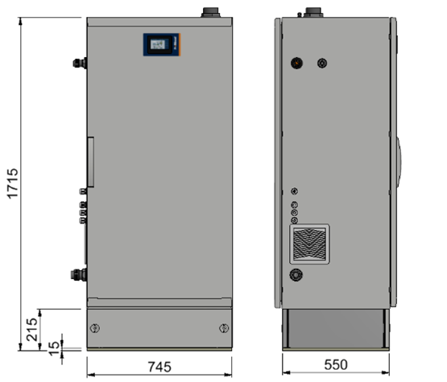
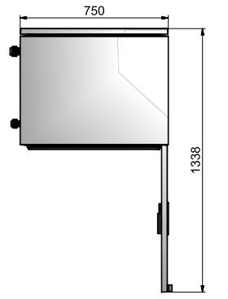
Cabinet Chlorinsitu® IIa
Corrosion resistant Polyester reinforced fibreglass
Optional plinth to elevate total height to 1715 mm
Sealed IP54
Sizing:
Height 1500 mm w/o plinth
Width 750 mm
Depth 620 mm

Slide 10
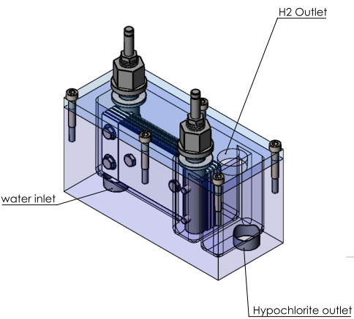
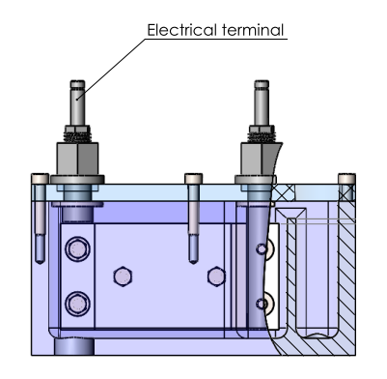
New Electrolysis Cell
Innovative and unique cartridge design
Each cell produces 60 g chlorine/h
Installed in series to increase capacity
Very efficient flow path of the brine through cell results in outstanding efficiency:
> 9 g/l chlorine @ only 3 kg salt / kg chlorine
High safety due to barrage that prevents dry-running of the electrodes
Long lifetime warranty 5 years @ 100% operation
Can be flushed with acid solution to be cleaned and restore capacity
Cell housing made from PVC-U

Slide 11
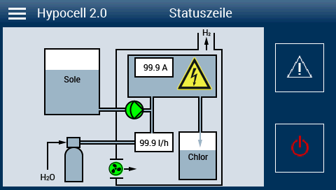
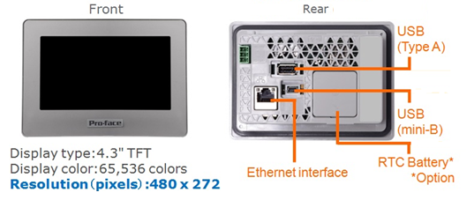
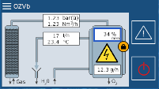
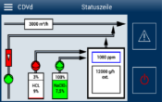
Controller CIIa (HMI)
4.3“ Color display touch panel
USB Port
Ethernet interface
Easy to use / operate
Future standard in BU4-products
Exemplary: OZONFILT OZVb

Slide 12
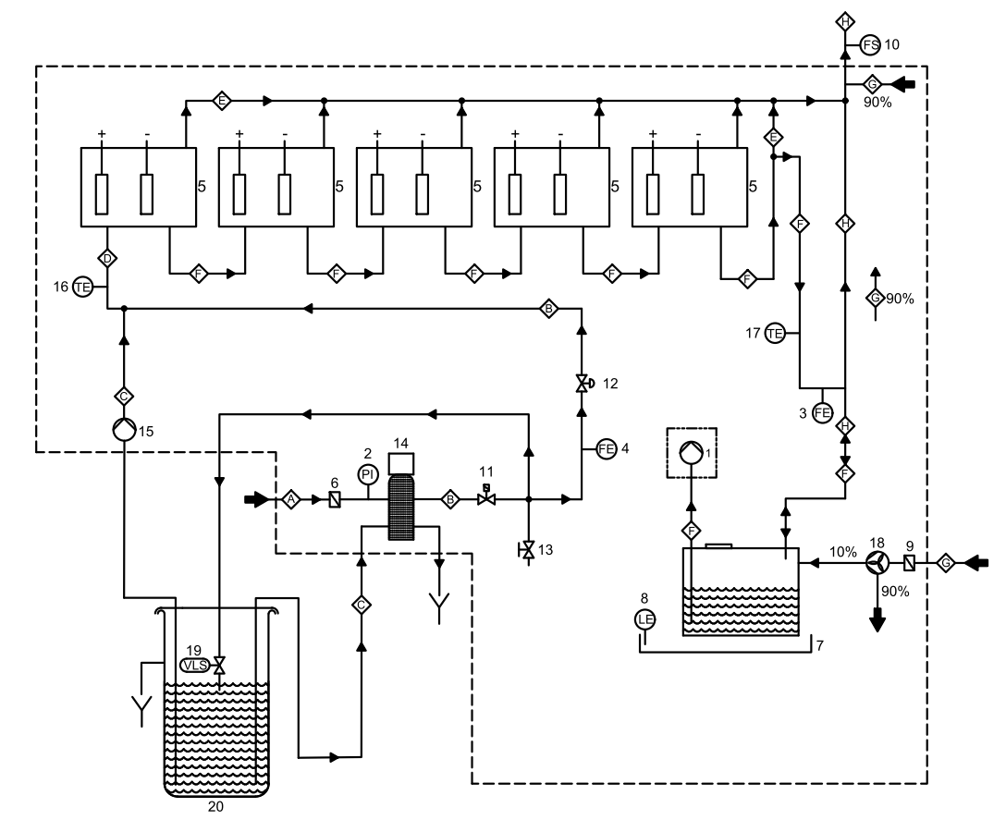
Flow Diagram Chlorinsitu® IIa
A = Inlet water
B = Softened water
C = Saturated brine
D = Diluted brine
E = Hydrogen
F = Product
G = Air
H = Diluted Hydrogen
1 = Optional product dosing pump
2 = Pressure gauge tap water
3 = Flow sensor cell output product
4 = Flow sensor cell input softened water
5 = Hypocell (1-5 depending on capacity)
6 = Tap water candle filter
7 = Drip pan
8 = Level sensor drip pan
9 = Air filter
10= Air flow sensor
11= Solenoid valve softened water (after softener)
12= Control valve dosing softened water (after flow sensor “4”)
13= Sample valve for testing softened water
14= Water softener
15= Brine dosing pump
16= Temperature sensor diluted brine cell input
17= Temperature sensor product cell output
18= Air fan
19= Level operated valve for filling brine tank
20= Salt tank

Slide 13
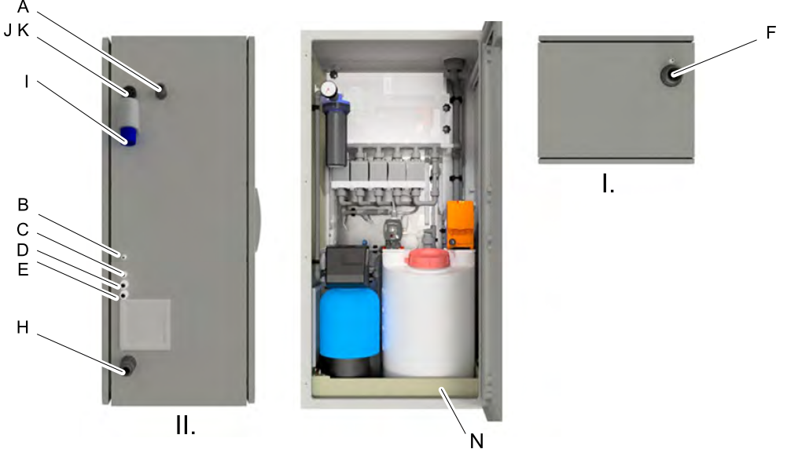
Connections Chlorinsitu® IIa
Top view
A – Water supply
B – Brine supply
C – Brine supply softener
D – Filling brine tank
E – To external storage tank or process
F – Diluted hydrogen discharge
I – Power supply 230 VAC
J – Control signal internal product dosing pump (option)
K – Ethernet Cable (option)
N – Drip pan

Slide 14
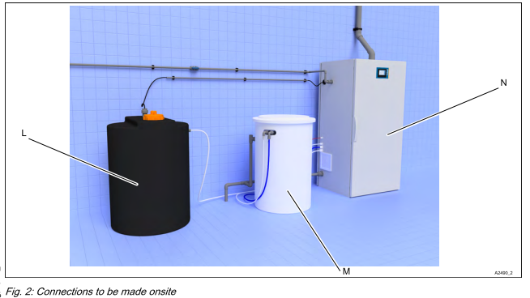
Installation Chlorinsitu® IIa
L – External product tank / Storage tank (optional)
M – Salt container
N – Chlorinsitu® IIa Cabinet

Slide 15
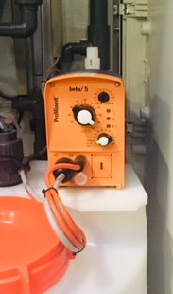
Option: Chlorine Dosing Pump
Identcode option
Configuration fixed for each model/capacity of CIIa
When ordered without pump, customer can use own pump
Internal storage tank with 3 Level switches: too high, start/stop and empty (PLC inputs available)
Controlled externally via 0/4 - 20 mA or potential free contact
When an external product storage tank is used, the chlorine pump functions only as transfer pump and is controlled (on/off) by the CIIa
Chlorine Pumps:
60 g/h BT5B0713
120 g/h BT5B0420
180 g/h BT5B0232
240 g/h BT5B0232
300 g/h GMXA0245

Slide 16
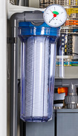
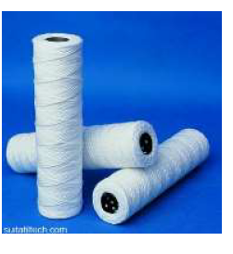
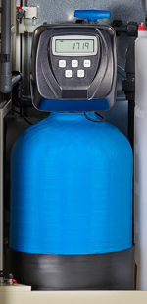
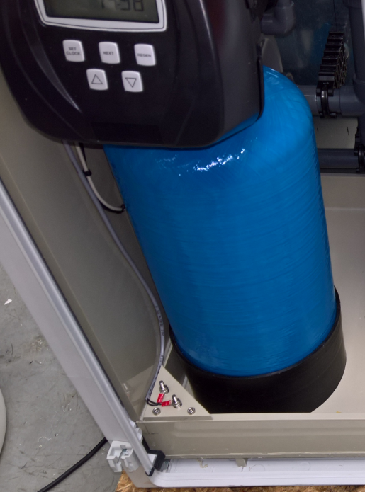
Softener (Option)
Integrated reliable softener
Protected by integrated pre-filtration of CIIa (50 micron, 10“ standard housing)
Preset to regenerate once every 48h
Electrical contact plus solenoid to prevent not-softened water to pass during regeneration

Slide 17
Maintenance of CIIa
Maintenance Pack 1-yearly & 3-yearly
Annual service kit for chlorine dosing pump
Annual service kit for brine dosing pump
Cells can be flushed with acid solution once a year to remove eventual scaling and restore the initial efficiency
Cells are planned to be replaced (earliest) every 5 years
Yearly Maintenance includes (expected 2-4 h):
Replacement of O-Rings and gaskets in contact with chlorine
Exchange of water filter
Exchange of air filter
Cleaning of the salt tank if neccessary
Acid flushing if neccessary
3-Yearly Maintenance also requires (4-6 h):
Exchange of cell of flow sensor
Cleaning of water softener
5-Yearly Maintenance also requires:
Exchange of cells
Exchange water control micro valve
Replace float switch of product tank
It´s electrolEasy!

Slide 18
Acid flushing
Easy procedure to restore the initial capacity of the system in case it got decreased by scaling of the electrodes.
Recommended once a year during regular maintenance or when increasing voltage indicates scaling.
Procedure:
Stop CIIa
Flush cells with water (via HMI)
Attach flushing pipe to the outlet of the cells and place end of pipe into a collection container
Place brine suction hose into a container with HCl 5% and start brine pump. Pump HCl for 40 minutes.
Flush cells with water again (via HMI)
Remove flushing pipe and reconnect cell drain
Re-Fill cells with brine (via HMI)
Start operation

Slide 19
Salt specifications for CIIa (based on DIN EN 973:2009-12, extended)
NaCl-Content of dried product | > [%] | 99,4
Anticaking Hexacyanoferate [Fe(CN₆)]⁴⁻ | max. mg/kg | 20
Water-insoluble substances | max. [%] of NaCl content | 0,05
Moisture content of dried product | max. [%] of NaCl content | 0,6
Moisture content of undried product | max. [%] of NaCl content | 5
Calcium + Magnesium (Ca + Mg) | max. [mg/kg] | 100
Arsenic (As) | max. [mg/kg] | 13
Cadmium (Cd) | max. [mg/kg] | 1,3
Chromium (Cr) | max. [mg/kg] | 13
Mercury (Hg) | max. [mg/kg] | 0,26
Nickel (Ni) | max. [mg/kg] | 13
Lead (Pb) | max. [mg/kg] | 13
Antimony (Sb) | max. [mg/kg] | 2,6
Selenium (Se) | max. [mg/kg] | 2,6
Manganese (Mn) | max. [mg/kg] | 10
Iron (Fe) | max. [mg/kg] | 10

Slide 20
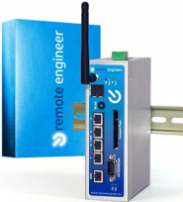
Features
Remote Control Engineer
Improved accessibility of installations
Possibility of assistance long distance
No firewall problems
No ATEX-rating
Hydrogen degassing is regarded with active ventilation of the cabinet and the product tank
Very low Chlorate
DIN EN 90116: 5.4% Chlorate based on FAC in sodium hypochlorite solution for disinfection of drinking water
CIIa: < 4% Chlorate

Slide 21
CHLORINSITU® IIa (60 g/h – 300 g/h)
Simple operation
Low chlorate product
Robust design
Simplified technology
High efficiency
Space saving
Low maintenance
No ATEX requirements
FAC concentration 9 g/h
3 kg salt per kg FAC

Slide 22
Any questions ?
Thank you for your attention

