Slide 1
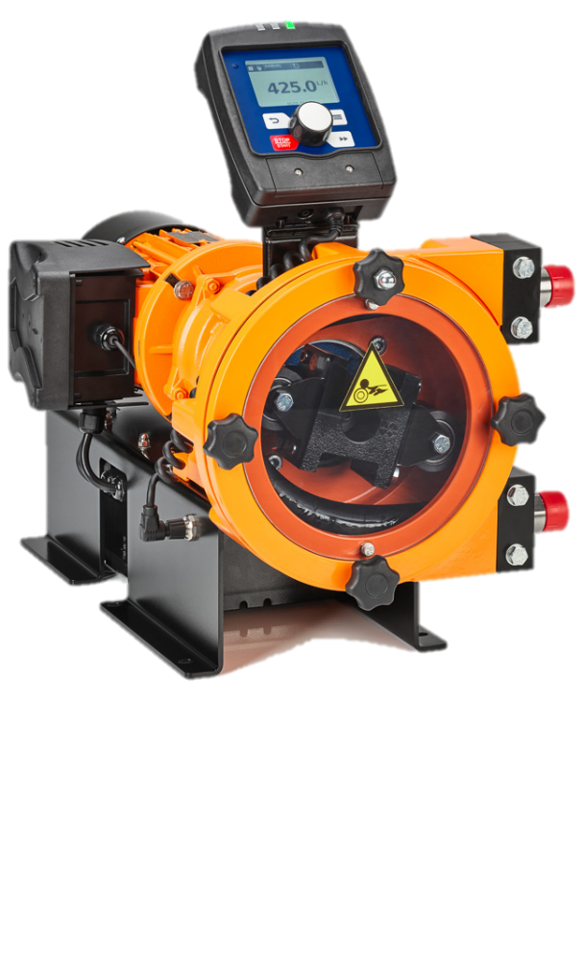
DULCO flex Control
DFYa

Slide 2
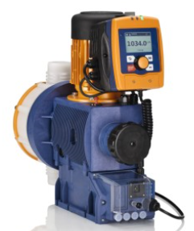
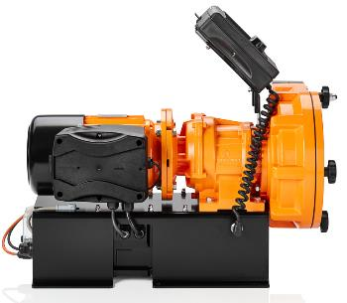
The DFYa combines the intelligence of the Sigma X with the robustness and high capacity of the DFBa
The brain of the peristaltic dosing pump consists of the Sigma X electronics, which can be found in the foot of the DFYa. The DFYa is driven by the Sigma 3 motor with frequency converter.

Slide 3
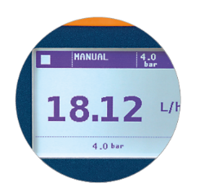
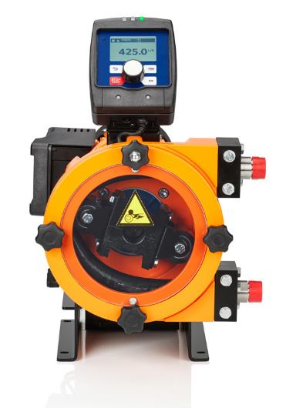
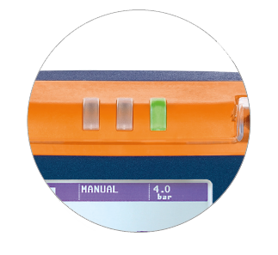
Features
Large illuminated high resolution LCD
Hose Rupture Detection
Halar Coating Available
Suitable for Dosing
Outgassing
Highly viscous (>40,000 centipoise)
Abrasive
Shear-sensitive media
Solids up to ¼ of the inner diameter of hose
Simple Adjustment of Capacity Directly in GPH
Menu Guided Hose Change
Reversible Direction of Rotation
Removable HMI
Dosing Head Orientation Left or Right

Slide 4
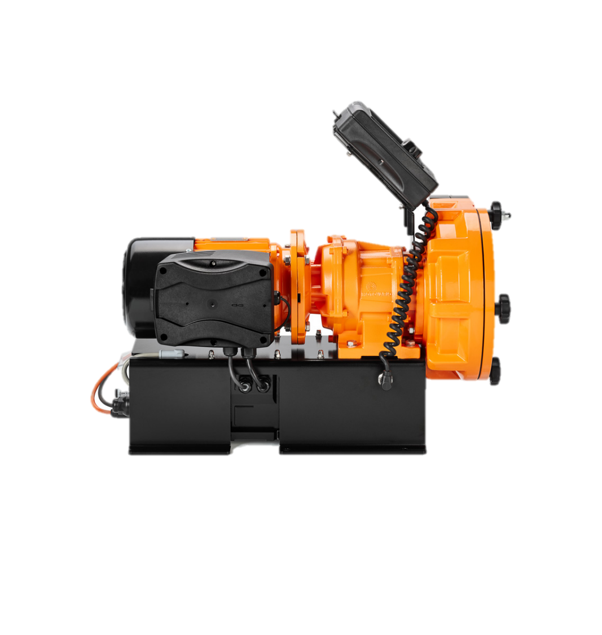
Technical Features
75:1 Turndown
±2% Repeatability
Dosage Range 1.5gph to 108gph
For Pressures Up to 116psi
Suction Lift 26ft
Universal Power Supply 100-230VAC ±10% 50/60Hz
Available hose materials:
NR
NBR
NBR-A (food grade)
EPDM
Hypalon
Notes:
Maximum flow rate of 108gph is achieved at <80 rpm Dosing head → Slow rotation leads to long hose life

Slide 5
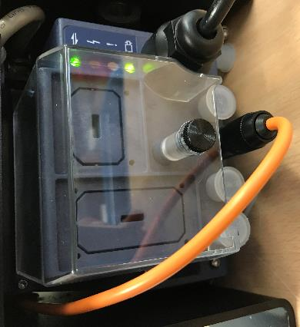
Technical Features
Inputs
Manual
Contact/Batch
Analog (0/4....20mA)
Timer
Pause
Auxiliary frequency
2 stage level switch
Communication
Fieldbus as Profibus, Profinet, CANopen,
DULCOnnex
Outputs
Fault Indicating Relay
Fault Indicating + Pacing
Fault Indicating + Analog 0/4-20 mA
Hose Rupture Detection

Slide 6
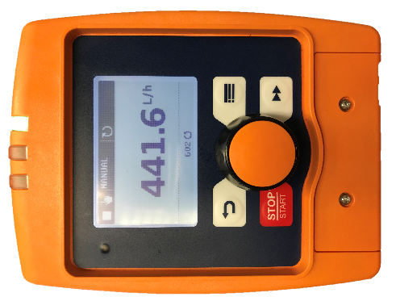
Universal User Interface
Use of the Sigma X HMI (removable)
Operation via click wheel and 4 buttons
Fully visible status LED
The user interface and menu are now identical
Gamma X
Gamma XL
Sigma X
DULCO flex Control (DFXa)
DULCO flex Control (DFYa)
Operating indicator
GREEN: no faults or alarm messages. Blinks signaling each stroke
YELLOW: alarm, the pump continues dose
e.g. first stage float
RED: critical error, the pump stops
e.g. second stage float

Slide 7
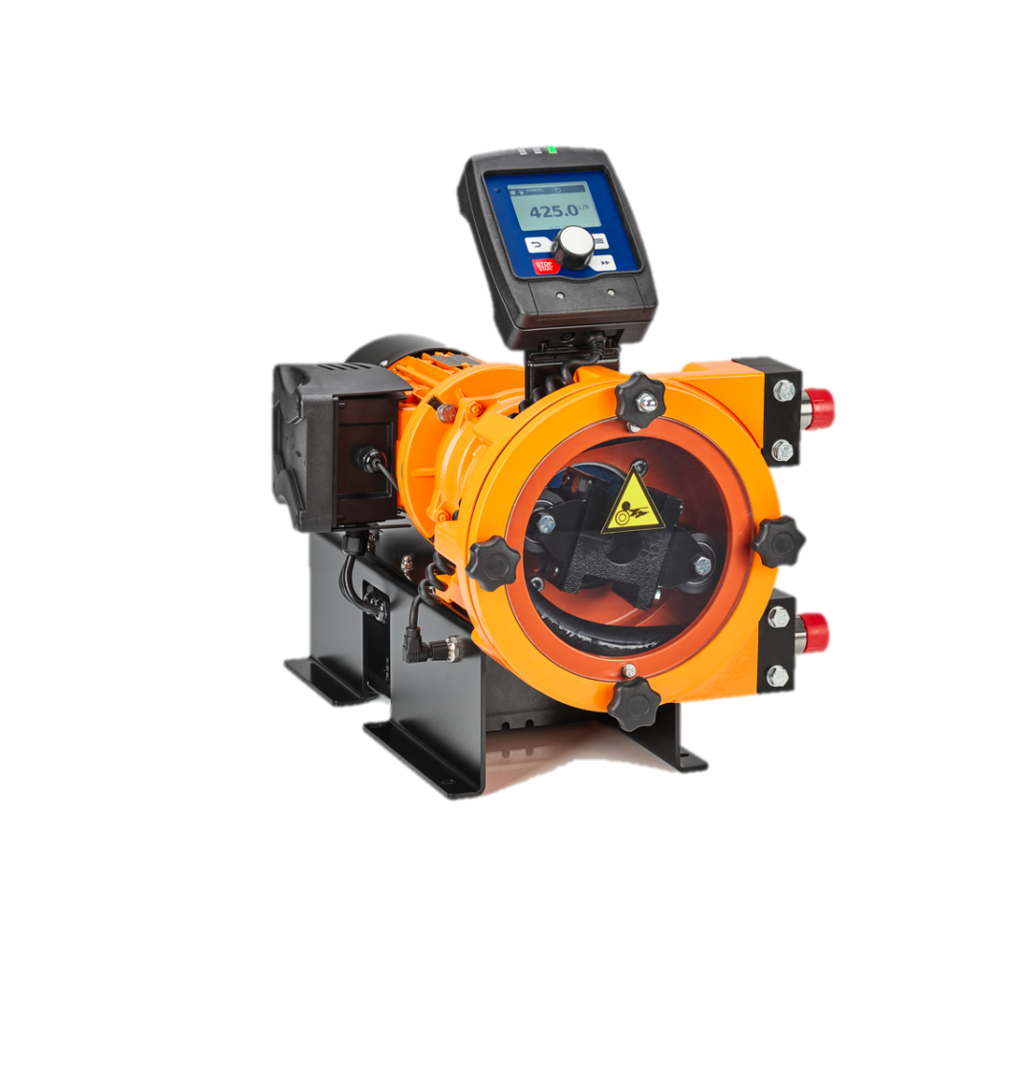
Dimensions
18.5”
22”
12.5”

Slide 8
What Pump to Use
When do I use a peristaltic metering pump?
High viscosity media
Outgassing media
Abrasive media
Large particles in the medium
Shear sensitive media
High suction lift needed
When do I use a diaphragm pump?
Continuous operation (significantly longer maintenance intervals)
Filling tasks (adjustable stroke length and stroke frequency)
High precision dosages
High pressures (>116psi)
Notes:
Since ProMinent offers both peristaltic dosing pumps and diaphragm dosing pumps, it is extremely important to know which product is to be offered when, to be able to provide the customer with the best dosing results. Therefore, already above mentioned points are taken up here again. It is important to know that there is no wrong pump, only a more suitable or less suitable pump for the application.
When to offer which type of pump:
If a customer explicitly requires a peristaltic pump or a diaphragm pump, it is easy to prepare an offer. Nevertheless, in such cases it is advisable to ask about the application in order to be able to offer an even more suitable product. However, if the customer does not know exactly what he wants, the following comparison can be considered.
Continuous running properties:
ProMinent diaphragm metering pumps have always scored with reliability and longevity. In principle, a diaphragm metering pump requires less maintenance than a peristaltic metering pump. Due to the constant compression and decompression of the tube, the tube of peristaltic dosing pumps has to be changed at regular intervals. In applications where continuous operation is necessary, a diaphragm metering pump should therefore be considered first. In general, it can be said that diaphragm metering pumps are preferable to peristaltic metering pumps due to their continuous running properties when it comes to simple metering of non critical media.
Valveless dosing:
Diaphragm metering pumps require a suction and discharge valve for metering, tube dosing pumps do not. Nevertheless, it is recommended to install at least one non-return valve on the discharge and suction side of a peristaltic dosing pump. If this is not done, the liquid can flow back in the event of a tube burst. In addition, the tube cannot be replaced without a valve. That’s because the liquid will flow back when the screw connections are loosened. Since most applications only pump in one direction, the installation of a non-return valve on the pressure side is not a limitation. If it is necessary to change the dosing direction often in a certain application, valves can also be dispensed with. However, the problems described above with missing valves must be taken into consideration and other measures taken.
High viscosity:
Peristaltic dosing pumps can be used to dose highly viscous media, often significantly higher than 10,000 mPas. However, it should be noted that the peristaltic pump should then no longer run at maximum flow rate, as the hose needs more time to reposition. (ProMinent has data for the different peristaltic pumps and their viscosity.) ProMinent diaphragm metering pumps are also suitable for higher viscosities. For highly viscous media, the suction stroke of the diaphragm pump should be slowed down and a HV head should be used. However, it is not possible to pump such high viscosities with diaphragm pumps as with peristaltic pumps.
Chemical resistance:
Diaphragm metering pumps are suitable for almost all chemicals due to the appropriate material selection. The suitability of the tube materials must be checked more carefully, as an aggressive medium will greatly impair the service life of the tube. The ProMinent resistance list is very helpful here.
High abrasiveness:
Even abrasive media can easily be pumped with peristaltic dosing pumps, as solid particles, unlike on diaphragm dosing pumps, cannot settle in the valves on the pressure and suction side. Liquids with solid particles up to a size of 1/4 of the internal tube diameter can be pumped with the DFYa (4 mm particles). When dosing abrasive media, it is important to note that the service life of the tube is reduced and therefore frequent tube changes are necessary.
Dosing of air inclusions / suction height:
As is generally known, diaphragm dosing pumps cannot pump air well. If air now enters the dosing head of a diaphragm dosing pump, this can lead to dosing failures. ProMinent has developed various venting mechanisms to remedy this situation. E.g. venting via a solenoid valve which switches in case of air inclusion, or via the dosing head with groove or ball
With peristaltic dosing pumps, venting of any kind is not necessary, as air is conveyed without problems.
Suction is also no problem with peristaltic dosing pumps. Peristaltic dosing pumps can suck in much better than diaphragm dosing pumps. The DFYa reaches a suction height of 8 m wc.
Filling tasks:
Diaphragm metering pumps are predestined for filling tasks. The stroke frequency, stroke volume and stroke time can be precisely set in these pumps.

Slide 9
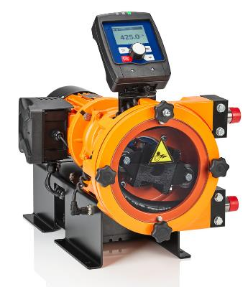
Clear differentiation from DFBa
DFBa:
DFBa is a peristaltic pump for transferring liquids
Dosing can be controlled by switching the DFBa on and off.
The DFBa can be equipped with a VFD
DFYa:
DFYa is a true peristaltic “METERING” pump
Many control options
Very good price-performance ratio thanks to economies of scale

Slide 10
The intelligence offers the DFYa a broad range of applications
Exact transfer of large quantities of chemicals
Flow-proportional dosing of polymer solutions in the water treatment sector
Conveying liquids with large particles
Dosage of slurries
Dosage of foaming agents in the mining industry
Dosing of mash in wineries – And many other applications in the food industry

Slide 11
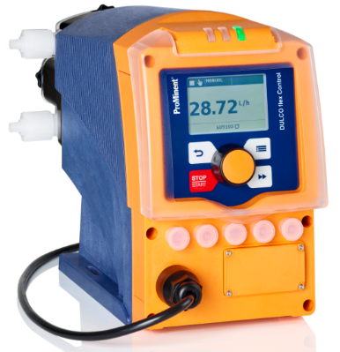
Capacities from 10 ml/h to 108gph can now be covered with peristaltic dosing pumps
DFXa
10 ml/h – 8gph
101psi
DFYa
1.45gph – 108 gph
116psi
Both pumps come with identical user interface and identical control options

Slide 12
There is no comparable product on the market
Worldwide there is no intelligent and versatile controllable peristaltic metering pump available which:
Has such a high gallon capacity at back pressures of up to 116psi
Has fiber reinforced hoses
Can dose viscosities of over 40,000 centipoise

Slide 13
Thank you for listening.
And what can I do for you?

