Slide 1
Sigma Pump Safety Diaphragm
Webinar
March 25th, 2011
Host: Ken Gibson

Slide 2
What is it?
Diaphragm rupture monitoring system using a multi-layer diaphragm
Upon rupture, chemical is contained between layers and channeled to sensor area
A switch is activated for a visual indication of rupture or it generates an alarm or stop pump condition
Provides safety factor for operator upon rupture - No chemical leakage upon failure
Liquid is prevented from leaking – contained in diaphragm cavity
2

Slide 3
Important Facts
Available on Sigma 2 and Sigma 3 models
Sigma 1 will come later in 2011
Safety diaphragms now standard on all PVDF and SS liquid ends
Old-style diaphragms are still available as spare parts
Specifiable option
Concept is safety

Slide 4
Important Facts
Old-style liquid ends WILL fit on new drive units
BUT…
New liquid ends will NOT fit on old-style drive units

Slide 5
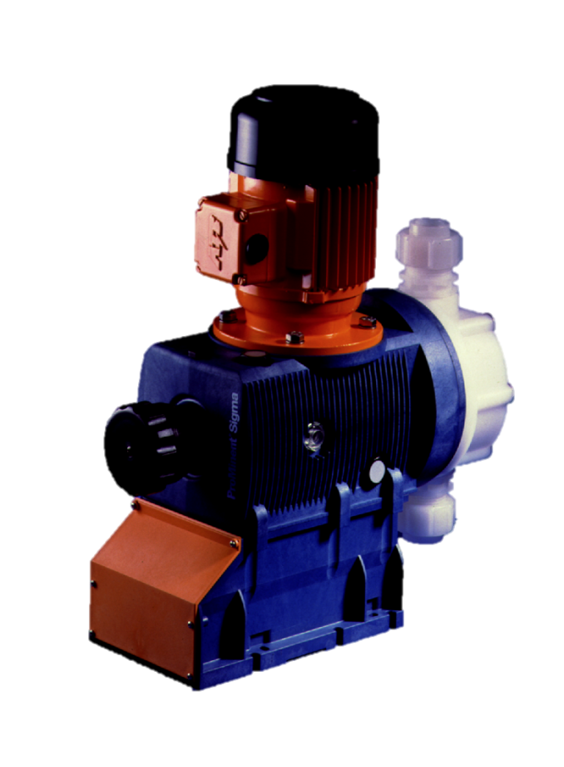
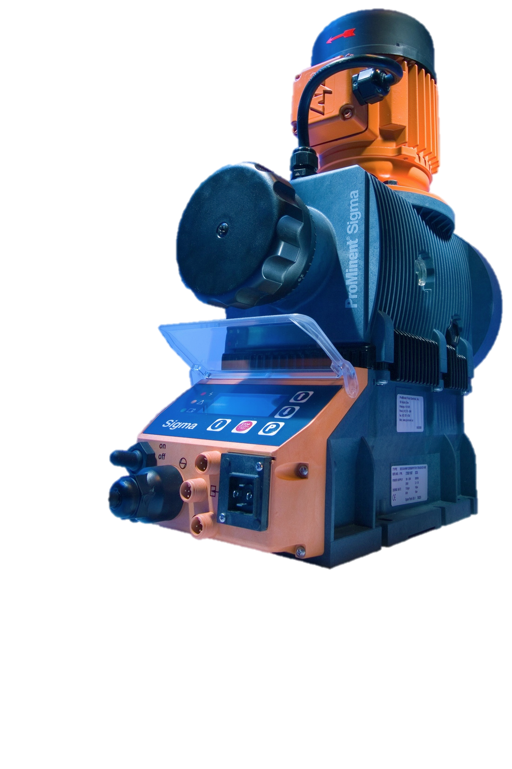
Sigma Pump Styles
Visual indication on both Basic and Control versions
Basic version can have dry contact option
Control version has pump stop or alarm

Slide 6
Sigma Control
Diaphragm rupture sensor connects to front of pump
If fault occurs, red LED on front of pump is activated
“Fault” shows up on LED screen and “error” and “DIAPH” flashes
Pump can be ordered for “Stop” or “Alarm”

Slide 7
Ordering Information
Option S (basic & control) = visual indicator upon rupture ($343)
Option A (basic models) = dry contact signal upon rupture ($430)
Option A (control models) = pump stops upon rupture ($430)
Option B (control models) = alarm signal upon rupture ($430)

Slide 8
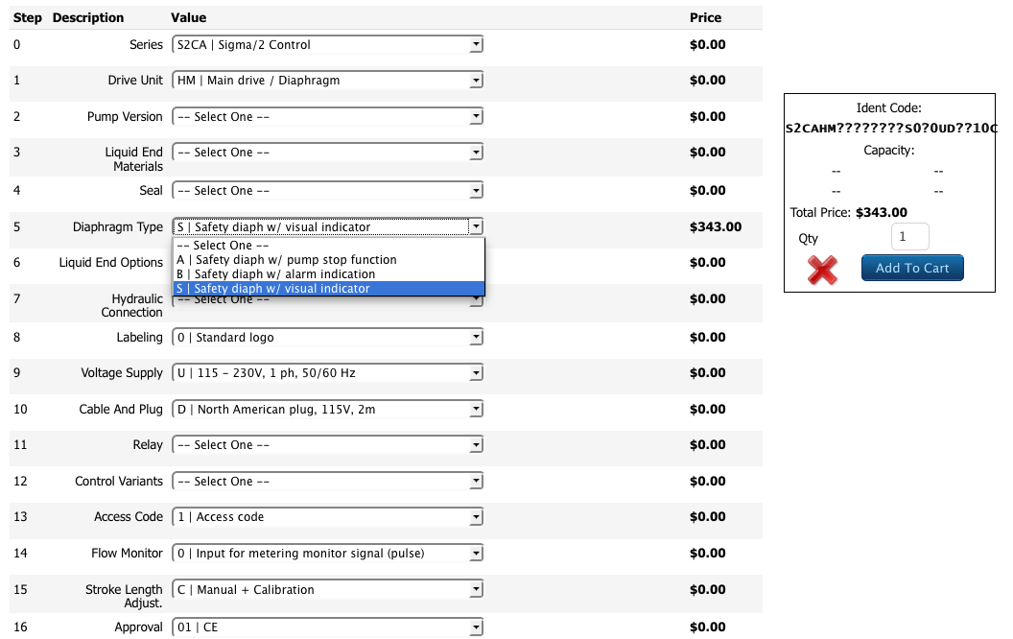
Selecting Diaphragm Type
Notes:
8

Slide 9
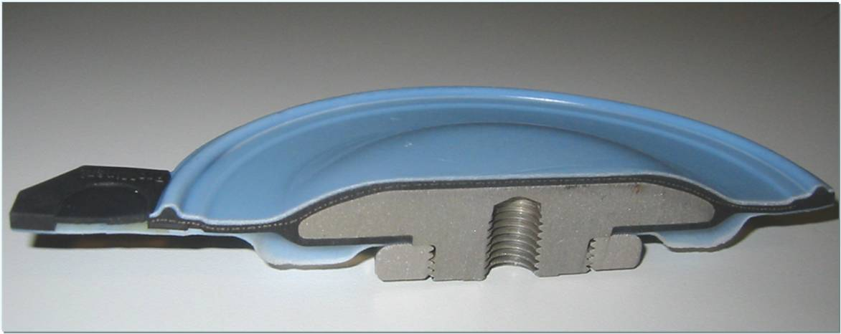
Multilayer Safety Diaphragm
Sensor area
Diaphragm rupture
EPDM + Polyester layer
PTFE
Operation layer
Gap
Metallic core
PTFE
Safety layer

Slide 10
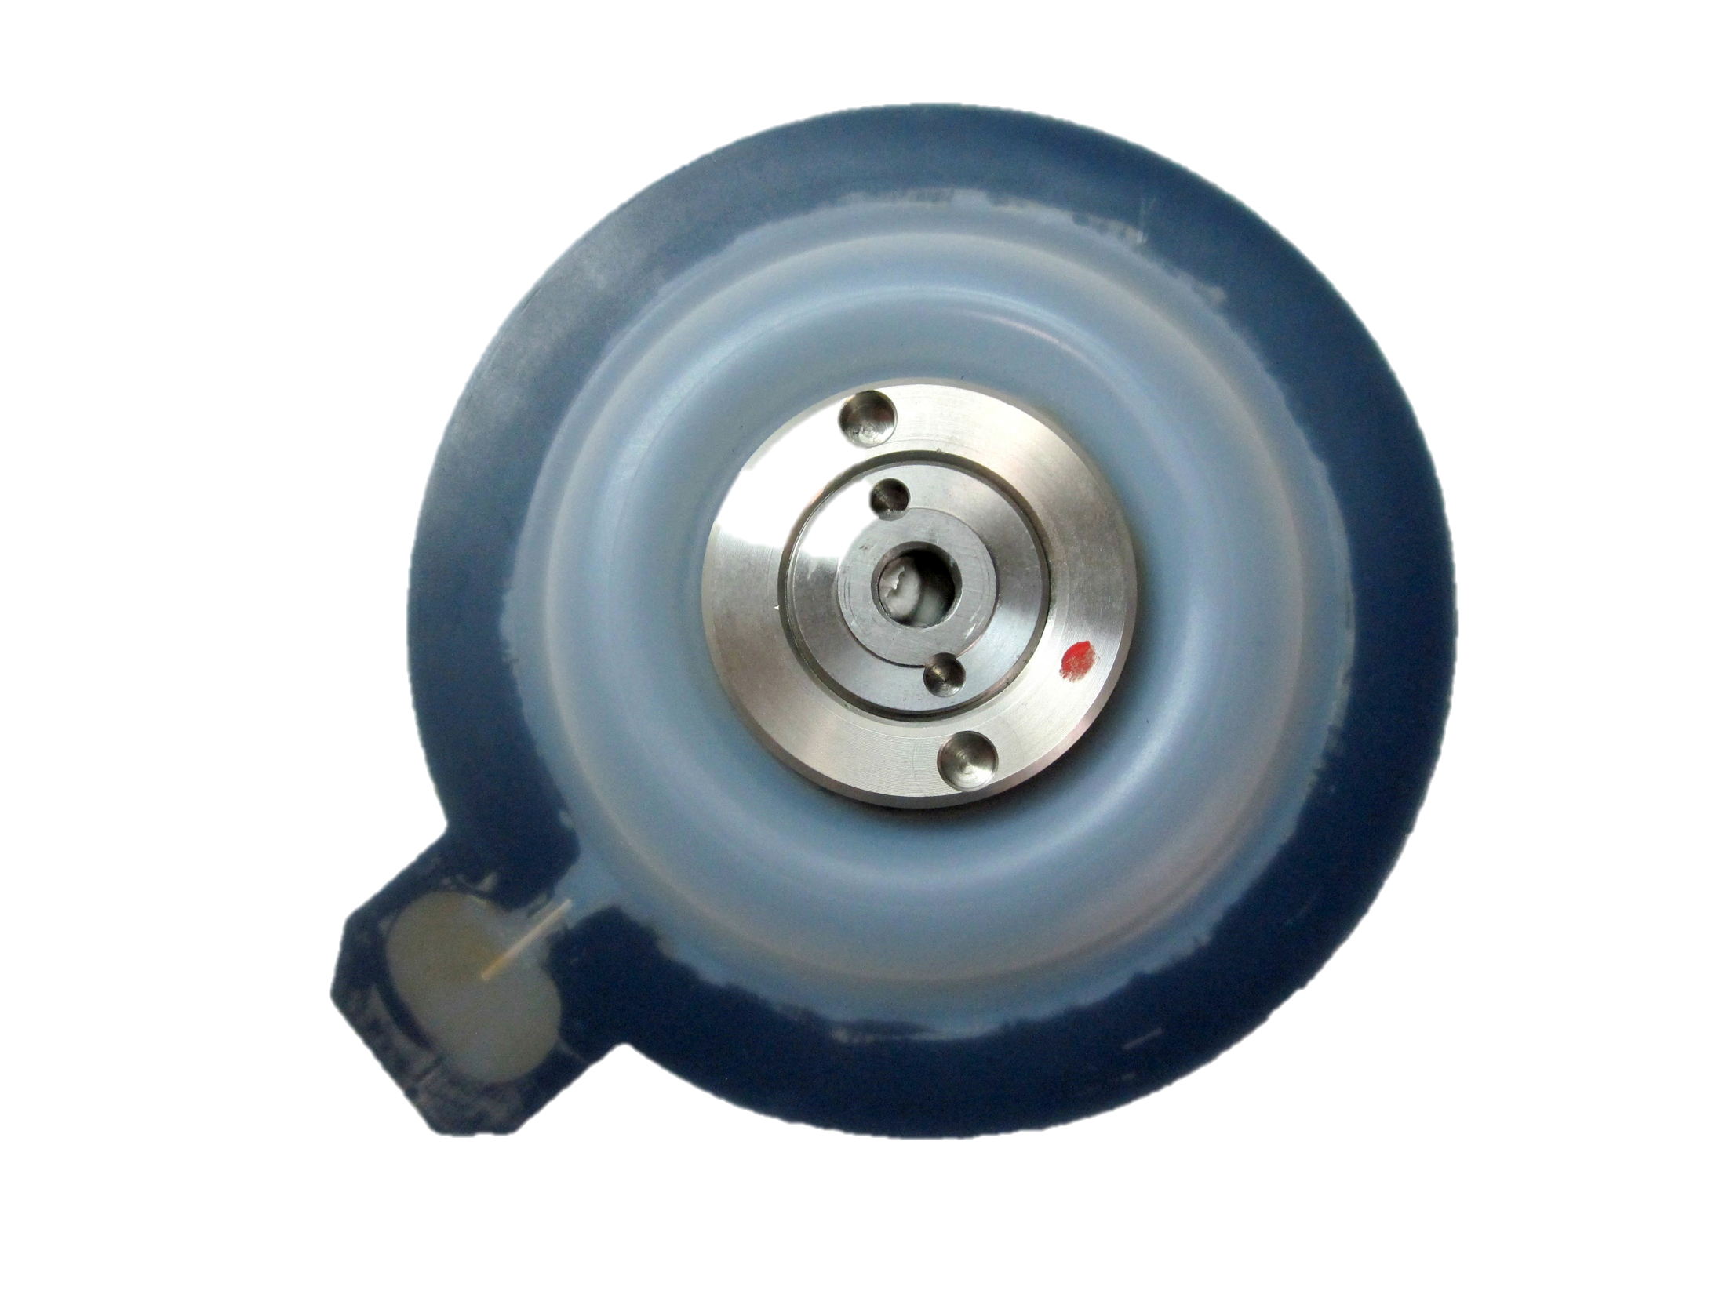
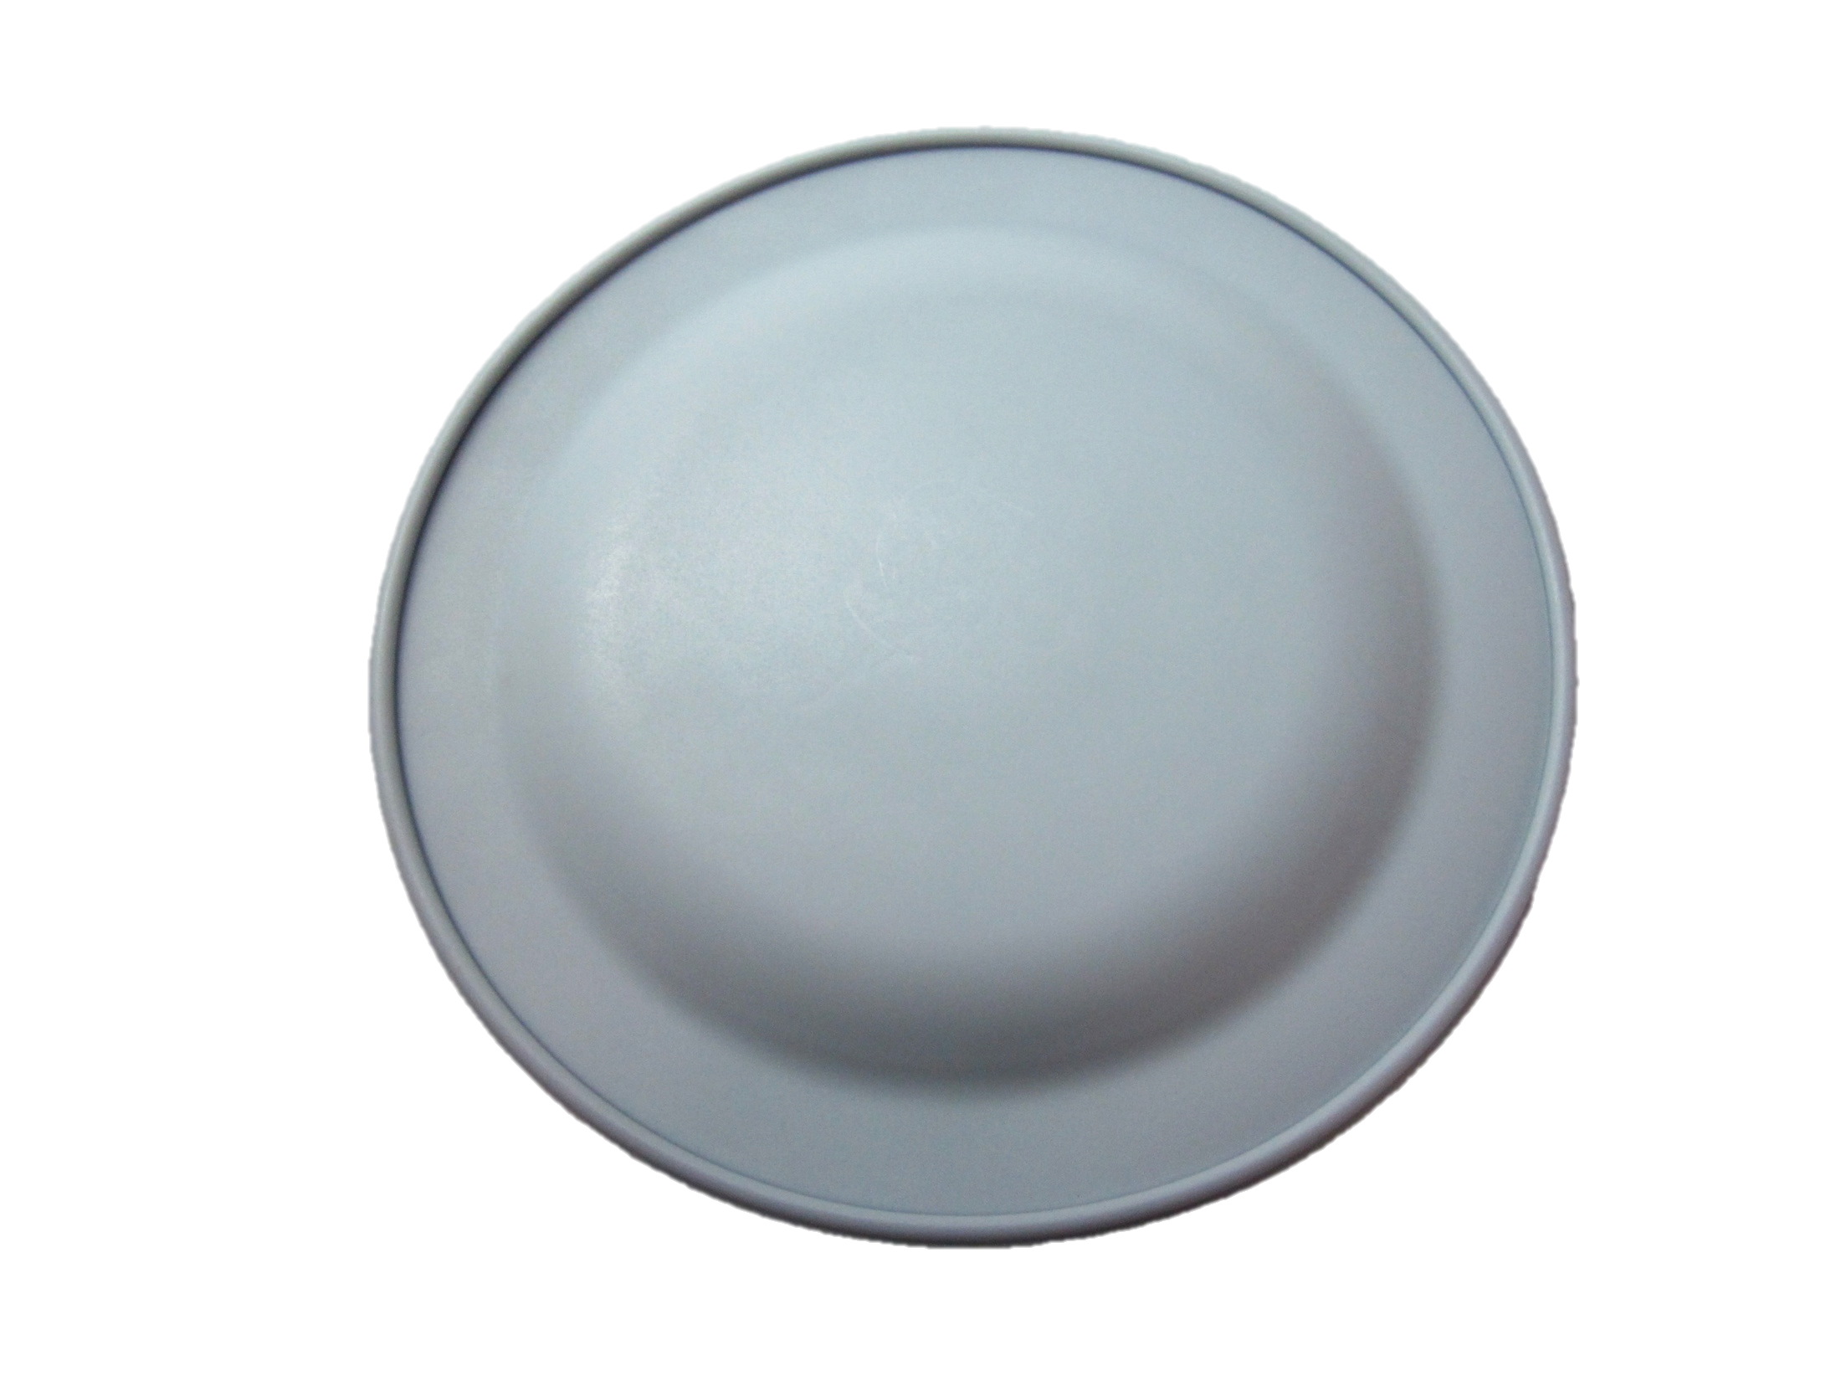
Diaphragm Comparison
New style
Old style

Slide 11
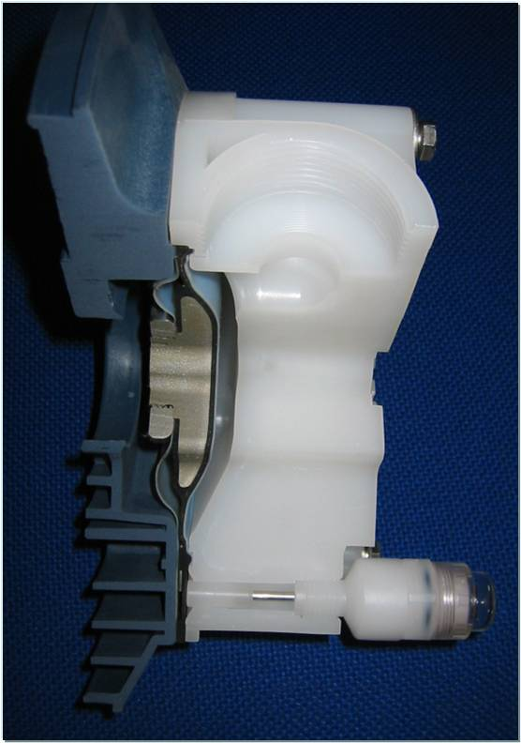
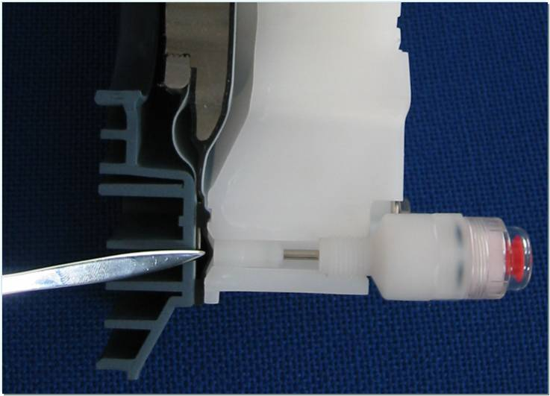
Liquid End Cutaway
Operating status, diaphragm is o.k.
A diaphragm rupture causes a rise of pressure in the sensor area which triggers the diaphragm rupture sensor.

Slide 12
Sigma Safety Diaphragm Video
Watch the Safety Diaphragm Video on You Tube!
http://www.youtube.com/user/prominentusa

Slide 13
Sigma Pump Safety Diaphragm
Webinar
March 25th, 2011
Any Questions??

